Slide 1

KLU · SECTION 2
Capstone
Project-1
Intercity Bus Reservation System
2620030346 · Ch. Siri Chandana
2620040098 · V. Yasaswi
Notes:
Introduce the capstone project as a coordinated digital workflow for intercity bus reservations. Name the student team and establish that the review will move from purpose and objectives to development, outcomes, and demonstration.

Slide 2
KLU · 01 / INTRODUCTION
One workflow connects the entire reservation journey
The Intercity Bus Reservation System is a digital platform that helps passengers search for routes, check bus schedules and seat availability, select a preferred seat, and complete a reservation through one coordinated workflow. It connects passengers, buses, schedules, and booking records while reducing the manual effort required to access travel information.
Search
Check
Select
Reserve
Find a route and schedule.
Review buses and seat status.
Choose a preferred seat.
Capture details and confirm.
System view: passengers, buses, schedules, and booking records work together in one coordinated platform.
Notes:
Explain the system from the passenger's point of view. The important shift is from separate manual actions to a connected workflow that brings travel information and booking records together.

Slide 3
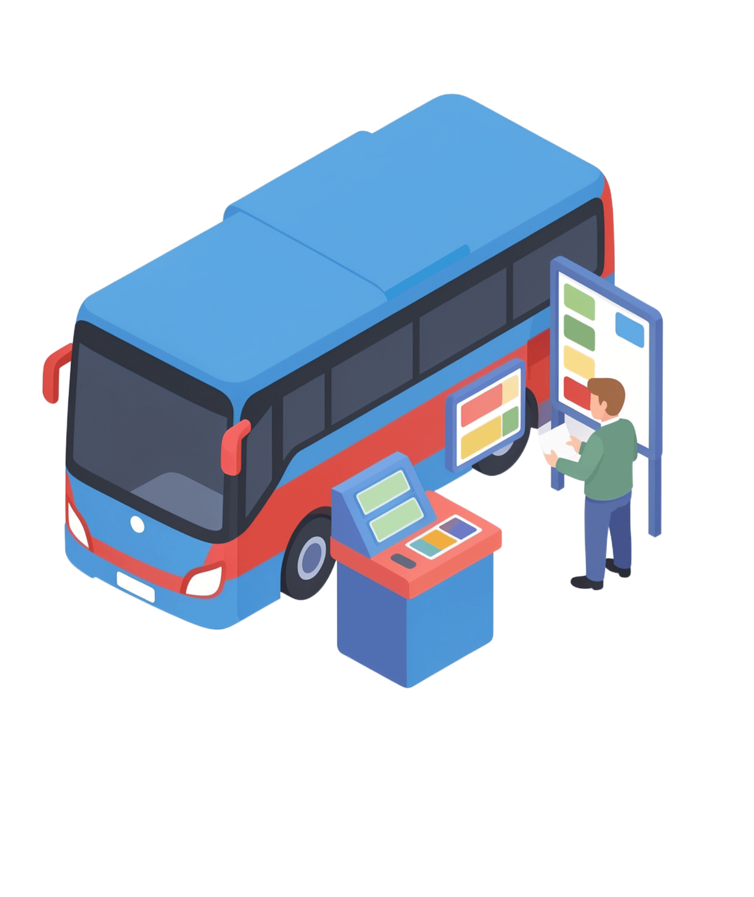
KLU · 02 / PROJECT OBJECTIVES
2. Project Objectives
Make booking simple, accurate, and manageable.
Provide a simple and reliable way to search routes and schedules, and view seat availability.
Capture passenger and reservation details accurately, reducing duplicate entries and booking confusion.
Give administrators a manageable view of buses, routes, and reservations.
Notes:
Frame the objectives as design decisions rather than a feature list. The platform must help passengers make an informed booking and help staff maintain a dependable operational record.

Slide 4
KLU · 03 / ADVANTAGES
The system turns a counter process into visible, shared information
PASSENGER EXPERIENCE
INFORMATION QUALITY
Faster and more convenient booking
Centralized records improve accuracy
Passengers can review routes, timings, and seat status before completing a reservation, reducing uncertainty at the point of booking.
A shared reservation record reduces duplicate entries and gives staff a clearer view of current bookings.
OPERATING FOUNDATION
STAFF SUPPORT
Ready for broader service features
One view serves passengers and staff
The platform creates a foundation for payments, notifications, travel reports, and future operational improvements.
The same coordinated system supports customer booking and administrative oversight without separating the underlying records.
Notes:
Emphasize that the advantage is organizational as well as technical. Clear information helps passengers choose, while centralized records help staff work with fewer ambiguities.

Slide 5
KLU · 04 / LIMITATIONS
The prototype is useful, but operational trust still needs proof
Service & reservations
Validation before production
The system depends on reliable internet access and continuous service availability. The current prototype may not include a live payment gateway. Seat information must be updated consistently to prevent booking conflicts.
Additional validation is required for security, heavy-load performance, accessibility, mobile optimization, and accurate maintenance of operational data.
Notes:
Present limitations as the boundary between a working prototype and a dependable production service. The limitations identify what must be tested, integrated, or maintained next.

Slide 6
KLU · 05 / COURSE OUTCOMES
CO1–CO6: Java concepts mapped to the Intercity Bus Reservation System
CO1
CO2
CO3
MODULE 1 · JAVA FOUNDATIONS
MODULE 2 · CONTROL FLOW
MODULE 3 · METHODS & ARRAYS
Algorithms, variables, operators and Scanner input
Selection, switch, loops, break and continue
Methods, recursion, 1D/2D arrays and processing
Booking workflow: take passenger, route and reservation inputs and process them using Java fundamentals.
Reservation decisions: check seat status, accept/reject bookings, and repeat menu or booking operations.
Modular operations for routes, seats and bookings; arrays can represent seat layouts and schedule data.
CO4
CO5
CO6
MODULE 4 · OOP & EXCEPTIONS
MODULE 5 · STRINGS & FILE I/O
MODULE 6 · COLLECTIONS & STREAMS
Classes, objects, encapsulation, inheritance and exceptions
String processing, search/sort and file input/output
List, Set, Map, lambdas and Stream pipelines
Model Passenger, Bus, Route, Seat and Reservation objects; handle invalid or failed booking operations.
Process passenger and route text, search/sort reservation records, and read or save booking data in files.
Manage routes, buses and reservations with collections; filter, sort, group and generate reservation reports.
Course alignment: Modules 1–6 map directly to CO1–CO6 in the PSP (Java) handout.
Notes:
Separate near-term service completion from longer-term intelligence. Payments and confirmations strengthen the transaction, tracking and alerts strengthen the journey, and analytics strengthen operational planning.

Slide 7
KLU · 06 / PROJECT DEVELOPMENT
Development moved from requirements to tested workflow
1
2
3
Define & design
Develop & test
Refine
Gather requirements; define passenger, staff, and administrator workflows; then design the interface, reservation flow, data model, and validation rules.
Develop the web interface, server-side application, and relational data layer. Test route search, seat selection, booking, cancellation, and error scenarios.
Use iterative feedback to refine the prototype. The process used browser-based testing, documentation, and version-controlled teamwork.
Notes:
Walk across the development line in order. Requirements define the problem, design makes the workflow explicit, development creates the system, testing checks behavior, and feedback helps the team refine the result.

Slide 8
KLU · 08 / TOPICS COVERED
The project brings software topics together around one usable system
UNDERSTAND
BUILD
Requirements and design
Logic and data
Requirements analysis, system design, frontend form design, user interaction, database entities, and relationships.
Backend logic, validation, CRUD operations, authentication, authorization, and data integrity.
VERIFY
WORK TOGETHER
Quality and debugging
Documentation and teamwork
Software testing, debugging, error handling, and checking that reservation behavior matches requirements.
Documentation, collaborative teamwork, shared review, and clear communication of the implemented system.
Notes:
Use this slide to connect individual course topics to visible project work. Each category supports a different part of the system: understanding the problem, building the solution, verifying it, and working as a team.

Slide 9
KLU · 09 / CONCLUSION & FUTURE SCOPE
Conclusion & Future Scope
CONCLUSION
FUTURE SCOPE
Simplifies intercity bus reservations through a coordinated digital workflow.
Organizes routes, schedules, seats, passengers, and booking records.
Demonstrates practical use of Java concepts from CO1 to CO6.
Integrate a secure online payment gateway and instant booking confirmation.
Add live bus tracking, estimated arrival times, and SMS/email notifications.
Build a mobile-friendly app with multilingual and accessibility support.
Use admin analytics and reports to understand demand and improve scheduling.
Strengthen security, prevent double-booking, and test performance under heavy traffic.
INTERCITY BUS RESERVATION SYSTEM · JAVA CAPSTONE PROJECT
Notes:
Run the demonstration in the same order a passenger would use the system. Keep the final two minutes for course outcomes and future scope, so the review ends with evidence of learning and a clear direction for improvement.

