Slide 1


PotHole Management System
N.B.K.R INSTITUTE OF SCIENCE AND TECHNOLOGY (Autonomous) Vidyanagar,Tirupati-524413
DEPARTMENT OF IT & AI&DS
Batch No.
02
Group Members :
Roshini (20KB1A1216)
Sekhar (20KB1A1246)
Hema Saitha (20KB1A1257)
Siva Kumar (20KB1A1260)
Under the Guidance of
Dr. G.V.Konda Reddy,M.Tech., Ph.D,.
Assistant Professor Dept. of IT & AI&DS

Slide 2
Introduction
Potholes plague roadways, compromising safety, damaging vehicles, and disrupting traffic flow.
Effective management is crucial for maintaining road integrity and ensuring public satisfaction.
Delving into cutting edge technology which is designed to detect road hazards efficiently.
By exploring the potential of advanced AI in improving road safety and minimizing vehicle damage.

Slide 3
Literature Survey…1
Year | Author | Title | Description | Results | Drawback
2022 | E Sai Tarun Kumar Reddy; Rajaram V. | "Pothole Detection using CNN and YOLO v7 Algorithm“. | Pothole detection system utilizes CNN and YOLO v7 algorithm Smartphone's camera and location data used for pothole categorization. | The detection probability of potholes is 95% and 99%. During our training, the model started with almost 10% accuracy rate and eventually it reached 85% . | Accuracy limitations in challenging lighting and weather conditions.. Inconsistencies in detection process affect overall system reliability.
2020 | Y. Pan, X. Zhang, G. Cervone and L. Yang. | “A Real-time pothole Detection Based on Deep learning Approach”. | Use of non-destructive remote sensing data for efficient pavement inspection. Widely adopted methods include digital images, light detection and ranging (LiDAR), and radar. | validation accuracy of 91.66%. validation loss of 23.28% . | Data Annotation, Model fitting, Environmental conditions, Maintenance and calibration, Limited Training Data Diversity. Addressing these challenges requires careful data collection, model development, and ongoing system maintenance.

Slide 4
Literature Survey…2
Year | Author | Title | Description | Results | Drawback
2019 | Aparna, Yukti Bhatia, Rachna Rai , Varun Gupta. | “Convolutional Neural Networks Based Potholes Detection Using Thermal Imaging.” | Pothole detection system utilizes CNN algorithm. | The training and validation losses were on still higher side. Test accuracy achieved was 73.06% | Careful planning, data management, and ongoing maintenance are necessary to overcome these disadvantages and maximize the benefits.
2021 | Anas Al-Shaghouri, Rami Alkhatib, Samir Berjaoui | “Real-Time Pothole Detection Using Deep Learning”. | SSD-TensorFlow, YOLOv3-Darknet53, and YOLOv4-CSPDarknet53 are used to compare their performances on pothole detection. | The proposed system achieved high recall 81%, high precision 85%, and 85.39% mAP. Moreover, this pothole detector attained a processing speed up to 21 FPS using Colab GPU, NVIDIA Tesla P100-PCIE. This system can work with raw data collected from dashboard Cameras for roads. | The vibration method, which is based on an accelerometer sensor, can’t predict potholes ahead of time. This is because the vehicle should pass over the pothole for detection. Laser scanning systems are classified among the 3D reconstruction methods. This system can detect potholes in real time. However, such a type is costly and has a short range of detection.

Slide 5
Literature Survey…3
Year | Author | Title | Description | Results | Drawback
2022 | Kshitija chavan,chinmay chawathe,Amruta sankhe | “Pothole detection system using YOLOV4”. | Using YOLOV4 image classification for detecting potholes. It was a pretrained model and could easily detect potholes in real time as compared to CNN. | This model easily achieved a great accuracy of 83% on average in real time pothole detection system. YOLOV4 is considered as a best fit pothole detection with 90% detection accuracy and 31.76FPS. | The YOLOV4 real time pothole detection has fast detection speed and high accuracy. The YOLOV4 object detection doesn't tend to perform well on detecting the smaller potholes.
2020 | DharneeshkarJ, Soban Dhakshana V, Aniruthan S A, Karthika R, Latha Parameswaran | “Deep Learning based Detection of potholes in Indian roads using YOLO”. | Convolutional Neural Networks (CNNs) have the ability to learn the art of extracting relevant features from an Image. To over come this The dataset is annotated and trained using YOLO (You Only Look Once). | Precision is nothing but the ability of our model to identify only the relevant objects. Recall says about the percentage of finding out all the positives. | Our experiment is carried out on neural network architectures such as yolov3, yolov2, and tiny-yolov3. Each architecture has its own trade-off. Tuning the architecture model is cardinal in getting the required mean average precision. More Data storage Is required for large data set.

Slide 6
Literature Survey…4
Year | Author | Title | Description | Results | Drawback
2022 | Mallikarjuna Anandhalli, vishwanath Baligar | “ Indian pothole detection based on CNN and anchor-based deep learning method” | The Experiment are carried out on sequential CNN and YOLOV3 that was implemented using python language. | Experiments were conducted to evaluate the classification performance using the CNN framework. The accuracy vs epochs and loss vs epochs are visualized. In Yolo, training directly depend on the number of iterations. | while CNNs and anchor-based deep learning methods have the potential to improve pothole detection in India, addressing these challenges is crucial . The successful deployment of such systems. Careful planning, data management, and ongoing maintenance are necessary to overcome these disadvantages and maximize the benefits.

Slide 7
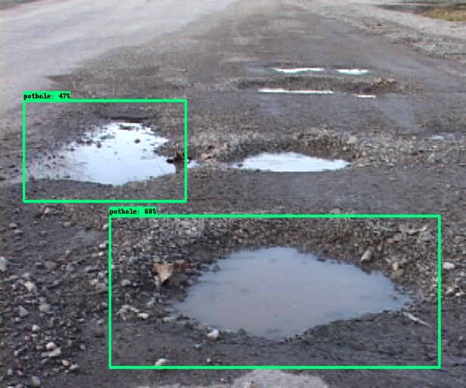
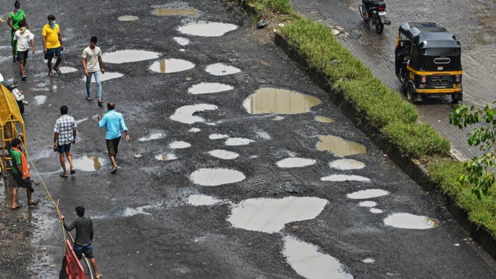
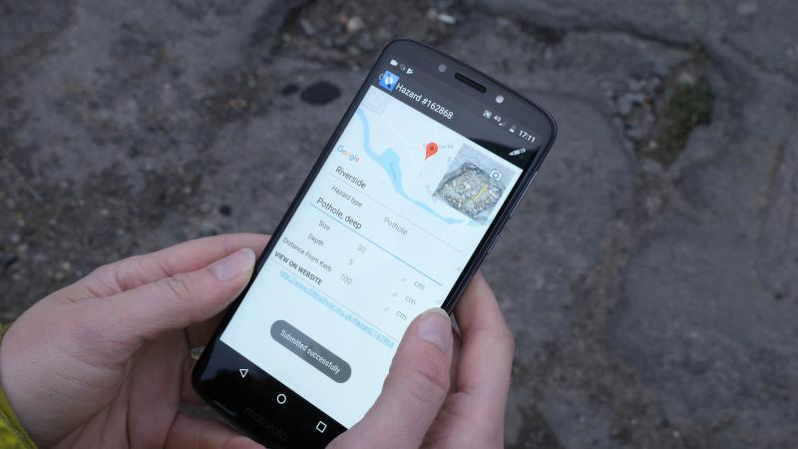
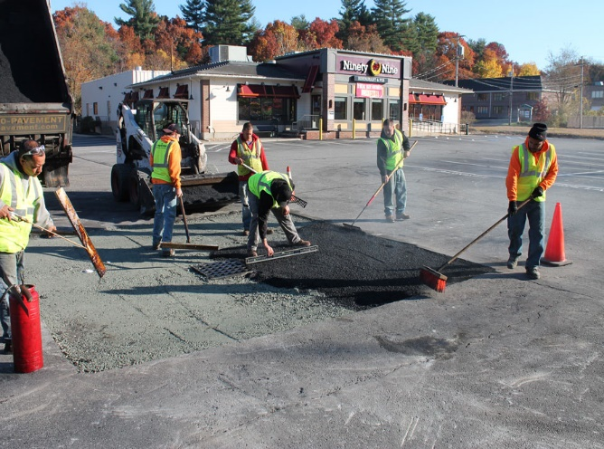
Parameters in PotHole Management
POTHOLE SIZE
SEVERITY
LOCATION
RESPONSE TIME
Specify the dimensions of potholes, such as length, width, and depth.
Assess the severity of potholes, such as low, medium, or high.
Identify the precise location of potholes, including street names and GPS coordinates.
Swift response and repair of reported potholes is critical for safety.

Slide 8
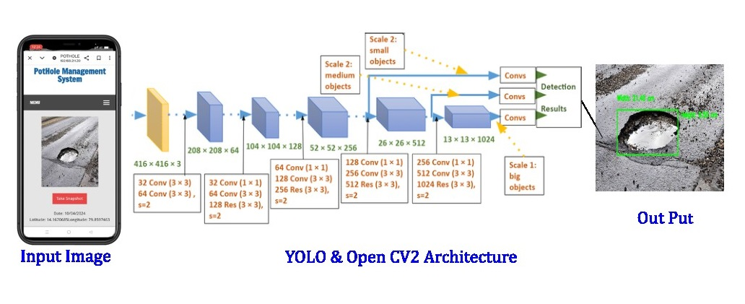
Methodology Architecture

Slide 9
Methodology Architecture
Here are the steps involved in the YOLOv3 architecture methodology:
Resize the input image to 416 x 416 pixels.
Pass the image through a series of convolutional layers.
Pass the image through a pooling layer.
Pass the image through another series of convolutional layers.
Pass the image through three convolutional layers with 1024 filters each.
Use anchor boxes to predict the location and size of objects in the image.

Slide 10
Methodology Implementation
User Reporting
Complaint Submission along with Geo-location.
Engineer Survey and Report
Identification of Damage Materials
Traffic Control
PWD Review and Action
Repair Execution and Completion
User Notification and Closure

Slide 11
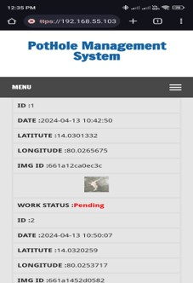
Results…1
User Reports

Slide 12
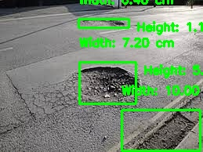
Results…2

Slide 13
Results Analysis
Analyze the YOLO algorithm's detection results. Look for:
True Positives: Correctly detected potholes.
False Positives: Incorrectly detected objects (e.g., misclassified road cracks as potholes).
False Negatives: Missed potholes that were not detected by the model.
Visualize the detection results with bounding boxes overlaid on the original images to understand where the model succeeded and where it needs improvement.

Slide 14
Conclusion
Mobile phones offer a promising avenue for pothole detection: The ubiquitous ownership of smartphones presents an opportunity to engage citizens in infrastructure monitoring, enabling cost-effective and scalable data collection methods.
Integration of computer vision technology improves accuracy: By leveraging computer vision algorithms to analyze images or videos captured by mobile devices, pothole detection becomes more precise and efficient, reducing the need for manual inspections.
Enhanced road maintenance practices: The proposed system facilitates more efficient road maintenance by providing real-time data on pothole locations and severity, allowing authorities to prioritize repairs and ultimately improve road safety for motorists.
Empowerment of citizens in infrastructure improvement: Citizen engagement in pothole detection fosters a collaborative approach to addressing road maintenance issues, leading to more comprehensive and timely data collection, and ultimately contributing to better road conditions.

Slide 15
Conclusion
5. Potential for smart city initiatives: The study highlights the potential of crowd- sourced infrastructure monitoring and smart city initiatives in addressing challenges related to road maintenance. By harnessing mobile phones and computer vision technology, coupled with citizen engagement, cities can move towards more sustainable and effective management of their road infrastructure.

