Slide 1
ChipTrust Security IP - MicroArchitecture
Jishnu Mohan
Lokesh Kumbaganti
Sravanthi Vennapusa

Slide 3
SoC (host chip)
.cptra_pwrgood .cptra_rst_b .fuse writes .AXI manager .TAP/JTAG
AXI subordinate
Chip Trust IP boundary
Firmware stack (SW – runs on VeeR EL2)
ROM (96 KiB)
FMC
Runtime FW
VeeR EL2 RISC-V core (32-bit, 4-stage in-order pipeline)
.IFU (AHB-Lite) .LSU (AHB-Lite) .31 external IRQs .PMP enabled .WDT NMI .ICCM 256 KiB .DCCM 256 KiB
AHB-Lite fabric (32-bit addr, 64-bit data, 17 targets)
AHB-Lite Interconnect – address decoder routes to 17 target slaves
Crypto subsystem
Peripherals
SoC interface
Chip Trust outputs to SoC
.ready_for_fuses .ready_for_fw .error_fatal .error_non-fatal .security_state .idevid_cert_chain

Slide 4
Firmware Stack
Firmware stack (SW – runs on VeeR EL2)
ROM (96 KiB - immutable)
First code executed
UDS decrypt
Mailbox enable
Asserts READY_FOR_FW
FMC (First Mutable Code)
DICE cert chain build
IDevID → LDevID
Loads runtime firmware
Verifies signature
Runtime FW
Post-boot services
Attestation requests
Crypto services
WDT servicing
Impactless FW update

Slide 5
Crypto subsystem, Peripherals and SoC Interface Blocks
Crypto subsystem 0x1000_0000
Peripherals 0x2000_0000
SoC Interface 0x3000_0000
Crypto Init Engine (CIE)
UDS / field entropy derive
CSRNG
Crypto-secure RNG 0x2000_2000
Mailbox FSM + SRAM 256 KiB
.FW load .protocol lock
0x3002_0000/0x3004_0000
Crypto subsystem
Crypto Init Engine (CIE)
ECC Secp384 (ECDSA)
Sign/verify – 0x1000_8000
Entropy source
Physical RNG seed
0x2000_3000
AXI DMA Assist Engine
Streaming SHA/AES-LOCK
0x3002_2000
ECC Secp384 (ECDSA)
HMAC-512
MAC engine – 0x1001_0000
Watchdog timer
2-stage cascade NMI on timeout
SHA-512/ SHA-256
Hash – 0x1002_0000
SoC IFC CSR
.Fuse regs .timer .flow ctrl
0x3003_0000
HMAC-512
SHA-512/ SHA-256
ICCM 256 KiB
Instruction memory
0x4000_0000
AES-128/192/256
ECB CBC CFB OFB CTR GCM
SHA-512 Accelerator
Save/restore .streaming
0x3002_1000
AES-128/192/256
ABR-ML-DSA/ ML-KEM
Adams Bridge – 0x1003_0000
ABR-ML-DSA/ ML-KEM
DCCM 256 KiB
Data memory
0x5000_0000
TAP/JTAG
Debug/auth breakpoint
AXI subordinate
SoC inbound
R/W access
SHA3
0x1004_0000
Key Vault
0x1001_8000
SHA3
KeyVault
PCR Vault + Data Vault
Boot FSM
FUSE→DONE states
PCR Vault + Data Vault
Measurement storage
AXI manager (outbound)
Chip Trust initiates SoC reads

Slide 6
Phase 1-4: power on/boot fsm/fuse programming/firmware load
SoC
AXI Interface
Boot FSM
VeeR EL2
Crypto
Mailbox
cptra_pwrgood
cptra_rst_b (deassert)
BOOT_IDLE
ready_for_fuses
fuse_req_interrupt
AXI write: fuse_uds
AXI write: fuse_field_entropy
AXI write: fuse_done = 1
fuse_done
cptra_uc_rst_b_deassert
ROM executes
AHB read: mailbox_SRAM
fw_data[31:0]
FW loaded
ICCM

Slide 7
Phase 5: Crypto Operations
SoC
AXI Interface
Boot FSM
VeeR EL2
Crypto
Mailbox
AHB_write: sha512_block
sha512_valid
AHB_write: ecc_cmd
ecc_valid
AHB_write: hmac_key, block
hmac_valid
AHB_write: pcr_extend
pcr_valid

Slide 8
Phase 6: Mailbox Command
SoC
AXI Interface
Boot FSM
VeeR EL2
Crypto
Mailbox
AXI write: mbox_lock
lock granted
AXI write: mbox_cmd, mbox_dlen
AXI write: mbox_datain
AXI write: mbox_execute = 1
mbox_notif interrupt
AHB_read: mbox_cmd, data

Slide 9
Phase 7: Attestation Response
SoC
AXI Interface
Boot FSM
VeeR EL2
Crypto
Mailbox
AHB_write: ecc_sign_r/s
ecc_sign_valid
AHB_write: mbox_dataout
AHB_write: mbox_status = DATA_READY
mbox_data_avail interrupt
AXI read: mbox_dataout
cert/signature data
AXI write: mbox_unlock = 1

Slide 10
Jishnu – ICCM, DCCM
SROM, Pipelines – IFU (Fetch control, branch predictor, instruction aligner)
Lokesh – SHA512,256,HMAC, DRBG. (power reduction technique application)
Sravanthi – Address Decoder, DMA ASSIST Engine, Fuse Registers, Functional Registers, power reduction technique application), Interface Signals.

Slide 11
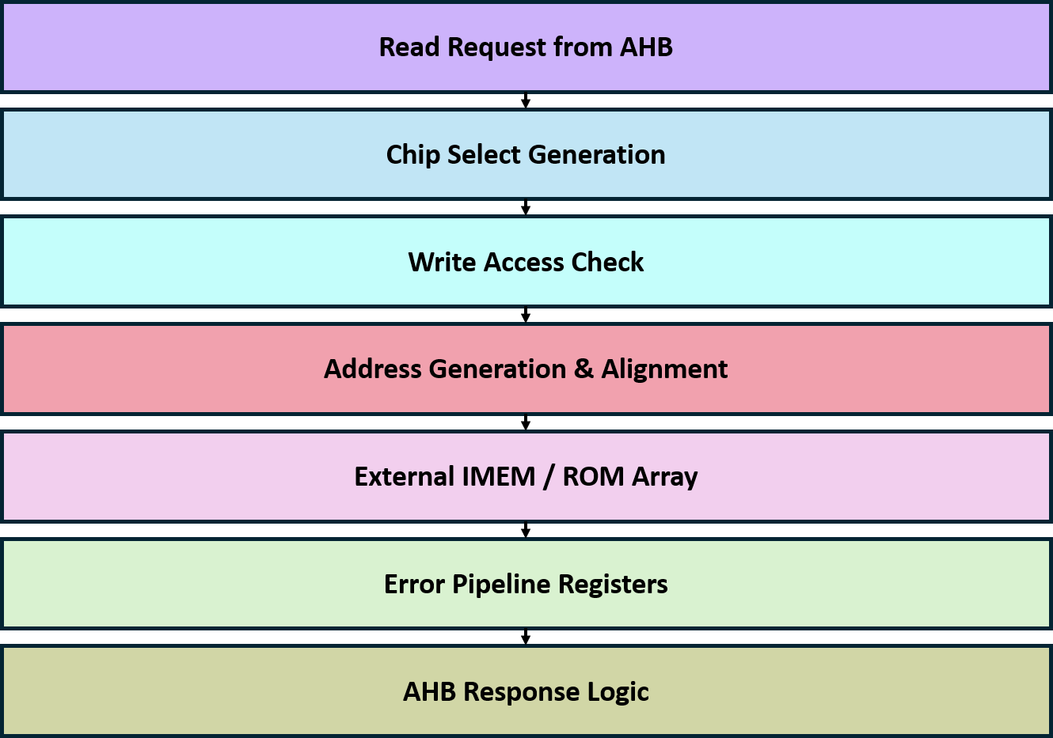
AHB-SROM Interface

Slide 12
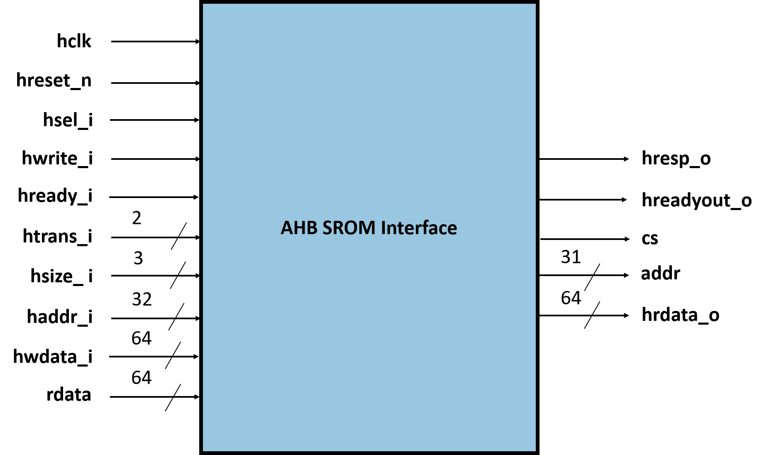
AHB-SROM Interface

Slide 13
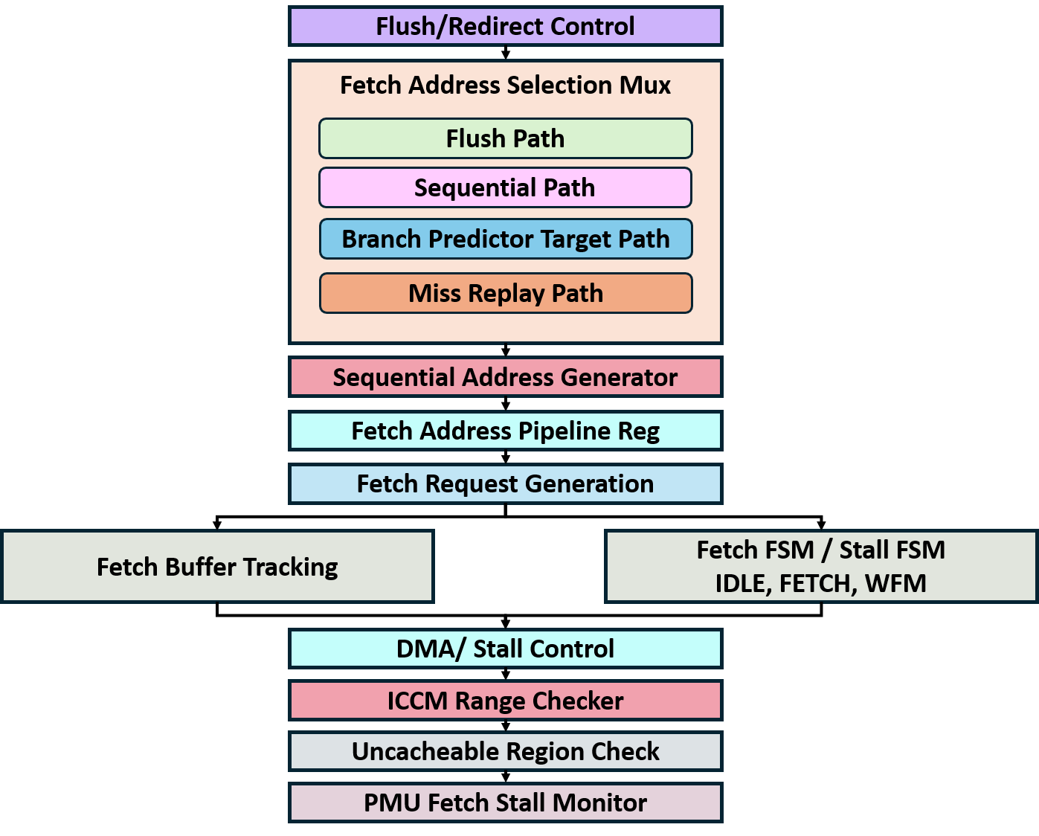
Instruction Fetch Unit (IFU) - Fetch Control

Slide 14
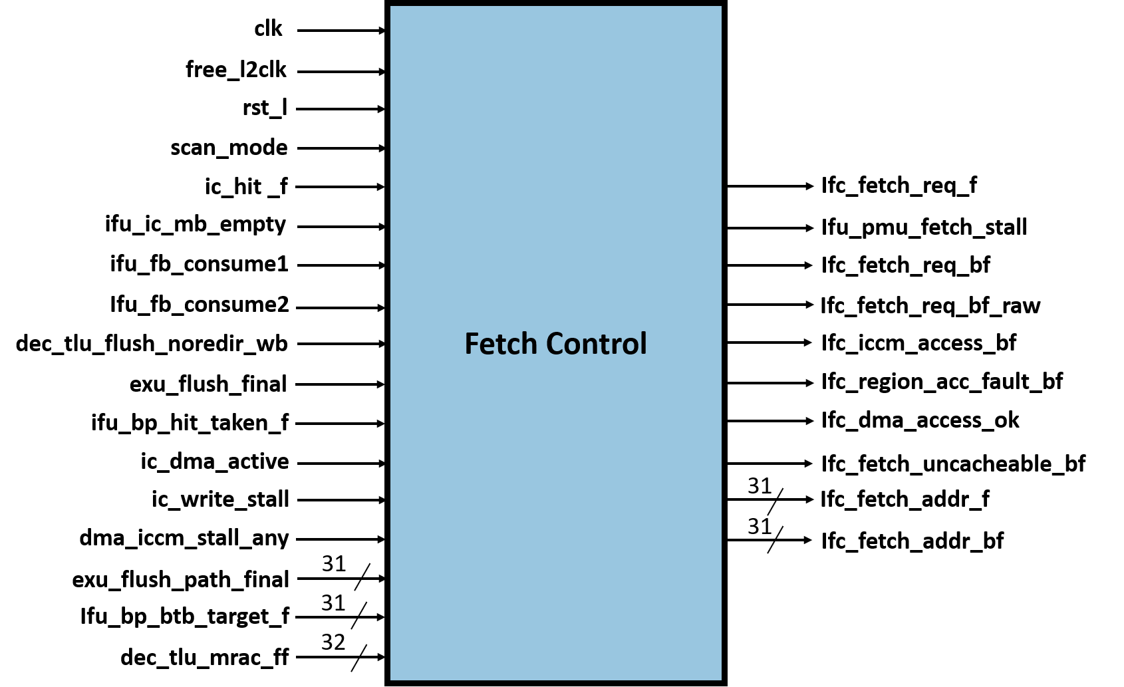
Instruction Fetch Unit (IFU) - Fetch Control

Slide 15
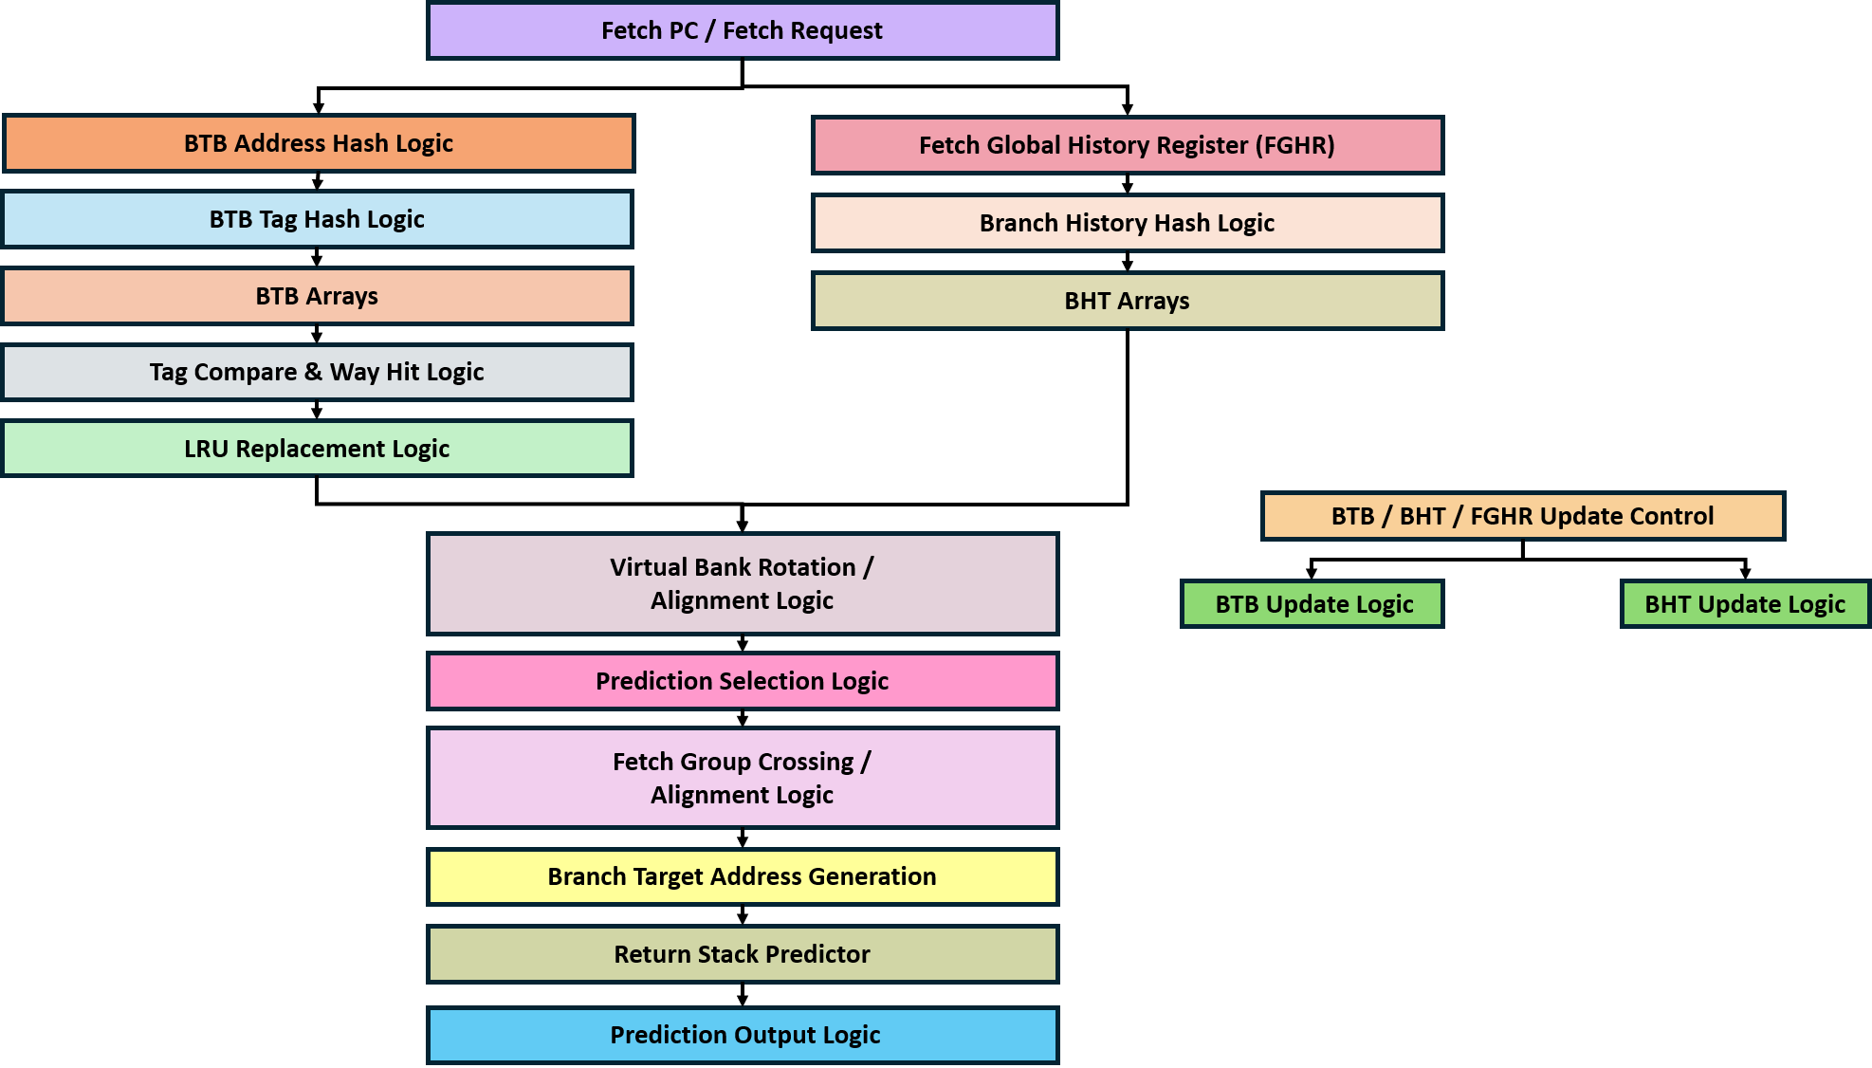
Instruction Fetch Unit (IFU) - Branch Predictor

Slide 16
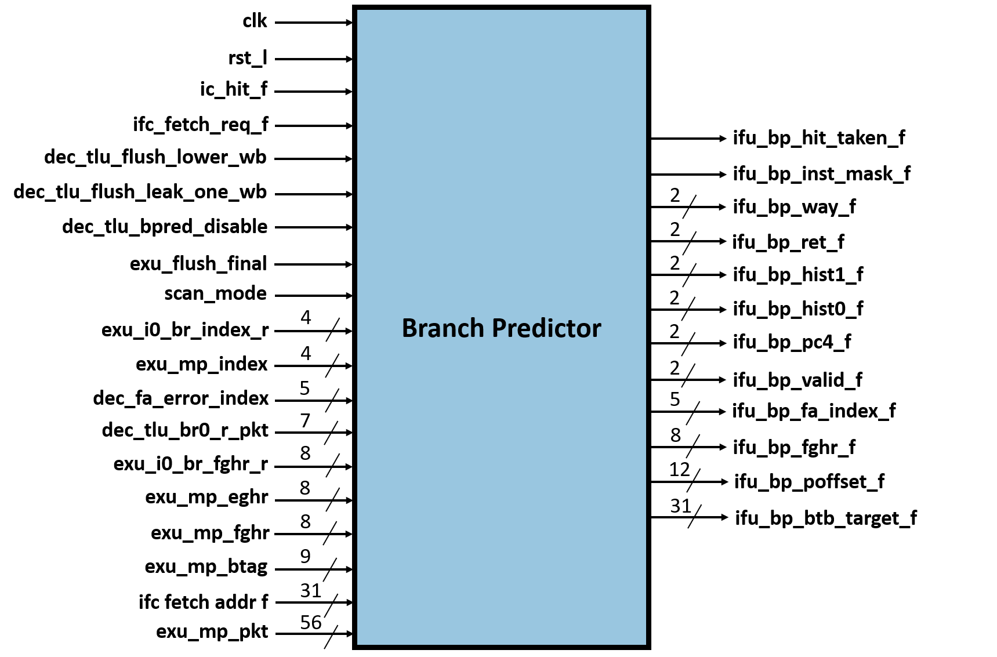
Instruction Fetch Unit (IFU) - Branch Predictor

Slide 17
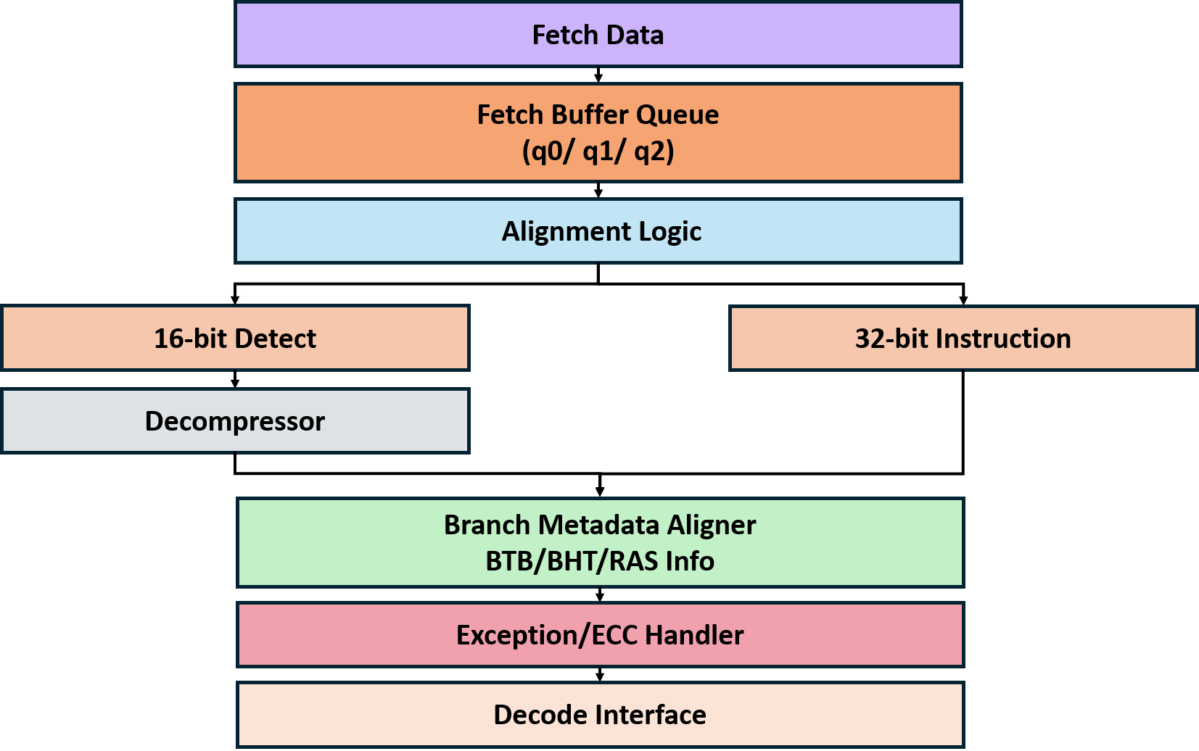
Instruction Fetch Unit (IFU) - Instruction Aligner

Slide 18
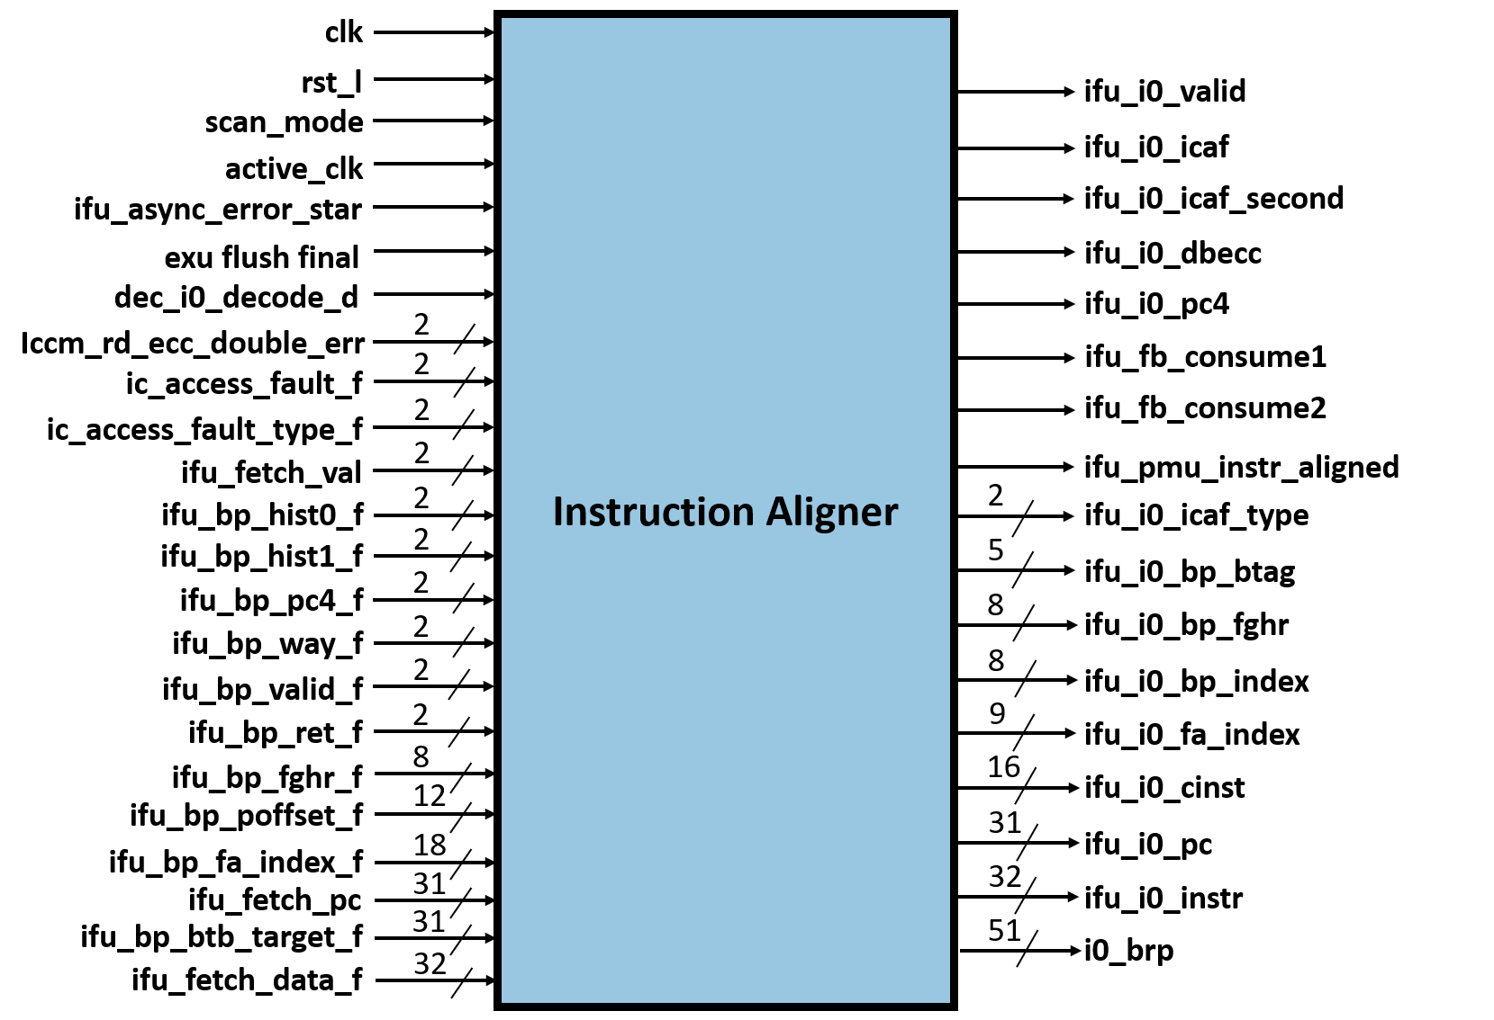
Instruction Fetch Unit (IFU) - Instruction Aligner

Slide 19
SoC Interface Address Decode & Arbitration
The SoC Interface Address Decode & Arbitration is the central arbitration and address decoding block used in the SoC Interface subsystem.
The module receives requests from two masters, namely the UC (Microcontroller) and the external SoC, and routes these requests to different internal peripherals such as the Mailbox, SHA Engine, DMA Register block, and SOC IFC Register block.
The arbiter performs address decoding by checking the incoming request address against predefined address ranges. Based on the decoded address, the request is directed to the corresponding destination block.
The module also validates access permissions for protected resources such as the Mailbox, SHA engine, and Fuse registers using user validation signals.

Slide 20
SoC Interface Address Decode & Arbitration
The SoC Interface Address Decode & Arbitration is the central arbitration and address decoding block used in the SoC Interface subsystem.
The module receives requests from two masters, namely the UC (Microcontroller) and the external SoC, and routes these requests to different internal peripherals such as the Mailbox, SHA Engine, DMA Register block, and SOC IFC Register block.
The arbiter performs address decoding by checking the incoming request address against predefined address ranges. Based on the decoded address, the request is directed to the corresponding destination block.
The module also validates access permissions for protected resources such as the Mailbox, SHA engine, and Fuse registers using user validation signals.

