Slide 1
RDC(Reset Domain Crossing
BY SRAVANTHI
CHIPWEAVE TECHNOLOGIES PVT LMD

Slide 2
Contents
What is RDC(Reset Domain Crossing)?
WHY RDC?
Features of Reset Domain Crossing
Timing Requirements
RDC Techniques
Types of Resets

Slide 3
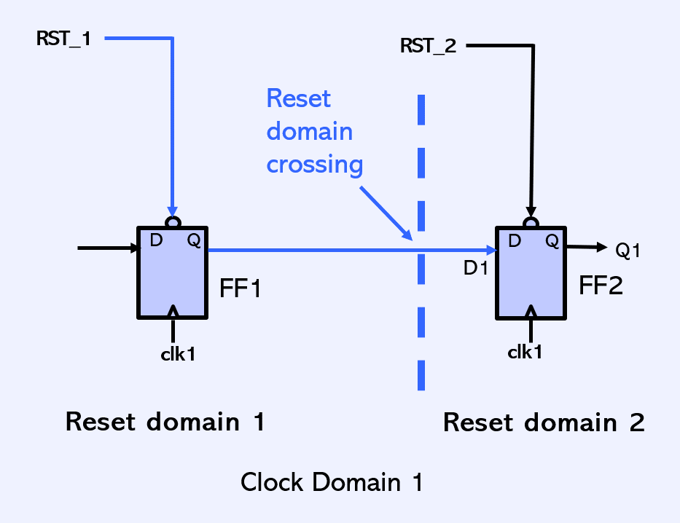
What is Reset Domain Crossing?
Reset Domain crossing(RDC) occurs when one reset domain interact with another reset Domain
Even if both flops are using same clock if their resets are different that is an RDC

Slide 4
WHY RDC
Complexity: Past chips had 1-2 resets; modern SoCs have hundreds.
Power Management: Independent "Power Islands" require independent resets to wake/sleep specific blocks (Wi-Fi, Bluetooth, GPU).
IP Integration: Mixing IP from different vendors leads to uncorrelated reset strategies.
Verification Gap:
STA (Static Timing Analysis) ignores asynchronous paths.
CDC (Clock Domain Crossing) tools don't check for reset-induced metastability.
Simulation rarely catches these because resets happen infrequently .

Slide 5
why RDC is important​
When the reset of one flip flop de-asserts earlier than another flip flop it can ​causes Metastability, Unknown ,Functional failures​
Metastability​
Metastability occurs when a flop in reset domain A becomes active while the flop driving it in reset domain B is still held in reset.​
Unknown​
combinational paths may generate invalid values when upstream logic isn’t initialized yet​
Functional failures​
Design behaves unpredictably during reset release.​

Slide 6
Features of RDC
Automated Reset Mapping: Identifies all asynchronous reset sources and traces their propagation paths through the chip logic.
Global Metastability Detection: Finds signals crossing between different reset domains that could cause system hangs or unpredictable states.
Isolation Logic Verification: Checks if "blocking" gates (like AND/OR) effectively freeze signals during a reset to prevent glitches.
Metastability Risk Analysis: Models the probability of a flip-flop entering an unstable state when a source reset asserts asynchronously.

Slide 7
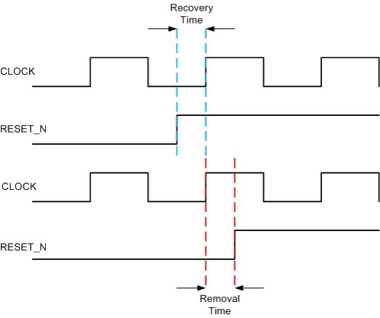
Timing requirements
Reset Recovery​
Minimum time required for reset must remain asserted before a clock edge, so flops reset correctly.
Reset Removal​
Minimum time required so that reset must remain stable after a clock edge when it is de-asserted.

Slide 8
RDC (RESET DOMAIN CROSSING )TECHNIQUES​
There are 4 techniques are there for fixing RDC
Synchronizer reset​
Use handshake or valid signal after reset​
Add gating​
Globally Synchronizer reset

Slide 9
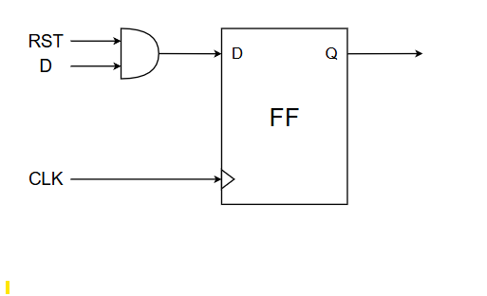
Synchronizer reset
In synchronous reset circuits, the reset signal is synchronized with the clock. When the reset is applied, the action only occurs at clock edges (positive or negative edge), avoiding glitches and metastability.
The coding style to model synchronous reset is an if/else priority style with reset in the if condition and all the other logic in the else section.
Ex: module sync_rst (clk,rst,d,q);
input clk,rst,d;
output reg q;
always_ff@(posedge clk)
if(!rst) q<=1’b0;
else q<= d

Slide 10
Use handshake or valid signal after reset​
Here we add valid signal when ever valid is high that time flop a samples flop b​
FLOP_A : generates data + valid​
FLOP_B : accepts data when valid is high​
FLOP_A​
always_ff @(posedge clk or negedge rst_n1)​
FLOP_A <= (!rst_n1) ? 1'b0 : data in;​
a_valid <= (!rst_n1) ? 1'b0 : 1'b1;​
FLOP_B​
always_ff @(posedge clk or negedge rst_n2)​
FLOB_B <= (!rst_n2) ? 1'b0 : a_valid ? FLOP_A : FLOP_B;​

Slide 11
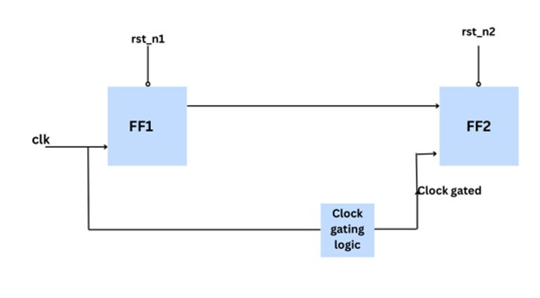
Clock Gating
When gated clock = 0 → flop does NOT toggle → so it will NOT go metastable.​
Reset must de-assert fully first, become stable, and then only the gated clock should be enabled.​
After clock resumes, the flop samples clean and stable value → hence NO metastability.​

Slide 12
Reset
Reset is a control signal used to initialize and re-initialize a digital system to a known, safe state.
Why we use reset:
To clear random/invalid values in registers and logic after power-up
To ensure the system starts predictably and safely
To recover the system from errors, hangs, or abnormal conditions

Slide 13
Types of resets
There are different types of resets are there in a typical SoC
Hard Reset
Soft Reset
Power-on Reset (POR) /System reset /cold reset
Watchdog Reset
Peripheral Reset:
Core reset
DMA Reset
Functional Reset
Warm reset
Hot reset

Slide 14
Hard Reset
A hard reset, also known as a “factory reset” or “hard reboot,” is a process that restores a device to its original system state.
This means it erases all the data that has been added to the device since its purchase and reinstalls the operating system.
It clears all registers, state machines, memories (if connected) and stops everything immediately.
Ex: Restarting your phone
Why we use Hard Reset
To recover from serious faults or hangs
To guarantee a fully known, clean start
To reset hardware after power-up or watchdog timeout

Slide 15
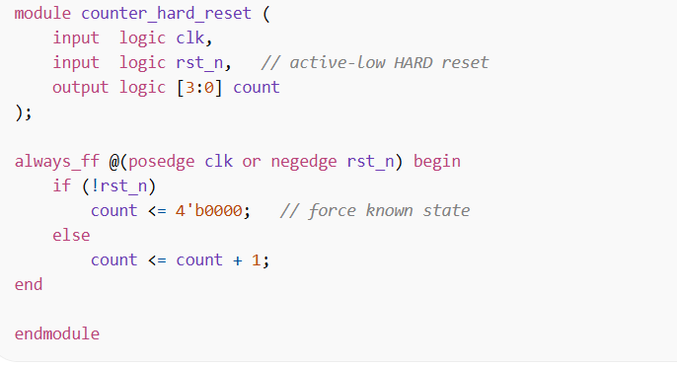
Hard Reset h

Slide 16
Soft reset
A soft reset resets only selected logic blocks while the clock keeps running. It brings parts of the system back to a known state without a full power-cycle.
ex:Restarting an app
Why we use Soft Reset
To recover from functional errors without restarting the whole system
To reinitialize a specific module or protocol (FIFO, link layer, FSM)
To allow faster recovery and minimal service disruption

Slide 17
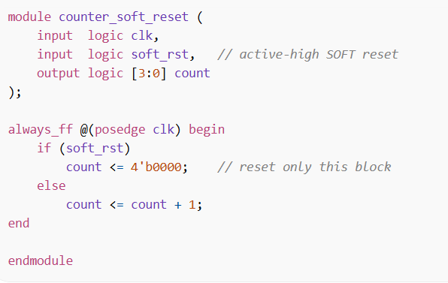
Soft Reset

Slide 18
Power-On Reset (POR)
What: Reset automatically asserted when power is first applied. Why: Ensures the entire chip starts from a known, clean state. Example: On power-up, all registers = 0, clocks and PLLs initialize.
always_ff @(posedge clk or negedge por_n) begin
if (!por_n)
state <= IDLE; // power-up default
end

Slide 19
Watchdog Reset
What: Reset triggered when software fails to respond within a timeout.
Many SoCs incorporate a watchdog timer, which is a hardware timer that monitors the system’s operation. If the timer expires due to a software or hardware failure, it triggers a watchdog reset, resetting the system to its initial state Why: Recovers system from hangs, deadlocks, infinite loops. Example: CPU crashes → watchdog times out → full system reset.
if (wdog_timeout)
sys_reset <= 1'b1;

Slide 20
Peripheral Reset
Peripheral Reset
Reset applied only to selected hardware blocks.
Some SoCs provide individual reset signals for different peripheral components or subsystems. These resets allow specific peripherals to be reset independently without affecting the entire SoC.
Why: Reinitialize faulty modules without rebooting the whole system. Example: Reset UART, SPI, DMA while CPU keeps running.

Slide 21
Core Rest
Core Reset
Resets CPU core (pipeline, registers, FSMs). Why: Restart software execution cleanly. Example: CPU jumps back to reset vector, peripherals stay active.
if (core_rst) pc <= RESET_VECTOR

Slide 22
DMA Reset
What: Resets only the DMA controller. Why: Clear stuck transfers or invalid descriptors. Example: DMA error → reset DMA → restart transfer.
if (dma_rst) dma_state <= DMA_IDLE;

Slide 23
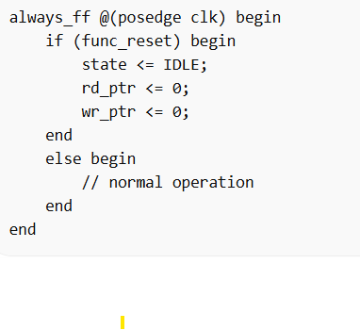
Functional reset
A functional reset resets only the logic needed to restart operation, without rebooting the whole chip/system.
What it typically resets
State machines, Counters, Pointers,FIFOs (rd/wr pointers) and Credits / timers
When it is used
Protocol error recovery
Link retraining
FIFO overflow recovery
Software-triggered reset of a block
“Restart this module” command
Real-world example
PCIe link retrain
SerDes block restart
Network packet engine reset

Slide 24
Warm Reset
A warm reset resets almost the entire system, but keeps power ON.
What it typically resets
CPU core,Interconnect, Most peripherals,State machines, Interrupt controllers
When it is used
Software reboot
System hang recovery
Firmware update
Watchdog reset

Slide 25
Hot Reset
A hot reset resets only a very small, selected part of the system while everything else keeps running.
What Hot Reset usually resets
✔ A single IP block ✔ One protocol engine ✔ One channel / lane ✔ One FSM or FIFO

Slide 26
Summary
Hard Reset → Full hardware reset without power off
Soft Reset → Software-triggered reset (scope varies)
Cold Reset / POR → Power OFF → ON reset
Watchdog Reset → Safety reset on hang
Peripheral Reset → Reset one IP only
Core Reset → Restart CPU core
DMA Reset → Clear DMA engine state
Functional Reset → Reset internal logic only
Warm Reset → Reboot system without power cycle
Hot Reset → Live reset of a small block

Slide 27


