Slide 1
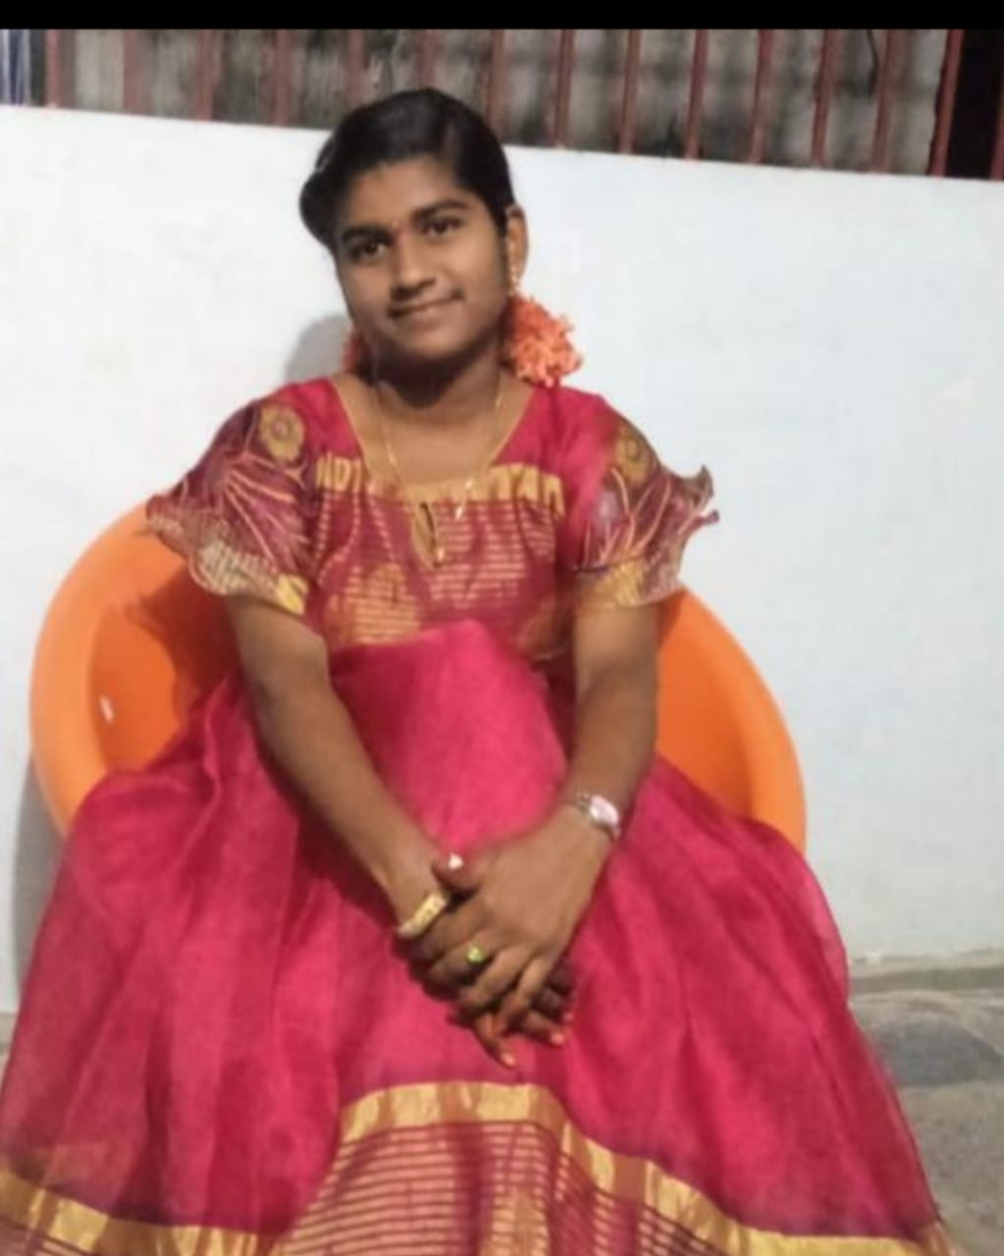
Vennapusa sravya reddy
Life of sravanthi's world(sravya)

Slide 2
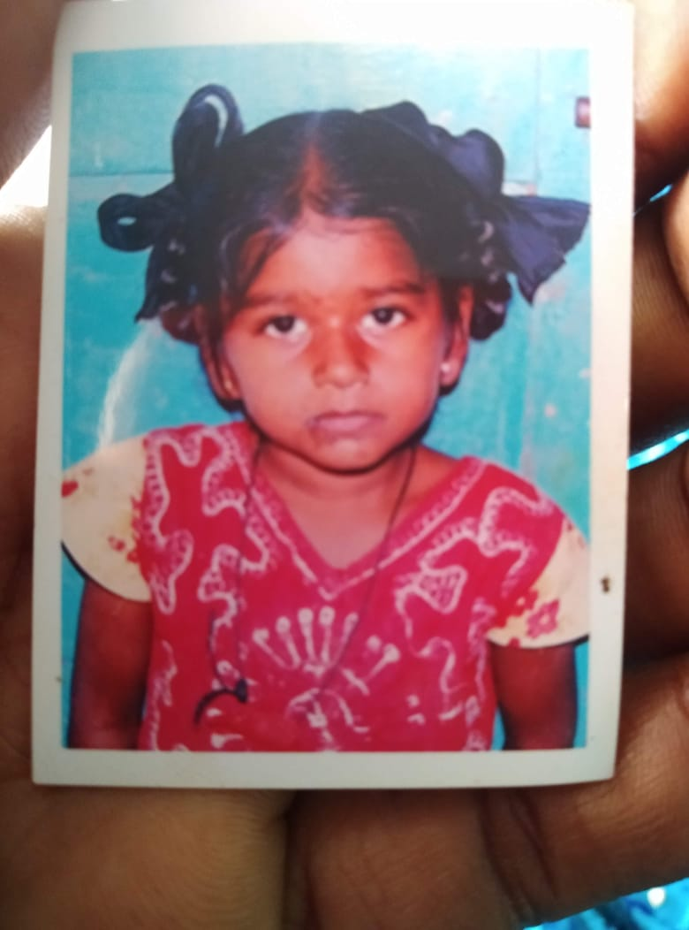
Life
Dearest one of my family
My life's name is sravya
She is everything to me

Slide 3
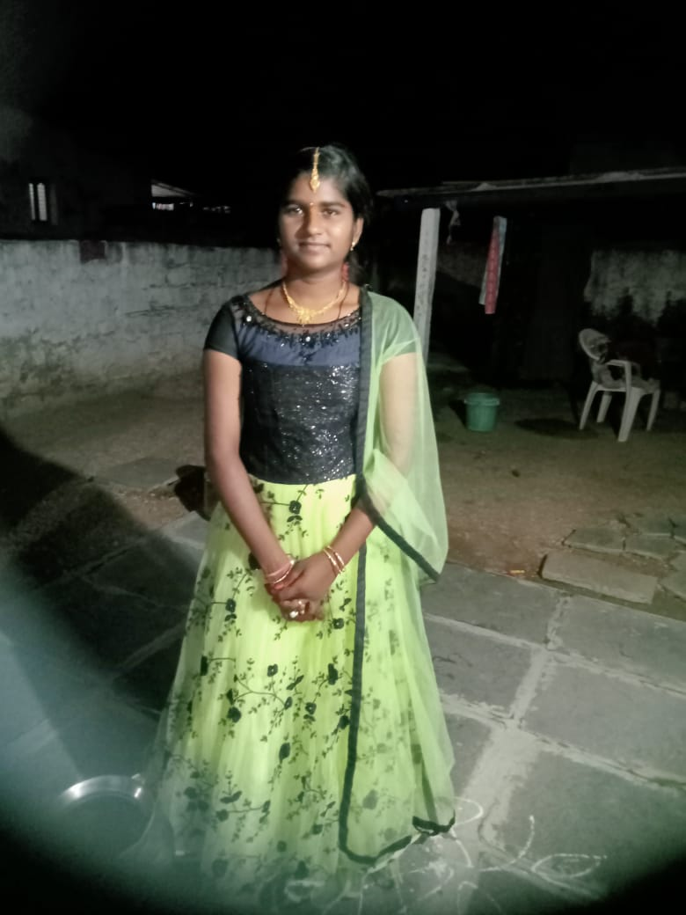
I remember the day she born in my family that is september 11 ,2006
That day is memorable day for my family.

Slide 4
Childhood memories

Slide 5
Influence
Jan. 20YY
Describe your subject’s impact
Feb. 20YY
Describe your subject’s impact
Mar. 20YY
Describe your subject’s impact
Explain to your audience the influence and/or impact he/she had in life.

Slide 6






Awards and recognition
Award description
Award description
Award description
Share the awards and recognition awarded to him/her.
Award description
Award description
Award description

Slide 7







Legacy
Legacy description
Legacy description
Legacy description
Legacy description
Legacy description
Legacy description
Describe for your audience the legacy he/she has left. How has he/she changed the world.

Slide 8

How to use this template
Follow the instructions on each slide to create your presentation.
Remember a PowerPoint is a visual for your presentation. The words on each slide should serve only as talking points (rather than everything you are going to say).
Images and graphics add interest; be sure to add them to your slides when appropriate.
Use the Design Ideas feature to create beautiful presentations.
Go to the Design ribbon and select Design Ideas.
Choose Transitions and Animations carefully. (You want your audience to focus on your content, rather than your effects.)

Slide 9
Customize this Template
Template Editing Instructions and Feedback

