Slide 1
B Trees
In a binary search tree, AVL Tree, Red-Black tree etc., every node can have only one value (key) and maximum of two children but there is another type of search tree called B-Tree in which a node can store more than one value (key) and it can have more than two children.
B-Tree was developed in the year of 1972 by Bayer and McCreight with the name Height Balanced m-way Search Tree. Later it was named as B-Tree.

Slide 2
B-Tree is a self-balanced search tree with multiple keys in every node and more than two children for every node.
B-Tree of Order m has the following properties...
Property #1 - All the leaf nodes must be at same level.
Property #2 - All nodes except root must have at least [m/2]-1 keys and maximum of m-1 keys.
Property #3 - All non leaf nodes except root (i.e. all internal nodes) must have at least m/2 children.
Property #4 - If the root node is a non leaf node, then it must have at least 2 children.
Property #5 - A non leaf node with n-1 keys must have n number of children.
Property #6 - All the key values within a node must be in Ascending Order.

Slide 3
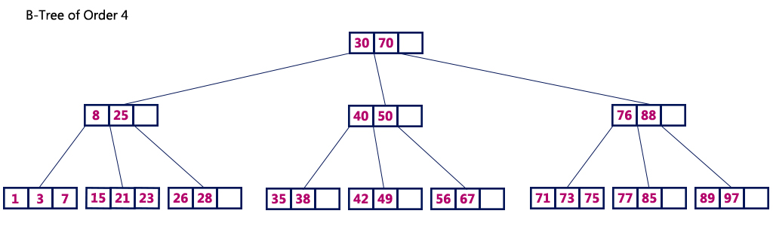
B-Tree of Order 4 contains maximum 3 key values in a node and maximum 4 children for a node

Slide 4
Operations on a B-Tree
The following operations are performed on a B-Tree...
Search
Insertion
Deletion

Slide 5
Search Operation in B-Tree
In a B-Ttree, the search operation is similar to that of Binary Search Tree.
In a Binary search tree, the search process starts from the root node and every time we make a 2-way decision (we go to either left subtree or right subtree).
In B-Tree also search process starts from the root node but every time we make n-way decision where n is the total number of children that node has.
In a B-Ttree, the search operation is performed with O(log n) time complexity

Slide 6
Step 1: Read the search element from the user
Step 2: Compare, the search element with first key value of root node in the tree.
Step 3: If both are matching, then display "Given node found!!!" and terminate the function
Step 4: If both are not matching, then check whether search element is smaller or larger than that key value.
Step 5: If search element is smaller, then continue the search process in left subtree.
Step 6: If search element is larger, then compare with next key value in the same node and repeate step 3, 4, 5 and 6 until we found exact match or comparision completed with last key value in a leaf node.
Step 7: If we completed with last key value in a leaf node, then display "Element is not found" and terminate the function.

Slide 7
Insertion Operation in B-Tree In a B-Tree, the new element must be added only at leaf node. That means, always the new keyValue is attached to leaf node only.
Step 1: Check whether tree is Empty.
Step 2: If tree is Empty, then create a new node with new key value and insert into the tree as a root node.
Step 3: If tree is Not Empty, then find a leaf node to which the new key value cab be added using Binary Search Tree logic.
Step 4: If that leaf node has an empty position, then add the new key value to that leaf node by maintaining ascending order of key value within the node.
Step 5: If that leaf node is already full, then split that leaf node by sending middle value to its parent node. Repeat tha same until sending value is fixed into a node.
Step 6: If the spilting is occuring to the root node, then the middle value becomes new root node for the tree and the height of the tree is increased by one.

Slide 8
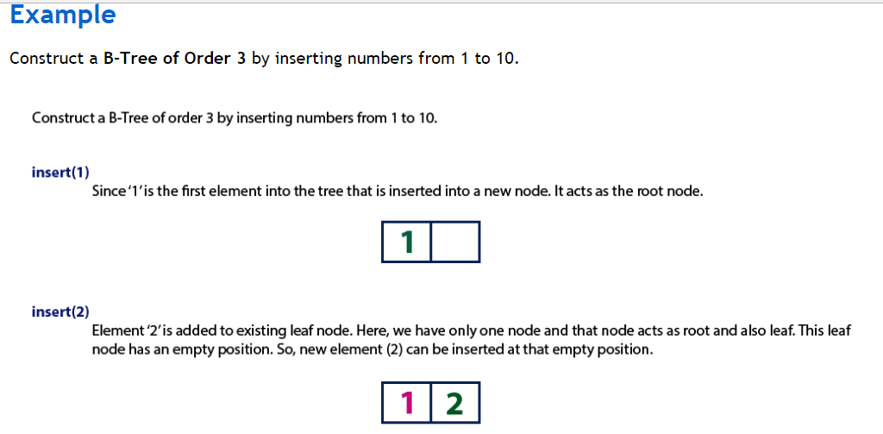

Slide 9
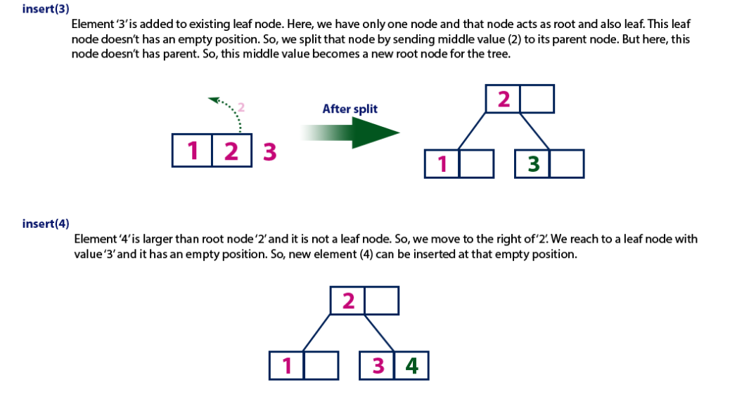

Slide 10
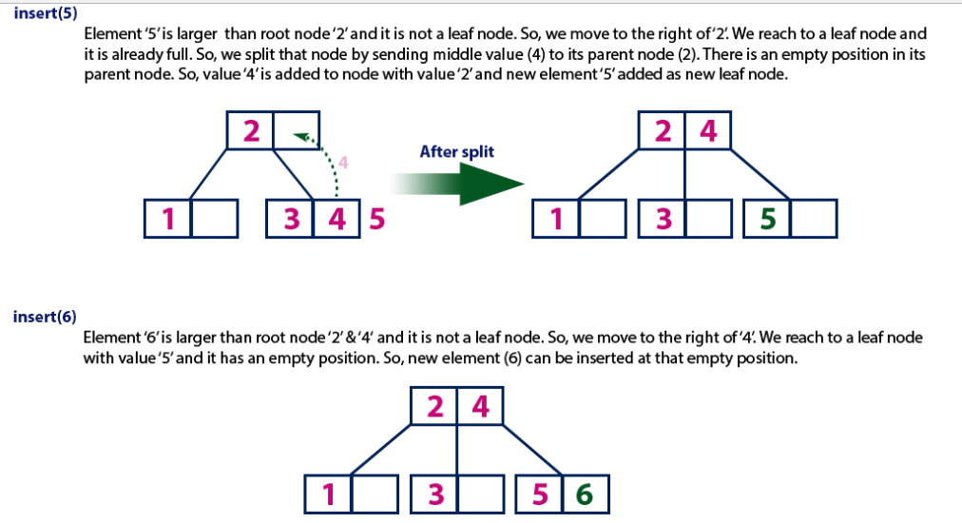

Slide 11
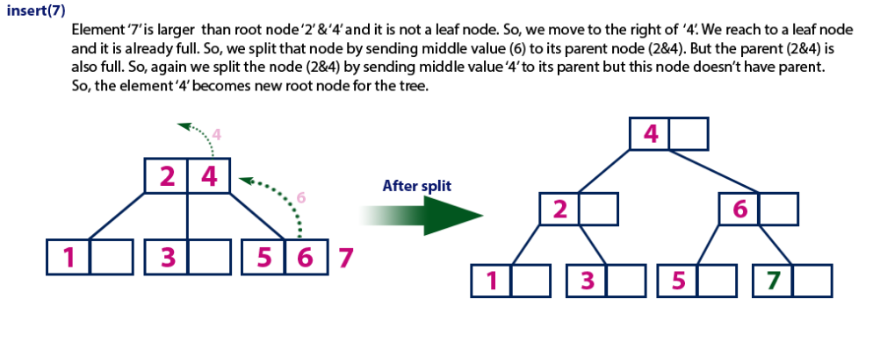

Slide 12
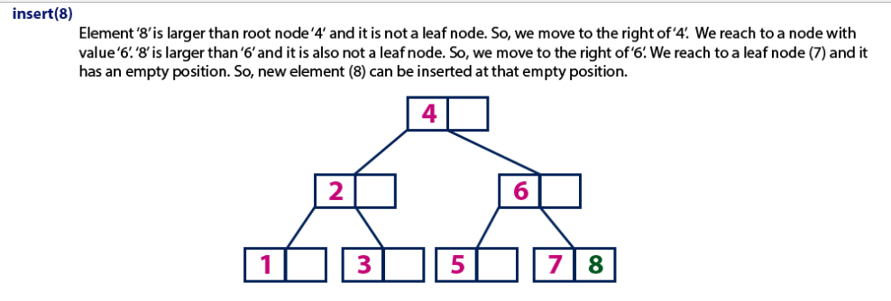

Slide 13
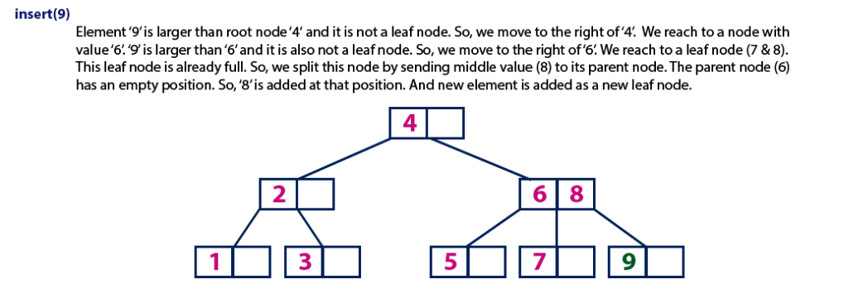

Slide 14
