Slide 1
Sentiment Analysis on Financial News
Sample Project Presentation
NAME: vennelaboinapalli
INTERN ID:EX-1753693472398

Slide 2
Project Description
Create a model that predicts market movements by analyzing the sentiment in financial news articles.
This project highlights how sentiment influences financial decisions and the importance of real-time data processing.
Tip: Fine-tune the model with recent data to adapt to the changing financial landscape.

Slide 3
Steps and Guidelines
1. Data Collection: Scrape financial news articles from reputable sources.
2. Preprocessing: Clean text data, remove stopwords, and perform lemmatization.
3. Model Selection: Choose a model (e.g., LSTM, BERT).
4. Training: Train the model on labeled financial news data.
5. Evaluation: Test accuracy with unseen data and fine-tune.
6. Prediction: Predict market trends using sentiment scores.

Slide 4
Tools and Technologies
- Programming Language: Python
- Frameworks: TensorFlow, PyTorch
- NLP Libraries: NLTK, SpaCy
- Data Sources: Financial news websites/APIs

Slide 5
Sample Project Architecture
1. Data Ingestion → Financial News Articles
2. Preprocessing → Tokenization, Lemmatization, Stopword Removal
3. Model → LSTM / BERT for Sentiment Classification
4. Sentiment Scores → Positive, Negative, Neutral
5. Prediction Layer → Market Trend Forecasting

Slide 6
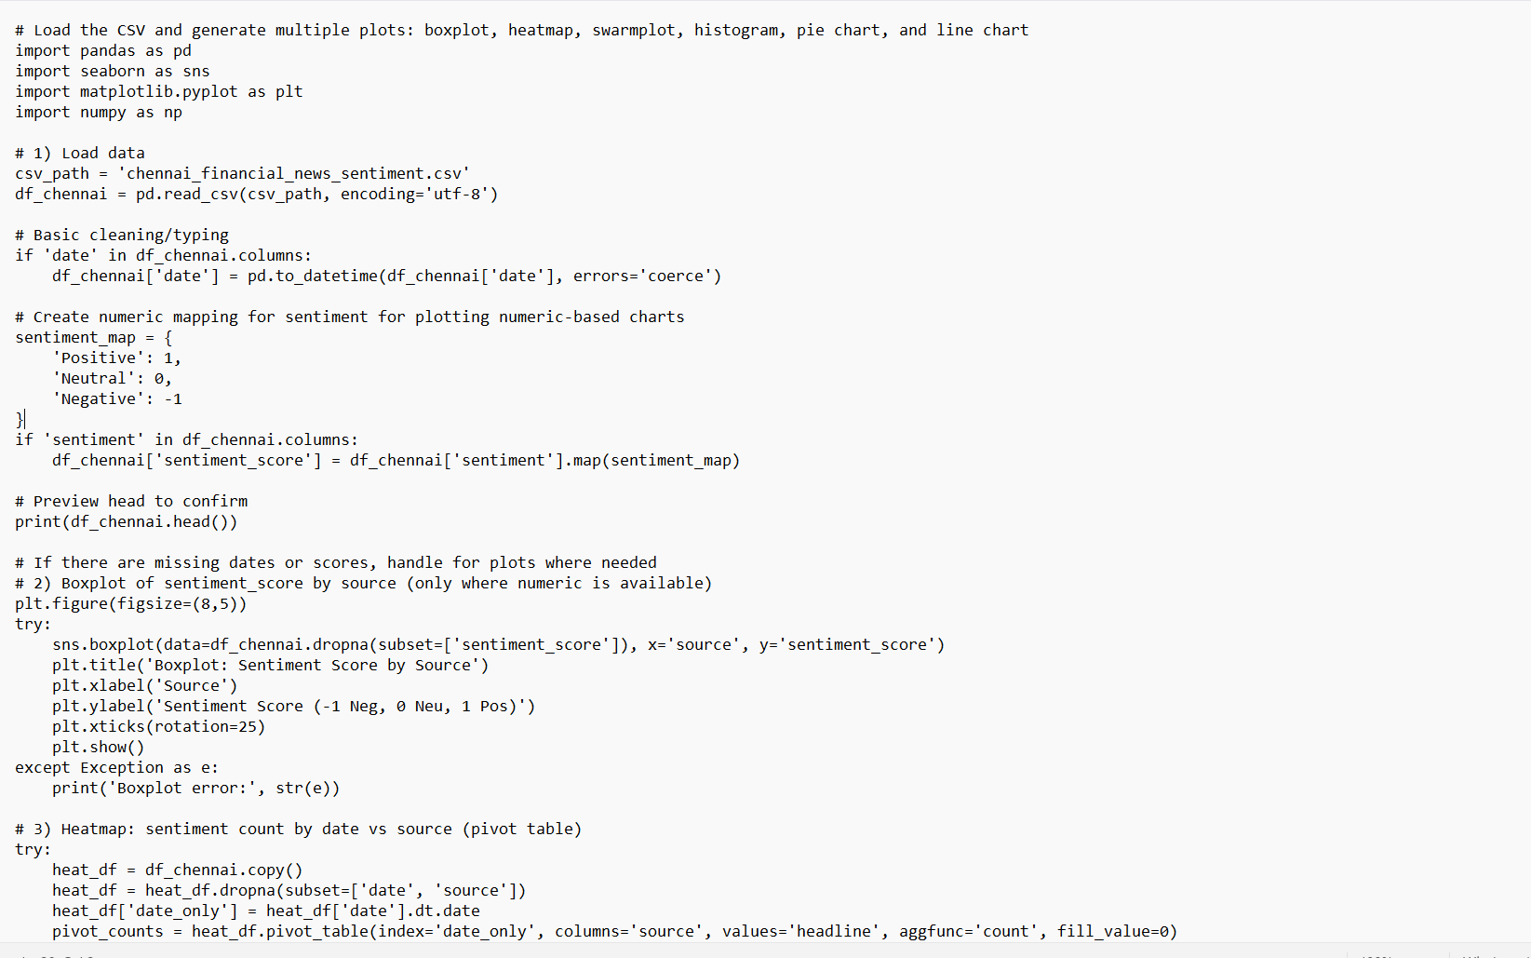

Slide 7
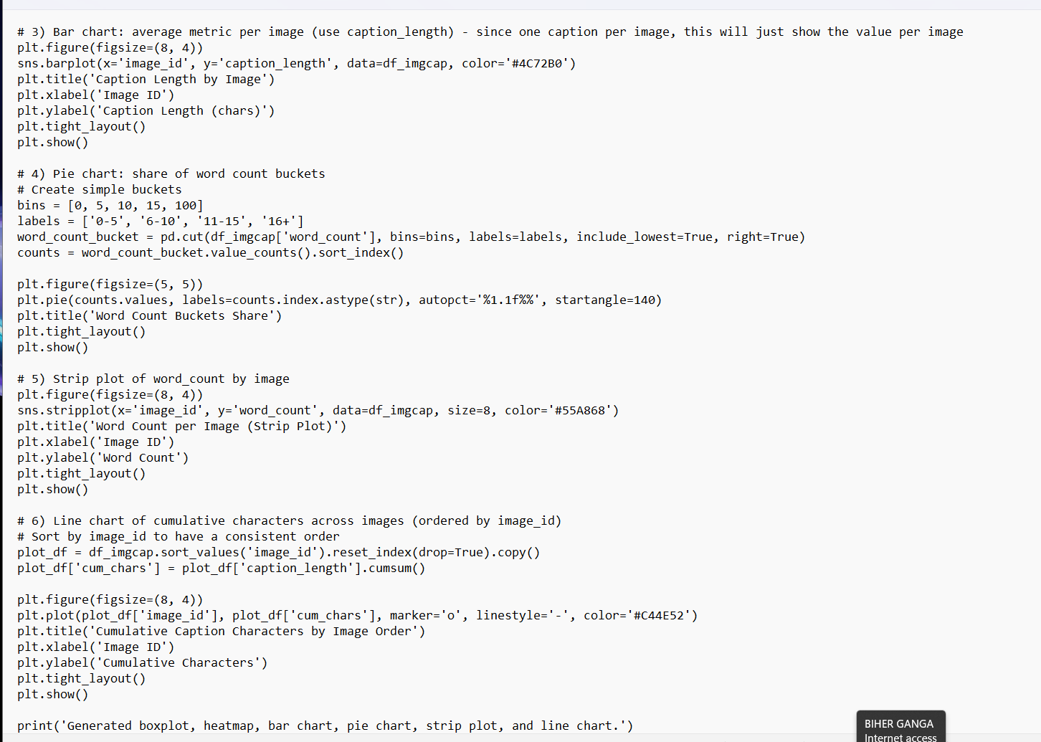

Slide 8
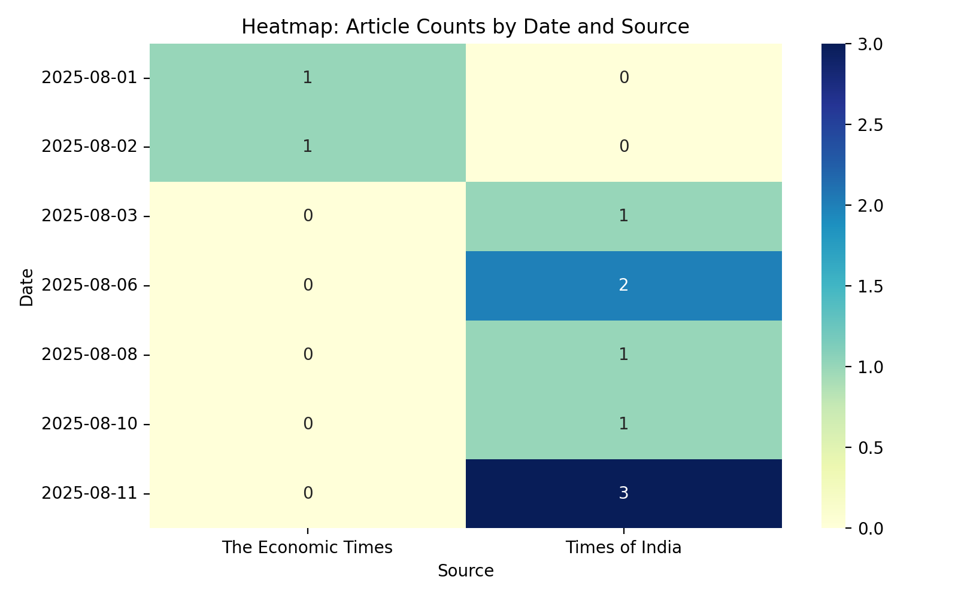
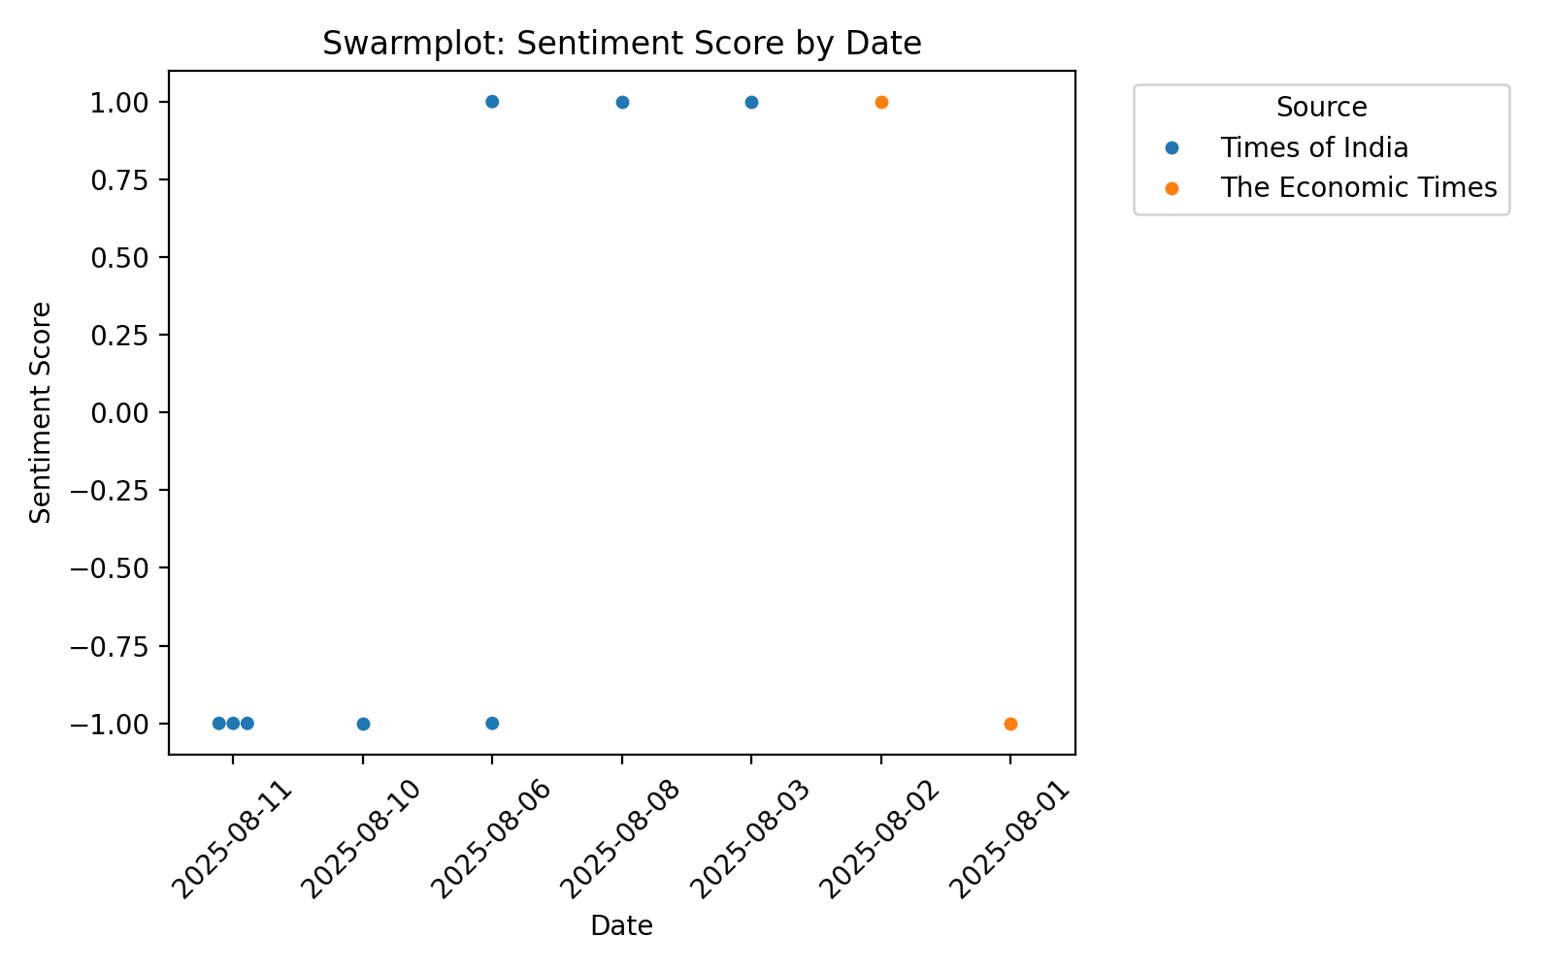

Slide 9
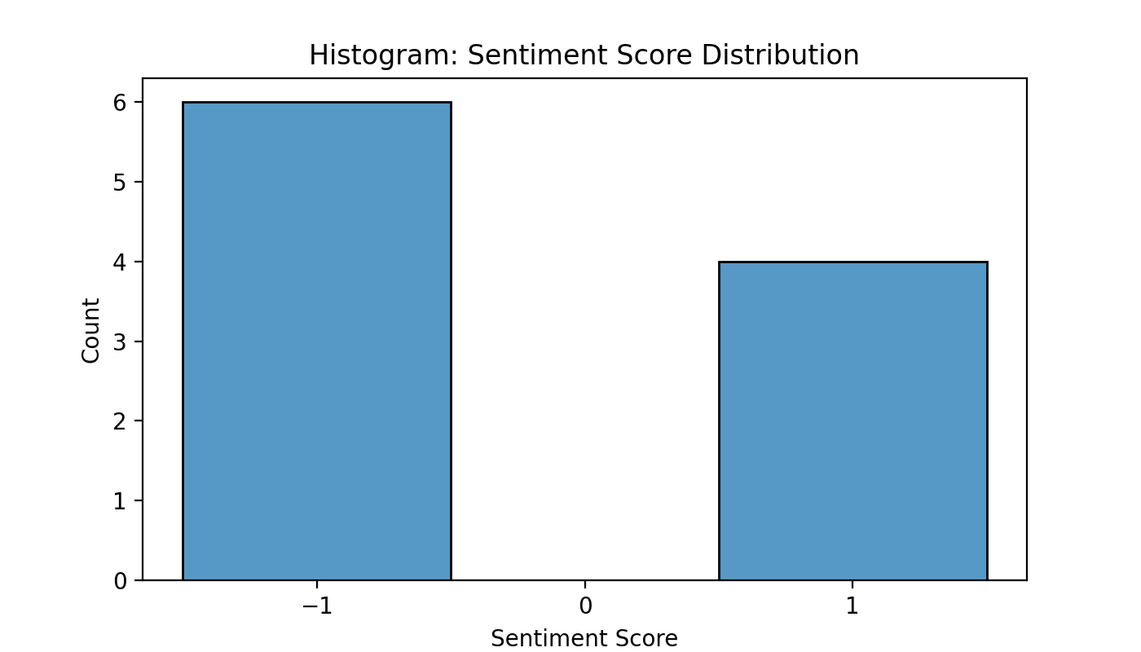
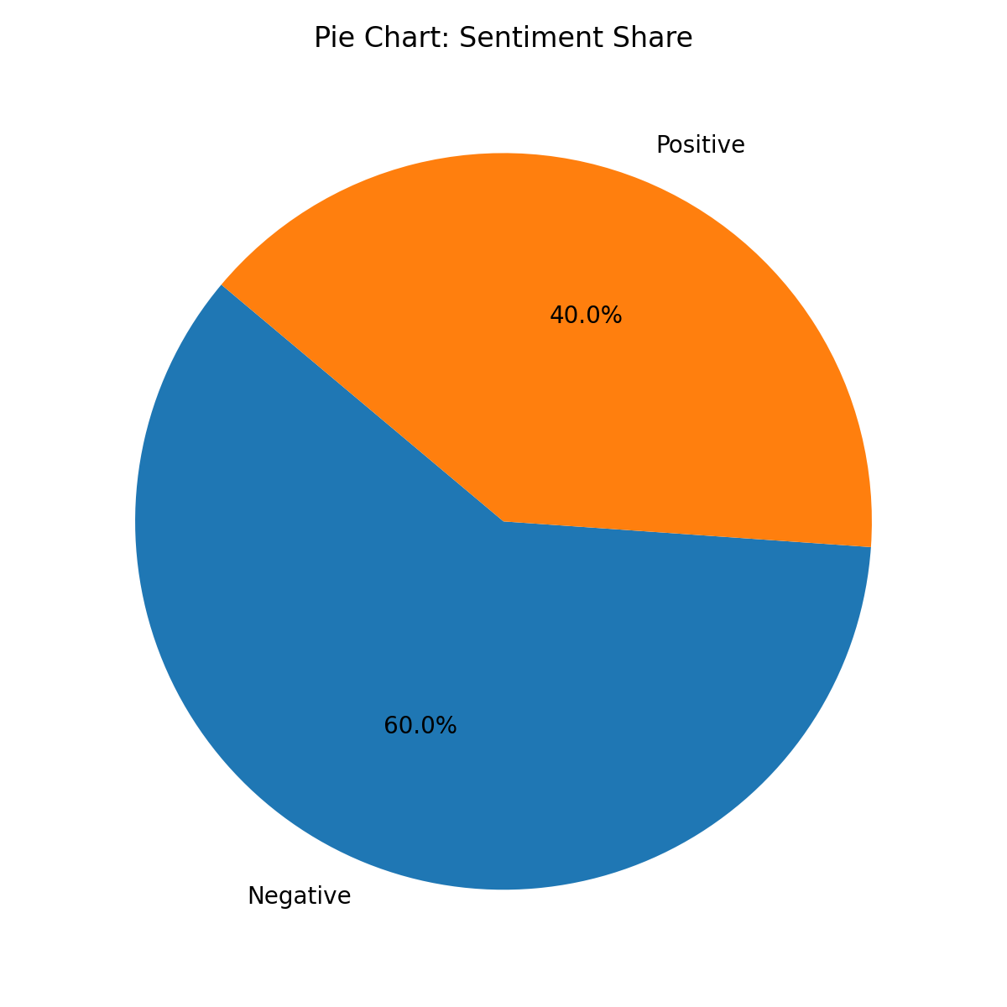

Slide 10
Conclusion
This project demonstrates how sentiment analysis on financial news can assist in predicting market movements. By leveraging NLP and deep learning, we can better understand the impact of news on financial decisions.
Future Work: Incorporate real-time streaming data and multi-lingual news sources.

