Slide 1
AI-Driven Music Genre Classification
Sample Project Presentation
Name:Vennelaboinapalli
Intern Id:Ex-1753693472398

Slide 2
Project Description
Build a model that classifies songs into genres based on audio features.
This project combines signal processing with machine learning, providing insights into how AI can interpret and classify audio data.
Tip: Experiment with different feature extraction techniques like Chroma features and Mel Spectrograms to see which yields the best results.

Slide 3
Steps and Guidelines
1. Data Collection: Gather a dataset of songs labeled by genre.
2. Feature Extraction: Extract audio features (e.g., MFCCs, tempo) using Librosa.
3. Model Selection: Choose a model (e.g., CNNs, SVM).
4. Training: Train the model on a portion of the dataset.
5. Evaluation: Test the model with unseen data and tune hyperparameters.
6. Deployment: Develop a web or mobile interface for genre prediction.

Slide 4
Tools and Technologies
- Programming Language: Python
- Libraries: Librosa for audio feature extraction
- Frameworks: TensorFlow, PyTorch
- Deployment: Flask/Django for web interface

Slide 5
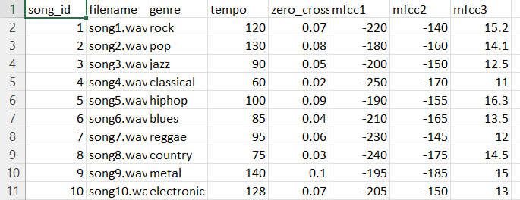
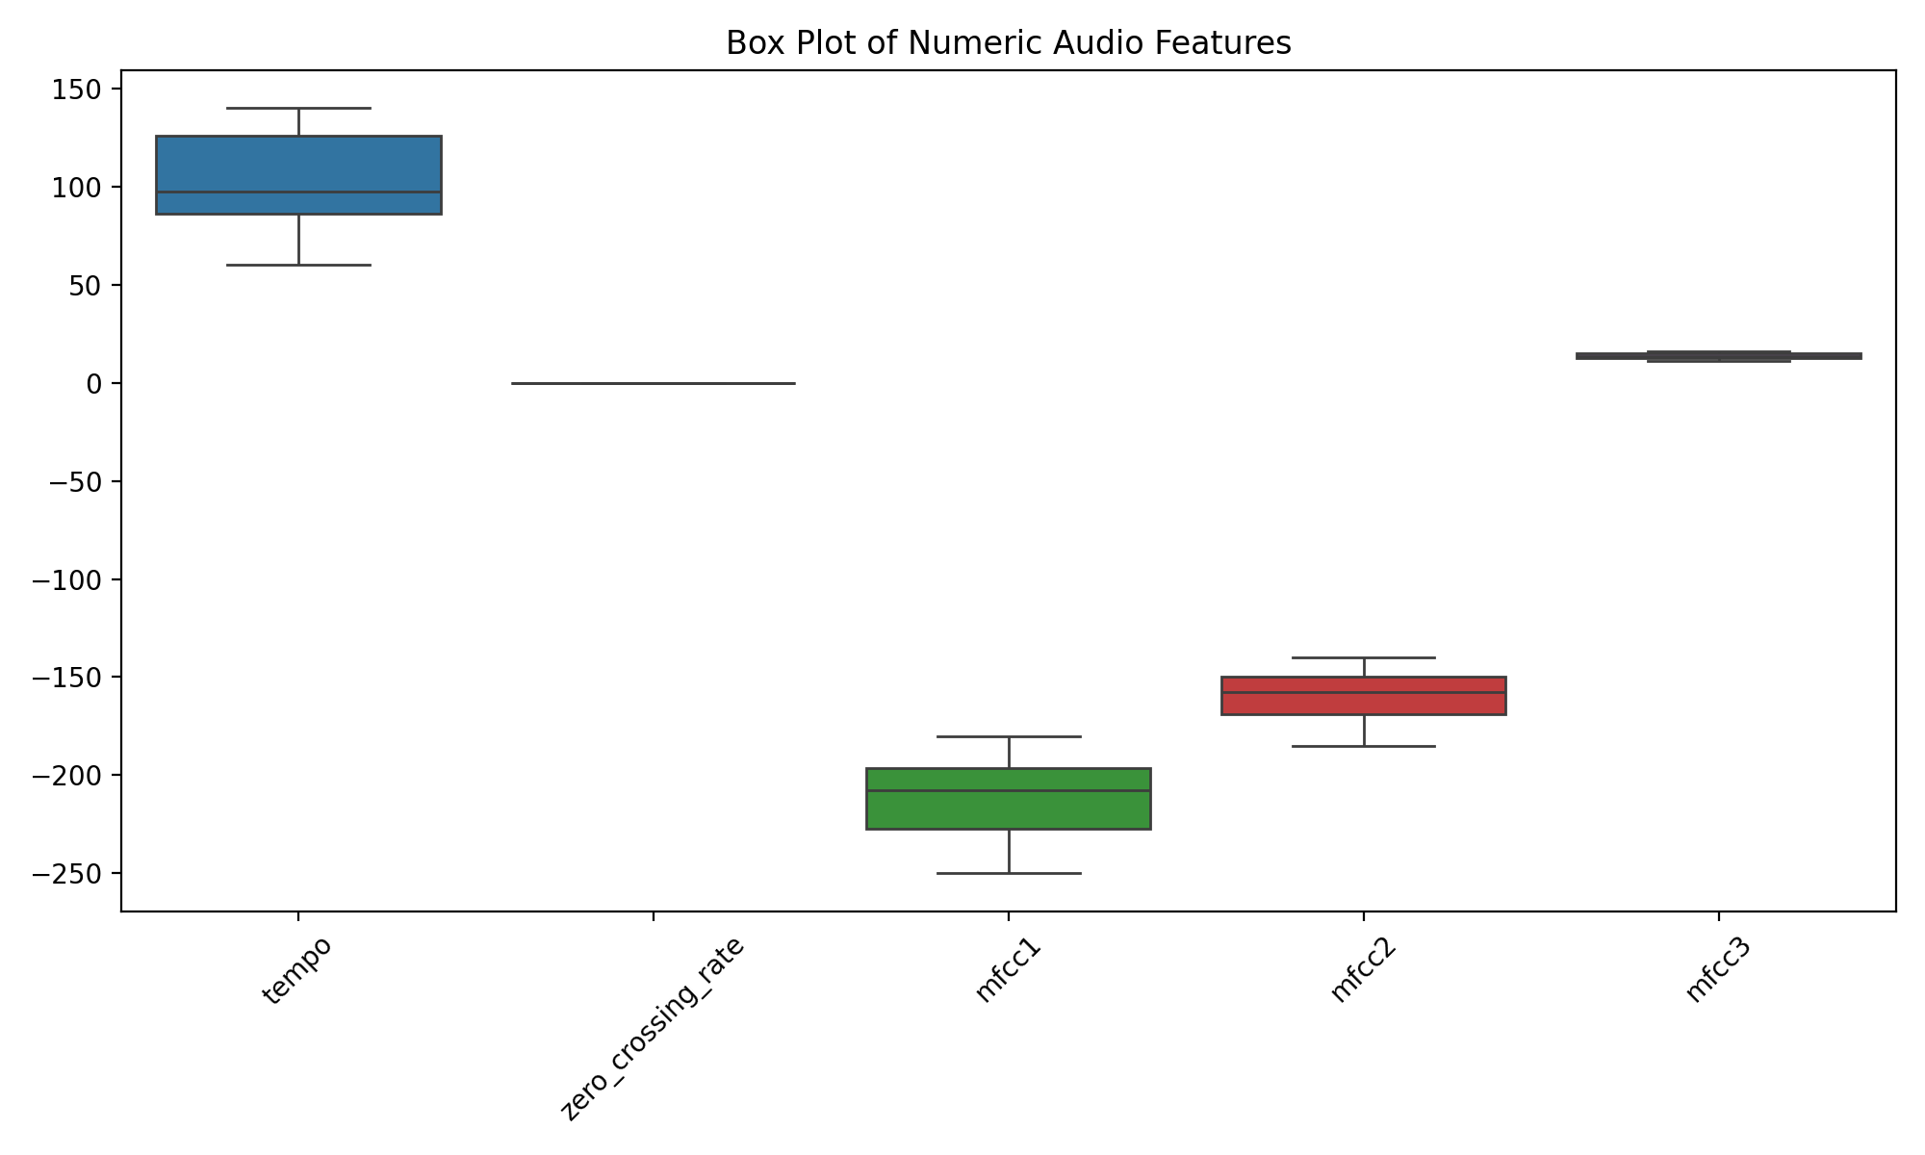

Slide 6
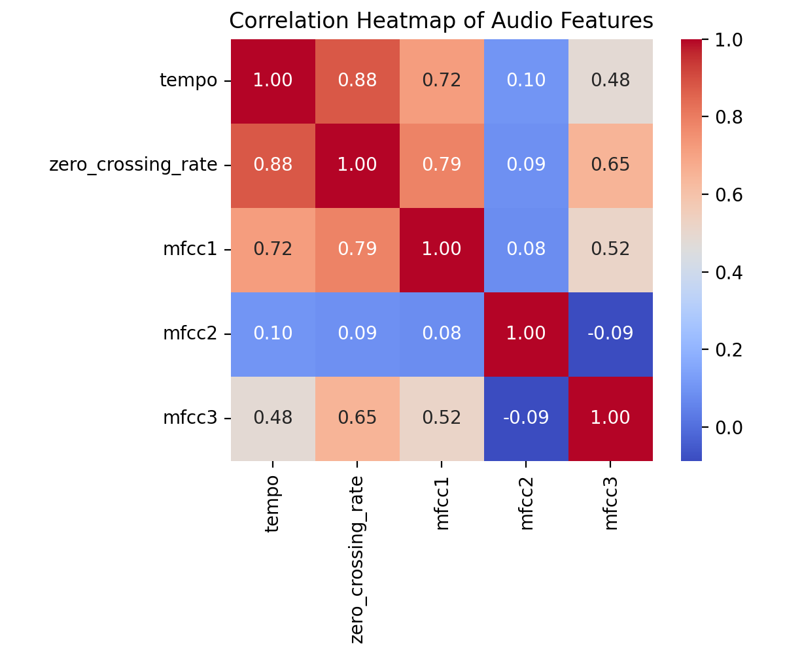
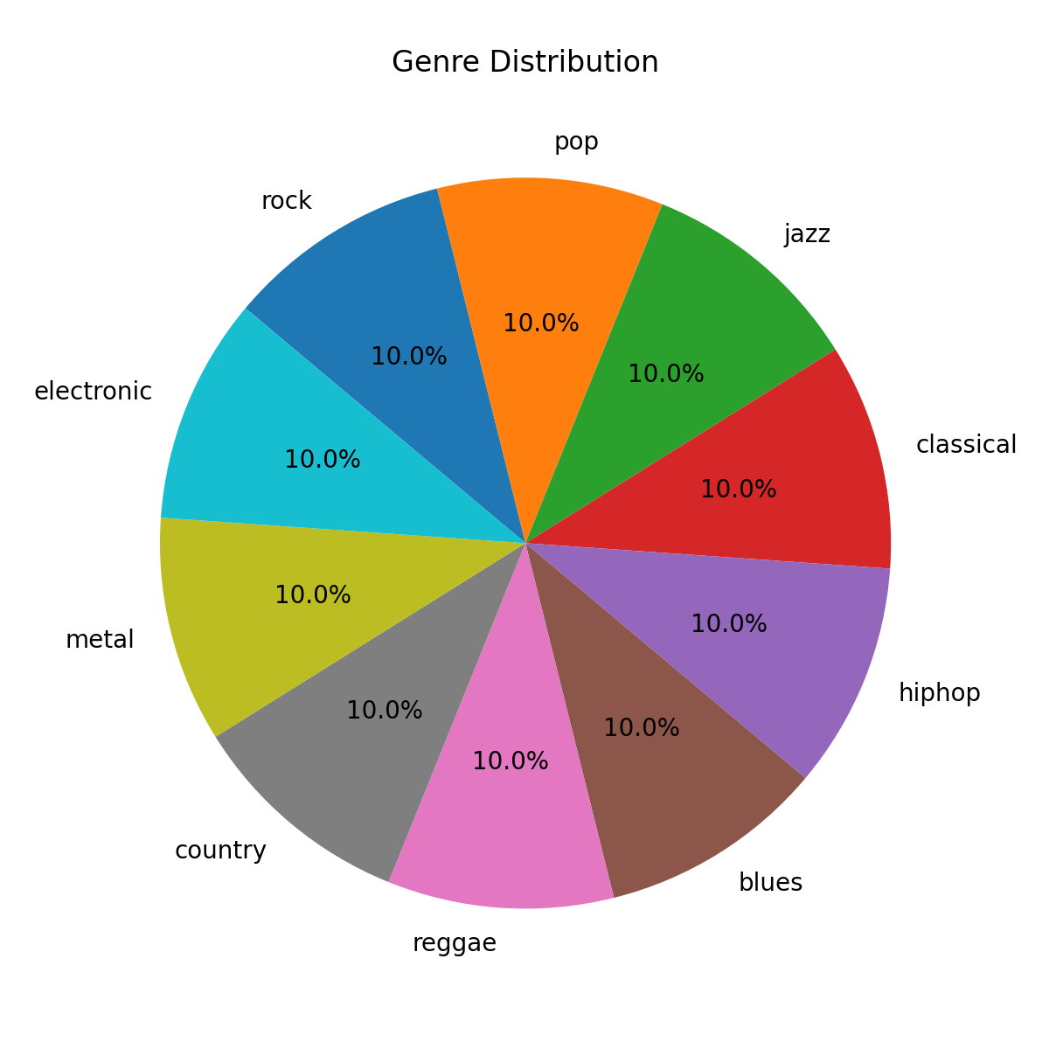

Slide 7
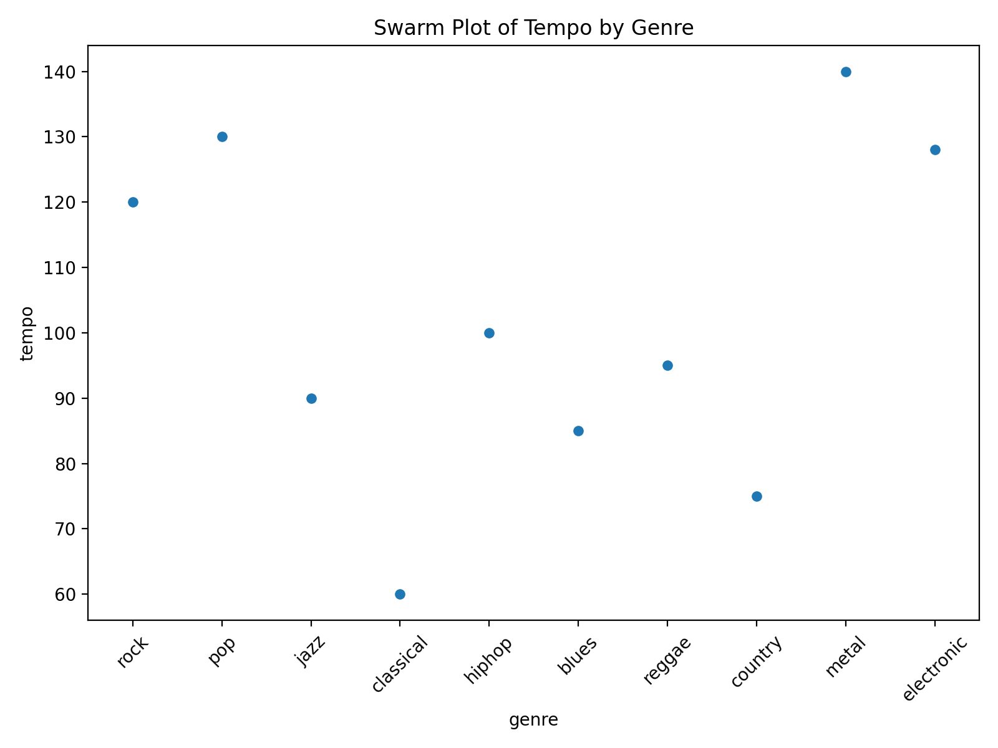
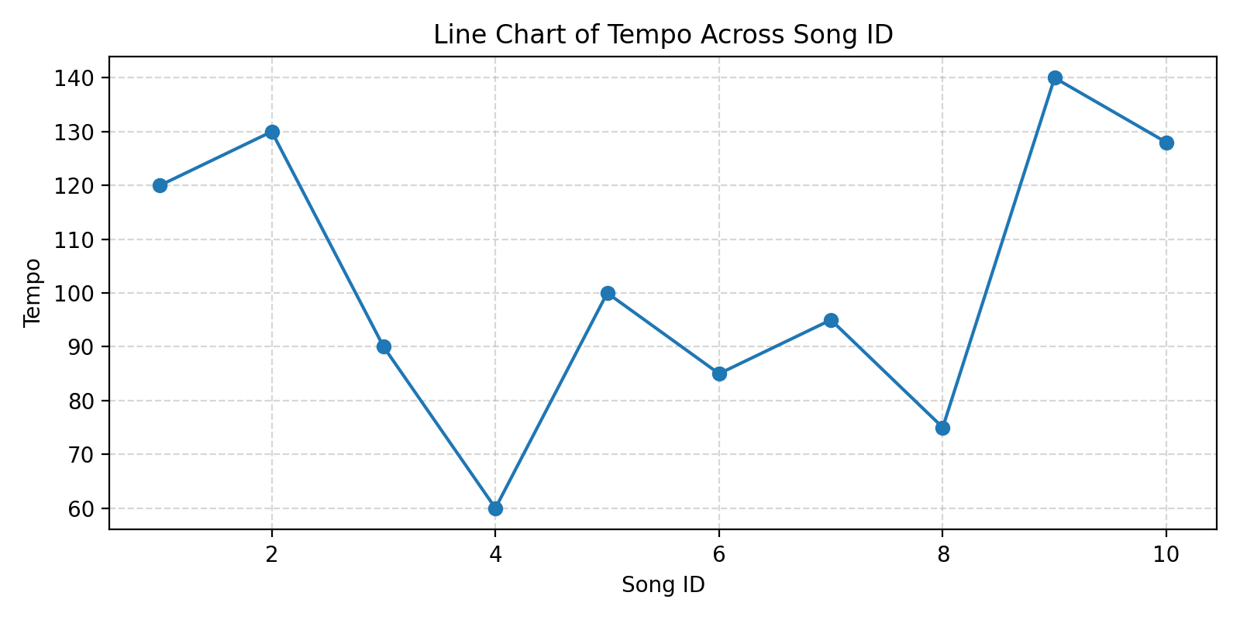
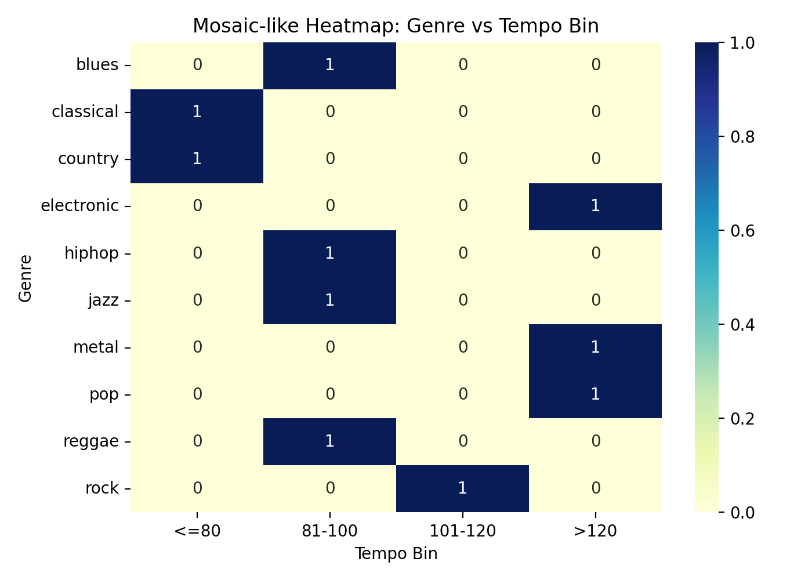

Slide 9
Sample Project Architecture
1. Input: Audio File (e.g., WAV, MP3)
2. Feature Extraction: MFCCs, Chroma, Spectrograms
3. Model: CNN / SVM for Classification
4. Output: Predicted Genre Label
5. Deployment: Web/Mobile Application

Slide 10
Conclusion
This project shows how audio signal processing and machine learning can be combined to classify music into genres.
Future Work: Add real-time genre classification and expand to multi-genre predictions.

