Slide 1
AI-Powered Resume Screening
Using NLP and Machine Learning
Name:Vennelaboinapalli
Intern Id:EX-1753693472398

Slide 2
Project Introduction
This project focuses on developing an AI-powered system that automates the process of screening resumes and matching candidates to job descriptions based on skills and experience. It leverages NLP techniques to extract relevant information and rank candidates effectively.

Slide 3
Problem Statement
Recruiters often spend significant time manually screening resumes. The goal is to automate resume screening using AI to improve efficiency, reduce human bias, and match candidates more accurately to job roles.

Slide 4
Project Objectives
1. Automate the process of resume screening.
2. Extract relevant skills, experience, and qualifications using NLP.
3. Match resumes to job descriptions using similarity algorithms.
4. Implement a scoring system to rank candidates.
5. Deploy the system using Flask for real-time screening.

Slide 5
Steps and Guidelines
1. Dataset Preparation: Collect resumes and job descriptions.
2. Feature Extraction: Extract skills, experience, and qualifications.
3. Model Development: Match resumes to job descriptions using NLP.
4. Scoring System: Rank candidates based on similarity scores.
5. Evaluation: Validate using real-world hiring data.

Slide 6
Tools & Technologies
• Programming Language: Python
• Libraries: NLP, Scikit-learn, Pandas, NumPy
• Framework: Flask for deployment
• Techniques: Cosine Similarity, Transformers
• Visualization: Matplotlib & Seaborn

Slide 7
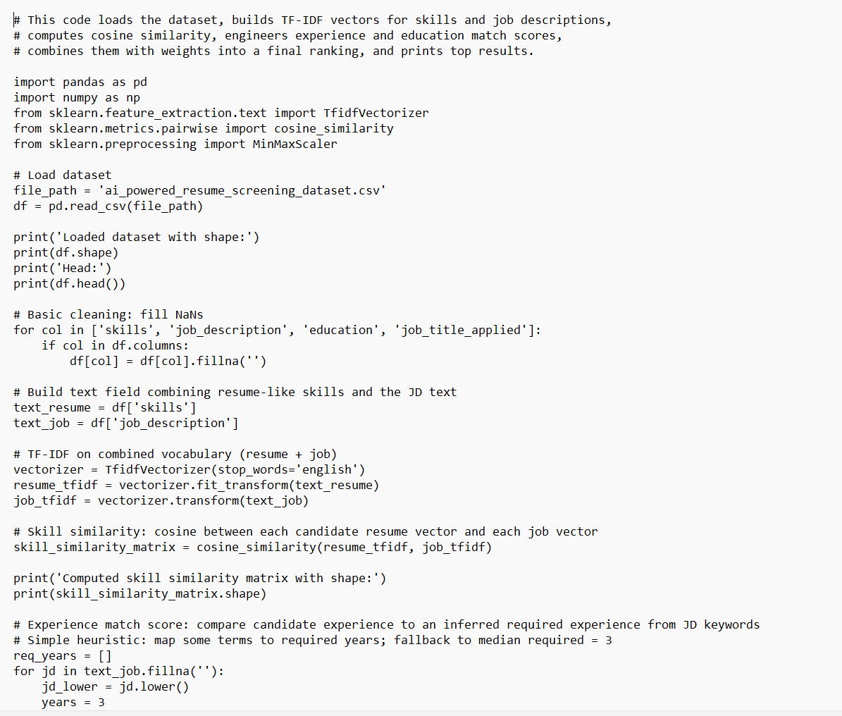

Slide 8
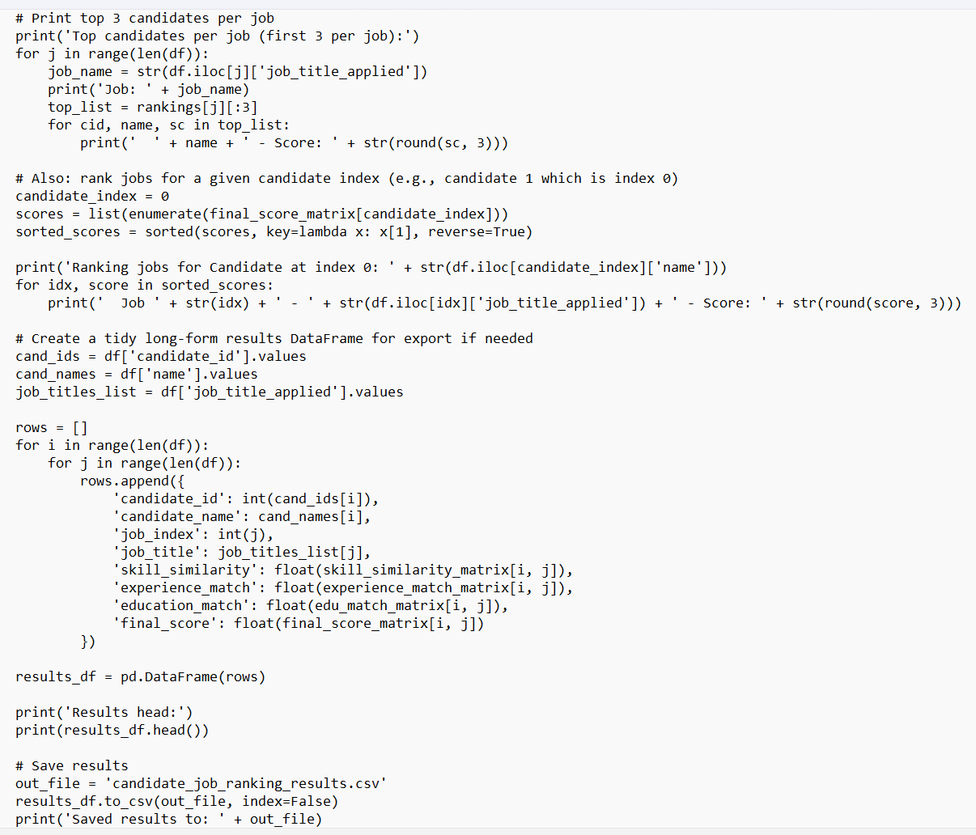

Slide 9
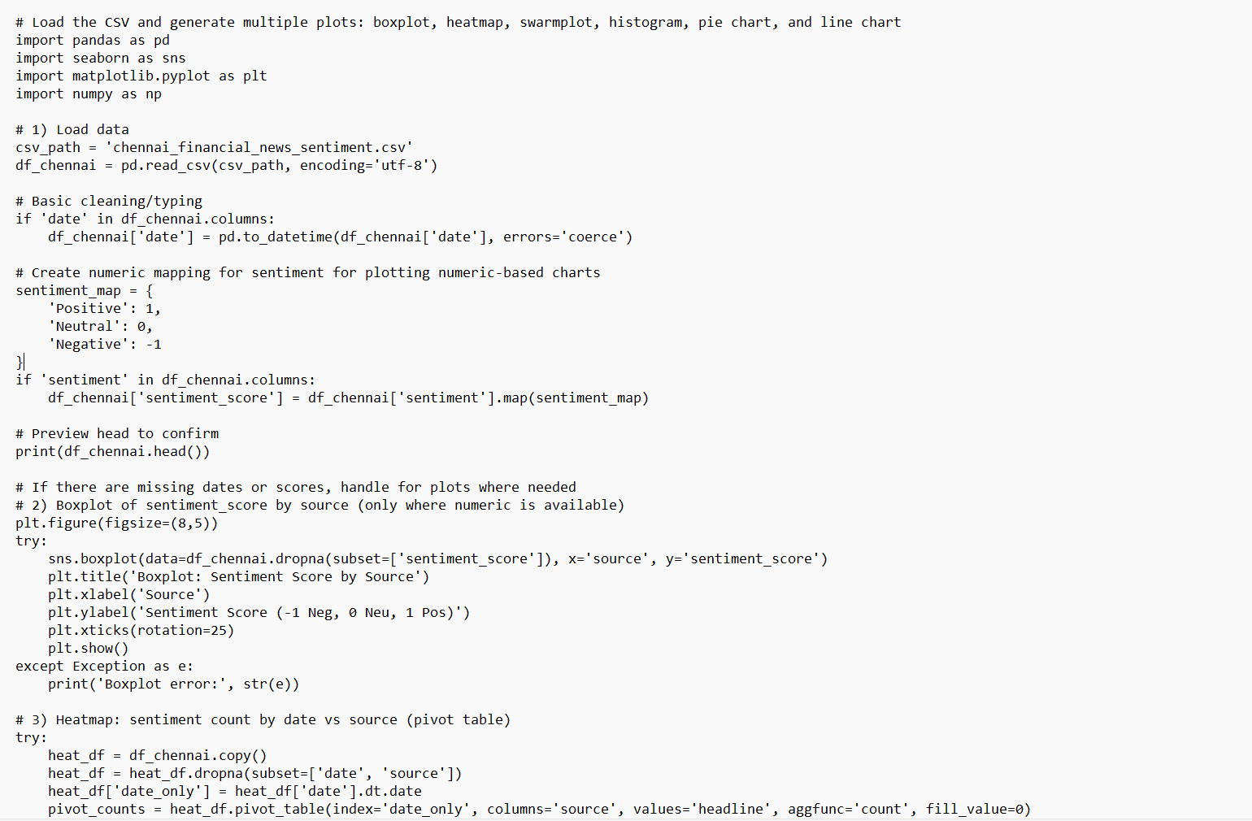

Slide 10
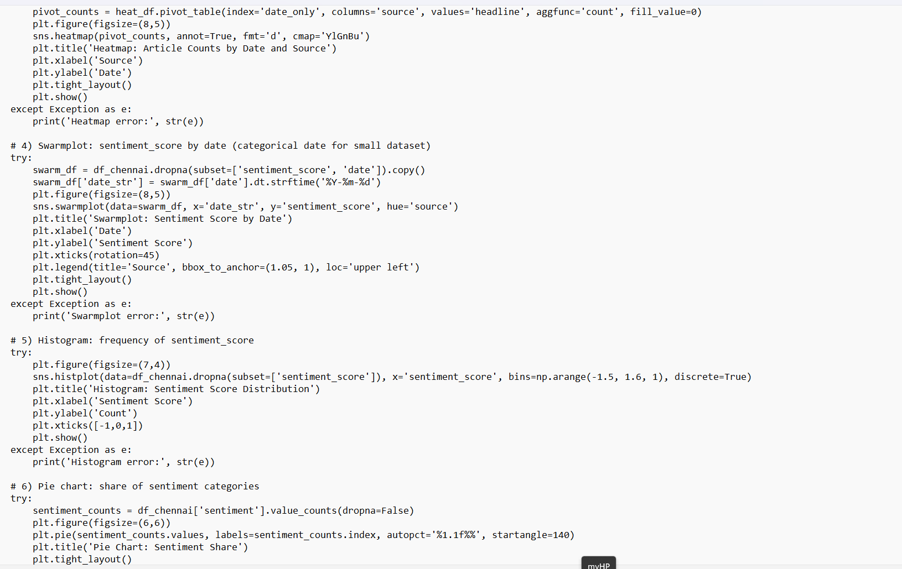

Slide 11
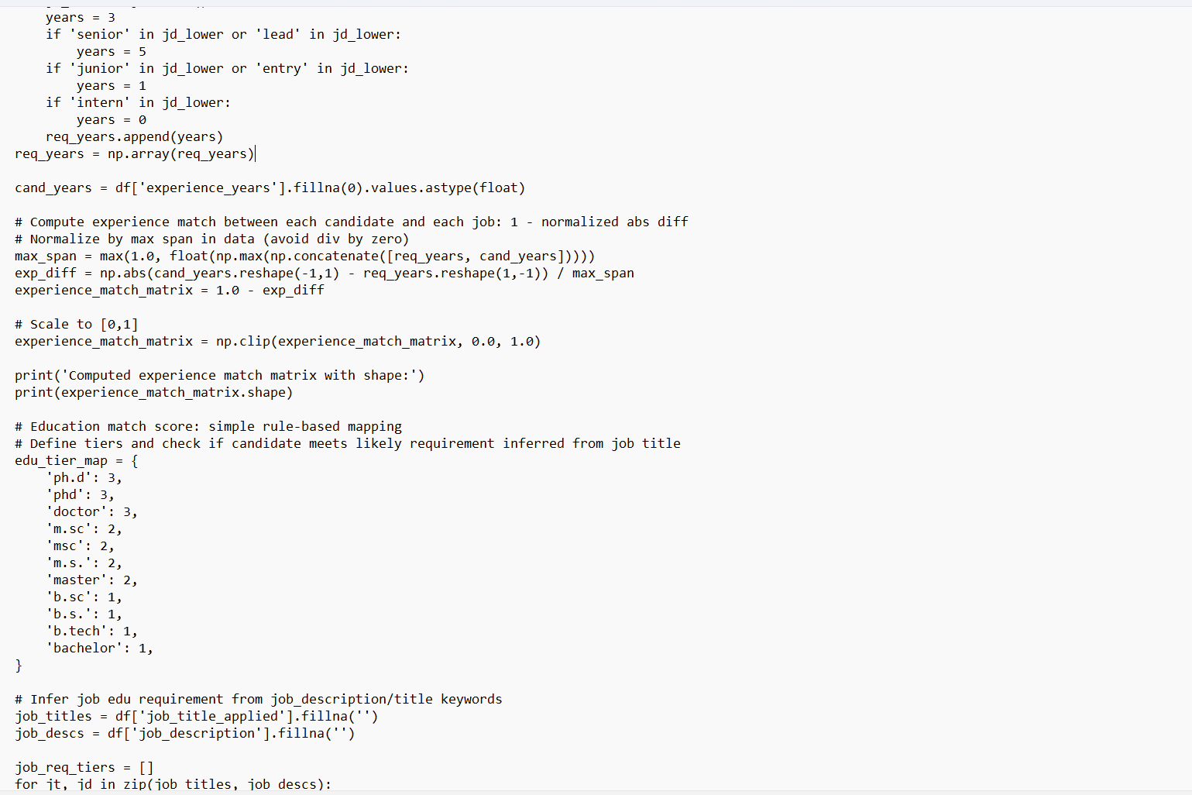

Slide 12
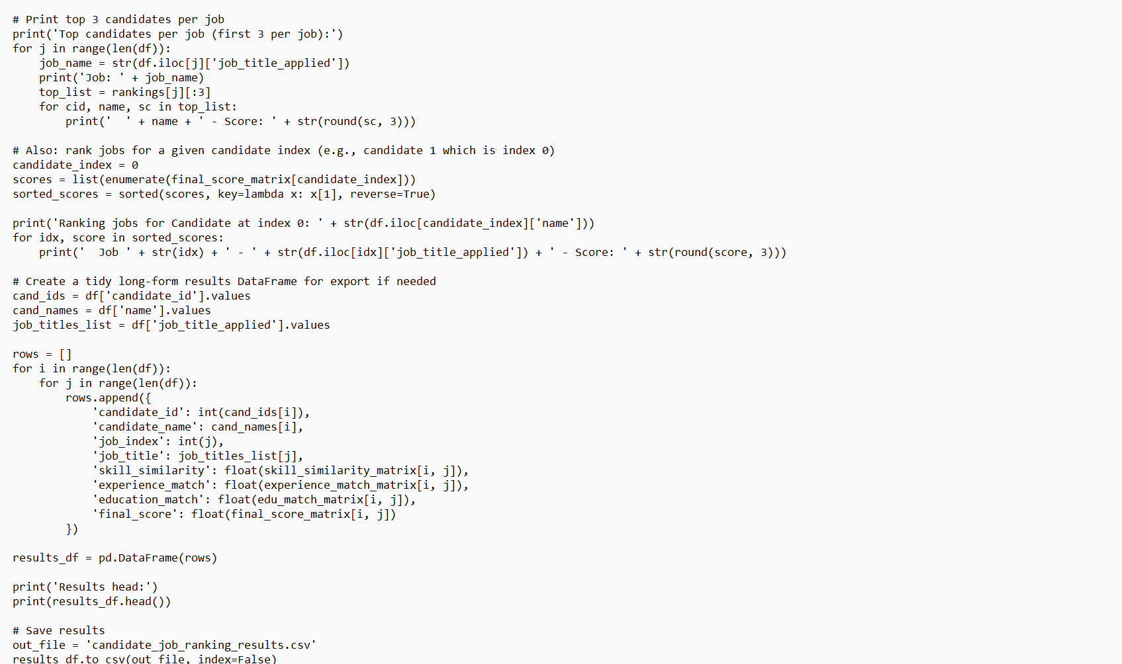

Slide 13
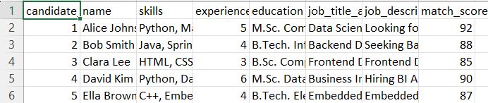

Slide 15
Conclusion & Future Scope
• Automates resume screening process.
• Reduces recruiter workload and increases efficiency.
• Future enhancements:
- Integrate deep learning models for better matching.
- Add recruiter feedback-based AI adjustment.

