Slide 1
Assignment-3 Discussion (Image captioning Validation)
Nikhita, 180050066
Pragna, 180050064
Vineetha, 180050118
4th May,2022

Slide 2
Problem Statement (1/2)
The goal is to create a system that combines the power of RNN, CNN and FFNN. You will have a two stage DNN, wherein the first stage is a CNN processing an image and an RNN/Transformer processing the caption of the image. The FFNN will take outputs of CNN and RNN and will give the verdict as a value between 0 and 1 (both included), expressing the degree of consistency between the image and the caption (1- consistent, 0-inconsistent).

Slide 3
Problem Statement (2/2)
For example, if the image is that of a tiger chasing a deer, the caption of "a peaceful scene of nature" is inconsistent with the picture. On the other hand, the picture of a long line of people can have many consistent captions- (a) Crowd eagerly waiting for a ticket to the cricket stadium, or (b) Hungry people in food-line during covid, or (c) Students waiting in queue for an admission form, but not (d) Snow-flakes falling from the sky.

Slide 4
Dataset Discussion
We resort to a dataset with a large number of image-caption annotations: Flickr-8K
Flickr-8k contains nearly 8K images of natural scenes each with five unique captions that are grammatically complete and lexicographically correct phrases
Train : Test : Validation = 6K : 1K: 1K

Slide 5
Details of Examples: positive and negative
How many positive examples (1 category)
How many negative examples (0 category): how did you create negative examples
8K images are used, each of which is paired with 10 captions.
The positive examples are the 5 captions paired with the image and the remaining five are negative examples that are generated by randomly sampling captions from the rest of the Flickr dataset.

Slide 6
System implementation
We are using Pre-trained CNN model (InceptionV3) for spatial map extraction of images
For captions, we embed each word into a vector through a word embedding matrix, and then use a recurrent Long-Short Term Memory (LSTM) network to scan through the embedded word sequence
Next, we concatenate the both image and caption features and input it to the feed forward network
This will be the input to a Feed forward layer to produce a binary image caption validation output.

Slide 7
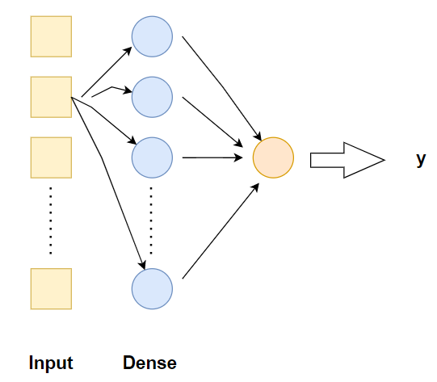
Details of the FFNN N/W
Layers :
FFNN is a 2-layer fully-connected network separated by a ReLU activation
Neurons/layer
Our 2-layer fully-connected network outputs a single value, representing whether or not the encoded language expression accurately captions the given feature map
The classification network is applied over the extracted features , with a ReLU nonlinearity between them and a hidden layer with dimensionality N = 256
Different Hyper parameters
no. of layers L = 2,
no. of hidden units N= 256
Activation function used at hidden layer is ReLU
Activation function used for the classification task
is sigmoid

Slide 8
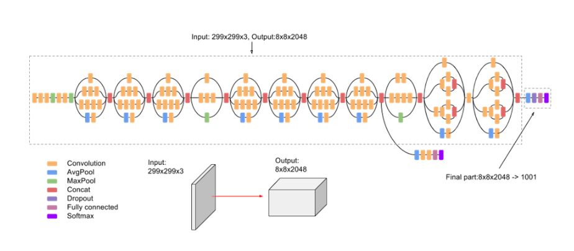
Details of the CNN N/W
We made use of InceptionV3 model pre-trained on image net database.
Inception-v3 is a convolutional neural network that is 48 layers deep
We extracted features from the last but one layer
(last layer before the classification layer)

Slide 9
Details of the RNN/Transformer N/W
We used an LSTM to represent the caption as a fixed size vector
Embedding dimension (200)
We used a pre-trained word embedding matrix, the Global Vectors for Word Representation (GloVe)
Different Hyper parameters
batch_size = 40
Hidden state dimension = 256

Slide 10
Training details (hyper-parameters)
(All of FFNN, RNN get trained together)
How many epochs?
10 epochs
What is the learning rate?
Adam Optimizer with learning rate = 0.001
Convergence criterion (at what error level do you stop)
Early Stopping is used when validation loss is minimal
Loss function : Binary Cross Entropy loss

Slide 11
Various performance parameters: P, R, F-score, Accuracy
P, R, F, A overall
Precision : 0.853
Recall : 0.902
F-score : 0.877
Accuracy : 87.34%
For 1-class and 0-class separately
Accuracy (1-class) : 90.20%
Accuracy (0-class) : 84.48%

Slide 12
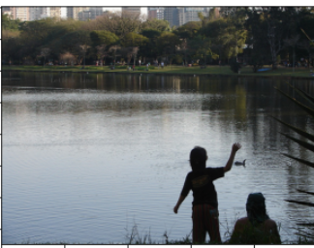


Error Analysis
Good cases
Bad cases

Slide 13
Comment slide (evaluation guideline- students to note)
You are being evaluated on:
Data gathering and preparation (10 marks)
Implementation (40, FFNN+CNN+RNN/Transformer+combination)
Performance reporting (10)
Performance demonstration (10)
Error Analysis (10)

