Slide 1



BEECHCRAFT DENALI
21 DAY DEMO TOUR STRATEGY
Team 12 OSU Datathon 2023

Slide 2

WELCOME,
Today we will discuss our aircraft demo analysis consisting of:
Constraints
Things That Impact Our Data.
Our Data
What Did We Find?
Goals: Maximizing Future Sales
How Do We Find Our Desired Market and Apply Our Findings?
Visualization
Locations, Data Sets, Risks, Unique Analysis, and Competitors.
Our Solution, Our Answers , Success, and Why.

Slide 3

THE BUSINESS CHALLENGE?
Revenue Projection of Beechcraft Denali
Market Penetration
Reaching Target Consumers
Legal Constraints
Aircraft Size & Costs
Desired Location

Slide 4

OPERATIONAL CHALLENGES & CONSTRAINTS
⛽
Aircraft Range Limitation
⏰
Pilot Duty Regulations
1,600 nm per tank
12-hour shift max (10hr rest) or 14-hour shift max (12hr rest)
Required strategic routing to ensure fuel availability and minimize repositioning flights
Limited daily airport coverage and required careful scheduling of demo windows
📅
Crew Rest Requirements
👥
Capacity Constraints
6 consecutive duty days maximum, then 1 mandatory rest day
6-9 passengers total, single pilot operation
21-day tour requires 3 mandatory rest days built into schedule
Limited demonstration capacity per stop; prioritized high-value prospects only
Solution: Optimized routing algorithm balancing range, duty time, rest days, and prospect density

Slide 5

EXECUTIVE SUMMARY
40
445
$215,159
AIRPORTS
PROSPECTS
TOUR COST
Tour Details
21-day nationwide demo tour targeting 445 pre-qualified prospects
Target Market
3,195 potential buyers across 40 strategic airports
Expected Outcome
$707,500 in projected year savings vs PC-12, 5-year savings of $7,995,000

Slide 6

MARKET OPPORTUNITY
All Aircraft Owners
10,580
Target Aircraft Owners
5,115
All SET Owners
1,430
Aging SET Owners
1,149
Golden
Leads
154
Current Denali Market Share: 0 of 3,195 (Domestic)

Slide 7

BUYER PROFILE & SEGMENTATION
Overall Market Share for Comparable Jets
Prospecting Fleet Replacement

Slide 8

TARGET ACCOUNTS BY ZONE

Slide 9
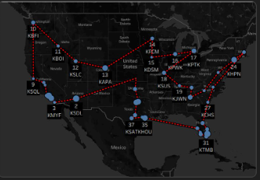

21-DAY TOUR ROUTE
Strategic Approach
Coverage: 40 airports across 3 zones (West, Central, East)
Engagement: Pre-invited aircraft owners near each stop
Audience: 445 direct replacement buyers reached
Duration: 2.2 airports per day, 2.5-hour demo windows

Slide 10
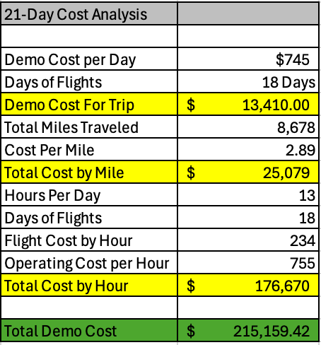

FINANCIAL ANALYSIS
Tour Cost Breakdown

Slide 11

VALUE PROPOSITION
💰
Cost Efficiency
🚀
Performance
$707,500 savings vs PC-12 over 5 years
Superior range and payload in single-engine turboprop class
🎯
Target Match
📊
Market Position
Perfect fit for aging SET fleet replacement cycle
Competing in $7.995M addressable market segment

Slide 12



NEXT STEPS
Approve 21-day demo tour budget
Finalize route and airport partnerships
Launch pre-invitation campaign to 445 prospects
Deploy aircraft and support team
Execute tour with daily demos at 40 strategic airports
Questions?

