Slide 1

Improving Image Generation with Better Captions
Link

Slide 2
Content
Abstract
Introduction
Literature Survey
Methologies Used
Results
Conclusion
Future Scope
References

Slide 3
Abstract
We show that prompt following abilities of text-to-image models can be substantially improved by training on highly descriptive generated image captions.Existing text-to-image models struggle to follow detailed image descriptions and often ignore words or confuse the meaning of prompts. We hypothesize that this issue stems from noisy and inaccurate image captions in the training dataset. We address this by training a be spoke image captioner and use it to recaption the training dataset. We then train several text-to-image models and find that training on these synthetic captions reliably improves prompt following ability. Finally, we use these findings to build DALL-E 3 a new text-to-image generation system, and benchmark its performance on an evaluation designed to measure prompt following, coherence, and aesthetics, finding that it compares favorably to competitors.

Slide 4
Introduction
Recent advances in generative modeling have drastically improved text-to-image generation, particularly through methods like autoregressive modeling and diffusion processes. These approaches decompose the complex task of image generation into manageable steps, enabling neural networks to learn more effectively. Simultaneously, the use of self-attention layers has enhanced image generation by decoupling spatial biases and leveraging the scalability of transformers. With large datasets, these techniques have brought the quality of generated images closer to human-level artwork and photography.
A key challenge remains in prompt following, where models struggle to adhere precisely to the input text. Issues include inconsistent word interpretation and overlooked meanings, as highlighted in works like Drawbench and Parti Prompts. This research address this by improving text-to-image training datasets through a novel, robust image captioning system. By generating highly detailed and accurate synthetic captions, enhance the quality of text-image pairs, resulting in better prompt adherence in models like DALL-E 3. The study evaluates the impact of synthetic captions on prompt-following performance and establishes reproducible benchmarks, demonstrating the significant improvements gained by refining training datasets. Limitations and risks are discussed to provide a comprehensive perspective on the approach.

Slide 5
Literature Survey
Recent advances in generative modeling have allowed text-to-image generative models to achieve drastic performance improvements. In particular, tackling the problem with sampling-based approaches such as autoregressive generative modeling[27, 2, 1, 20, 30] or using diffusion processes[25,6, 11, 12, 19, 22] have allowed us to decompose the problem of image generation into small, discrete steps which are more tractable for neural networks to learn.In parallel, researchers have found ways to build image generators out of stacks of self-attention layers[15, 3, 4]. Decoupling image generation from the implicit spatial biases of convolutions has allowed text

Slide 6
Gaps Identified
Lack of controllability in text-to-image generation systems, specifically in their ability to reliably follow prompts. Current models often misinterpret or overlook the semantic structure and meaning of captions, leading to inconsistencies in generated outputs. Despite advancements like DALL-E 2 and Parti, these issues persist due to the poor quality of text-image pairings in training datasets. Existing approaches, such as Drawbench and Parti Prompts, highlight these shortcomings but focus primarily on model scaling or conditioning on pre-trained language models. The proposed solution addresses this gap by enhancing dataset quality through improved image captions, aiming to strengthen prompt following by training models on more accurate and detailed captions.

Slide 7
Methodology
Natural Language Processing: DALL·E 3 uses advanced NLP models to deeply understand prompts and context.
Diffusion Models: It employs diffusion-based techniques to create images, gradually refining them from noise into fully detailed visuals.
Training on Large Datasets: DALL·E 3 is trained on diverse datasets of text and images, enabling it to handle a wide range of topics and styles.

Slide 8
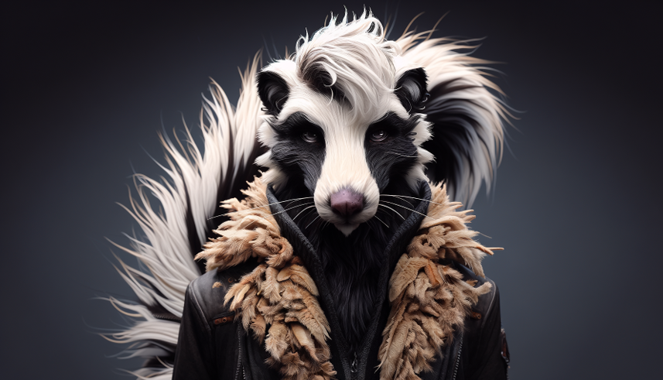
Results
In a fantastical setting, a highly detailed furry humanoid skunk with piercing eyes confidently poses in a medium shot,
wearing an animal hide jacket. The artist has masterfully rendered the character in digital art, capturing the intricate detailsof fur and clothing texture.

Slide 9
Results
We first compute the CLIP score using the public ViT-B/32 model. We use a set of 4,096 captions drawn from the MSCOCO 2014 evaluation dataset to generate our images. In this evaluation, we perform inference on the model with the short, ground-truth captions.
Drawbench evaluations, our model beats DALL-E 2 and Stable Diffusion XL. The gap widens significantly when we use the "upsampled" captions.
DALL-E 3 is state of the art on all benchmarks evaluated.

Slide 10
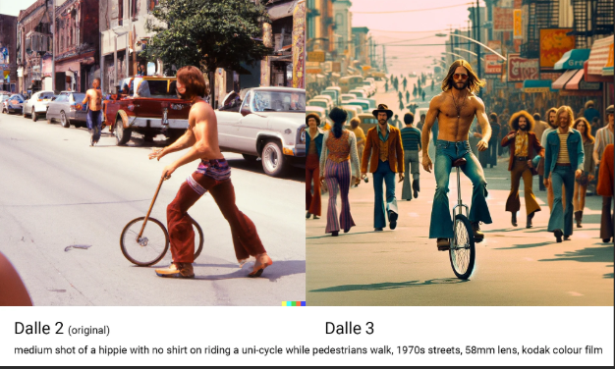
DALLE-2 Vs DALLE-3

Slide 11
Conclusion
The research concludes that training text-to-image models on highly descriptive, synthetically generated captions significantly improves their ability to follow complex prompts. Existing models often struggle with detailed descriptions due to noisy training data. By training a specialized captioner and using it to re-caption the training dataset, the researchers achieved substantial improvements in prompt adherence. This approach was used to develop DALL-E 3, which demonstrated superior performance in prompt following, coherence, and aesthetics compared to competing models. The authors provide evaluation tools to facilitate future research in this area.

Slide 12
Future Scope
Enhanced Dataset Quality: Further improving the quality and diversity of synthetic captions to capture nuanced details and context, enabling even more precise prompt adherence.
Real-World Applications: Extending the approach to domain-specific datasets, such as medical imaging or architectural design, to create specialized text-to-image tools.
Scalable Models: Investigating the scalability of the proposed method to train larger models with diverse datasets while maintaining efficiency.
Multimodal Integration: Combining improved captioning with other modalities, such as video or audio, for richer content generation.
Ethical and Bias Mitigation: Addressing potential biases in training data and ensuring ethical usage of advanced text-to-image systems.
Interactive Systems: Developing systems that allow users to refine prompts interactively for dynamic and personalized outputs.

Slide 13
Reference
Chen, M., Radford, A., Child, R., Wu, J., Jun, H., Luan, D., and Sutskever, I. (2020). Generative pretraining from pixels. In III, H. D. and Singh, A., editors, Proceedings of the 37th International Conference on Machine Learning, volume 119 of Proceedings of Machine Learning Research, pages 1691–1703. PMLR.
Chen, X., Mishra, N., Rohaninejad, M., and Abbeel, P. (2017). Pixelsnail: An improved autoregressivegenerative model.
Child, R., Gray, S., Radford, A., and Sutskever, I. (2019). Generating long sequences with sparse transformers.
Dosovitskiy, A., Beyer, L., Kolesnikov, A., Weissenborn, D., Zhai, X., Unterthiner, T., Dehghani, M.,Minderer, M., Heigold, G., Gelly, S., Uszkoreit, J., and Houlsby, N. (2021). An image is worth 16x16words: Transformers for image recognition at scale.
Hessel, J., Holtzman, A., Forbes, M., Bras, R. L., and Choi, Y. (2022). Clipscore: A reference-free evaluation metric for image captioning.
Ho, J., Jain, A., and Abbeel, P. (2020). Denoising diffusion probabilistic models

Slide 14
