Slide 1
MEDVID -Visualising Medical Information
Team Mates
B.Vennela
K.Harika
P.Deekshitha
U.Nandini
Guide
Dr.D.Shanthi
Professor and HOD
Artificial Intelligence and Machine Learning

Slide 2
Abstract
Medical reports, particularly MRI reports, are often filled with complex terminology that can be difficult for patients to understand. There is a need to transform these medical reports into patient-friendly formats, such as videos, which provide clear, concise, and visually engaging explanations. MedVid seeks to bridge this communication gap by leveraging natural language processing (NLP) and video generation technologies to create personalized videos from MRI reports.

Slide 3
Introduction
Medical reports, especially MRI results, are often filled with complicated words and technical details that can confuse patients, with around 36% of adults in the U.S. struggling to understand basic health information. This confusion leads to anxiety, affecting about 70% of patients when receiving a diagnosis, particularly if they don't fully grasp its meaning.As per the news in Times of India on July 25 ,2021 their is Rise in mental illness cases identified in Hyderabad , due to lack of proper Knowledge about the disease they are facing.

Slide 4
Probelm Statement
The problem we are addressing here,complexity in understanding the MRI reports which is crucial thing for patients

Slide 5
Literature Survey
S.NO | Title | Details | Metholodogies | Archievements | Limitations/Drawbacks
1 | Visualizing Scanner Utilization From MRI Metadata and Clinical Data | Pradeeban Kathiravelu,Nishchal Singi https://ieeexplore.ieee.org/document/10207050 | Analyzed MRI metadata and clinical data using statistical techniques and developed interactive visualizations with tools like Matplotlib and Plotly. | Identified scanner usage inefficiencies, enabling optimized resource allocation and reduced patient wait times. | Lacked real-time data integration and focused on a single healthcare network, limiting generalizability.

Slide 6
S.NO | Title | Details | Metholodogies | Archievements | Limitations/Drawbacks
2 | Patient 3D Data Visualization with AR-based Interactive Technology for Brain MRI | Vishakha Pareek , Shreyansh Sharma https://ieeexplore.ieee.org/document/10707965 | Utilized augmented reality (AR) technology to create interactive 3D visualizations of brain MRI data, enabling surgeons to manipulate and analyze detailed brain structures in real time. | Enhanced surgical planning and in-situ guidance for brain tumor resections, improving precision and reducing risks. | Limited to specific surgical scenarios and requires specialized hardware, restricting accessibility and scalability.

Slide 7
S.NO | Title | Details | Metholodogies | Archievements | Limitations/Drawbacks
3 | A Web-Based Medical Video Indexing Environment | Engin Mendi; Coskun Bayrak https://ieeexplore.ieee.org/document/5628948 | Developed a web-based system using database management and indexing techniques to enable efficient retrieval and organization of medical video content. | Facilitated streamlined access to large medical video repositories, enhancing usability for educational and clinical applications. | Focused primarily on indexing and retrieval, lacking advanced features like content analysis or automatic tagging.

Slide 8
S.NO | Title | Details | Metholodogies | Archievements | Limitations/Drawbacks
4. | Medical Image Processing, Analysis and Visualization in Clinical Research | M.J. McAuliffe; F.M. Lalonde https://ieeexplore.ieee.org/document/941749 | Developed a platform-independent program for medical image processing and visualization, utilizing modular tools for analysis and visual representation. | Supported clinical research and diagnostic applications by providing a flexible, extensible system for processing and visualizing medical images. | Limited by the computational capabilities of the time, making it less suitable for handling modern high-resolution datasets and real-time processing..

Slide 9
S.NO | Title | Details | Metholodogies | Archievements | Limitations/Drawbacks
5. | Visualizing MRI & CT Scans Using Mixed Reality | Naeema Ziyad; Salih Yoosaf https://ieeexplore.ieee.org/document/10778692 | Developed a platform-independent, extensible program using modular tools for medical image processing, analysis, and visualization tailored to clinical research. | Enabled researchers to analyze and visualize medical images efficiently, supporting a wide range of diagnostic and research applications. | Lacked advanced features for handling modern high-resolution datasets and real-time image processing.

Slide 10
Existing System
The existing systems for medical report explanations typically offer general or broad medical content that is not specific to particular reports like MRIs. These systems often require manual intervention, such as medical professionals simplifying the content or creating educational materials by hand. They use general Natural Language Processing (NLP) tools, which are not fine-tuned for medical terminology, leading to limited focus on detailed medical conditions. The content generated is usually in the form of generic videos or text-based explanations, with static images and plain text, lacking the personalization or clarity needed for individual patients. These systems often support limited media formats and may not deliver video-based content, instead providing static documents. Security and compliance, such as HIPAA, are not always prioritized, and scalability is limited due to reliance on manual efforts.

Slide 11
Drawbacks of Exisiting System
Time Consuming Process
Lack of Real-Time Imaging
No 3D or Volumetric Views
Non-Specific to Pathology
High Noise and Artifacts

Slide 12
Proposed System
MedVid stands out from other projects in the realm of medical communication and patient education by offering unique features and advantages that enhance its usability and effectiveness
Tailored for MRI Reports
End-to-End Automation
Advanced NLP for Medical Terminology
Multimedia Video Generation
Personalized and Patient-Centric Communication
Accessibility and Usability
Integration with Emerging Technologies

Slide 13
Module Split-Up
1. Input Processing
2. Script Generation
3. Text-to-Speech
4. Converting into Multiple Languages
5. Video Generation & Synchronization

Slide 14
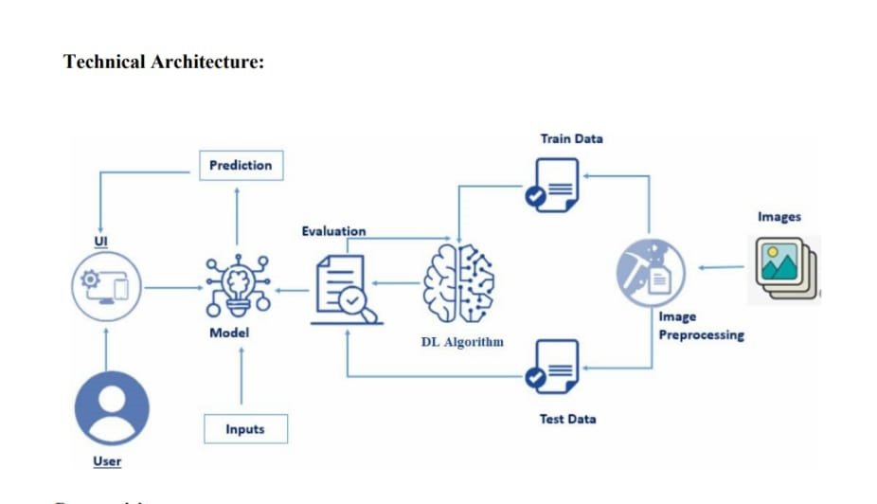
Architecture

Slide 15
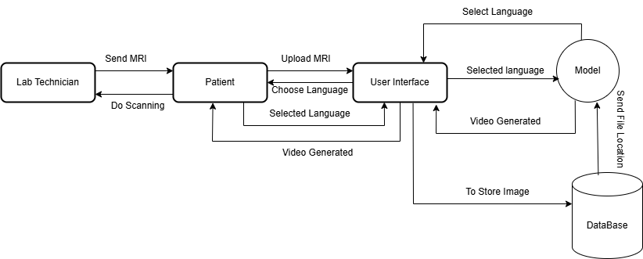
Data Flow Diagram

Slide 16
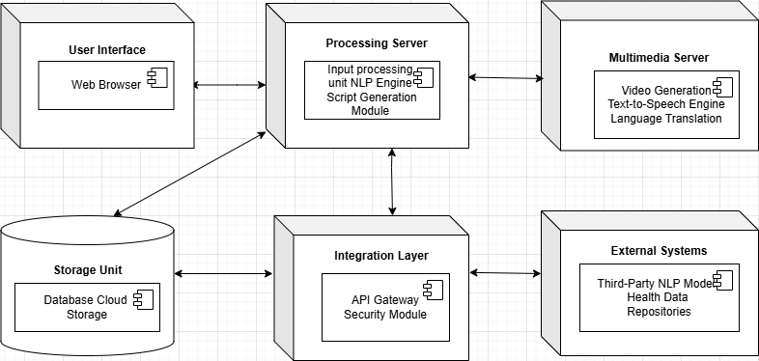
Deployment Diagram

Slide 17
Algorithms & Models Used
1. BART (facebook/bart-large-cnn)
• Type: Sequence-to-sequence Transformer
• Purpose: Summarization
• Working: Uses encoder-decoder architecture to understand and rewrite long medical reports into concise summaries.
2. KeyBERT
• Type: Keyword Extraction via BERT embeddings
• Purpose: Extract relevant medical terms from the summary.
3. Google Custom Search
• Purpose: Retrieve images related to keywords for visualization.

Slide 18
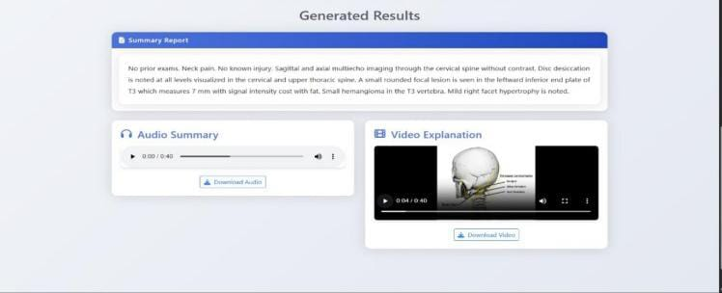
RESULT

Slide 19
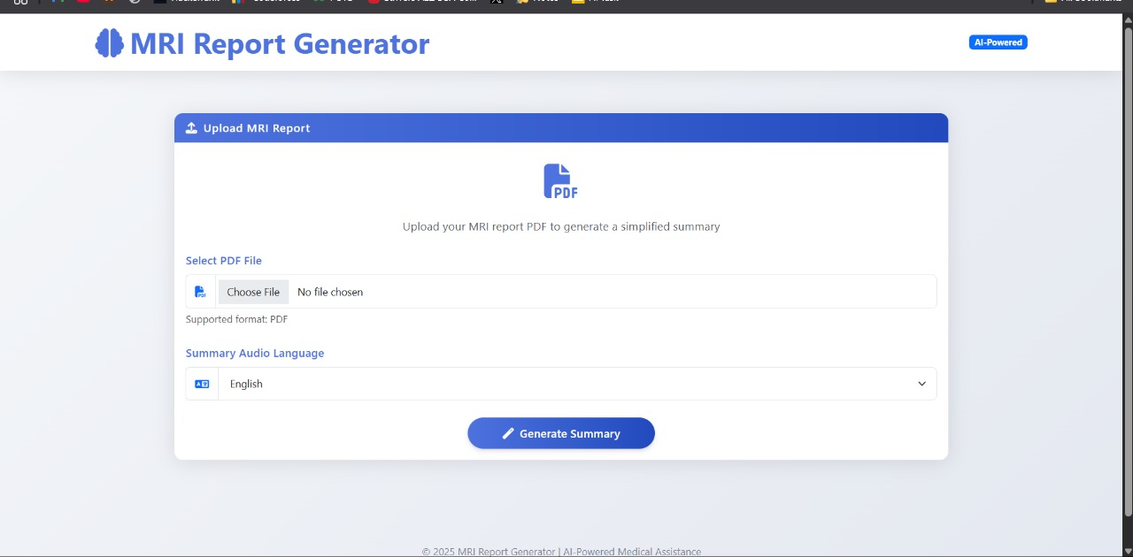

Slide 20
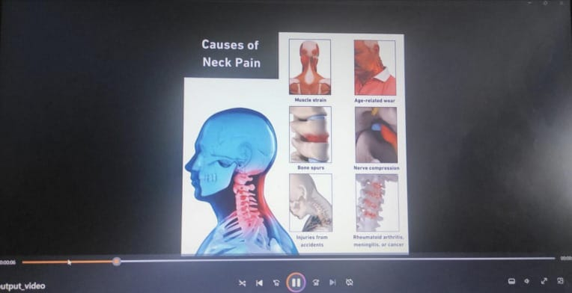

Slide 21
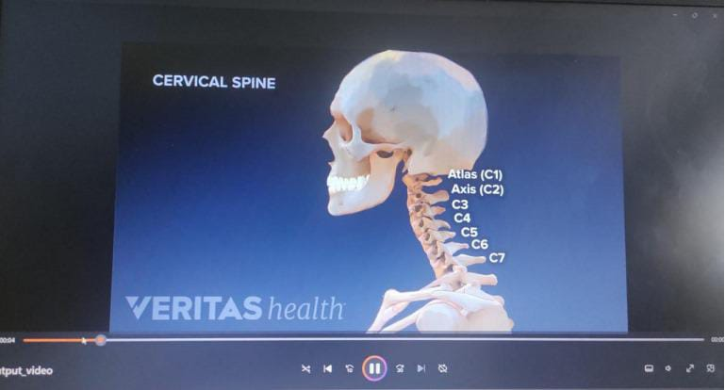

Slide 22
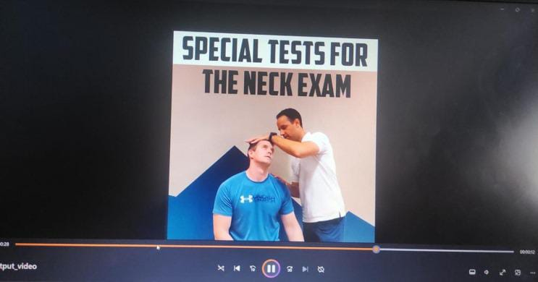

Slide 23
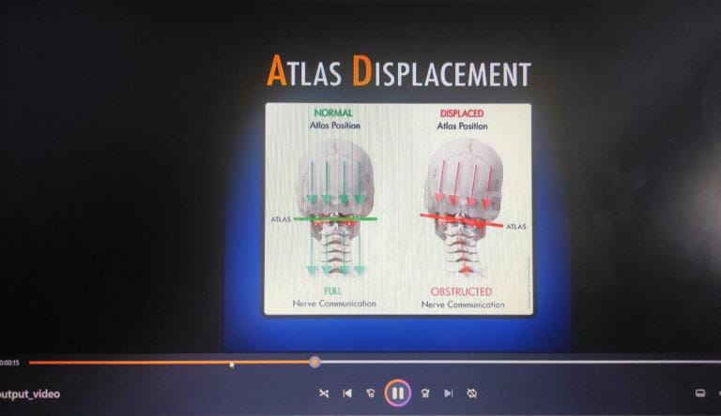

Slide 24
Conclusion
In conclusion, this project leverages advanced technologies in natural language processing (NLP) and video generation to address a critical gap in patient communication and health literacy. By transforming complex MRI reports into clear, engaging, and multilingual animated videos, it aims to significantly reduce patient anxiety, foster understanding, and empower patients to make informed health decisions.The integration of custom algorithms, along with activity, sequence, and data flow diagrams, illustrates a structured and effective approach to seamlessly convert medical data into patient-friendly insights. Ultimately, this project represents an innovative step towards making healthcare information accessible, thereby promoting better health outcomes and patient satisfaction.

Slide 25
FUTURE SCOPE
Integrate AR/VR visualization for 3D MRI explanation
• Use text classification to identify report type (e.g., cervical spine, brain)
• Improve summarization with BioBERT or domain-specific models
• Add user authentication and report history tracking

Slide 26
References
[1]
Automatic generation of conclusions from neuroradiology MRI reports through natural language processing https://link.springer.com/article/10.1007/s00234-024-03312-3/metrics
Video-assisted patient education to modify behavior: A systematic review https://pubmed.ncbi.nlm.nih.gov/25043785/
GANcMRI: Cardiac magnetic resonance video generation and physiologic guidance using latent space promptingMilos Vukadinovic, Alan C Kwan, Debiao Li, and David Ouyang
Deep-Learning-Based Generation of Synthetic High-Resolution MRI from Low-Resolution MRI for Use in Head and Neck Cancer Adaptive Radiotherapy
Zahniser, N. (2016). Video creation with Python using MoviePy. Available online at: https://zulko.github.io/moviepy/.
[2]
[3]
[4]
[5]

Slide 27
Thank You

