Slide 1
Travel Agency
Meda Saikanth Reddy 001389103
Vennela Reddy Karaddi 001081643
Naga Vuyyuru 001344678

Slide 2
Problem Statement
Build an effective system to improve the Features of travel agency to make booking and traveling easier for the customer.The Model must enable the travel agency to manage its operations at the customer, flight schedule, car booking ,hotel booking levels.

Slide 3
Airliner Directory
Airliner Directory has array of Airliners and connected to Flight and travel agency.

Slide 4
Customer Directory
Customer Directory has all the details of customer personal details, Flight Booking details.
Using Travel agency customer directory can be accessed.
Customer is also connected to car directory and hotel directory with bookingID.

Slide 5
Flight Directory
Flight Directory has all the information to schedule the flight and it is connected to Airliner Directory and Travel agency.

Slide 6
Car Directory
Car Directory contains all the details of car such as Car Number,Destination,Source,Driver details and if the car is available at that location at that time or not.
Car directory is connected to travel agency and Through travel agency using bookingID we can link customer to cab rides.

Slide 7
Hotel Directory
Hotel Directory contains all the details of hotel room as Hotel Number, Location and if the room is available at that time or not.
Hotel directory is connected to travel agency and Through travel agency using bookingID we can link customer to hotel room.

Slide 8
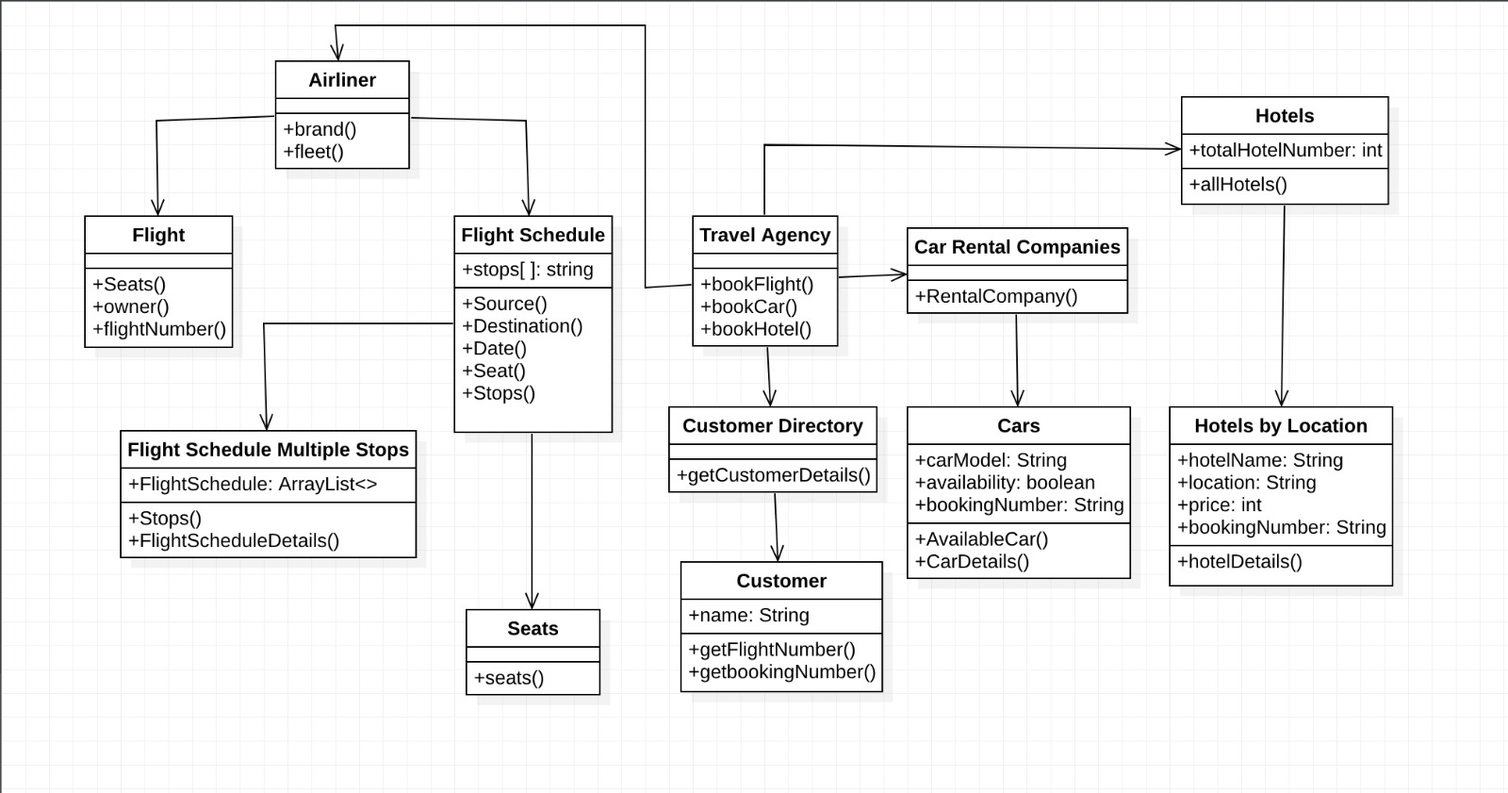
Object Model
Type to enter a caption.

Slide 9
Thank You.

