Slide 1

Turnout & Demographics Analysis of Indian Elections
1951–2024
Interactive Power BI Dashboard Project
Padiginati Vennela | MCA – Data Analytics

Slide 2


About the Analyst
MCA Student
Technical Skills
Specializing in Data Analytics with focus on business intelligence and visualization
Power BI, Excel, SQL, and data preparation techniques
Professional Passion
Transforming raw data into actionable insights through compelling visualizations

Slide 3
Project Objectives
01
02
Turnout Trend Analysis
State Performance Review
Examine voter participation patterns across 73 years of Indian elections
Identify states demonstrating higher levels of electoral engagement
03
04
Constituency Engagement
Demographic Distribution
Analyze grassroots-level voter behavior and participation rates
Understand gender and category representation among election winners

Slide 4
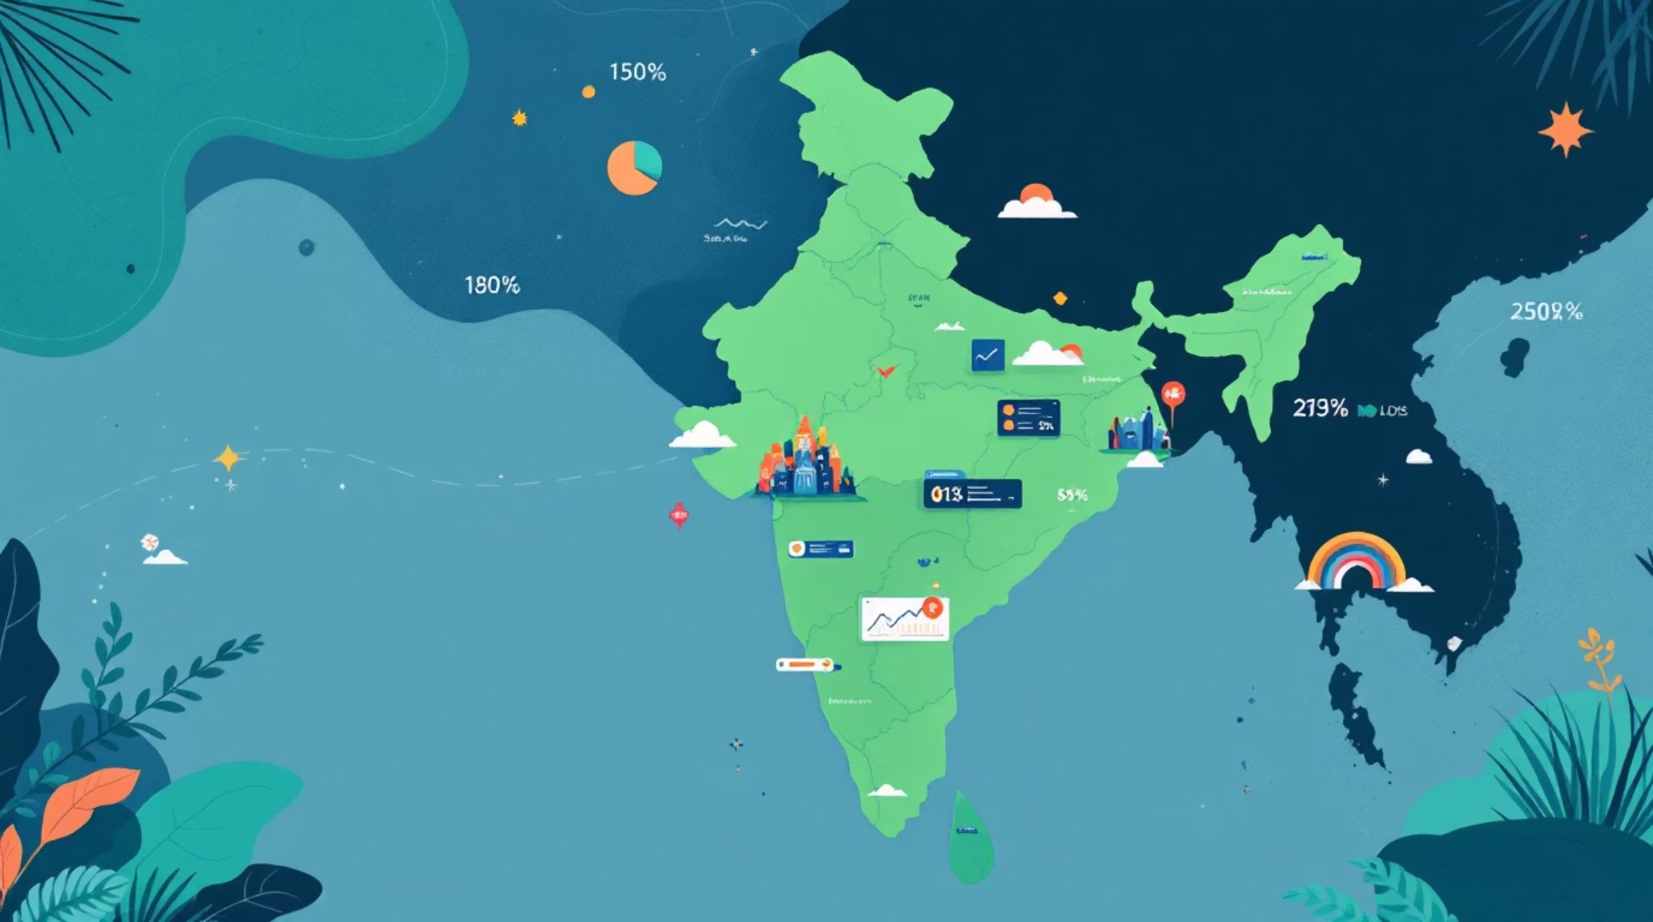
Dataset Overview
Comprehensive Coverage
Dataset spans 73 years of Indian electoral history from the first general election in 1951 through 2024, encompassing over seven decades of democratic participation.
Key Data Elements
Election Year and Cycle
State and Constituency Names
Political Party Affiliation
Vote Counts and Turnout %
Constituency Category Classification
Winner Gender Demographics

Slide 5
Tools & Technologies
Power BI
Excel & CSV
Primary platform for interactive dashboard development, data visualization, and business intelligence reporting
Data preparation, cleaning, and transformation workflows to ensure data quality
SQL
Analytical Methods
Querying and extracting insights from structured datasets efficiently
Geographic mapping, trend analysis, and demographic segmentation techniques

Slide 6
Dashboard Overview
The interactive Power BI dashboard organizes election analytics into five key sections:
KPI Cards
State Comparison
Geographic Map
Turnout metrics and participation rates at a glance
Regional turnout percentages side-by-side
Visual distribution of votes across India
Top Constituencies
Gender Distribution
High-participation areas ranked by turnout
Male and female winner breakdown

Slide 7
Key Performance Indicators
100%
38.45%
Highest Turnout
Average Turnout
Single constituency achieved maximum participation in an election cycle
Overall voter participation across all elections from 1951–2024
These metrics provide a summary of voter participation levels and highlight the gap between maximum potential turnout and actual average participation.

Slide 8

State-Level Turnout Analysis
Regional comparison reveals significant variation in electoral participation across Indian states:
Geographic Insights
Visual mapping highlights regional patterns in voter engagement, with certain states consistently demonstrating stronger electoral participation than others.
Key Findings
States with higher literacy rates and urbanization levels show elevated turnout percentages, while remote and rural regions face accessibility challenges.

Slide 9


Demographic Insights
Gender Distribution of Winners
94.1%
5.44%
Male Winners
Female Winners
Overwhelming majority of election victors across 1951–2024
Significant gender gap in political representation
The data reveals persistent gender disparity in electoral success, with male candidates winning 17 times more frequently than female candidates. This gap reflects broader societal challenges in political participation and representation.

Slide 10




Conclusion & Key Takeaways
Visual Storytelling
Interactive dashboards transform complex electoral datasets into intuitive, actionable insights
Research Value
Comprehensive analysis supports academic research and governance understanding
Professional Growth
Project enhanced practical data analytics, visualization, and business intelligence capabilities
Next Steps: Expand analysis to include party performance trends, margin of victory patterns, and correlation between socio-economic indicators and voter turnout.

