Slide 1

a Mini project on movie ticket booking system
BATCH MEMBERS DETAILS-
17121a1222 GM Hemanth
17121a1223 G Vennila
17121a1224 G Rajasekhar
17121a1225 G Raveena
17121a1226 G Vanitha
17121a1227 G Jaswanth Tej
17121a1231 G T Gnanaprasanna
17121a1232 G SaiKartheek
17121a1233 G Bharath
DEPARTMENT OF INFORMATION TECHNOLOGY
SREE VIDYANIKETHAN ENGINEERING COLLEGE
(AUTONOMOUS)

Slide 2
Table of content
Content | Slide Number
Abstract
Introduction | 1
Modules and their Explanation | 2-9
Hardware and Software requirements | 10
Project flowchart | 11-12
Results | 13-20
Conclusion | 21
Roles of Batch members | 22
References

Slide 3
Abstract
This project is made for providing the customer an anytime and anywhere service for booking the tickets in the cinema hall
And the user can easily be able to know about the movies released and then make their choice.
It books the movie tickets for the user and displays the
total cost.
This project stores the records of customers who booked the tickets in a file which can be viewed by admin .

Slide 4
Abstract
User
Any user who has registered with the system with valid user id and password can use the facility of booking the tickets online.
Admin
Admin provides the information about the presently running movies
and has a provision to view the details of user.

Slide 5

1. introduction
Now a days most of us use this facility of booking the tickets online.
Book my show , Grab, Cinepolis are
some of the apps used for booking
movie tickets

Slide 6
2. MODULES
2.1 Admin Modules
Admin login
Insert details
Old records
2.2 User Modules
User login
Find
Book ticket
View all movies

Slide 7
2.1 Admin Modules
2.1.2 Admin login
Administrator should login into the system on entering his username and password correctly.
This is done using the function void admin_login ( ).

Slide 8
2.1 Admin Modules
2.1.2 Insert details
A structure is declared with structure members code,movie name,date and cost.
The data regarding a film is read using a variable of the structure and stored in a file.
This process is done using the function void insert().

Slide 9
2.1 Admin Modules
2.1.2 Old records
The transactions being made by the user can be viewed by the admin as they are stored in a file ‘old records’ after the ticket is being booked by the user.
And this is implemented in the function
void old_record( ).

Slide 10
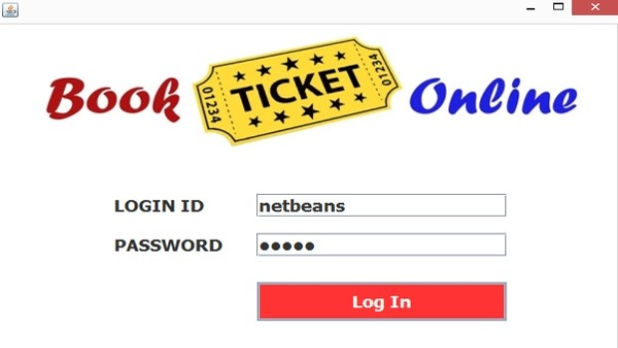
2.2 USER Modules
2.2.1 User login
The user should login with his respective user id and password.
On his/her successful login user is provided with the options to
View all movies
Find a movie
Book tickets
Cancel tickets

Slide 11
2.2 USER Modules
2.2.2 Find
In order to find a particular movie the user is asked to enter the movie code and based on the code entered the movie is searched in a file in which the data of all the movies is stored.

Slide 12
2.2 USER Modules
2.2.3 BOOK TICKETS
On selecting a particular film ,it displays the details of the film and asks the user to enter his details like name , mobile number etc and number of tickets required
Finally it displays the total cost of the tickets being booked and stores these details in a file of old records.

Slide 13
2.2 USER Modules
2.2.4 View all movies
It displays the details of all the films which are stored in a file.
Void view() is the function used to perform this task.

Slide 14
3.Hardware and software requirements
Hardware
RAM of minimum 1 GB
Hard disk of minimum 10 GB
Software
Operating system:Linux
Language used: c

Slide 15
4. Design of THE project
Start
If admin
Login
Is
successful
Asks
whether you
are user or
admin
If user
login
is
successful
Admin
User
Calls
void insert()
Calls
void find()
Calls
void
oldrecords()
Calls
void
book_tickets()
Calls
Void
viewall()
Exit
Stop

Slide 16
On executing the program this project asks whether you are admin or user
If you are a user then it displays the following options
View all movies
Find a movie
Book tickets
Exit
If you are the admin then it asks to choose one of the options
1. Insert a movie
2. View all transactions
3. Exit

Slide 17
5. results
5.1 User modules
Based upon the choice of the
user the output of the program
differs .Final result of these
modules is ,it books the movie
tickets for the user based on
his/her choice of movie and no.
of tickets and displays the total
cost.
5.2 Admin modules
Out of the two modules, one
module INSERT ,acts as input as
it takes the details of the movie and
stores them in a file. And the
module old records displays the
details of the users which are taken
while booking the tickets.

Slide 18
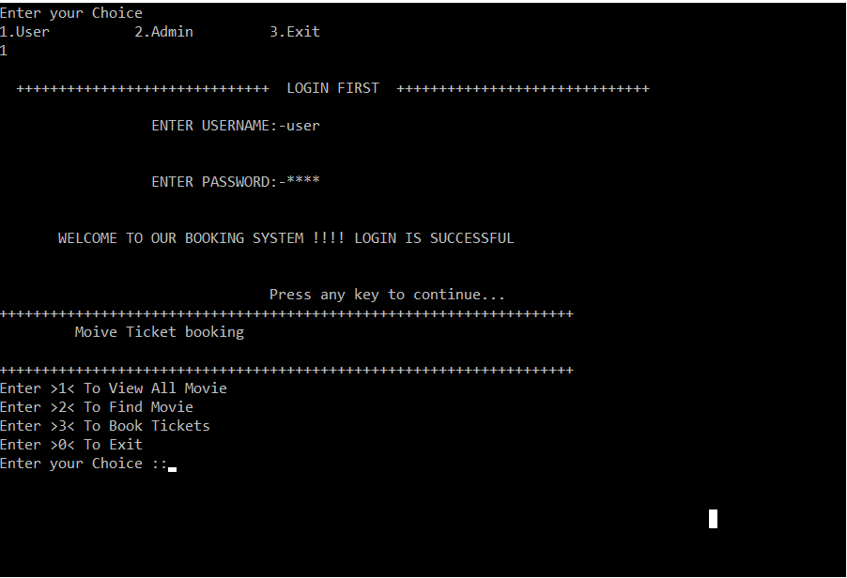
5.1 User modules
5.1.1 USER LOGIN
In order to perform user modules , first the user should login with his valid username and password.
On his successful login it displays the following
options as shown in the Fig 5.1.1.
Fig 5.1.1 User login screen

Slide 19
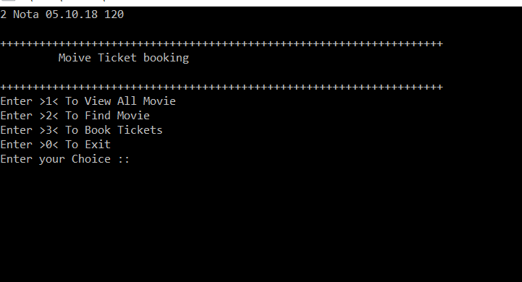
5.1 User modules
5.1.2 View all
This gives the list of all the films inserted
by the admin as shown in the
Fig 5.1.2
Fig 5.1.2 Output screen displaying the movies list

Slide 20
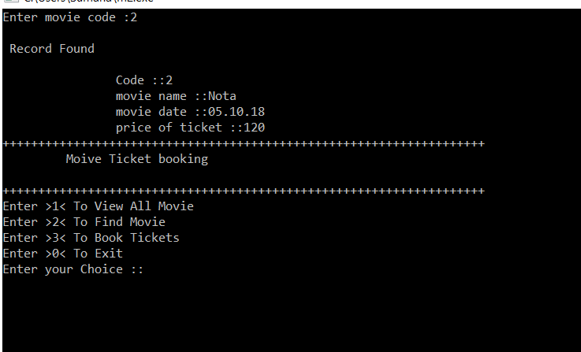
5.1 User modules
5.1.3 finding a Movie
This asks the user to enter the movie code and
gives the details of the movie like price of the
ticket ,release date .
Fig 5.1.3 Output screen displaying the details of a movie

Slide 21
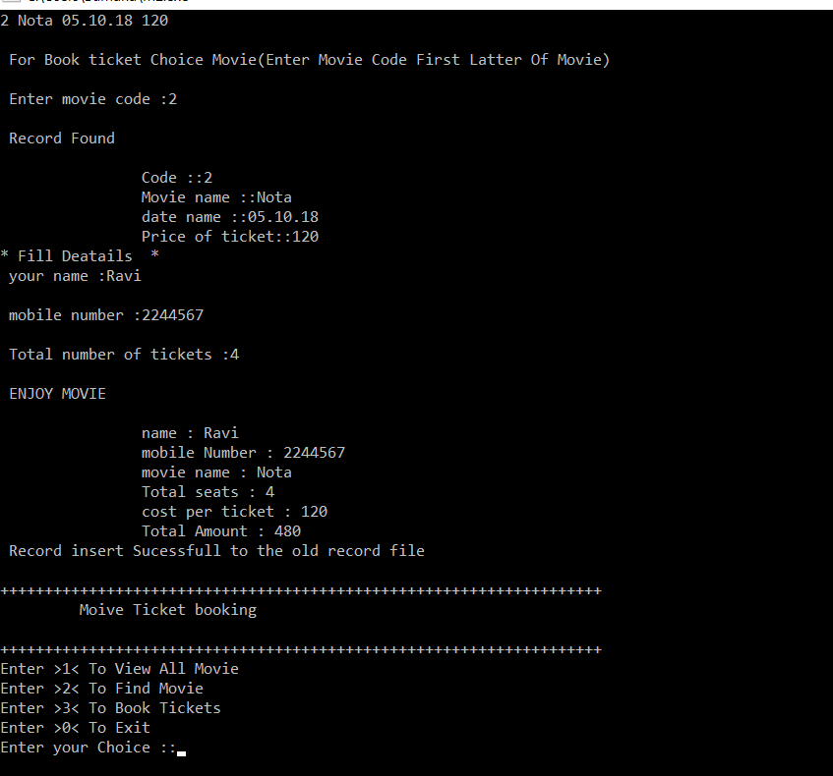
5.1.4 BOOKING TICKETS
On selecting the desired movie, it asks the
user to enter his/her details no. of tickets
required and displays the total cost of the
tickets .
5.1 USER MODULES
FIG 5.1.4 Booking tickets

Slide 22
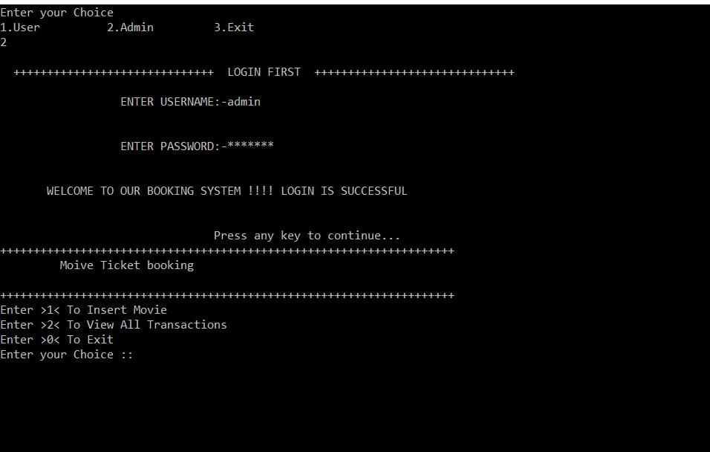
5.2 ADMIN MODULES
5.2.1 ADMIN LOGIN
In order to perform admin modules,
the admin should login with his
username and password.
If he/she enters wrong password or
username for more than three times
then the program terminates.
Fig 4.2.1 admin login
Fig 5.2.1 Admin login screen

Slide 23
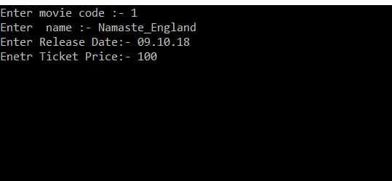
5.2 ADMIN MODULES
5.2.2 InSERTING A MOVIE
This asks the Admin to enter the details regarding
a movie and stores them in a file.
Fig 5.2.2 Inserting a movie

Slide 24
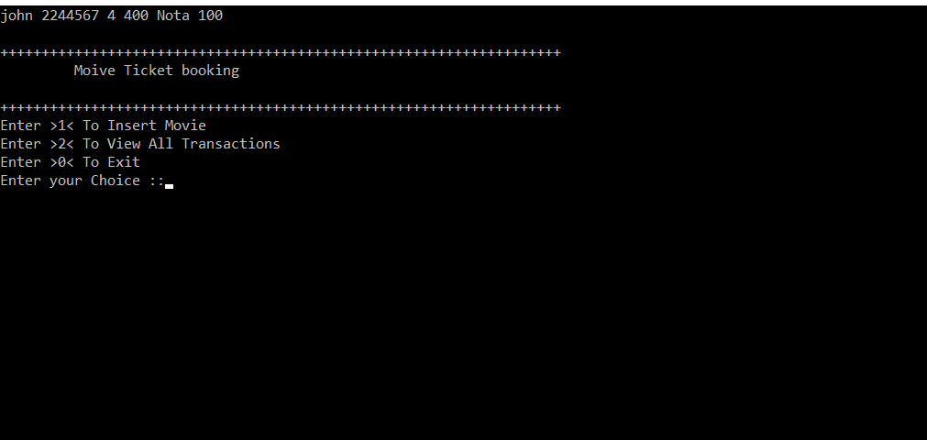
5.2 ADMIN MODULES
5.2.3 OLD RECORDS
This makes the admin to view the details
of the users who has booked the tickets.
Fig 5.2.3 Displaying old records of the users

Slide 25
6.conclusion
Finally to say, this project provides an easy environment to book the movie tickets.
It minimize the number of staff at ticket counter
It provides a 24*7 service to the customer.

Slide 26
Batch members and their roles
Roll number | Role
17121a1222 | Analyzer
17121a1223 | Coding regarding user modules
17121a1224 | Analyzer
17121a1225 | Designer
17121a1226 | Planning and sequencing the project
17121a1227 | Coding regarding user modules
17121a1231 | Designer
17121a1232 | Coding regarding Admin modules
17121a1233 | Coding regarding Admin modules

Slide 27
References
Neil matthew and richard stones
beginning linux programming
byron gottfried and jithendder kumar c
PROGRAMMING WITH C,Third Edition
Movie ticket booking system
Link:https://code-projects.org
Drafted on:08.09.18

Slide 28


