Slide 1


AI DRIVEN CCTV SECURITY SYSTEM

Slide 2
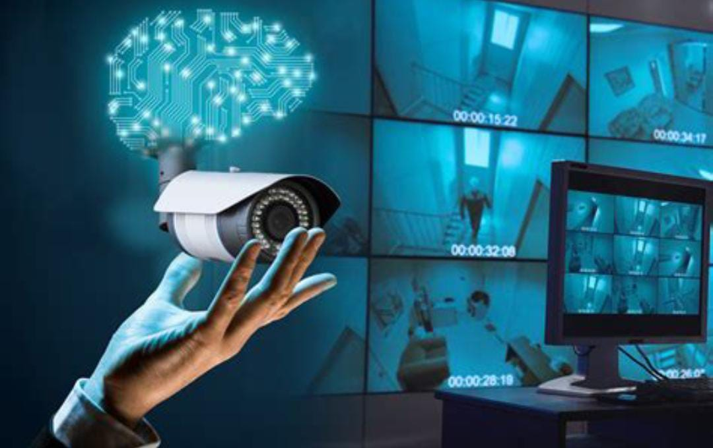
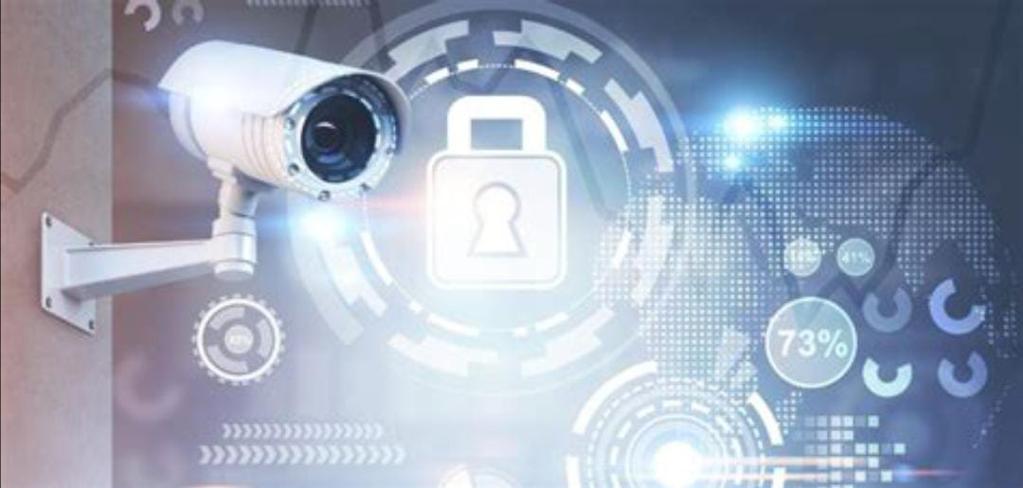
inTRoduction
Traditional CCTV systems rely on manual monitoring,
leading to delayed threat detection and response.
The AI-Driven CCTV Security System enables real-time surveillance, detecting weapons, identifying abnormal behavior, and recognizing faces.
This system minimizes human intervention, enhances response times, and provides scalable security for multiple sectors.

Slide 3
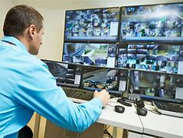
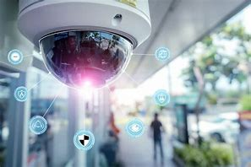
PROBLEM STATEMENT
Traditional CCTV systems rely heavily on manual monitoring, which often leads to delayed responses and missed threats. As security risks continue to rise in both public and private spaces, there is an urgent need for an automated system that can detect abnormal behaviour, detect weapons, and recognize faces in real-time to enhance security efficiency and response times.

Slide 4
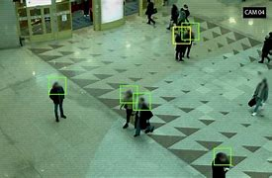
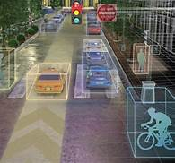
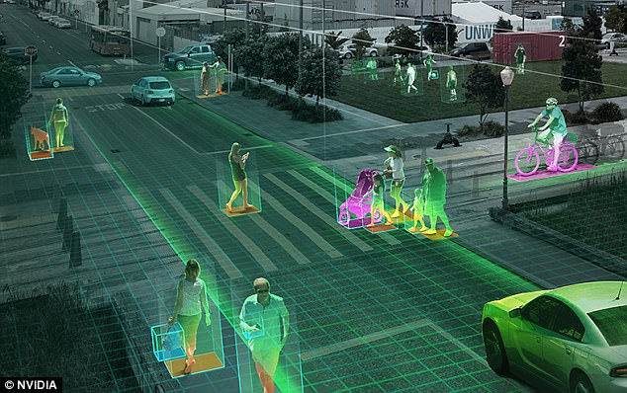
Concept & Objective
Concept: AI analyzes CCTV footage for threats.
Objective: Automate threat detection, send real-time alerts and reduce reliance on human monitoring.

Slide 5

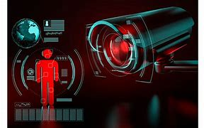
WHY IS THIS TECHNOLOGY NEEDED?
Security Threats: Increasing incidents of crime, violence, and public safety concerns demand faster and more accurate threat detection systems.
Limitations of Manual Monitoring: Traditional CCTV systems are inefficient, relying on humans to identify threats, which can result in delayed responses or oversight of critical situations.
AI Advancements : With the rise of AI and machine learning, it’s now possible to automate real-time threat detection, drastically improving response times and minimizing dependence on large security teams.

Slide 6
Crime trends After CCTV Installation
Delayed Detection: Over the past year, several crimes have occurred even after CCTV installation, where footage was reviewed only after the crime had already occurred.
Post-Incident Review: Traditional CCTV systems often rely on reviewing footage after an incident, causing delayed response and missed opportunities to prevent or mitigate the impact.
Need for Real-Time Monitoring: This highlights the urgent need for AI-driven real-time monitoring, allowing for instant detection and alerting, helping to prevent crimes or reduce response time significantly.
NCRB (National Crime Records Bureau) reports

Slide 7
PLAN OF ACTION
LIVE CCTV FOOTAGE
AI evaluation
If not anything detected loop will continuously detecting and recognizing
If suspicious activities detected it will record the session until the detection process is over
Faces ,weapons, suspicious activities and face detection and recognization

Slide 8





Technologies Used
Programming Language: Python Why Python? Easy to learn, rapid development, and strong community support.
Key Libraries :OpenCV: For image and video processing, essential for real-time CCTV analysis.
TensorFlow/ Keras : For building and training machine learning models, enabling accurate threat detection.
NumPy : For numerical computations and handling data efficiently.
Scikit-learn : For implementing machine learning algorithms for behaviuor recognition.

Slide 9
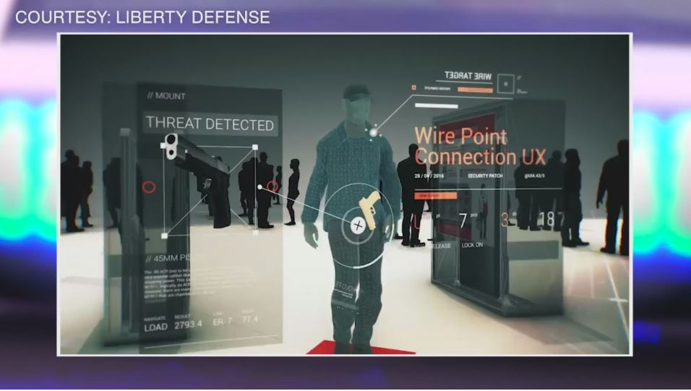

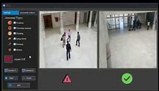

Key Features
Real-time weapon and behavior detection.
Instant alerts via SMS or email or call.
It will start record the footages when these all abnormality happens.
Face recognition of wanted individuals.

Slide 10


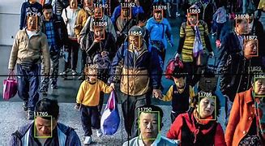
Applications
Retail: Detect shoplifting, violence.
Factories: Prevent theft, enhance safety.
Schools, College & Airports: Monitor large crowds for threats.

Slide 11


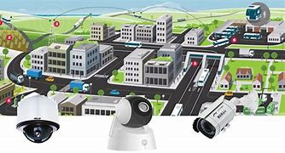
Market Potential
High demand for automated security systems.
Applicable for MSMEs, smart cities, and public sectors.
Cost-effective and scalable for existing CCTV systems.

Slide 12


Conclusion
1. AI-driven CCTV automates threat detection.
2. Reduces human error and improves
response times.
3. Scalable, affordable, and efficient
for various industries.

Slide 13

THANKING YOU
Thankyou for Spending your valuable time with us

