Slide 1
Digital Portfolio
STUDENT NAME: VENNILA S
REGISTER NO AND NMID:2422K1476 AND vennilasnm2422k1476@gmail.com
DEPARTMENT:B.Sc.COMPUTER SCIENCE
COLLEGE: COLLEGE/UNIVERSITY

Slide 2
PROJECT TITLE
DIGITAL PORTFOLIO

Slide 3
AGEND A
Problem Statement
Project Overview
End Users
Tools and Technologies
Portfolio design and Layout
Features and Functionality
Results and Screenshots
Conclusion
Github Link

Slide 4
PROBLEM STATEMENT
In today’s digital era, students and professionals need a streamlined way to showcase their skills, achievements, and experiences. Traditional paper-based portfolios are limited in accessibility, personalization, and real-time updates. A *Digital Portfolio* addresses this gap by offering a centralized, interactive, and customizable platform to display academic records, projects, certifications, and personal growth

Slide 5
PROJECT OVERVIEW
The Digital Portfolio project aims to create a professional, interactive, and visually appealing web-based platform that allows individuals to showcase their personal, academic, and professional achievements in a modern and accessible format. Unlike traditional resumes or static presentations, this portfolio will serve as a dynamic tool for self-promotion, networking, and career development.

Slide 6
WHO ARE THE END USERS?
1. *Students* – To showcase academic work, projects, and skills. 2. *Job Seekers* – To present resumes, experiences, and achievements. 3. *Professionals* – To display career growth, certifications, and expertise. 4. *Freelancers* – To highlight their work and attract potential clients. 5. *Educators* – To share teaching materials, research, and accomplishments. 6. *Employers/Recruiters* – To evaluate candidates’ skills and past work.

Slide 7
TOOLS AND TECHNIQUES
Digital portfolios showcase work and skills online. Key tools include website builders like Wix and WordPress, portfolio platforms like Behance, and design tools like Adobe Creative Cloud. Techniques involve curating best work, clear navigation, visual storytelling, SEO optimization, and regular updates. These enhance professional online presence, increase visibility, and create networking opportunities.

Slide 8
PORTFOLIO DESIGN AND LAYOUT
A well-designed portfolio showcases work effectively through clarity, consistency, and visual hierarchy. Key elements include a simple and clean layout, visual storytelling, responsive design, and easy navigation. Best practices involve showcasing best work, telling a story, and using white space to enhance readability and aesthetics.

Slide 9
FEATURES AND FUNCTIONALITY
A digital portfolio provides a modern, interactive platform to showcase personal, academic, or professional achievements. Key features include a homepage with personal introduction, project gallery, skills and experience section, downloadable resume, and contact form.

Slide 10
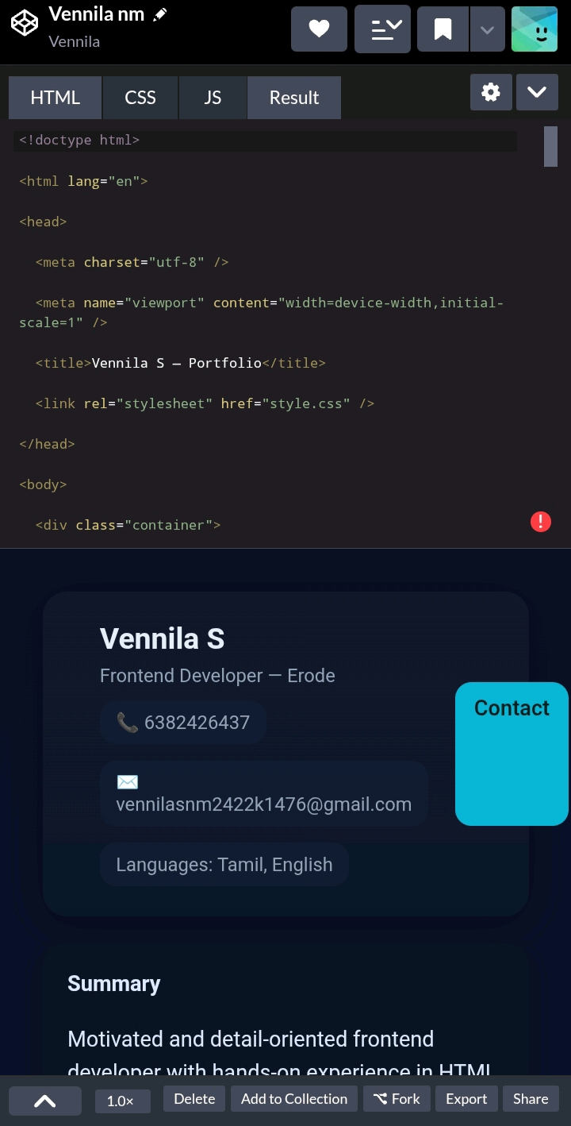
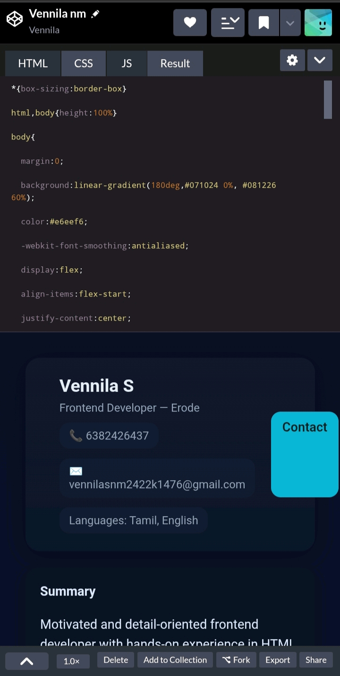
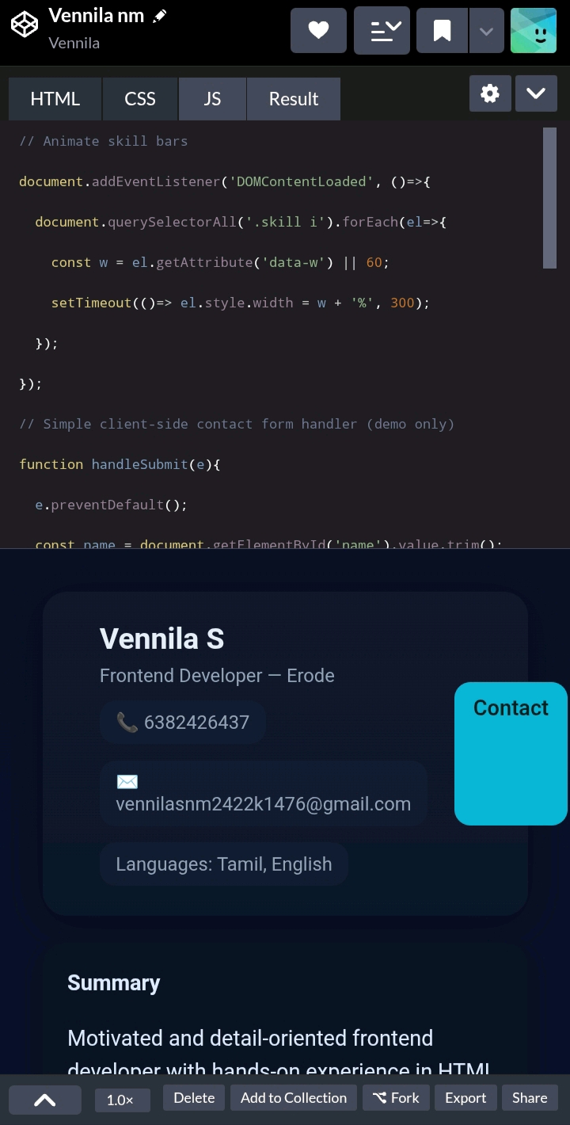
RESULTS AND SCREENSHOTS

Slide 11
CONCLUSION
In conclusion, this digital portfolio showcases my skills, growth, and dedication to continuous learning and creativity. Each project reflects my commitment to quality, innovation, and problem-solving. I look forward to new opportunities where I can apply my experience, learn more, and make a meaningful impact.

