Slide 1
END-TERM REPORT
SimuTech -Deep Learning
ROHAN VIRMANI
210871

Slide 2
About
Title: Case studies of cnn architectures
-Resnet50
-Inception net
-Mobile net
-VGG16
-Lenet 5

Slide 3
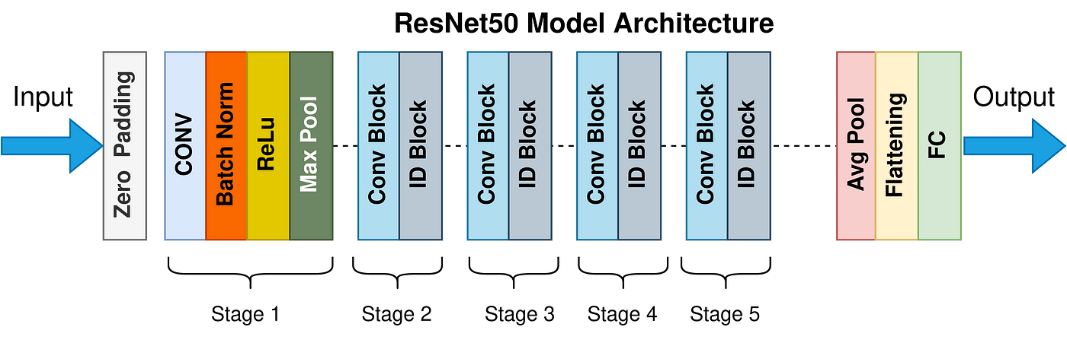
RESNET-50…
ResNet-50 is a classification benchmark that uses images of 224 pixels x 224 pixels, and performance is typically measured with INT8 operation.
ResNet-50 is a convolutional neural network (CNN) architecture that belongs to the ResNet family of models. ResNet-50 was introduced by Microsoft Research in 2015 and has been widely used and influential in the field of computer vision.
Residual Networks

Slide 4
The ResNet-50 model consists of 5 stages each with a convolution and Identity block. Each convolution block has 3 convolution layers and each identity block also has 3 convolution layers. The ResNet-50 has over 23 million trainable parameters.
Skip Connection — The Strength of ResNet
ResNet first introduced the concept of skip connection. The diagram below illustrates skip connection. The figure on the left is stacking convolution layers together one after the other. On the right we still stack convolution layers as before but we now also add the original input to the output of the convolution block. This is called skip connection
—--They mitigate the problem of vanishing gradient by allowing this alternate shortcut path for gradient to flow through
—---They allow the model to learn an identity function which ensures that the higher layer will perform at least as good as the lower layer, and not worse

Slide 5
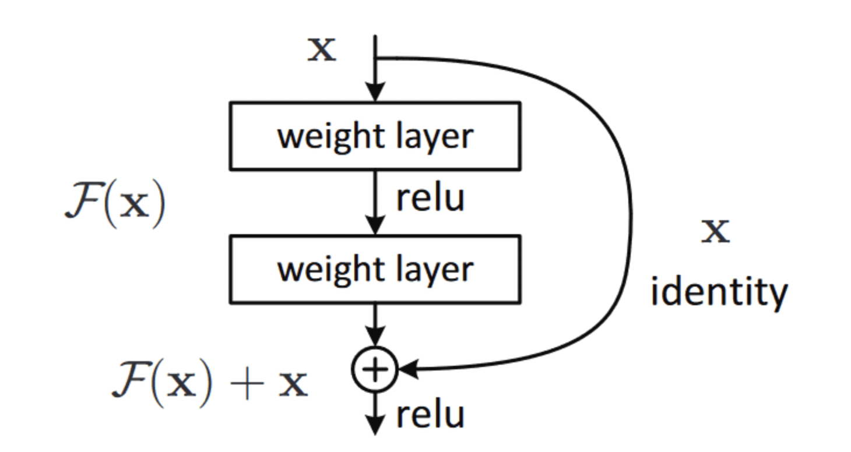

Slide 6
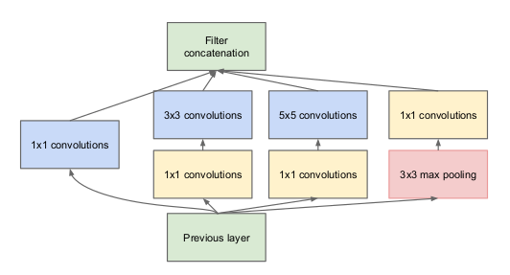
INCEPTION NET…
The main idea of the Inception architecture is based on finding out how an optimal local sparse structure in a convolutional vision network can be approximated and covered by readily available dense components. Note that assuming translation invariance means that our network will be built from convolutional building blocks. All we need is to find the optimal local construction and to repeat it spatially.

Slide 7
We assume that each unit from the earlier layer corresponds to some region of the input image and these units are grouped into filter banks. In the lower layers (the ones close to the input) correlated units would concentrate in local regions. This means, we would end up with a lot of clusters concentrated in a single region and they can be covered by a layer of 1×1 convolutions in the next layer, as suggested in [12]. However, one can also expect that there will be a smaller number of more spatially spread out clusters that can be covered by convolutions over larger patches, and there will be a decreasing number of patches over larger and larger regions. In order to avoid patch alignment issues, current incarnations of the Inception architecture are restricted to filter sizes 1×1, 3×3 and 5×5, however this decision was based more on convenience rather than necessity. It also means that the suggested architecture is a combination of all those layers with their output filter banks concatenated into a single output vector forming the input of the next stage. Additionally, since pooling operations have been essential for the success in current state of the art convolutional networks, it suggests that adding an alternative parallel pooling path in each such stage should have additional beneficial effect, too
As these “Inception modules” are stacked on top of each other, their output correlation statistics are bound to vary: as features of higher abstraction are captured by higher layers, their spatial concentration is expected to decrease suggesting that the ratio of 3×3 and 5×5 convolutions should increase as we move to higher layers.

Slide 8
One big problem with the above modules, at least in this na¨ıve form, is that even a modest number of 5×5 convolutions can be prohibitively expensive on top of a convolutional layer with a large number of filters. This problem becomes even more pronounced once pooling units are added to the mix: their number of output filters equals to the number of filters in the previous stage. The merging of the output of the pooling layer with the outputs of convolutional layers would lead to an inevitable increase in the number of outputs from stage to stage. Even while this architecture might cover the optimal sparse structure, it would do it very inefficiently, leading to a computational blow up within a few stages.
This leads to the second idea of the proposed architecture: judiciously applying dimension reductions and projections wherever the computational requirements would increase too much otherwise. This is based on the success of embeddings: even low dimensional embeddings might contain a lot of information about a relatively large image patch. However, embeddings represent information in a dense, compressed form and compressed information is harder to model. We would like to keep our representation sparse at most places (as required by the conditions of [2]) and compress the signals only whenever they have to be aggregated en masse. That is, 1×1 convolutions are used to compute reductions before the expensive 3×3 and 5×5 convolutions. Besides being used as reductions, they also include the use of rectified linear activation which makes them dual-purpose.

Slide 9
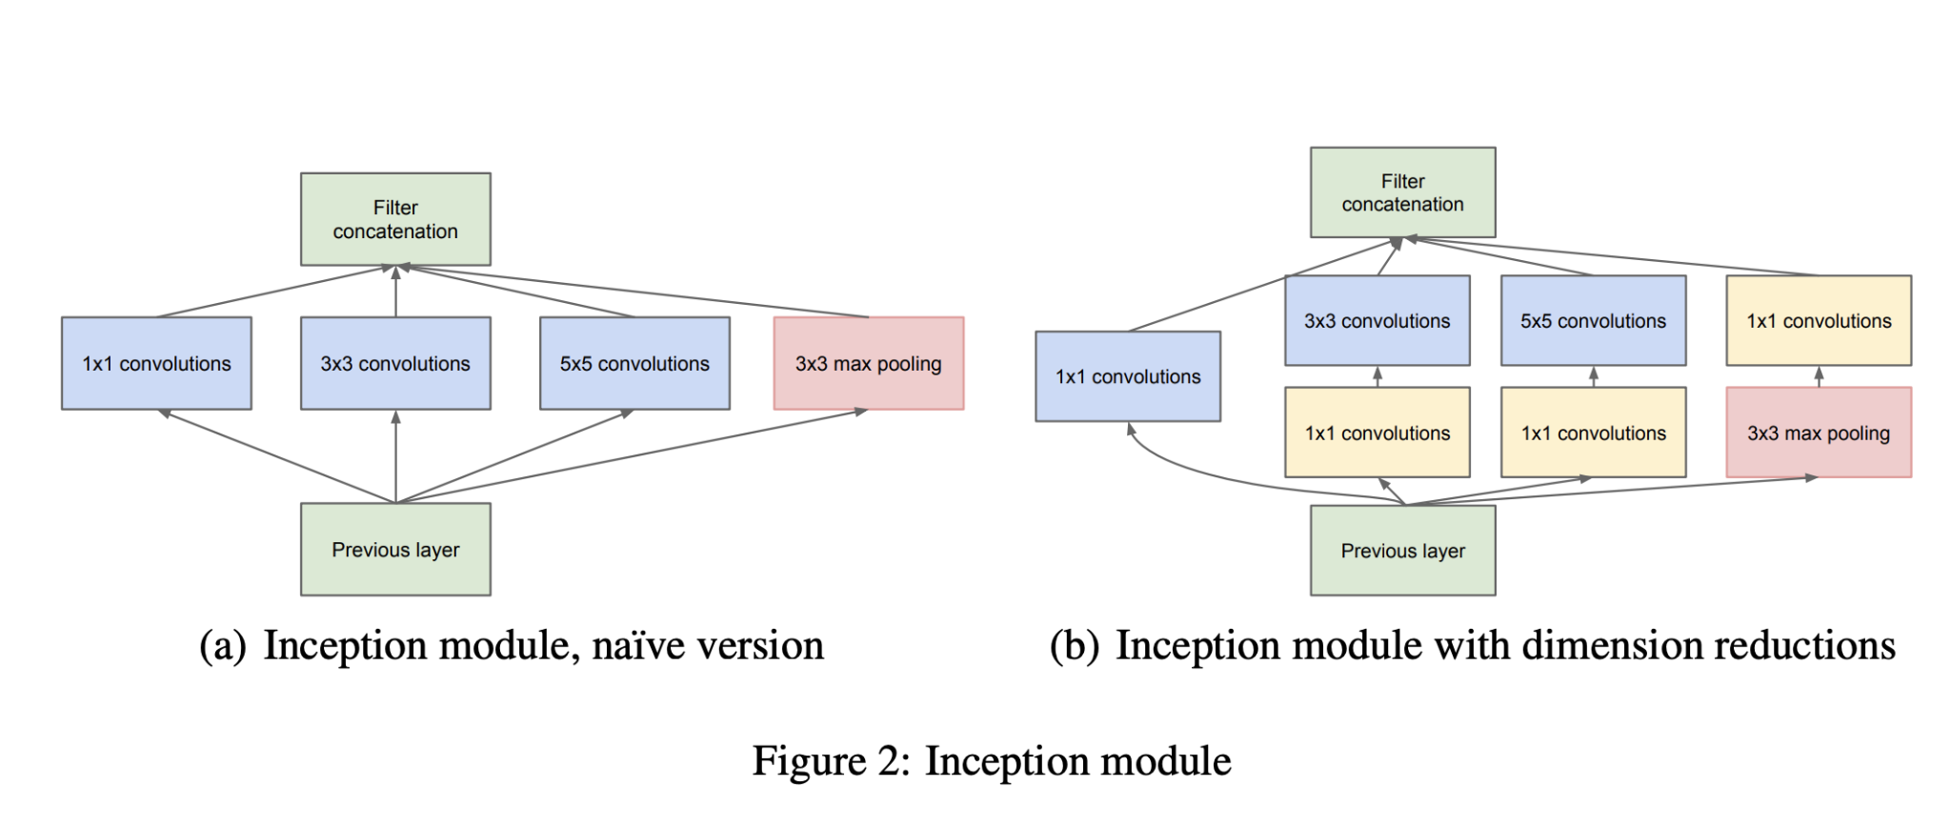
One of the main beneficial aspects of this architecture is that it allows for increasing the number of units at each stage significantly without an uncontrolled blow-up in computational complexity. The ubiquitous use of dimension reduction allows for shielding the large number of input filters of the last stage to the next layer, first reducing their dimension before convolving over them with a large patch size. Another practically useful aspect of this design is that it aligns with the intuition that visual information should be processed at various scales and then aggregated so that the next stage can abstract features from different scales simultaneously.

Slide 10
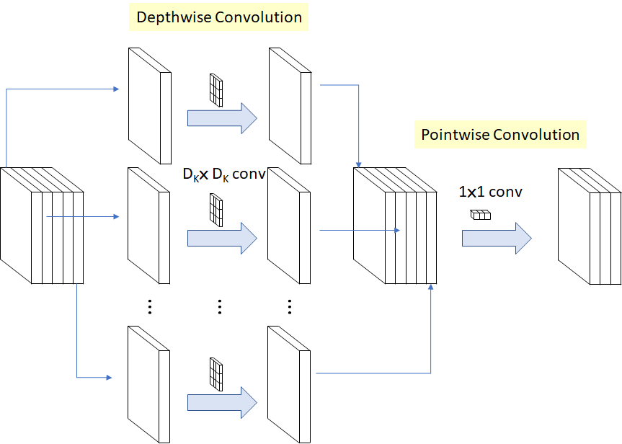
MOBILE NET…
MobileNet is a simple but efficient and not very computationally intensive convolutional neural networks for mobile vision applications. MobileNet is widely used in many real-world applications which includes object detection, fine-grained classifications, face attributes, and localization. In this lecture, I will explain you the overview of MobileNet and how exactly it becomes the most efficient and lightweight neural network.

Slide 11
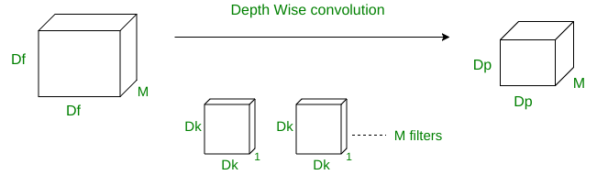
The depth-wise convolutions are used to apply a single filter into each input channel. This is different from a standard convolution in which the filters are applied to all of the input channels.

Slide 12
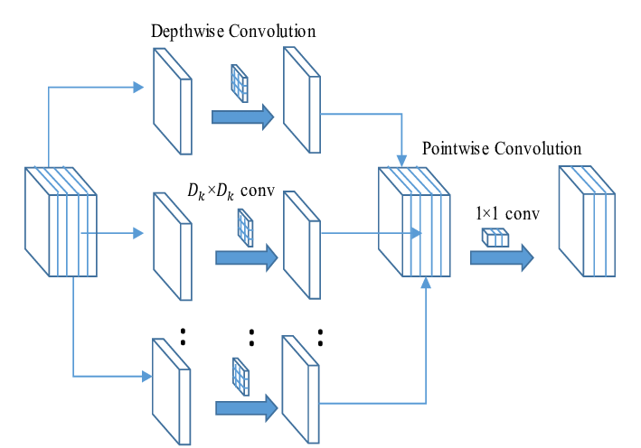
Since the depthwise convolution is only used to filter the input channel, it does not combine them to produce new features. So an additional layer called pointwise convolution layer is made, which computes a linear combination of the output of depthwise convolution using a 1 × 1 convolution.

Slide 13
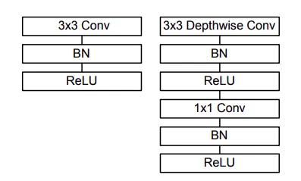
The architecture is somewhat like–
Note that the above architecture has 28 layers by counting widthwise and pointwise convolution as separate layers.

Slide 14

Although the base MobileNet architecture is already small and computationally not very intensive, it has two different global hyperparameters to effectively reduce the computational cost further.
One is the width multiplayer and another is the resolution wise multiplayer.
MobileNet is not the only model that competes with other state-of-art models but with this smaller and lightweight network by Depthwise Separable Convolution has done a really great job!

Slide 15
VGG-16..Visual Geometry Group
Of all the configurations, VGG16 was identified to be the best performing model on the ImageNet dataset. Let’s review the actual architecture of this configuration.
The input to any of the network configurations is considered to be a fixed size 224 x 224 image with three channels – R, G, and B. The only pre-processing done is normalizing the RGB values for every pixel. This is achieved by subtracting the mean value from every pixel.
Image is passed through the first stack of 2 convolution layers of the very small receptive size of 3 x 3, followed by ReLU activations. Each of these two layers contains 64 filters. The convolution stride is fixed at 1 pixel, and the padding is 1 pixel. This configuration preserves the spatial resolution, and the size of the output activation map is the same as the input image dimensions. The activation maps are then passed through spatial max pooling over a 2 x 2-pixel window, with a stride of 2 pixels. This halves the size of the activations. Thus the size of the activations at the end of the first stack is 112 x 112 x 64.
The activations then flow through a similar second stack, but with 128 filters as against 64 in the first one. Consequently, the size after the second stack becomes 56 x 56 x 128. This is followed by the third stack with three convolutional layers and a max pool layer. The no. of filters applied here are 256, making the output size of the stack 28 x 28 x 256. This is followed by two stacks of three convolutional layers, with each containing 512 filters. The output at the end of both these stacks will be 7 x 7 x 512.
The stacks of convolutional layers are followed by three fully connected layers with a flattening layer in-between. The first two have 4,096 neurons each, and the last fully connected layer serves as the output layer and has 1,000 neurons corresponding to the 1,000 possible classes for the ImageNet dataset. The output layer is followed by the Softmax activation layer used for categorical classification.

Slide 16
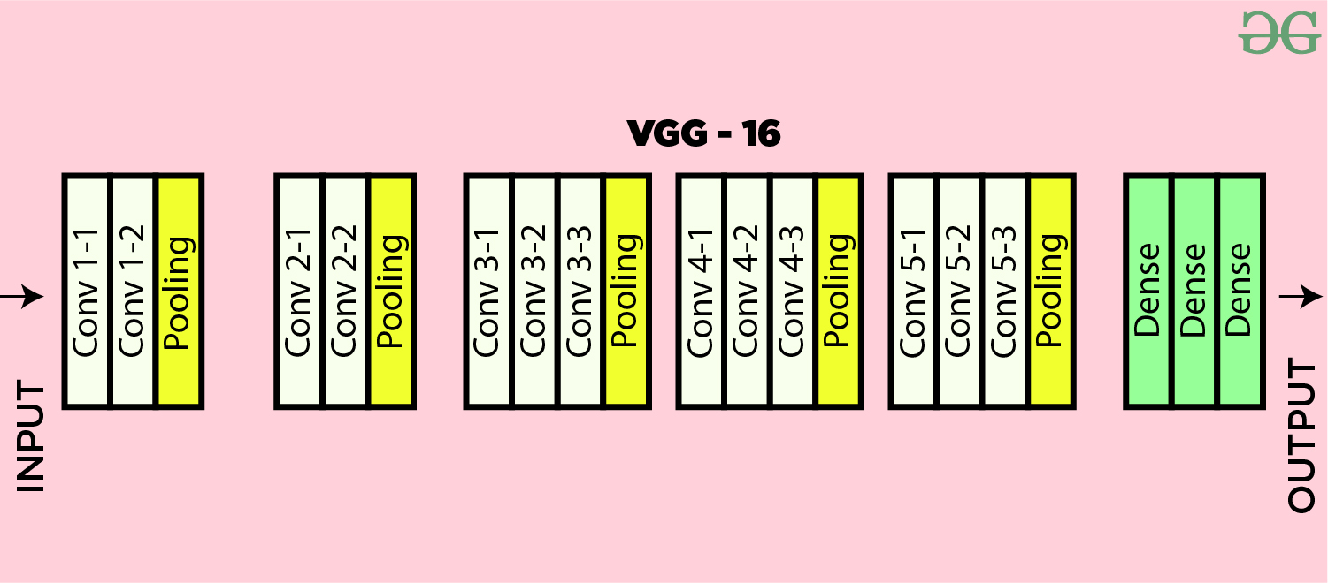

Slide 17
VGG-16..Visual Geometry Group
Of all the configurations, VGG16 was identified to be the best performing model on the ImageNet dataset. Let’s review the actual architecture of this configuration.
The input to any of the network configurations is considered to be a fixed size 224 x 224 image with three channels – R, G, and B. The only pre-processing done is normalizing the RGB values for every pixel. This is achieved by subtracting the mean value from every pixel.
Image is passed through the first stack of 2 convolution layers of the very small receptive size of 3 x 3, followed by ReLU activations. Each of these two layers contains 64 filters. The convolution stride is fixed at 1 pixel, and the padding is 1 pixel. This configuration preserves the spatial resolution, and the size of the output activation map is the same as the input image dimensions. The activation maps are then passed through spatial max pooling over a 2 x 2-pixel window, with a stride of 2 pixels. This halves the size of the activations. Thus the size of the activations at the end of the first stack is 112 x 112 x 64.
The activations then flow through a similar second stack, but with 128 filters as against 64 in the first one. Consequently, the size after the second stack becomes 56 x 56 x 128. This is followed by the third stack with three convolutional layers and a max pool layer. The no. of filters applied here are 256, making the output size of the stack 28 x 28 x 256. This is followed by two stacks of three convolutional layers, with each containing 512 filters. The output at the end of both these stacks will be 7 x 7 x 512.
The stacks of convolutional layers are followed by three fully connected layers with a flattening layer in-between. The first two have 4,096 neurons each, and the last fully connected layer serves as the output layer and has 1,000 neurons corresponding to the 1,000 possible classes for the ImageNet dataset. The output layer is followed by the Softmax activation layer used for categorical classification.

Slide 18
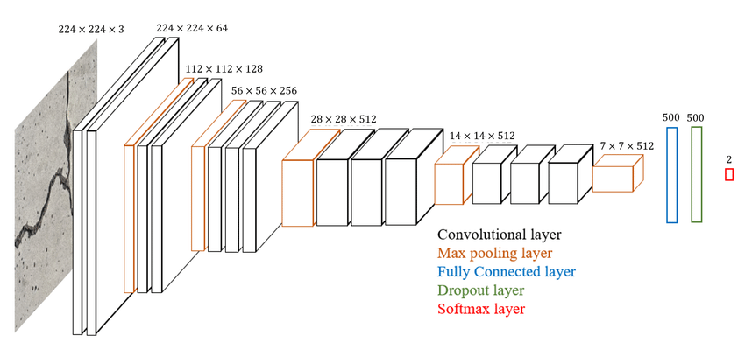
VGG-16 use cases..
VGG16 keeps the data scientists and researchers worldwide interested despite the advent of many new and better scoring models since the time VGG was originally proposed. Here are a few use cases where you may find VGG16 practically in use.
Image Recognition or Classification – VGG16 can be used for disease diagnosis using medical imaging like x-ray or MRI. It can also be used in recognizing street signs from a moving vehicle.
Image Detection and Localization – We didn’t discuss the detection abilities of VGG16 earlier, but it can perform really well in image detection use cases. In fact, it was the winner of ImageNet detection challenge in 2014 (where it ended up as first runner up for classification challenge)
Image Embedding Vectors – After popping out the top output layer, the model can be used to train to create image embedding vectors which can be used for a problem like face verification using VGG16 inside a Siamese network.

Slide 19
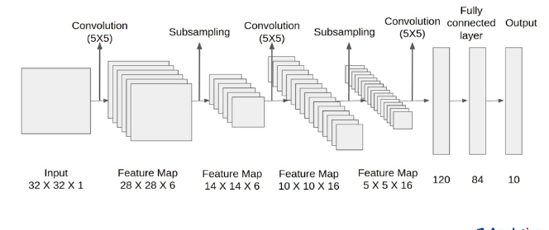
LENET 5…
LeNet-5 CNN architecture is made up of 7 layers. The layer composition consists of 3 convolutional layers, 2 subsampling layers and 2 fully connected layers.

Slide 20
The first layer is the input layer — this is generally not considered a layer of the network as nothing is learnt in this layer. The input layer is built to take in 32x32, and these are the dimensions of images that are passed into the next layer. Those who are familiar with the MNIST dataset will be aware that the MNIST dataset images have the dimensions 28x28. To get the MNIST images dimension to the meet the requirements of the input layer, the 28x28 images are padded.
The grayscale images used in the research paper had their pixel values normalized from 0 to 255, to values between -0.1 and 1.175. The reason for normalization is to ensure that the batch of images have a mean of 0 and a standard deviation of 1, the benefits of this is seen in the reduction in the amount of training time. In the image classification with LeNet-5 example below, we’ll be normalizing the pixel values of the images to take on values between 0 to 1.
The LeNet-5 architecture utilizes two significant types of layer construct: convolutional layers and subsampling layers.
Convolutional layers
Sub-sampling layers
Within the research paper and the image below, convolutional layers are identified with the ‘Cx’, and subsampling layers are identified with ‘Sx’, where ‘x’ is the sequential position of the layer within the architecture. ‘Fx’ is used to identify fully connected layers. This method of layer identification can be seen in the image above.
The official first layer convolutional layer C1 produces as output 6 feature maps, and has a kernel size of 5x5. The kernel/filter is the name given to the window that contains the weight values that are utilized during the convolution of the weight values with the input values. 5x5 is also indicative of the local receptive field size each unit or neuron within a convolutional layer. The dimensions of the six feature maps the first convolution layer produces are 28x28.
A subsampling layer ‘S2’ follows the ‘C1’ layer’. The ‘S2’ layer halves the dimension of the feature maps it receives from the previous layer; this is known commonly as downsampling.
The ‘S2’ layer also produces 6 feature maps, each one corresponding to the feature maps passed as input from the previous layer. This link contains more information on subsampling layers.

Slide 21
APPLICATION OF CV IN CHEMICAL ENG..
Computer vision, a subfield of artificial intelligence and computer science, has several applications in chemical engineering. Here are some areas where computer vision techniques can be applied:
Process Monitoring and Control: Computer vision can be used to monitor and control various processes in chemical engineering. For example, it can be used to analyze video feeds from cameras placed in a chemical plant to detect anomalies, monitor equipment conditions, and ensure that processes are running smoothly. Computer vision algorithms can detect visual patterns, such as changes in color, texture, or shape, that indicate process deviations or equipment malfunctions.
Quality Control: Computer vision can assist in quality control by automatically inspecting and analyzing chemical products or materials. It can detect defects, measure dimensions, and identify impurities or contaminants. This can be done using image analysis techniques, such as edge detection, pattern recognition, or machine learning algorithms, to classify and evaluate product quality based on visual characteristics.
Object Recognition and Tracking: Computer vision algorithms can be used to recognize and track objects in chemical engineering processes. This can include tracking the movement of chemicals, monitoring the position of containers or equipment, or identifying specific components in a system. Object recognition and tracking can help automate tasks, optimize workflow, and improve safety in chemical processes.
Image-Based Sensors: Computer vision can be used to develop image-based sensors for chemical analysis. By analyzing images or videos of chemical reactions or processes, computer vision algorithms can estimate chemical concentrations, identify reaction intermediates, or monitor reaction kinetics. This approach can provide real-time feedback and enable process optimization in chemical engineering.

Slide 22
Safety and Security: Computer vision can enhance safety and security in chemical engineering environments. It can be used to detect and track hazardous substances, monitor worker behavior to ensure compliance with safety protocols, and identify potential safety risks or security threats. Computer vision can analyze video feeds from surveillance cameras or thermal imaging to provide early warning systems and prevent accidents.
Image-Based Process Design: Computer vision techniques can be employed in the design phase of chemical processes. By analyzing images or videos of existing processes, computer vision algorithms can extract information on process parameters, flow patterns, or heat transfer rates. This information can aid in the optimization and design of new processes, improving efficiency and reducing costs.
Overall, computer vision has significant potential to improve various aspects of chemical engineering, including process monitoring, quality control, safety, and process design. By leveraging the power of visual information, computer vision algorithms can enhance efficiency, accuracy, and safety in chemical engineering applications.

Slide 23
COMSOL …
Lastly we ran simulation and created a laminar fluid flow in a pipe with a circular obstruction to observe the disruptions in the flow..
We provided the global parameters of height ,width, radius and inlet outlet velocity with a fixed pressure constraint..
We also set the fluid and material properties of density and dynamic viscosity..
We extracted the x,y data in a time dependent frame as txt file….
THE RESULTS ARE SHOWN IN THE FOLLOWING SLIDES—-

Slide 24
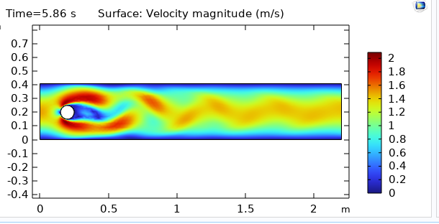

Slide 25
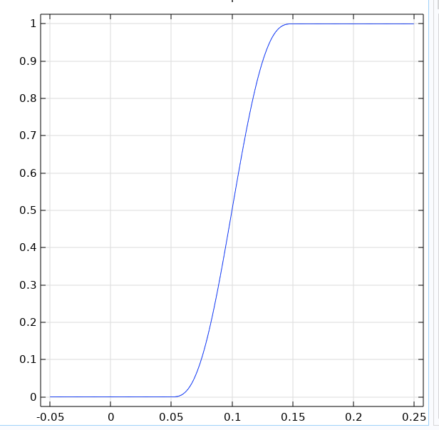
Convergence plot

Slide 26
