Slide 1

Introduction to Github
Greg heffner

Slide 2

What is Github
Github is a web-based platform that allows developers to store and share their code with others. It provides an easy way to manage code repositories and track changes over time using version control.

Slide 3

Why use Github?
Version Control
Github provides a powerful version control system that allows developers to track changes to their code, ensuring that the codebase is always up-to-date and can be easily rolled back to a previous version if needed.
Collaboration
Github makes it easy for developers to collaborate on code, even if they are working in different parts of the world. It provides tools for code reviews, issue tracking, and pull requests that make collaboration seamless and efficient.
Deployment
Github provides a platform for developers to deploy their code to production environments, ensuring that the code is always available and accessible. It also provides tools for continuous integration and delivery, making the deployment process faster and more streamlined.

Slide 4

Github Basics
Create an Account
To get started with Github, you need to create an account. Github provides free accounts for personal use and paid plans for businesses and organizations.
Create a Repository
A repository is a container for your code and files. You can create a new repository on Github in a few easy steps and start adding files to it.
Commit Changes
After you have made changes to your code, you can commit those changes to your repository. This allows you to keep track of changes and roll back if needed.

Slide 5
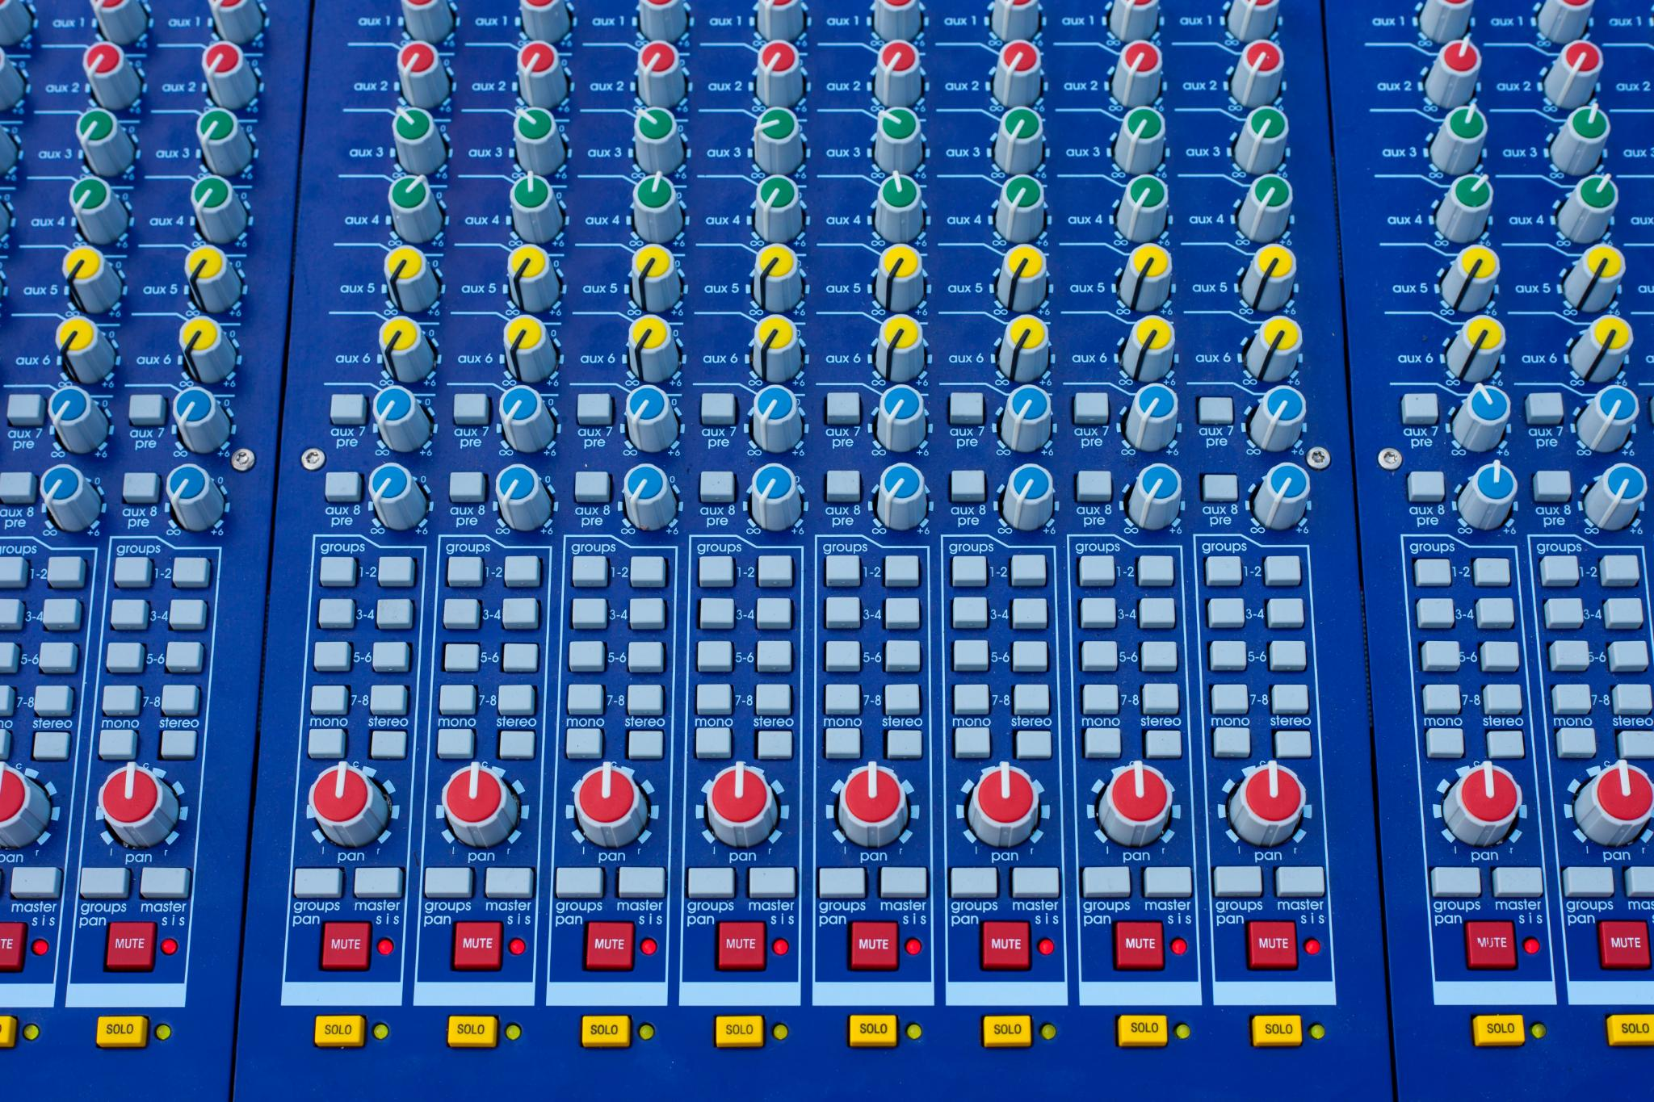
Using Git Commit
A Git commit is a snapshot of changes made to a repository at a specific moment in time.
The -m flag stands for message and is used to provide a brief description of the changes.
It's important to write clear and concise commit messages to aid in collaboration and code maintenance.
Notes:
When working with Git, you'll want to use Git commit to save your changes to the repository. To use Git commit, you'll need to first stage the changes you want to commit. This can be done with Git add. Once you've staged your changes, you can then commit them with Git commit. It's important to write clear and concise commit messages to aid in collaboration and code maintenance. Your messages should be descriptive and explain what changes you're making to the code. The -m flag is used to provide a brief description of the changes. You should aim to keep your commit messages short and to the point. By using Git commit correctly, you can easily manage changes to your code and collaborate with others.

Slide 6

Conclusion
Github is a powerful tool for software developers to work collaboratively. It provides version control and collaboration features that make it easy to work on projects with others.

