Slide 1
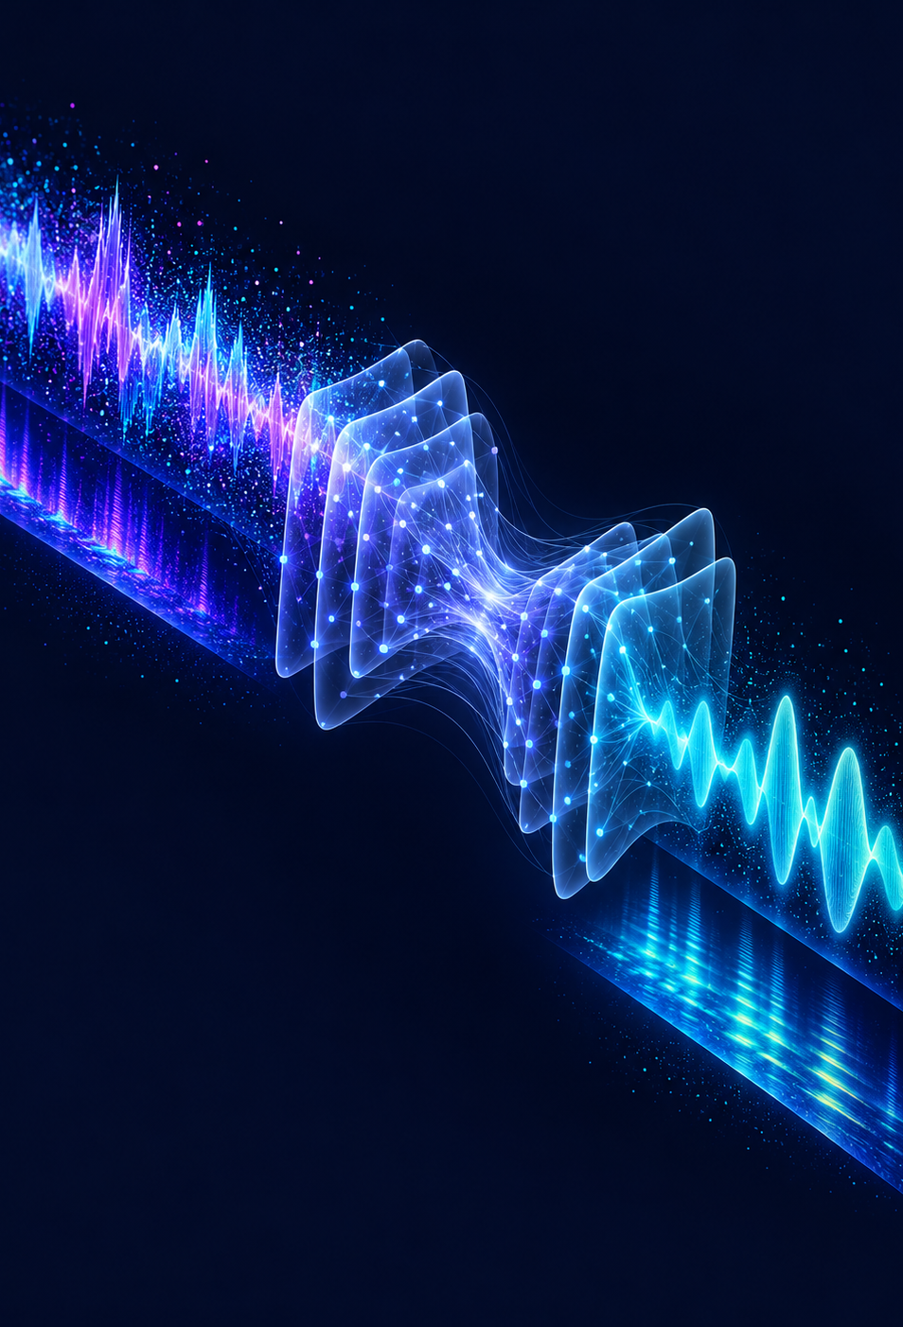
Deep Learning-Based
Speech Enhancement
and Context-Aware ASR Correction
Reducing noise and correcting
speech recognition errors
Yug Agrawal
PRN: 24070126209

Slide 2
Problem & Related Work
We study whether cleaner audio also helps speech recognition.
Our objective
Related work
Background noise can cause speech recognition errors. We train a U-Net to reduce noise, then use Whisper to convert speech into text.
We also test whether similar-sounding word replacements can improve the transcript.
Method | Contribution
SEGAN (2017) | One network cleans audio. Another judges how clean it sounds.
MetricGAN (2019) | A quality-score network guides the enhancer toward better speech.
DCCRN (2020) | It improves magnitude and phase to reconstruct cleaner speech.
MetricGAN+ (2021) | It improves MetricGAN training to achieve better speech quality.
We measure audio quality and word errors on the same recordings.

Slide 3
Dataset & Preprocessing
VoiceBank+DEMAND provides paired clean and noisy recordings of English speech.
Partition | Recordings | Speakers | Purpose
Training | 10,700 | 26 | The model learns its weights.
Validation | 872 | 2 | Validation loss selects the checkpoint.
Test | 824 | 2 unseen | The final systems use identical test data.
Audio preparation
Input to the model
We convert each recording to 16 kHz mono audio. STFT turns the waveform into a spectrogram showing frequency patterns over time.
Training uses paired clean and noisy clips of about one second. Each spectrogram has 257 frequency bins. Testing uses complete recordings.

Slide 4
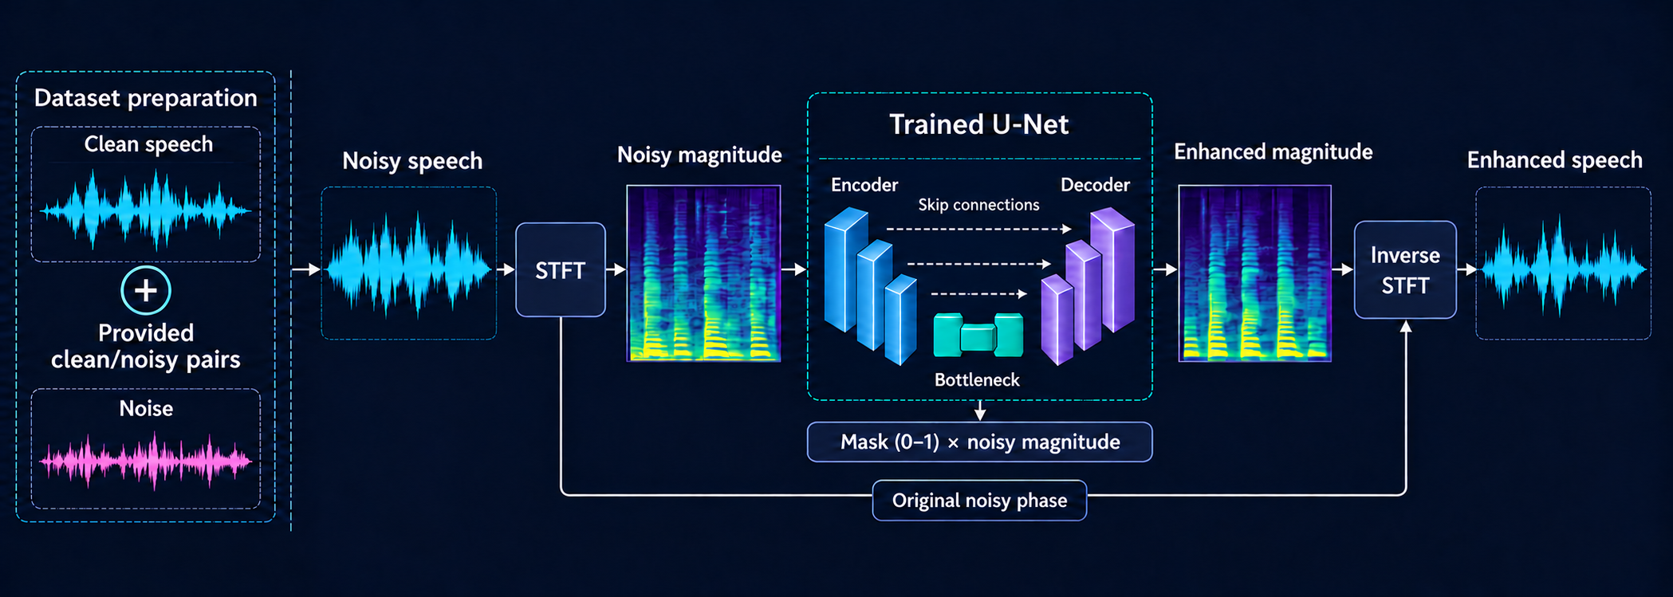
Speech Enhancement Workflow
The full system combines audio enhancement, automatic speech recognition (ASR), and optional text correction.
Original or enhanced
audio
Whisper base.en
Speech to text
Pronunciation + GPT-2
Optional text correction
Final transcript

Slide 5
U-Net Architecture & Training
The encoder learns speech patterns. The decoder restores detail and predicts a noise-suppression mask.
Magnitude input
Skip connections carry fine speech details to the decoder
Sigmoid mask
Encoder
16 channels
Decoder
16 channels
Encoder
32 channels
Decoder
32 channels
Encoder
64 channels
Decoder
64 channels
Bottleneck
128 channels
Skip connections preserve speech details while the decoder predicts a mask from 0 to 1.
We trained 482,449 parameters for 20 epochs using AdamW, a learning rate of 0.001 and batches of 16.
L1 loss compares enhanced and clean magnitudes. The best checkpoint comes from epoch 19.

Slide 6
Speech Recognition & Word Correction
Whisper produces the transcript. Pronunciation and sentence context guide possible corrections.
How correction works
When a word can change
Whisper base.en converts audio into text. CMUdict finds words with similar pronunciations, and GPT-2 scores how well each word fits the sentence.
A replacement must sound similar and score clearly better than the original. Extra safeguards discourage unnecessary changes.
An example from our test set
Whisper: “The piece process will be buried.”
Corrected: “The peace process will be buried.”
“Piece” and “peace” sound the same. The sentence context favors “peace”.

Slide 7
Results: Audio Quality
We compare noisy and enhanced audio against the matching clean recordings.
Metric | Noisy input | Enhanced audio | Mean gain
STOI | 0.9211 | 0.9338 | +0.0127
SI-SDR | 8.45 dB | 17.96 dB | +9.51 dB
SNR | 8.45 dB | 18.05 dB | +9.60 dB
What the scores mean
Main observation
Higher SNR and SI-SDR indicate better signal quality. Higher STOI suggests better speech intelligibility according to this objective measure.
The U-Net reduces noise and improves all three audio metrics. We separately check whether these gains improve the transcript.

Slide 8
Results: Transcription Accuracy
Word error rate (WER) measures incorrect, missing and extra words. Lower is better.
Enhancement trade-off
Small correction gain
Whisper makes more word errors after enhancement. Our model learns to reconstruct audio, so better signal scores do not guarantee better recognition.
Correction removes seven net word errors in each audio path. It can still introduce errors, such as changing the correct word “bottle” to “battle”.

Slide 9
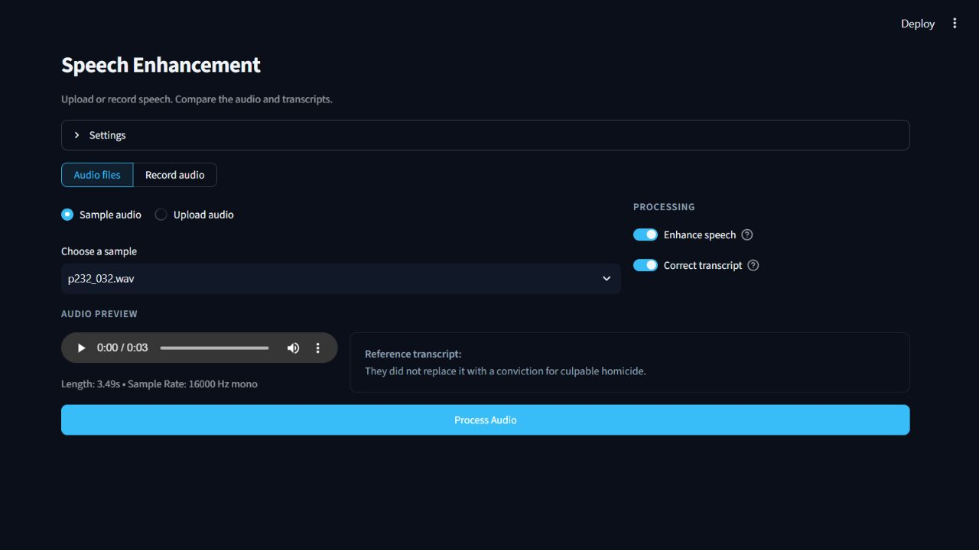
Implementation & Demonstration
The Streamlit application lets users compare audio and transcripts.
Implemented in this project
I implemented and trained the U-Net, including audio preprocessing and reconstruction.
I built the pronunciation search, correction safeguards and evaluation pipeline, then connected them in the interface.
Pretrained components
Whisper base.en and GPT-2 use pretrained weights. This project trains the U-Net.
The demo supports uploads and recordings, audio playback, transcript comparison and downloads.

Slide 10
Conclusions & Future Work
The main finding is that better audio scores do not guarantee better speech recognition.
What we learned
What limits the results
U-Net improves measured audio quality, but Whisper makes more errors after enhancement. Conservative text correction gives a small improvement in both audio paths.
The test set contains two speakers. Correction can still replace correct words, and the full pipeline does not beat Whisper on the original noisy audio.
Next steps
Future work should preserve phase information, train toward recognition accuracy, and test more speakers and noise conditions.

Slide 11
References
Primary research, dataset and implementation sources.
Valentini-Botinhao, 2017
VoiceBank+DEMAND paired speech database. doi:10.7488/ds/2117
Pascual et al., 2017
SEGAN. arXiv:1703.09452
Fu et al., 2019 / 2021
MetricGAN and MetricGAN+. arXiv:1905.04874 / 2104.03538
Hu et al., 2020
DCCRN. arXiv:2008.00264
Radford et al., 2022 / 2019
Whisper, arXiv:2212.04356. GPT-2 technical report.
Ronneberger et al., 2015
U-Net. arXiv:1505.04597. CMU Pronouncing Dictionary.
Project repository: github.com/venox-2007/speech-enhancement-asr-correction

Slide 12
Project Code & Resources
The complete implementation and setup instructions are available on GitHub.
https://github.com/venox-2007/speech-enhancement-asr-correction
The repository includes the trained U-Net and demonstration samples.
It also provides evaluation results and full dataset download instructions.

