Slide 1
Data Science for Psychologists
Ven Popov, PhD
Week 8, Classifiers, Part 1: Logistic regression
20/4/2021

Slide 2
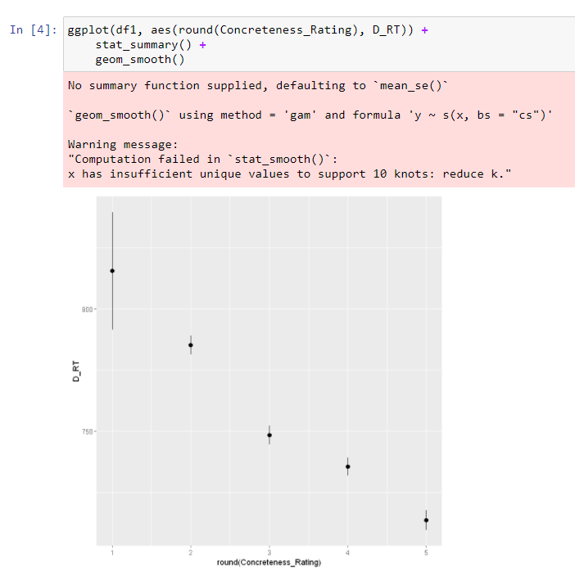
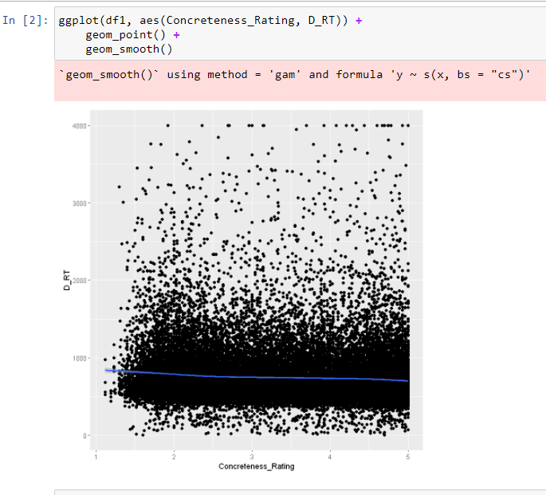
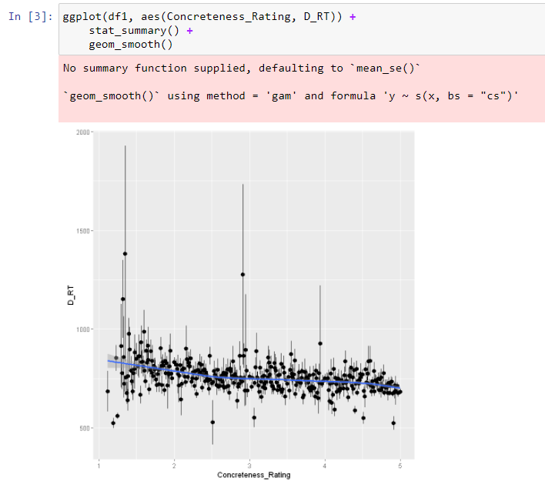
A note on plotting summarized data
Raw data (all data points)
Raw X, summarized Y
Rounded X, summarized Y

Slide 3
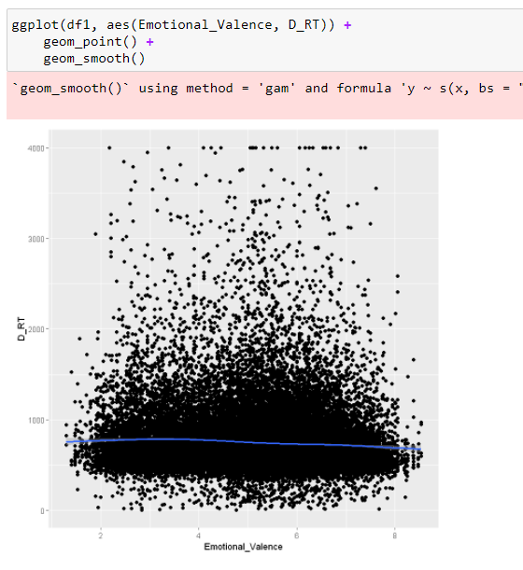
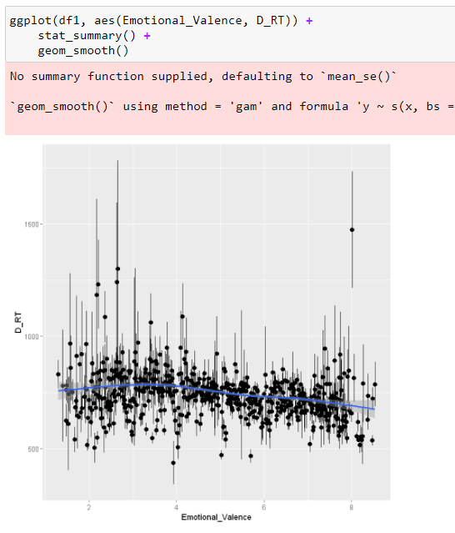
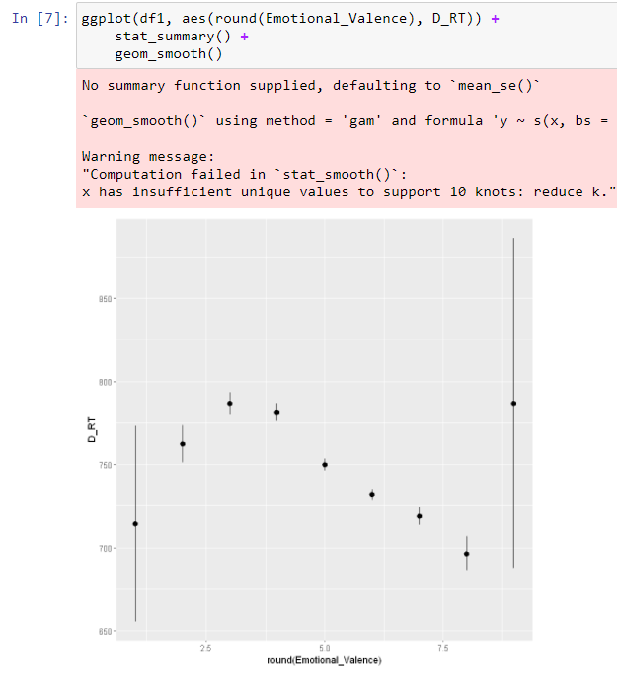
A note on plotting summarized data
Raw data (all data points)
Raw X, summarized Y
Rounded X, summarized Y

Slide 4
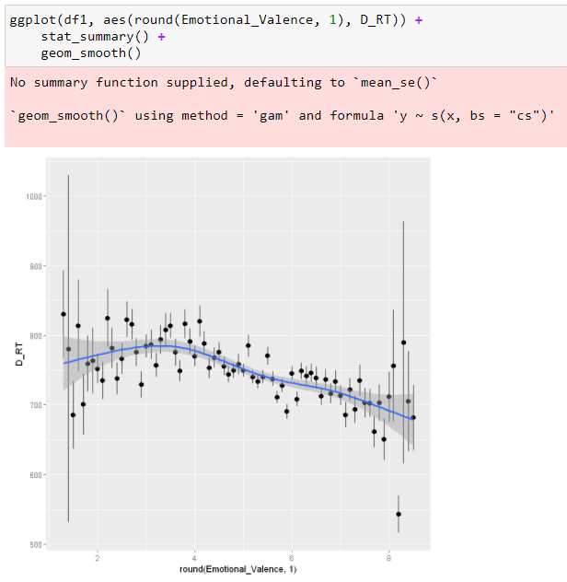

Slide 5
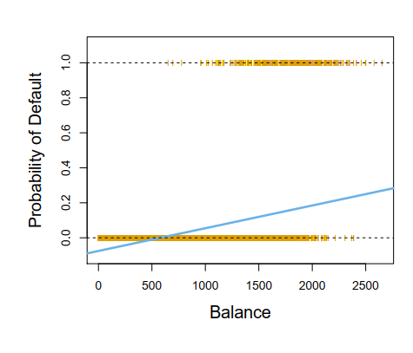
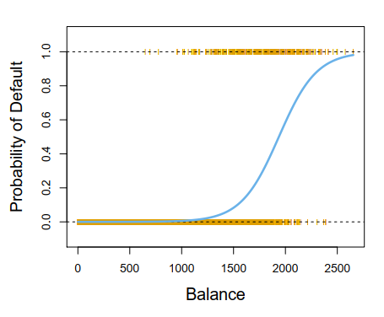

Binary outcomes
Linear regression:
$$p\left(X\right)=β_{0}+X_{1}β_{1}$$
Logistic regression:
$$\log\left(\frac{p\left(X\right)}{1−p\left(X\right)}\right)=β_{0}+X_{1}β_{1}$$

Slide 6
5% change is not the same everywhere
It is easier to increase something from 45% to 50% than to increase it from 93% to 98%
Linear regression assumes that X% change is the same regardless of where it occurs on the proportion scale

Slide 7
Silly example
New growth hormone treatment
Apply to women and men
Does it affect genders similarly?
We can’t measure height directly, but we can tell whether each person is taller or smaller than some threshold

Slide 8
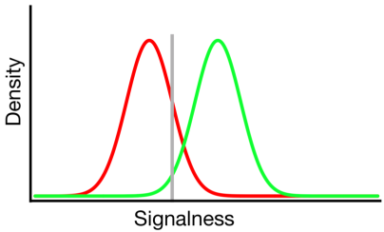
Simulate data
Ground truth – both genders increase height by 5 cm due to treatment
4 groups:
Women (Control) – mean height 159 cm, SD=6cm
Women (Treatment) – mean height 164 cm, SD=6cm
Men (Control) – mean height 176 cm, SD=6cm
Men (Treatment) – mean height 181 cm, SD=6cm
Measure: Proportion of people taller than 164 cm
Outcome:
Women (Control) – 20%
Women (Treatment) – 50%
Men (Control) – 97%
Men (Treatment) – 99%
Difference – 30% vs 2%

Slide 9
Breakout Discussion Questions
Jaeger and Gormila make very different recommendation for the analysis of binary outcomes. What are the strengths and weaknesses of each? Are there cases in which you would prefer one over the other? Which recommendation do you agree with more and why?

