Slide 1
Data Science for Psychologists
Ven Popov, PhD
Week 4, Data Visualization and Exploration
16/3/2021

Slide 2
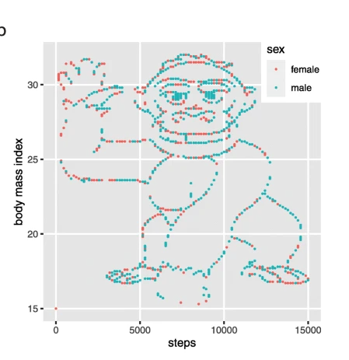

Slide 3
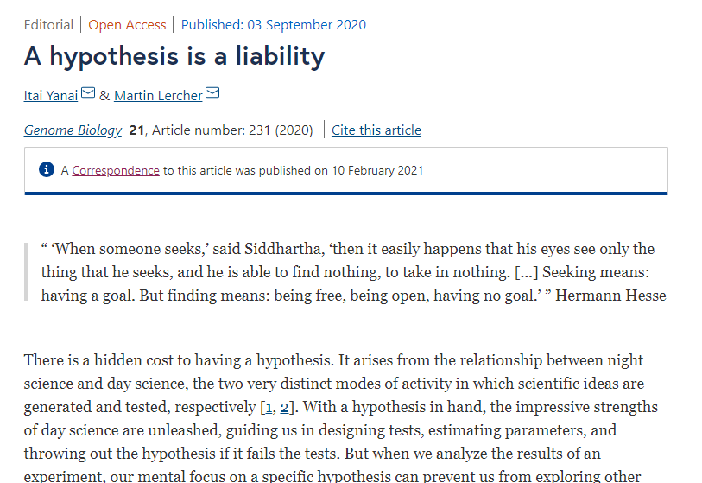
A hypothesis is a liability

Slide 4
Two groups of students
Hypothesis driven:
(i) that there is a statistically significant difference in the average number of steps taken by men and women,
(ii) that there is a negative correlation between the number of steps and the BMI for women, and
(iii) that this correlation is positive for men
Hypothesis free:
What do you conclude from the dataset?

Slide 5
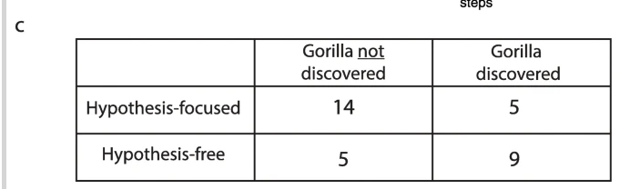

Slide 6
Breakout Discussion Questions
EDA is often framed as “hypothesis-free” or “theory-free” in the sense that it searches for patterns in the data without apriori hypothesis. Some philosophers of science have questioned whether “theory-free” observations are possible in principle. Do you think that there is such a thing as “theory-free” observations? Why? Why not?
Behrens (1997) describes the practice of “covert EDA” in which researchers are using confirmatory tools to explore the data. Why is this a problem? Provide specific examples in which covert EDA posed as CDA might cause invalid conclusions.

