Slide 1
Data Science for Psychologists
Ven Popov, PhD
Week 7, Mixed-effects models
13/4/2021

Slide 2
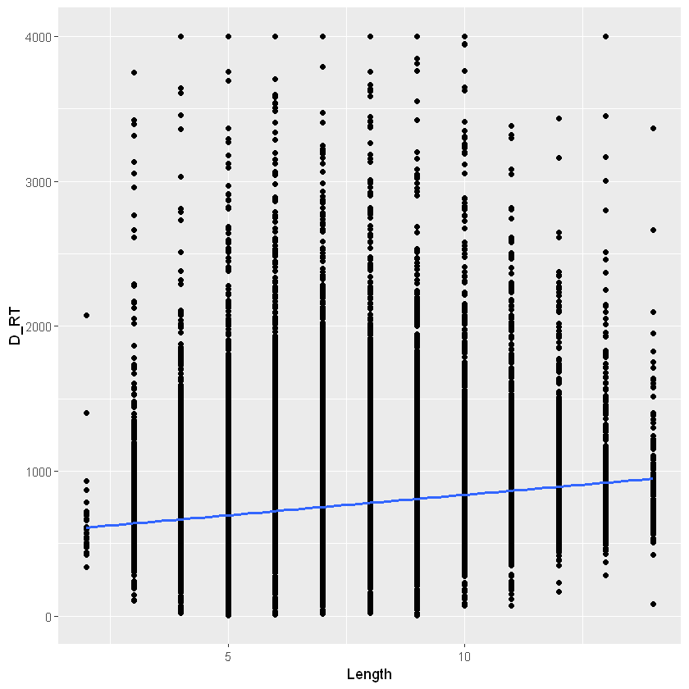
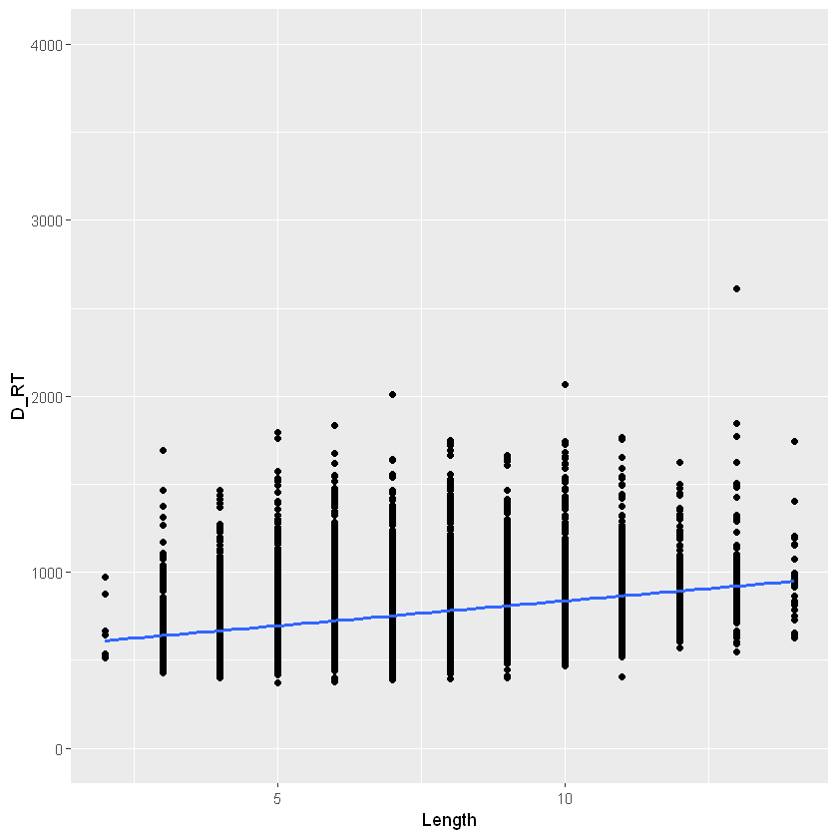
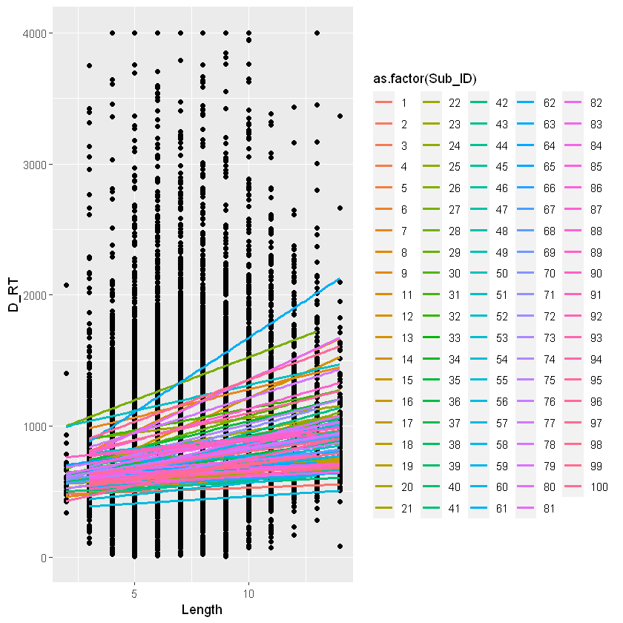

Mixed effects regression
3 approaches to analyze repeated measures data:
Pooled regression: $Y=β_{0}+β_{1}X_{1}+ε$
$$D_RT=β_{0}+β_{1}∗word_length+ε$$
Summarize/collapse data across participants or items
$$by_item_mean(D_{RT})=β_{0}+β_{1}∗word_length+ε$$
Mixed effects regression: $Y_{i}=β_{0i}+β_{1i}X_{1}+ε$
$$D_RT=β_{0i}+β_{1i}∗word_length+ε$$

Slide 3
Breakout Discussion Questions
Psychologists often “commit the fallacy of treating stimuli as fixed rather than random.” (p.2). What is the consequence? And how influential is this in terms of the conclusions we draw? Does this change our conclusions into one or the other direction, i.e. do we tend to over- or underestimate associations because of this?
Did you find the data simulation approach useful for understanding mixed-effects models? What benefits\drawbacks does a data simulation approach have for understanding statistical techniques?

