Slide 1
Data Science for Psychologists
Ven Popov, PhD
Week 9, Cross-validation & Bootstrapping
04/5/2021

Slide 2
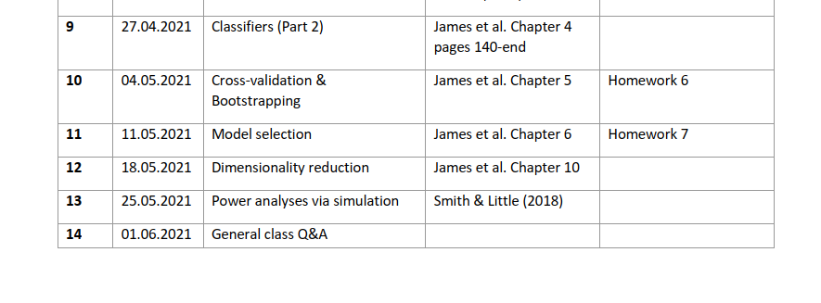
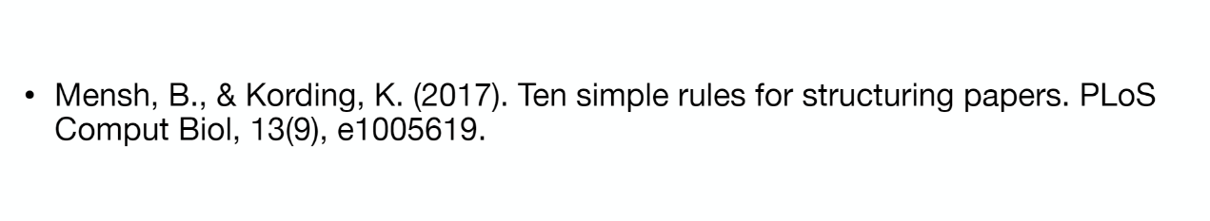
Final project
Due June 6:
Jupyter notebook
10 min prerecorded presentation
Example project on github
Reading for structuring papers

Slide 3
Final project
Requirements:
Description of data structure, project organization and data plan
Cleaning of data (or checking if data is clean)
Extensive data visualization
An appropriate method for analysis
Cross-validation & bootstrapping regardless of method

Slide 4
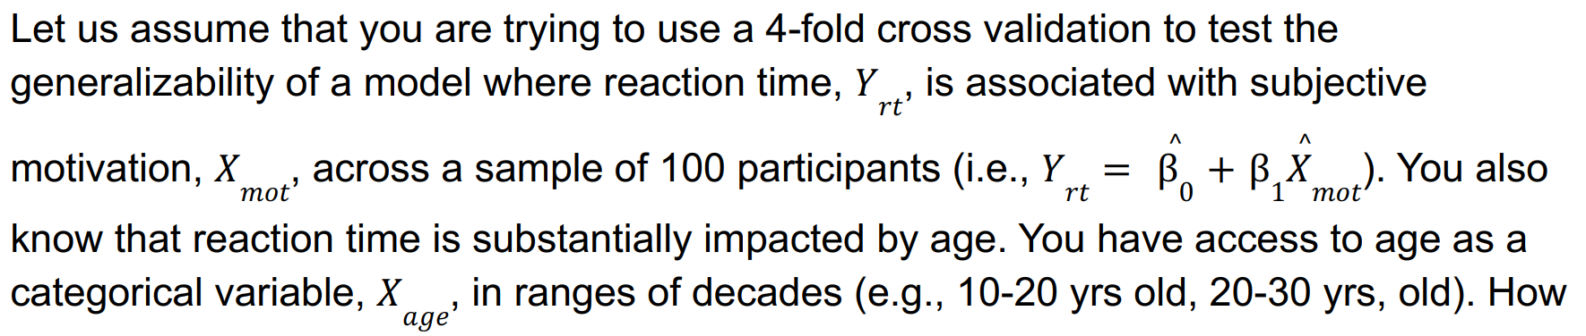
Breakout Discussion Questions
If you select the four folds at random, your 4-fold cross-validation results might be biased because you have not taken the influence of age on RTs into account.
Why and under what conditions would your cross-validation results be biased because of age influence on RTs?
What can you do to prevent the effect of age on RTs from biasing your cross-validation results?

