Slide 1
Data Science for Psychologists
Ven Popov, PhD
Week 4, Bias-Variance Trade-off
23/3/2021

Slide 2
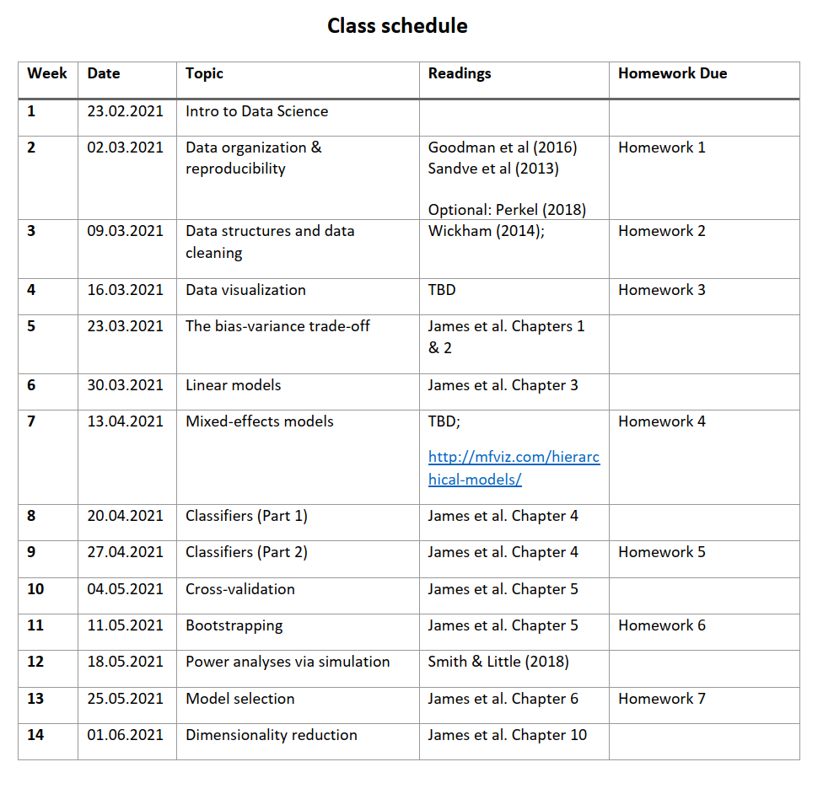

Slide 3
Throwback to class 1

Slide 4

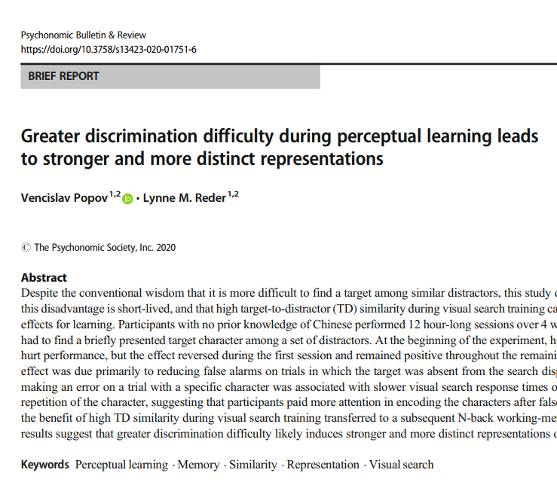
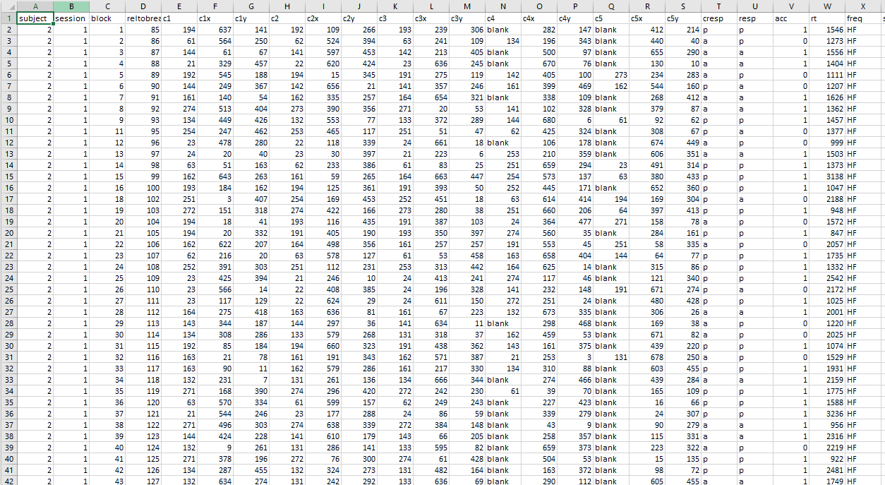
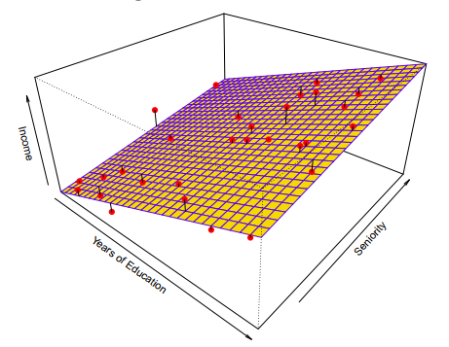



Data Science is like cooking

Slide 5
Data Science is like cooking
Numbers and data are meaningless on their own
There is no one “correct” recipe – multiple appropriate tools depending on type of data, goals of analysis, etc
Learning Data Science requires learning:
to recognize different data types and data problems (ingredients)
to know how to use various analytical tools (recipes)
to understand how your project goals (meals) determine the most appropriate tools for analysis

Slide 6


Data Science Chef vs Data Science Cook *
A cook
A chef
Knows how to apply a prespecified recipe to a fixed set of ingredients
Does not understand how or why the recipe works and cannot adapt it to novel problems
Cannot develop new recipes
Can be successful as long as they deal with repeating simple problems
Deeply understands different ingredients and recipes
Knows how and why different recipes work and can apply, adapt and extend them to novel problems
Can develop new recipes to deal with novel problems, or to better solve existing problems
Has a broad toolkit that allows them to address a variety of different problems and questions
* Analogy borrowed from Brandon Sanderson who uses these terms to describe the difference between novice and expert writers

Slide 7
Learning goals for the class
Become Data Science Chefs
understand and practice proper data organization, archiving and cleansing
learn how to create reproducible data processing workflows
learn how to use extensive visualization techniques in order to gain a deeper understanding of your data
understand the difference between inference and prediction, between regression and classification problems, and learn how to select the proper statistical tools for each
understand model overfitting and how to avoid it

Slide 8
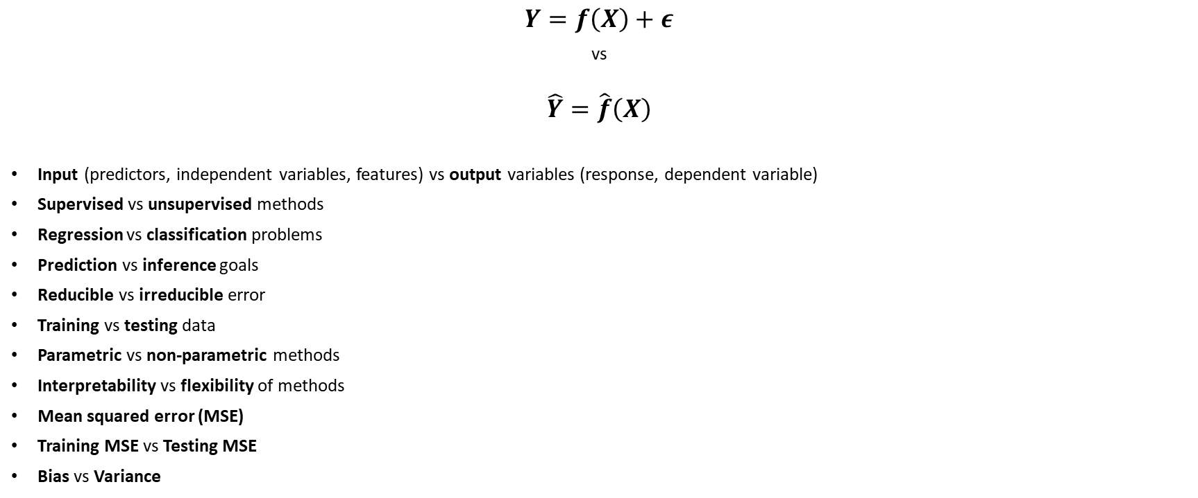
James et al, Chapters 1 & 2: Key concepts
$$Y=f\left(X\right)+ε$$
vs
$$\hat{Y}=\hat{f}\left(X\right)$$
Input (predictors, independent variables, features) vs output variables (response, dependent variable)
Supervised vs unsupervised methods
Regression vs classification problems
Prediction vs inference goals
Reducible vs irreducible error
Training vs testing data
Parametric vs non-parametric methods
Interpretability vs flexibility of methods
Mean squared error (MSE)
Training MSE vs Testing MSE
Bias vs Variance

Slide 9
Breakout Discussion Questions
Can you come up with some examples of (hypothetical or real) studies putting too much focus on either low bias or low variance and explain why this might lead to a bad outcome?
In psychology, which are more common, prediction or inference problems? Why do you think that is the case? Discuss in terms of the major advantages and disadvantages of each

