Slide 1
Data Science for Psychologists
Ven Popov, PhD
Week 6, Linear Model
30/3/2021

Slide 2

Final project proposal due

Slide 3


Slide 4
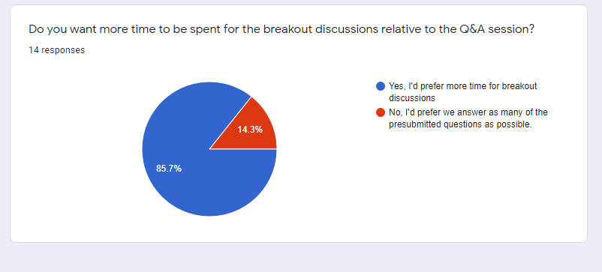

Slide 5
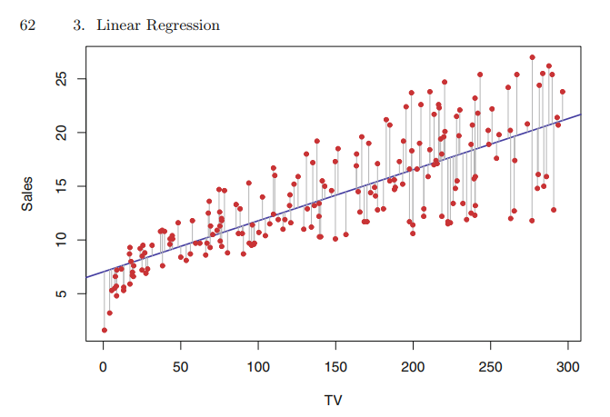

James et al, Chapter 3 (Linear regression): Key concepts
$$Y=f\left(X\right)+ε$$
vs
$$\hat{Y}=β_{0}+β_{1}X_{1}+ε$$

Slide 6
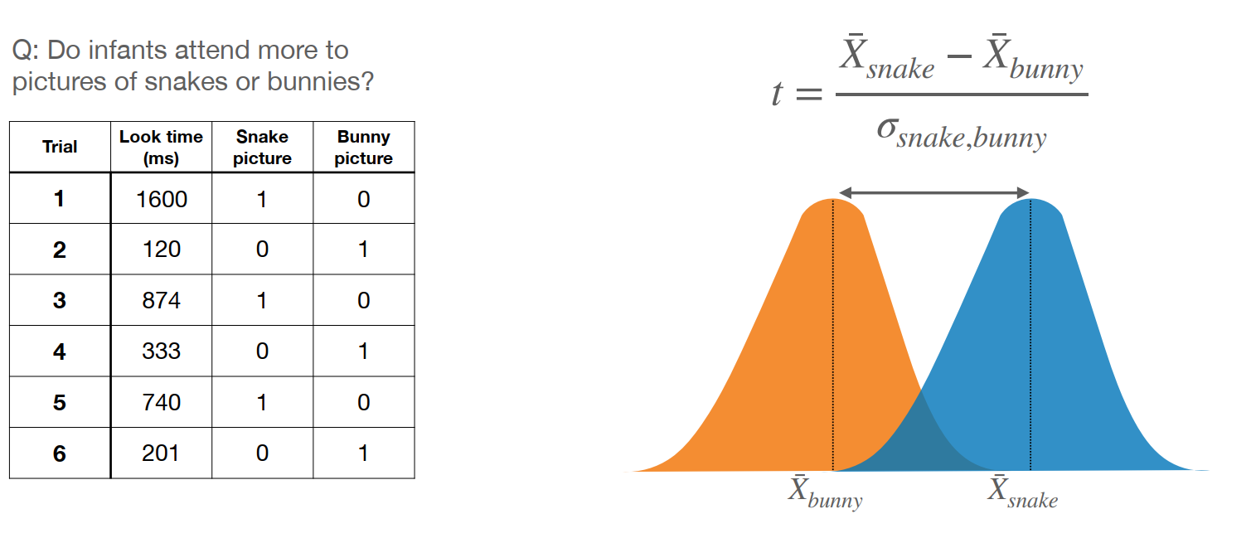
Relationship to the T-test and ANOVA
(Verstynen, 2021 - https://github.com/CoAxLab/DataSciencePsychNeuro/blob/master/Slides/09%20-%20Linear%20models.pdf)

Slide 7
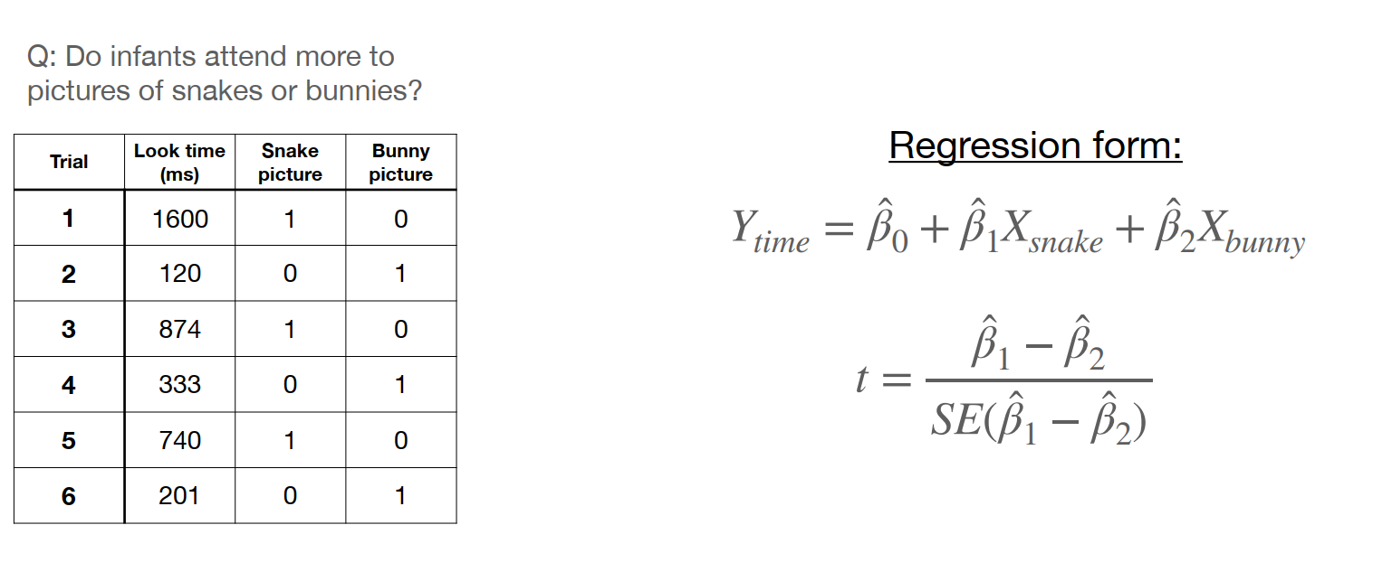
Relationship to the T-test and ANOVA
(Verstynen, 2021 - https://github.com/CoAxLab/DataSciencePsychNeuro/blob/master/Slides/09%20-%20Linear%20models.pdf)

Slide 8
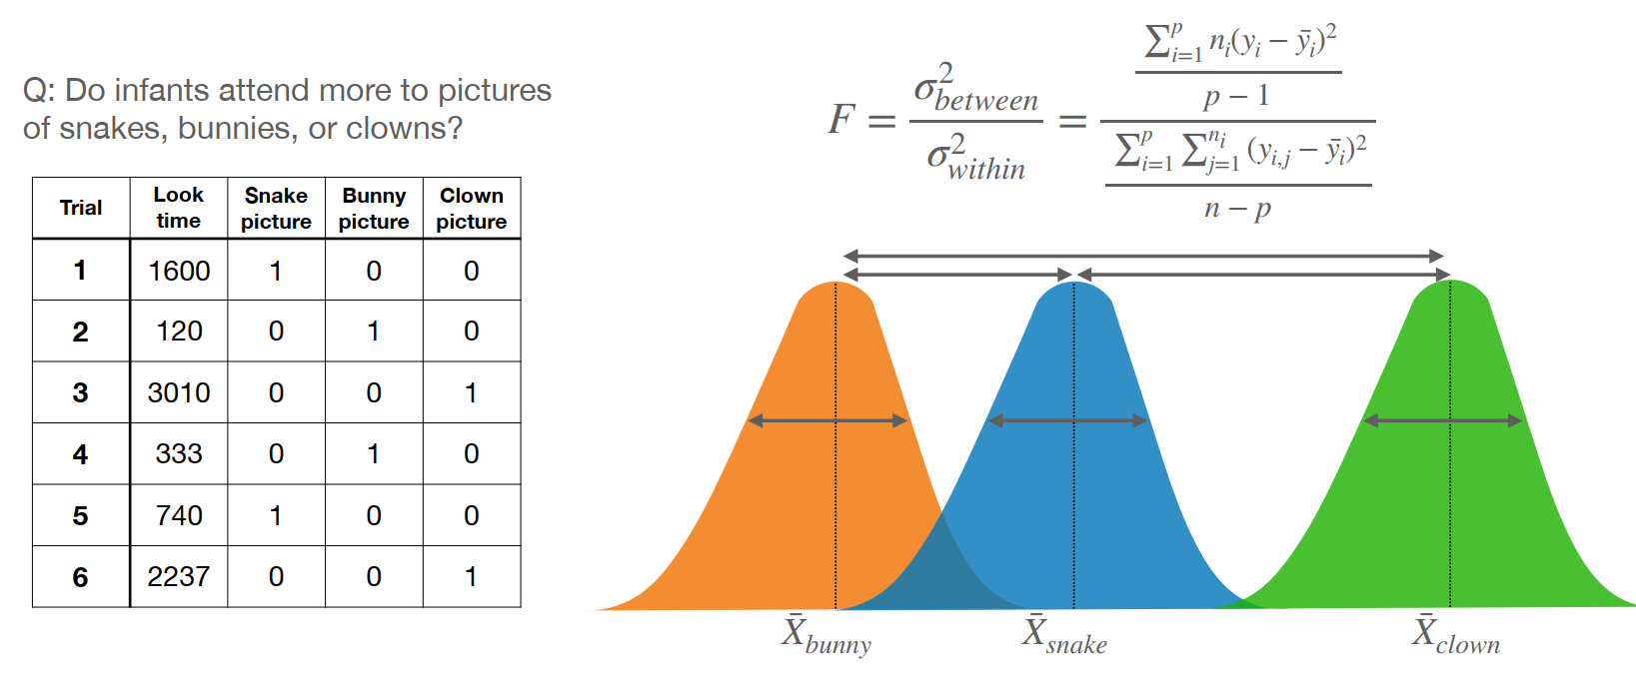
Relationship to the T-test and ANOVA
(Verstynen, 2021 - https://github.com/CoAxLab/DataSciencePsychNeuro/blob/master/Slides/09%20-%20Linear%20models.pdf)

Slide 9
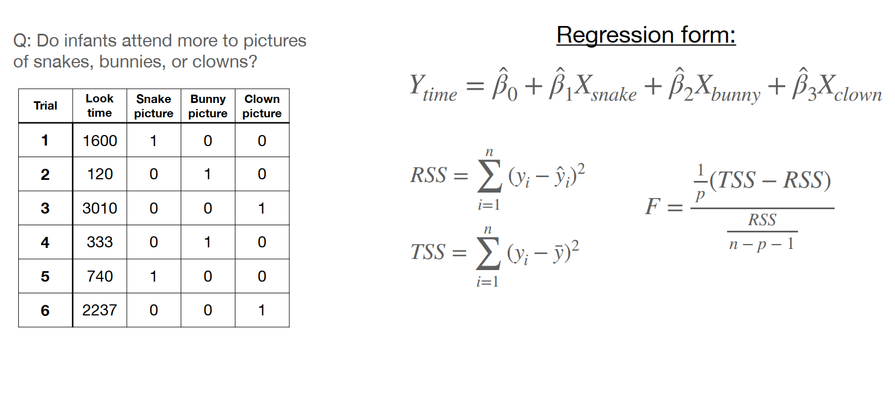
Relationship to the T-test and ANOVA
(Verstynen, 2021 - https://github.com/CoAxLab/DataSciencePsychNeuro/blob/master/Slides/09%20-%20Linear%20models.pdf)

Slide 10
Breakout Discussion Questions
On p. 65 the book says that the least squares line is an “unbiased” estimator of the true population regression line. To make this concept clear, it makes the analogy that the mean of a random sample is an “unbiased” estimate of the population mean. What is meant by “unbiased” in these cases? Can you think of a situation in which the sample mean or the least square regression coefficients would be biased, in other words, will either underestimate or overestimate the population parameters?
In physics R^2 values are usually close to 1, but in psychology they are much lower. Why is the unexplained variance much higher in psychological measurements? Is that a fundamental and unsolvable problem in psychology? What would it be necessary to achieve an R^2 close to 1 for a psychological model?

