Slide 1
Is the primacy effect caused by resource depletion?
Ven Popov

Slide 2
Resource depletion and recovery theory
Popov & Reder (2020), Psych Review
Encoding information in memory depletes a limited resource by proportion p
Resource recovers gradually over time

Slide 3
Resource depletion and recovery theory
Motivated by:
Word frequency list-composition effects in LTM and WM (Ward et al., 2003; Miller & Roodenrys., 2012)
Interaction between word-frequency and presentation rate (Popov et al., 2021, JEP:LMC)
Interaction between word-frequency and serial position
Supported predictions:
Proactive benefits of Word Frequency (Popov & Reder, 2020, Psych Review)
Proactive benefits of Forget cues (Popov et al., 2019, Psych Science)
Decline of performance over trials in a block (Popov et al., 2021, JEP:LMC)
Proactive benefits of Free Time (Mizrak & Oberauer, 2021, Psych Science)
Interaction between proactive benefits of WF and free time (Popov et al., Under revision)
Interaction between primacy effects and free time (Oberauer, in prep?)
Consistent with:
Proactive benefits of semantic similarity (Kowialewski et al., 2020, JML)
Better LTM for people with more WM capacity
Primacy effects

Slide 4
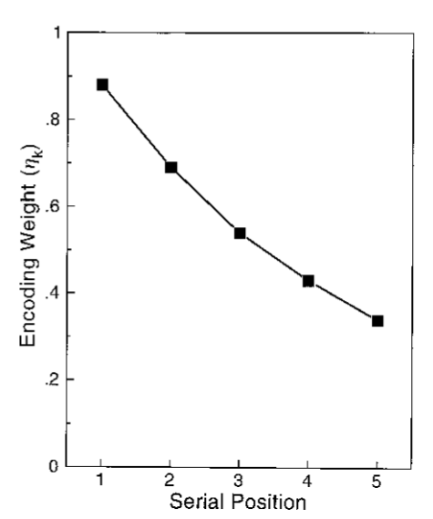
Primacy effects
Most common explanation – attentional gradient (for a review, see Oberauer, 2003)
Less attention is dedicated to each additional item
(e.g. Brown, Preece, & Hulme, 2000; Farrell & Lewandowsky, 2002; Lewandowsky & Murdock, 1989; Page & Norris, 1998)
Farrel & Lewandowsky (2002)

Slide 5
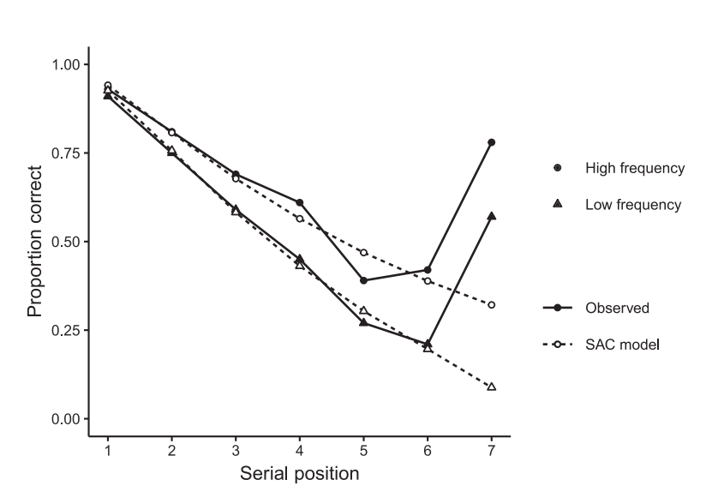
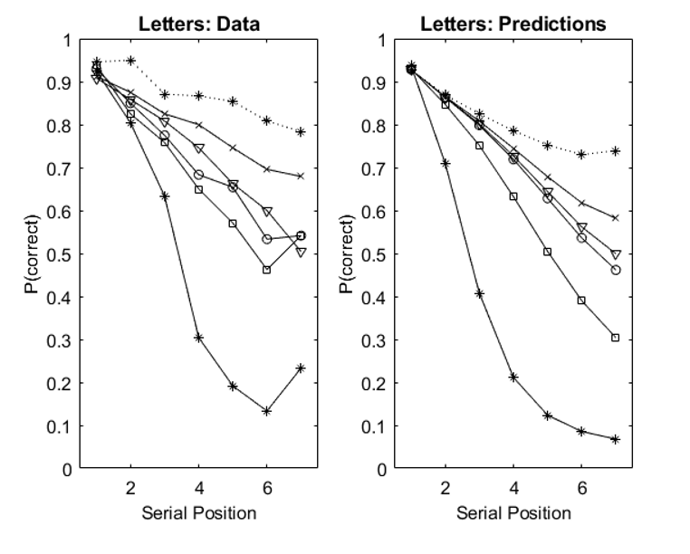
Primacy effects – resource depletion
Oberauer (from 2021 retreat slides)
Popov & Reder (2020)

Slide 6
Resource recovery
In Popov & Reder (2020)
Gradual recovery over time
No immediate recovery/release of resources if encoded information is no longer relevant
Prediction about primacy effects and list-wise directed forgetting

Slide 7
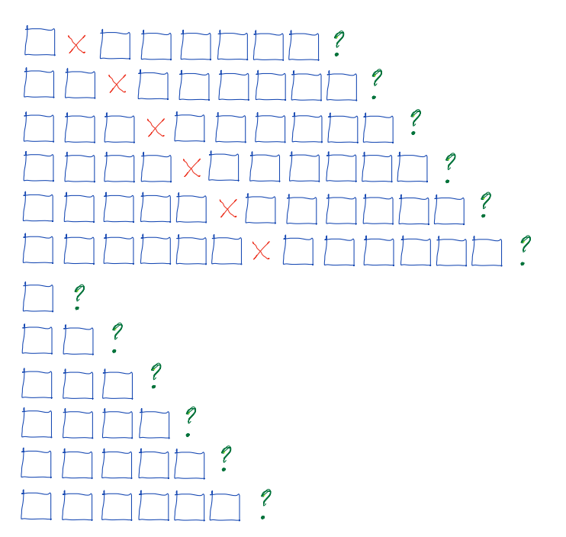

Slide 9
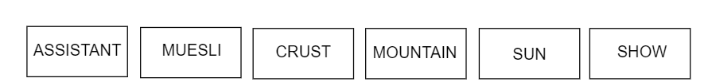
Exp 1 – immediate order reconstruction
Words presented sequentially in two parts with a reset cue between
Closed pool of items
2x6 within subject design
Number of items in part 1 (1-6)
Test after part 1 or part 2
48 trials, 95 participants (exp 1a) or 97 participants (exp 1b)
Timing
Item: 750 ms
ISI: 250 ms
Reset: 1000 ms (exp 1a) or 250 ms (exp 1b)
Encoding:
Test:

Slide 10
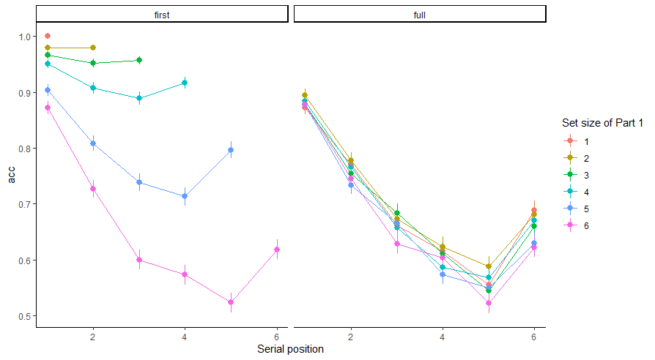
Results
Part 1
Part 2

Slide 11
Results
Part 1
Part 2

Slide 12
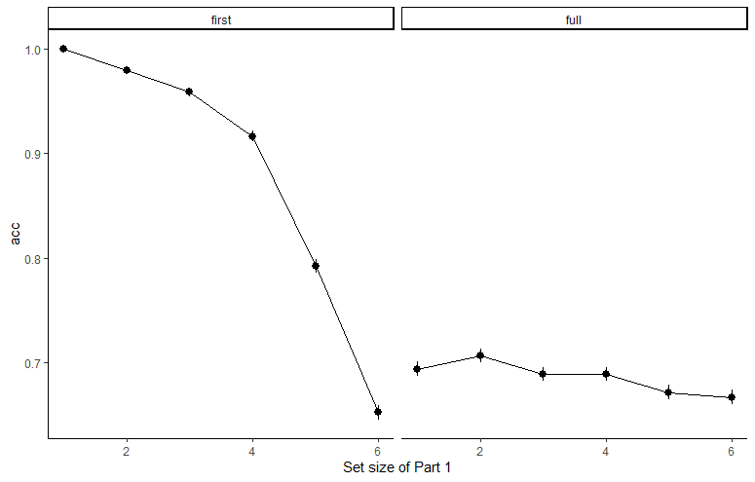
Part 1
Part 2
ml1 = acc ~ response_position + (setsize+response_position|id) + (1|correct_response)
ml2 = acc ~ response_position + setsize + (setsize+response_position|id) + (1|correct_response)
BF_{ml2} = 411354

Slide 13
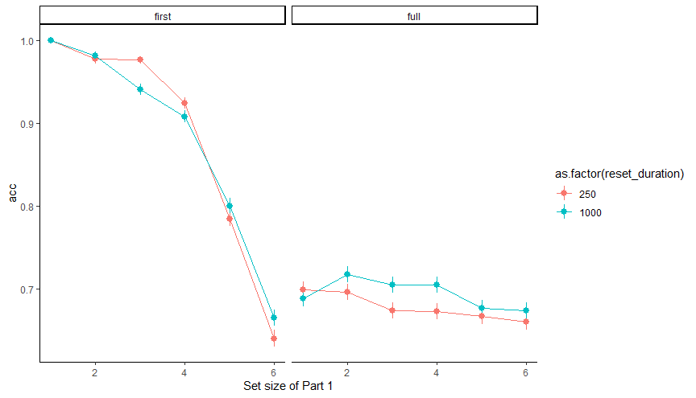
Part 1
Part 2

Slide 14
Exp 1 summary
A significant but small effect of Part 1 set size
~7 times smaller than the primacy effect
No interaction with reset cue duration
Input and output position are confounded

Slide 15
Exp 2
Oberauer (2003) dissociated input and output position by presenting items in random locations, then cueing locations in random order during recall
Same designs as E1, but:
Letters presented in 10 different boxes
Cue by random box, type letter
Set size reduced to 5
60 trials, N=91 participants
Reset duration = 250 ms

Slide 16

B
?
S
M
T
K

Slide 17
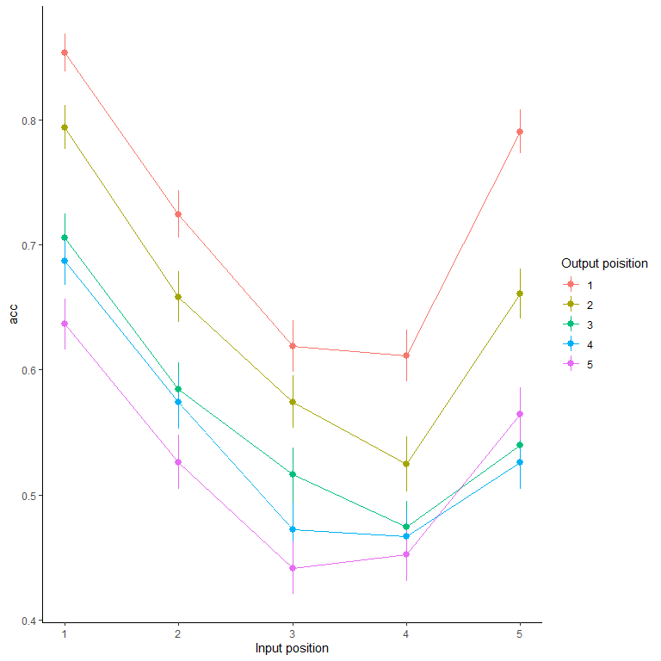

Slide 18
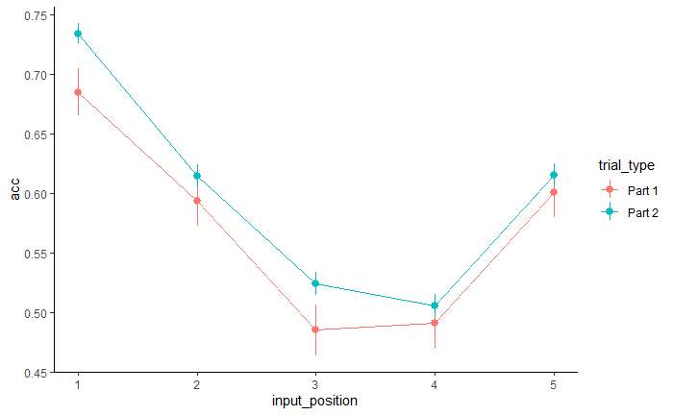

Slide 19
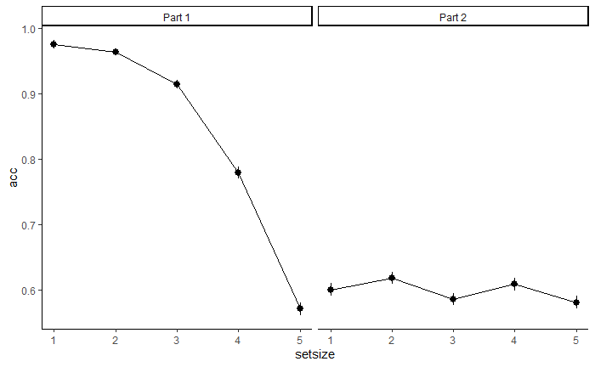

Slide 20
Exp 2
Exp 1

Slide 21
Summary
Small and difficult to detect effect of preceding set size
If it exists, it is several times smaller than the primacy effect
Conclusions
Either primacy is NOT caused by the depletion of a resource
OR
The resource can be released immediately when a reset/forget cue is presented
Consistent with assumptions in Klaus’s new version of the binding pool model

