Slide 1

MASAKU • KENYA • 2026
VENQUERESTARTUP
Empowering small businesses in Africa with smart financial tools.
Venquere Sunday — Founder

Slide 2


PROBLEM — KENYA SME REALITY
78%↑
Cash-based businesses rely on memory and torn notebooks. No digital financial records to prove performance.
₿
!
No affordable tools. QuickBooks is $20/mo and complex. Excel is manual, not mobile, no Swahili.
of SMEs in Kenya fail to track daily expenses and collapse within 2 years.
×
Leads to poor decisions, loan rejections by SACCOs & banks, overstocking, and business failure.
◐
Hustlers work hard but stay blind. Mama mboga doesn't know if she made KES 200 or lost KES 100 today.
Cash-based hustles have no records. No records → no loans, no growth, no clarity.

Slide 3



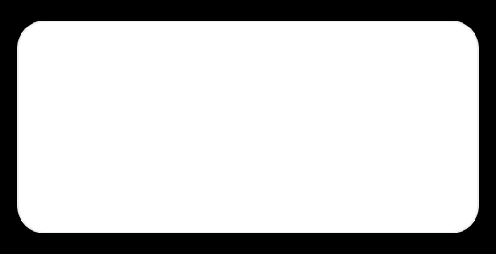
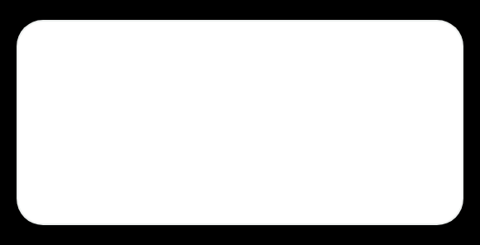

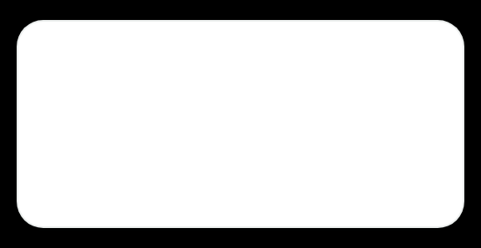
SOLUTION — VENQUERE ECOSYSTEM
Lightweight, mobile-first tools built for the hustle, not Silicon Valley.
◫
Budget Tracker — 2 taps to record
Income vs Expenses dashboard. Add sale, stock, rent in seconds. Works with 2G.
A
◐
Swahili, English & Sheng
Offline-first
"Leo umetumia mingi kwa stock" — insights they trust.
Bila bundles. Sync later. Built for low connectivity.
$
Affordable
Mama mboga to shop owner. Free start, KES 299 Pro.
Masaku market • Live user

Slide 4






PRODUCT — BUDGET TRACKER
Clean dashboard that mama mboga gets in 5 seconds.
◫
Income vs Expenses at a glance
Donut + bar + trend on one screen. No clutter, no accounting jargon.
+
Add transaction in 2 taps
Chap chap: Stock, Rent, Transport, Sales. Even with kiosk gloves on.
≡
Weekly reports + savings goals
"Uko 80% ya goal yako!" Smart nudges in Swahili/Sheng, not English only.
✦
Built with VENQUERE gold standard
Ornate trust, simple UX. Feels premium, works for low-literacy users.
Offline-first
M-Pesa ready
Swahili + Sheng
Today's Profit — Soko Mjinga
KES 850 ▲ 12%

Slide 5


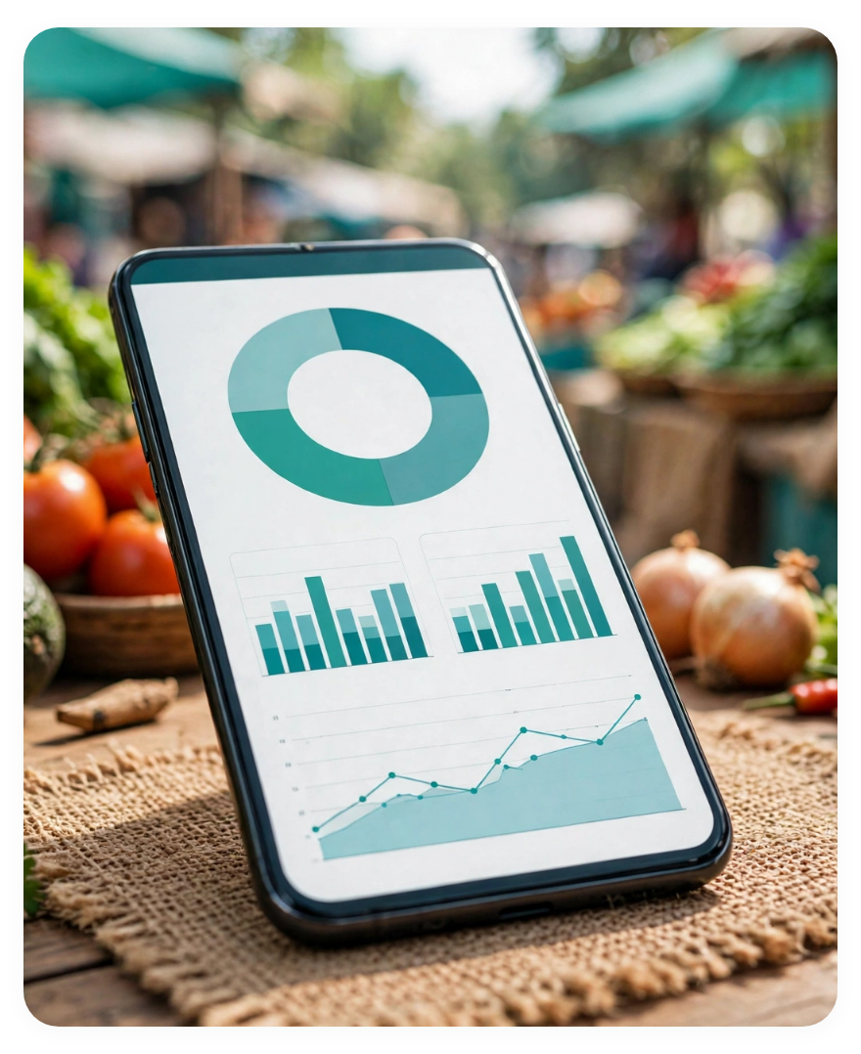





MARKET OPPORTUNITY — TAM SAM SOM
Massive market hiding in plain sight
40M+ SMEs in East Africa run on memory. Venquere turns memory into money clarity.
$12B
$850M
TAM — AFRICAN SME FINANCIAL MANAGEMENT
SAM — KENYA & EAST AFRICA
All small businesses needing simple budgeting, reporting & savings tools across continent.
Kenya, TZ, UG, RW focused: mobile-first micro-businesses with M-Pesa usage.
● Pan-African long term
● 3-year expansion
$15M
40M+
SOM — MASAKU, NAIROBI, MOMBASA
SMES NEED THIS NOW
Initial wedge: 120K micro-retailers, open-air market traders, boda boda shops. Capturable in 18 months.
No offline, no Swahili alternative exists. QuickBooks too complex, Excel not mobile.
◍ Beachhead: 3 counties
Product in the field — designed for mama mboga's table
Clean charts on cheap Androids, sitting between tomatoes & onions. Built for real market light.

Slide 6

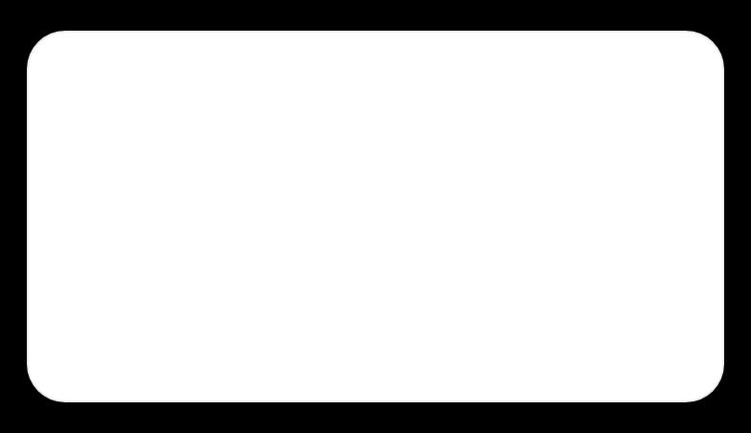




BUSINESS MODEL
How we make money — built for KES, not dollars
Freemium that respects hustlers. Start free, grow to Pro when you see value. Low burn, high retention.
FREE
PRO — MOST POPULAR
92% want this
BUSINESS
KES 0 / mo
KES 299 / mo
KES 999 / mo
Up to 100 transactions
Unlimited transactions & backup
Multi-user + staff accounts
Basic income vs expenses
Weekly reports + savings goals
Inventory + M-Pesa API auto-sync
Swahili & English
Offline-first, M-Pesa ready
Priority WhatsApp support
↗
Future: Financial literacy courses — paid Swahili video lessons, KES 499 per course, 70% margin.
$
Future: Loan referrals — partner with SACCOs & Branch, earn 3-5% referral on approved loans.

Slide 7











TRACTION — PLP VALIDATED
From idea to real users in Masaku markets
Brand system finalized
50+
92%
VENQUERE gold identity, VS crest, color & type ready for app
INTERVIEWS IN MASAKU
WILL PAY FOR PRO
Mama mboga to shop owners
KES 299/mo validated
Pain confirmed: manual books, no M-Pesa tracking, loan rejected.
Prototype tested with 15 users. 14 said "nitalipa" — high intent.
LOGO DONE
PLP COMPLETE
PLP Milestone journey
WEEK 1-6
1
2
3
Discover
Design
Validate
50 interviews, problem defined
Gold brand + prototype built
92% pay signal, PLP done
15 users
Prototype tested live
Budget Tracker demo on table in Masaku — real feedback loop.

Slide 8





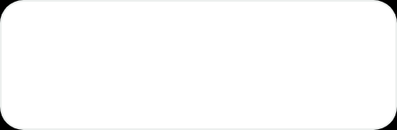
GO-TO-MARKET PLAN
Start hyperlocal in Masaku, scale across Kenya.
1
Masaku markets — direct onboarding
Walk the stalls with phone demos. 50 mama mboga/week. Trust beats ads.
2
WhatsApp groups + Chamas
Partner with existing savings groups. Group admin = evangelist. 70% in chamas.
3
PLP community & campus ambassadors
Power Learn alumni in 3 counties. Student interns to teach finance.
4
Referral: Free month for 3 invites
Viral loop. KES 0 CAC after first 500. Community-driven growth.
5
YouTube & TikTok in Swahili / Sheng
"Jinsi ya kutrack stock kwa simu" — 2-min tutorials. Education = acquisition.
3
15k+
92%
COUNTIES Y1
WHATSAPP REACH
SHENG CONTENT WATCH
Channel #1: Offline
Channel #2: Community
Market days = demo days. One-to-one conversion 40% in pilot.
Chama leaders get Business plan free. Network effect built-in.

Slide 9







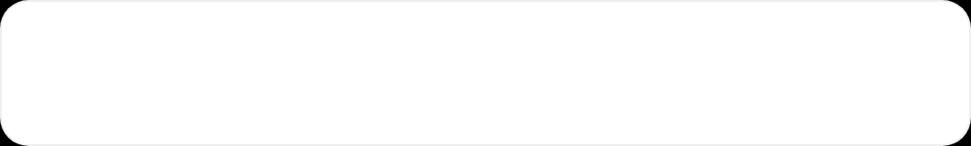


COMPETITION — WHY WE WIN
Others built for accountants. We built for hustlers.
Q
QuickBooks
Expensive
Venquere Advantage
Too complex, $20/mo, needs laptop + internet. Not for mama mboga.
GOLD STANDARD TRUST • LOCAL FIRST
E
Excel / Paper notebooks
Manual
Local
Simple
Manual, no insights, no backup, not mobile. Memory fails daily.
Swahili, English, Sheng insights made for Masaku markets
2 taps to add sale. 5-second dashboard. No training needed
L
Other local apps
Not local
No offline mode, English only, no M-Pesa link. Built in Nairobi office, not market.
Affordable
Offline-first
Free to start, KES 299 Pro. 1/10 price of QuickBooks
Bila bundles works. Syncs later. Built for 2G & low-data
M-Pesa API • Chama ready • Gold brand
Unfair advantage

Slide 10












THE TEAM BEHIND VENQUERE
Designers who live in the market, not just build for it.
Driven by real experience in Kenyan markets
VS
D
B
C
FOUNDER & PRODUCT DESIGNER
DEVELOPER
BUSINESS ADVISOR
COMMUNITY LEAD
Venquere Sunday
Mobile App Lead
PLP Mentor
SME Outreach — Eastern Kenya
Logo designer & branding expert. Gold system creator. From Masaku, understands hustle language.
Android offline-first build, M-Pesa API, backup. Lightweight APK for 2G.
Pricing, GTM, retention. Connects to SACCOs & fintech partners.
On-ground in Masaku, Machakos, Kitui markets. Speaks Swahili/Sheng, builds trust.
Brand owner • PLP
Leads product & vision
Offline + M-Pesa
Strategy & Finance
15k+ reach

Slide 11
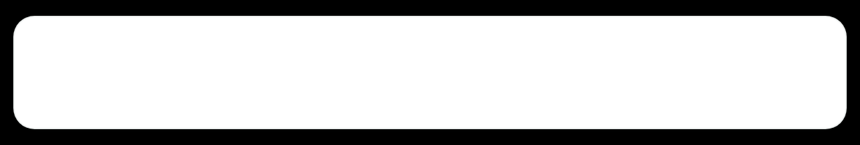



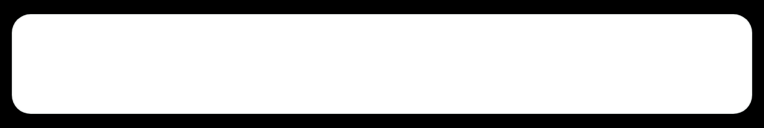








FINANCIAL PROJECTIONS — 3 YEARS
Path to KES 95M ARR with low burn
YEAR 1 — MASAKU WEDGE
2.8M
Why this is believable
Y1
5,000 users
800 Pro
16% conv
KES ARR
✓
Low burn, high retention. Offline-first = no server cost per user. M-Pesa sync only when needed.
✓
Scalable tech: Flutter + Firebase. One dev can support 50k users. No inventory.
YEAR 2 — 3 COUNTIES SCALE
21M
✓
Viral CAC: Referral 3 = free month. Chama groups = 15 users per onboarding.
Y2
30k users
6,000 Pro
20% conv
KES ARR
Unit economics — Pro plan
YEAR 3 — 100K HUSTLERS
ARPU / MO
CAC
PAYBACK
Y3
95M
KES 299
KES 120
< 1 mo
100k users
25k Pro + Biz
KES ARR
Based on 50 interviews & 15 prototype tests in Masaku. 92% willingness to pay at KES 299 validated.
KES 299
85%
2.1%
PRO PRICE
GROSS MARGIN
CHURN

Slide 12


OUR ASK — SEED ROUND
Raising KES 1.5M to bring clarity to 5,000 hustlers
KES 1.5M SEED 18 mo runway • Masaku → Nairobi → Mombasa
40%
Product Development
30%
Marketing & Acquisition
M-Pesa API auto-sync, offline backup, inventory module
3 counties launch, market demos, WhatsApp + chama partners
20%
Operations
10%
Legal & Registration
Community lead Eastern Kenya, PLP ambassadors, support
Business registration, data protection, contracts
Venquere Startup | Masaku, Kenya | venquere.startup@gmail.com | +254 7XX XXX XXX
Thank you! Let's build financial freedom — pamoja. ✦

