Slide 1
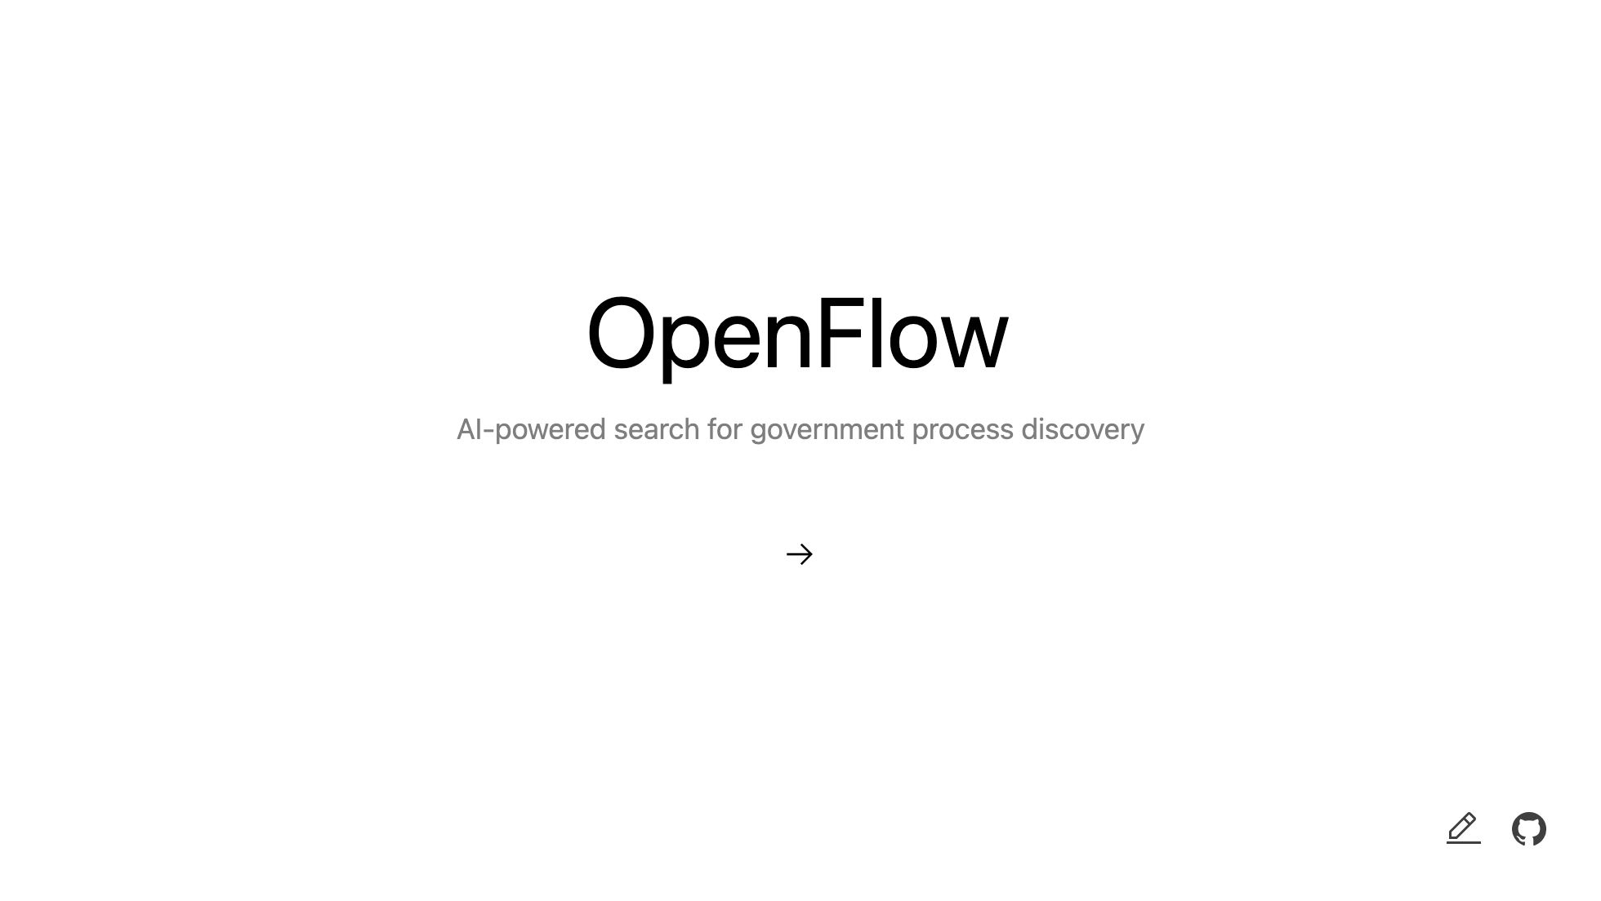

Slide 2

Notes:
- GOVTECH Hackathon Saarland 2025 - Team of 2 with Melanie - F13 Topic Area

Slide 3
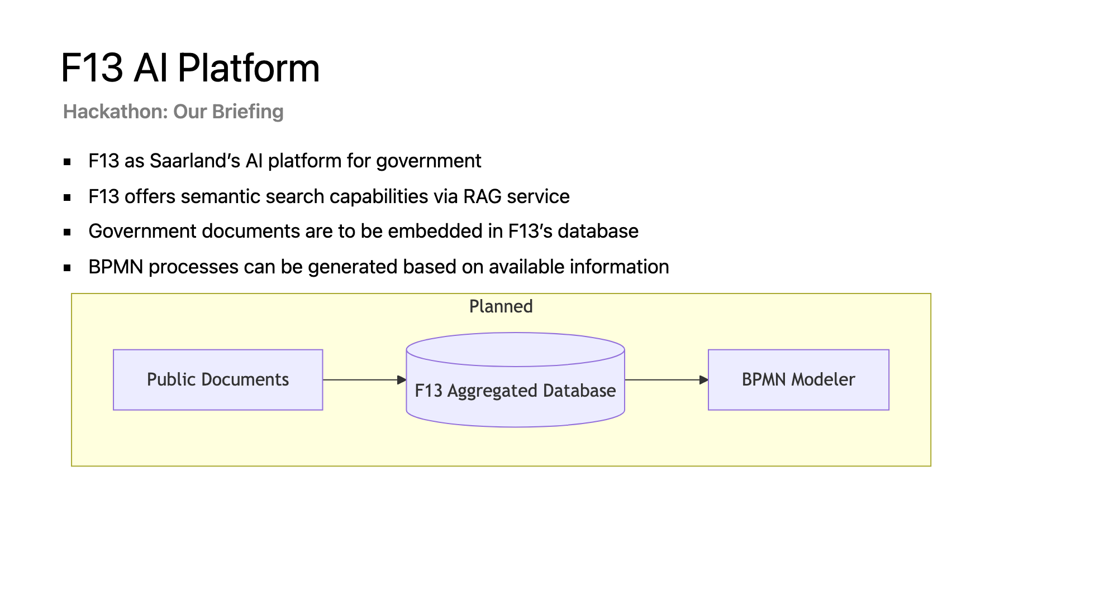
Notes:
- F13 provides RAG service and aggregated database - Government documents are embedded in F13 - BPMN Modeler is planned to generate process diagrams

Slide 4
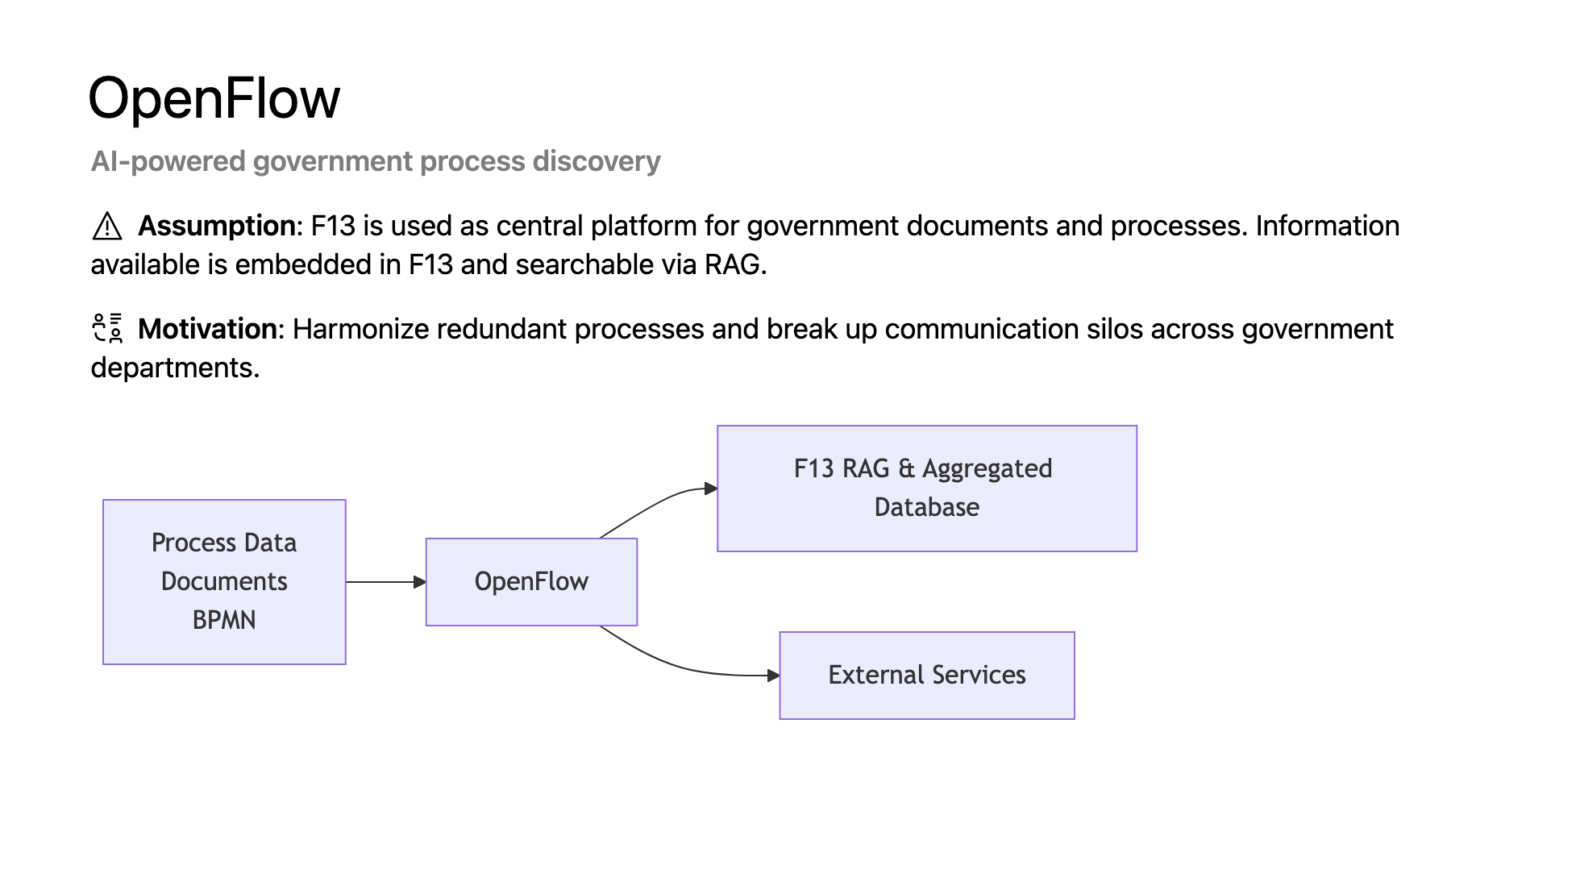
Notes:
- Idea: OpenFlow as central application for process discovery on top of F13 - Assumption: All government documents are embedded in F13 RAG - Goal: Streamline access to process information and improve collaboration

Slide 5
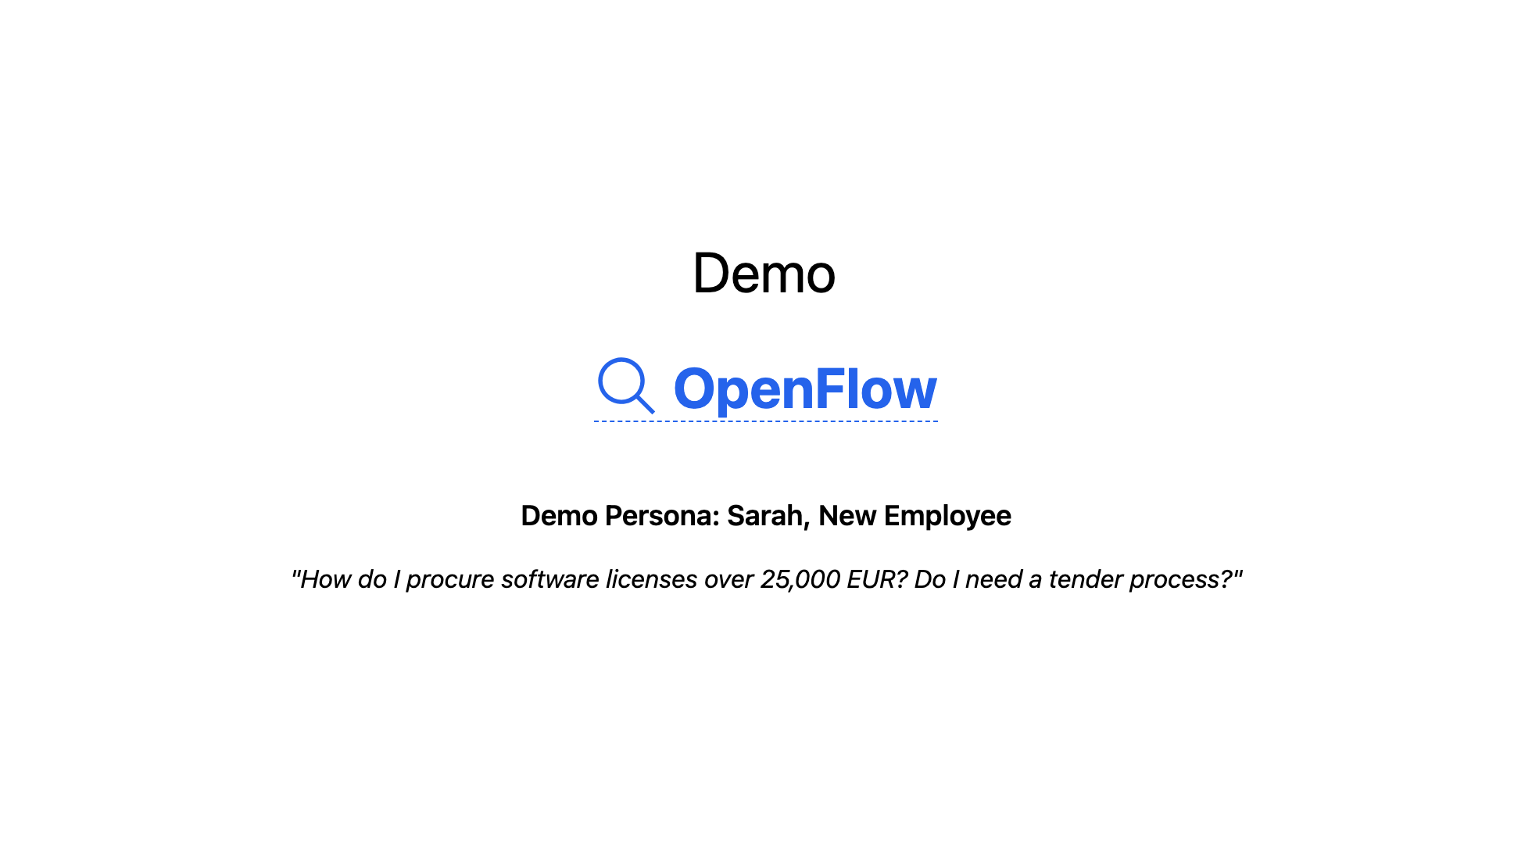
Notes:
- Sarah - New employee in a government department - Needs to procure software licenses > 25,000 EUR

Slide 6
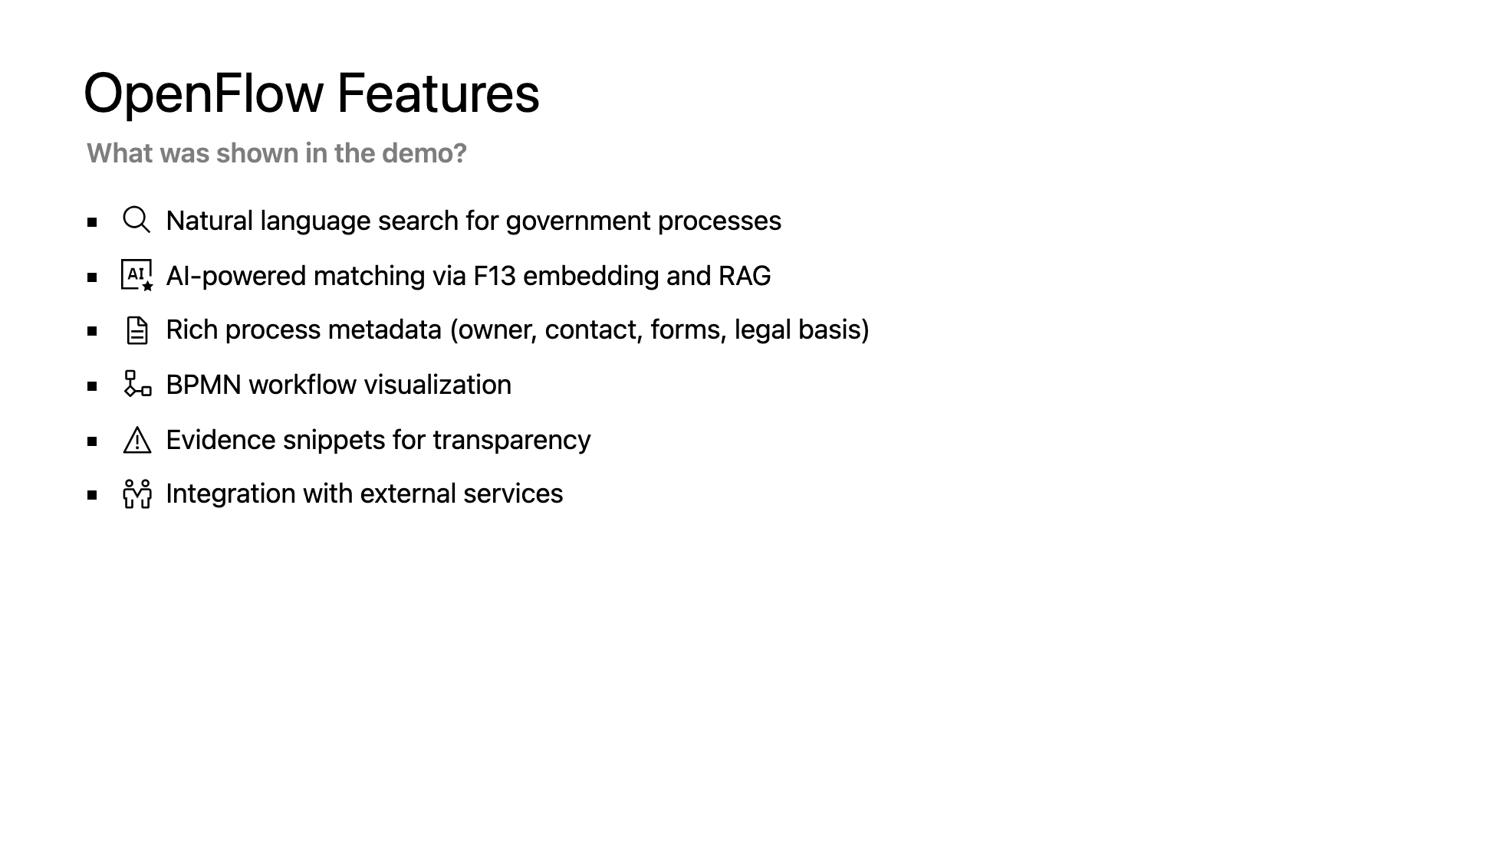
Notes:
OpenFlow provides matching processes with BPMN visualization, contacts, and evidence - Evidence for validation and transparency - Contact information for collaboration - Integration of external services (BPMN Modeler, Organigram)

Slide 7


Slide 8
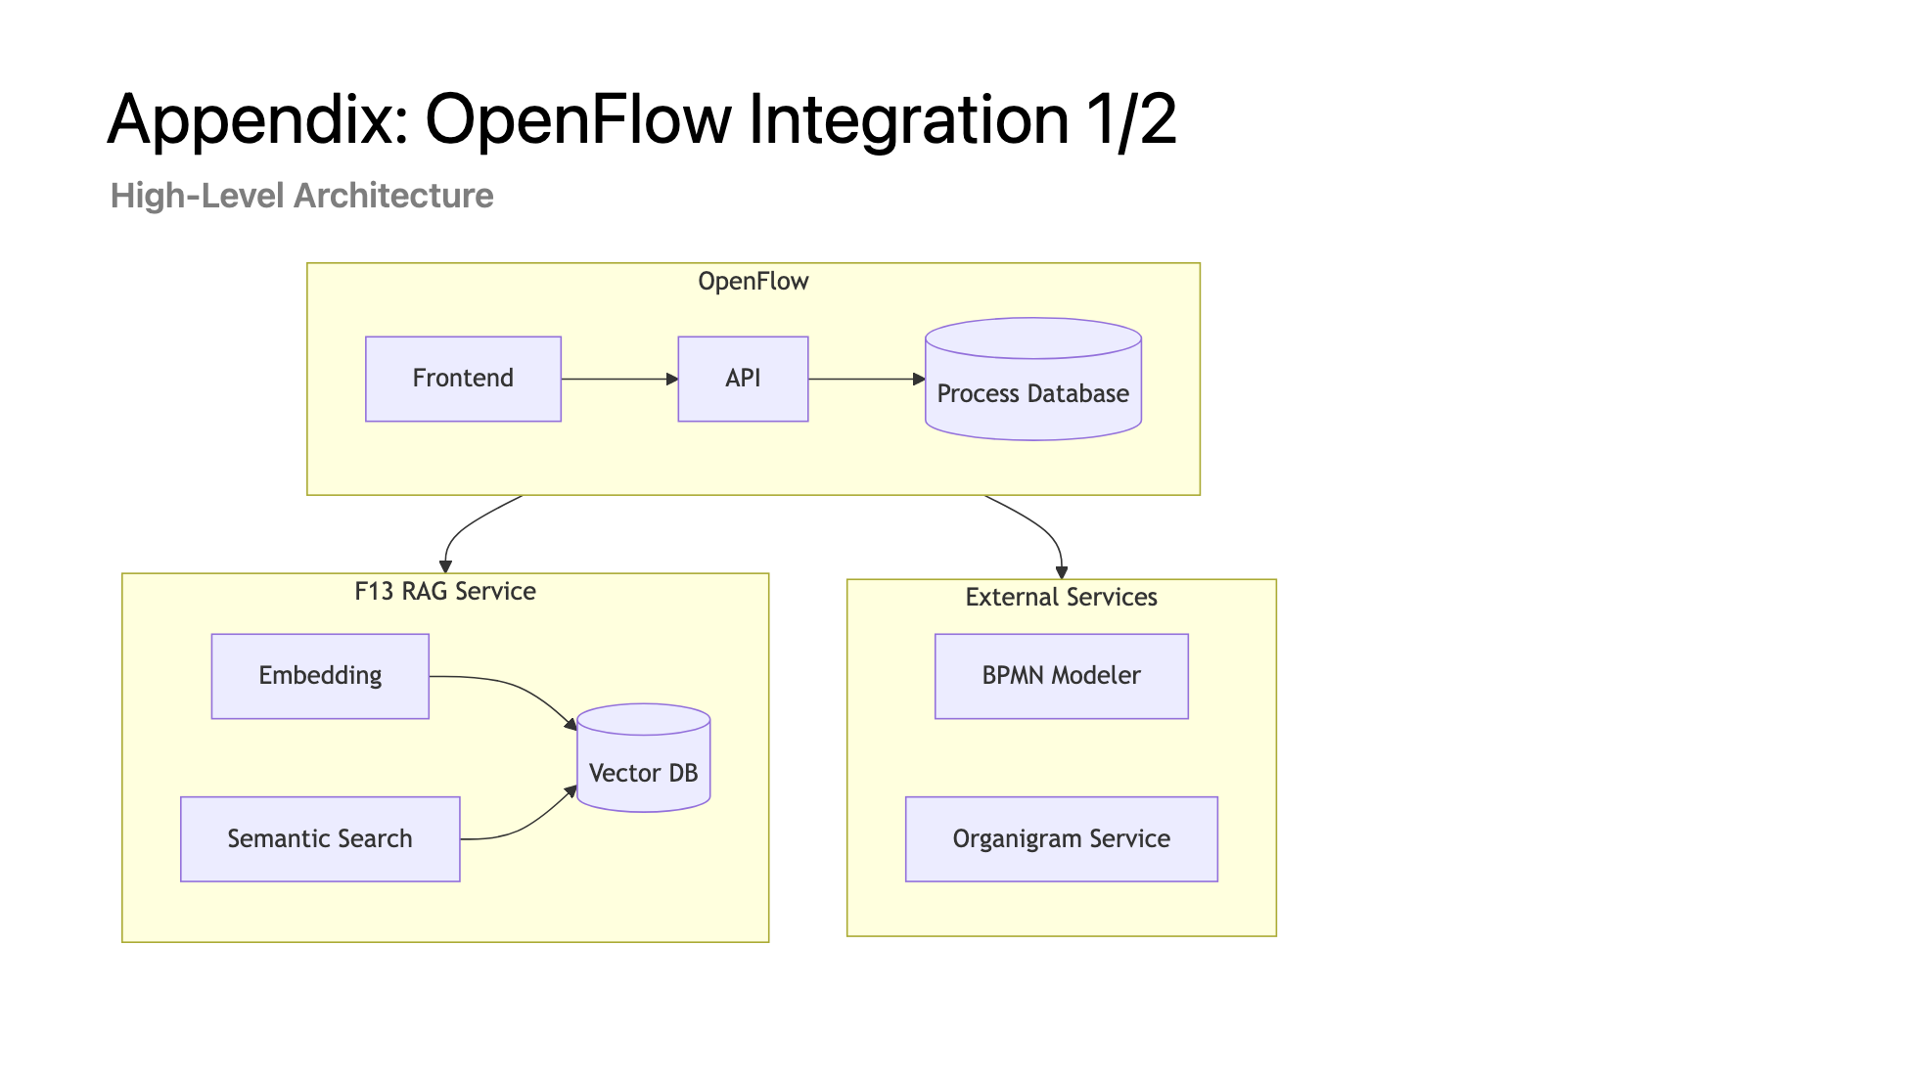
Notes:
Optional! High-level OpenFlow integration architecture

Slide 9
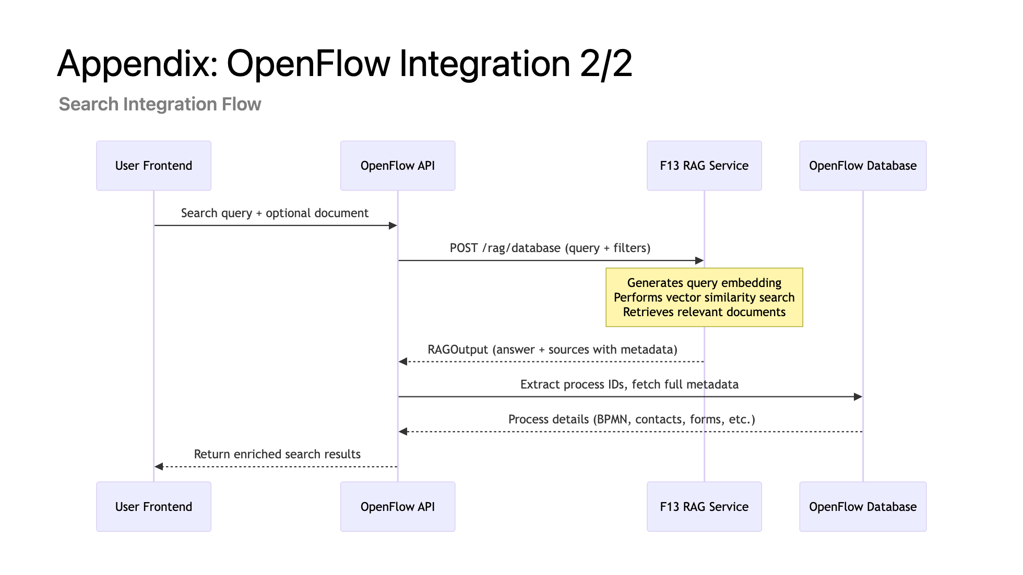
Notes:
Optional! Detailed sequence diagram of OpenFlow search integration with F13 RAG

