Slide 1
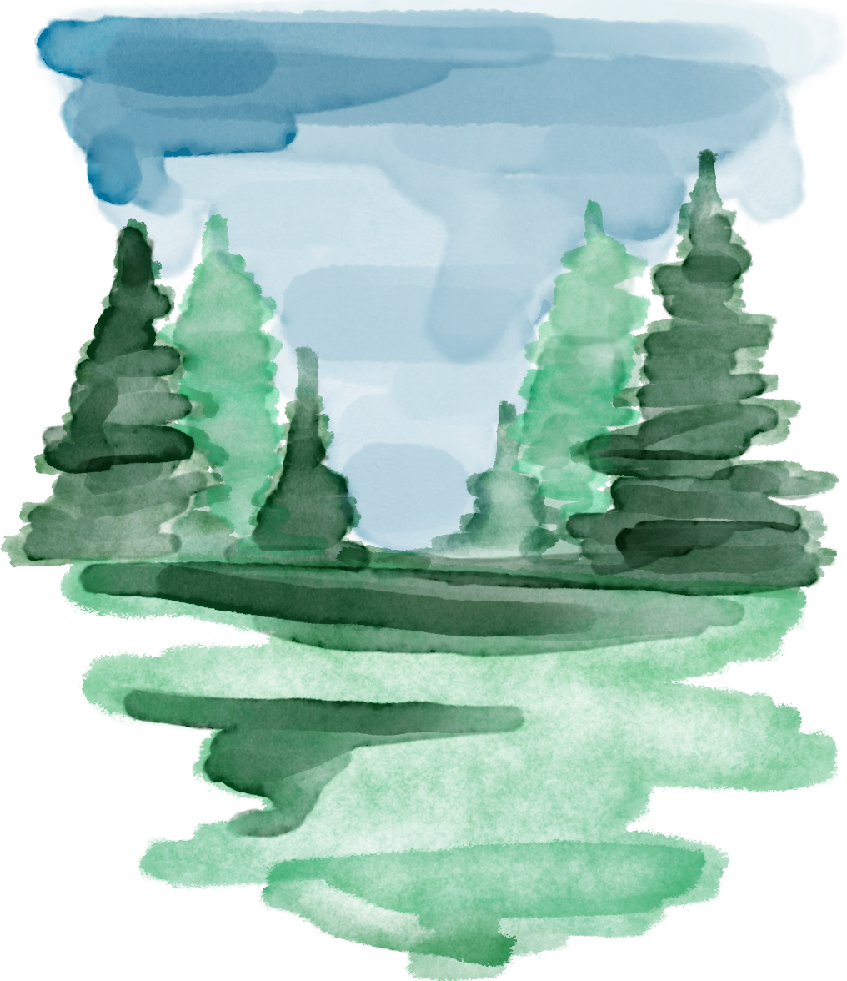

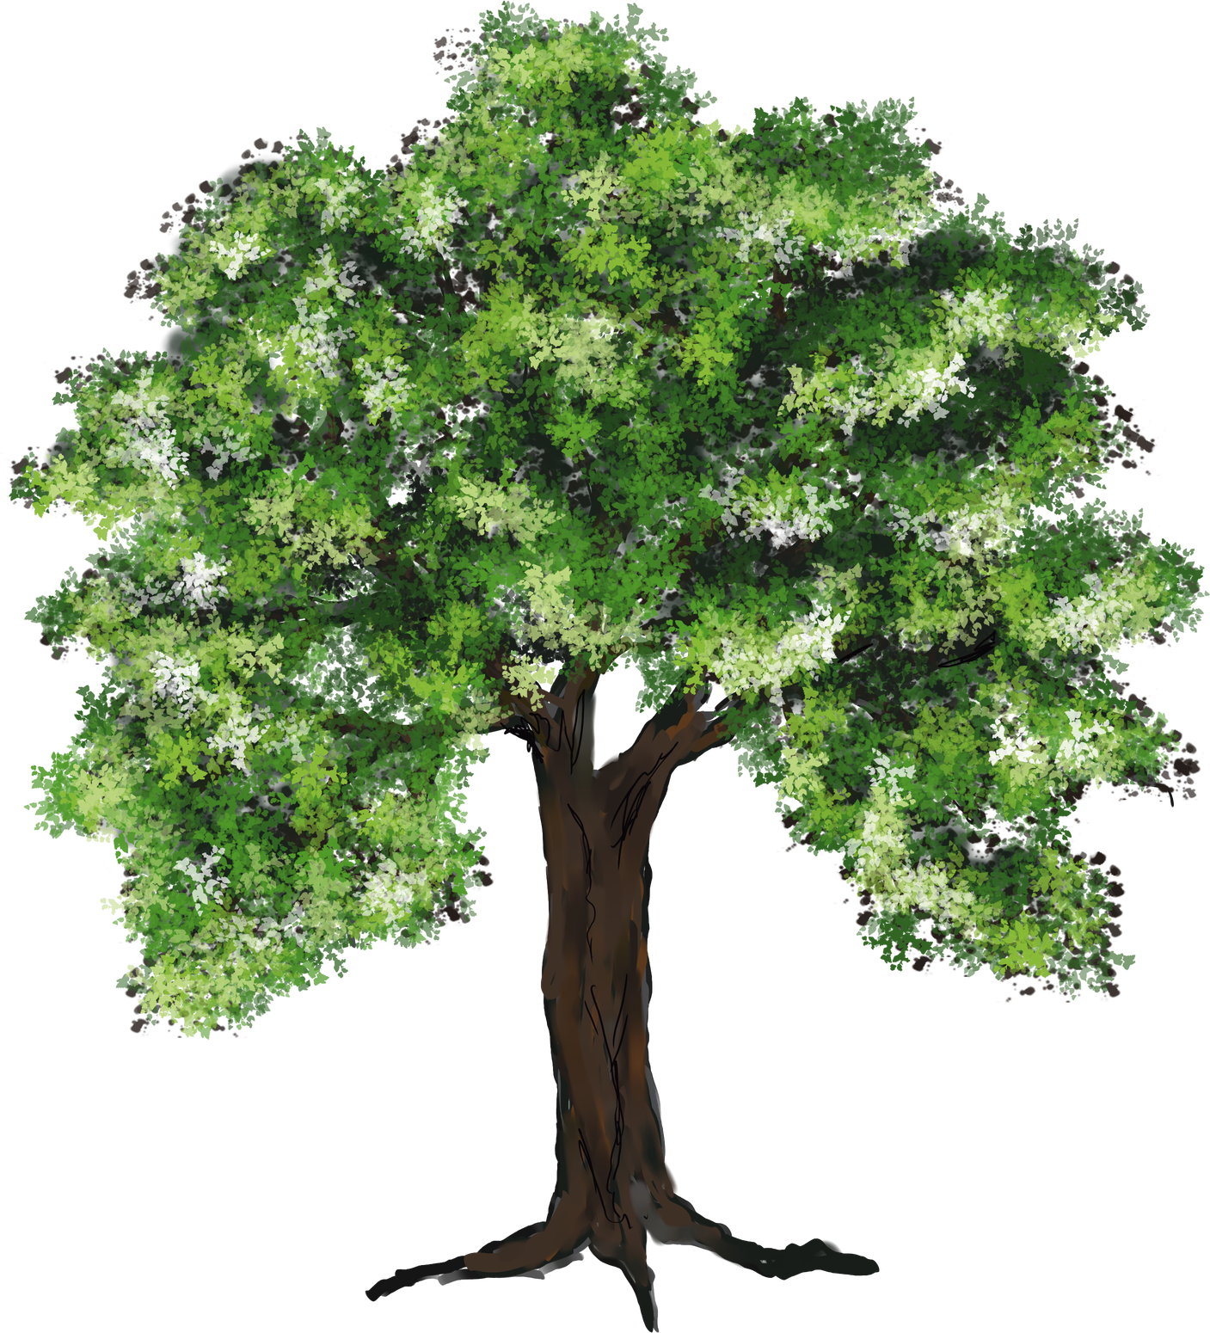
A project by:
Venslee Merilan
Forest or not
Forest Monitoring
Deep Learning Pipeline
Binary Classification of NDVI Satellite Imagery in the Pine Forests of Haiti using Convolutional Neural Networks.

Slide 2



Forest or not
A project by:
Venslee Merilan
Core objectives
Automated Detection: Distinguish between forest and non-forest cover.
Historical Analysis: Scale monitoring across 2020 and 2024.
Deep Learning: Move beyond simple thresholding to spatial feature extraction.
Conservation: Provide actionable binary maps for Haitian forestry.
10m
Spatial Resolution

Slide 3

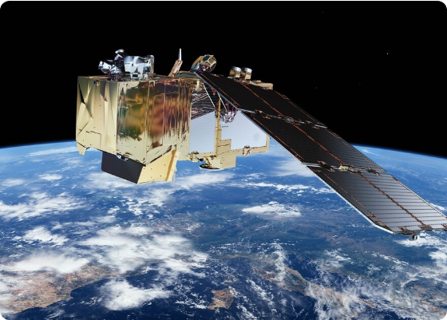
Forest or not
A project by:
Venslee Merilan
Google Earth Engine Pipeline
We leverage Sentinel-2 SR Harmonized data to build robust seasonal composites.
Dry Season focus (Jan - Mar) for cloud-free images.
NDVI Computation using B8 (NIR) and B4 (Red) bands.
Median composting to eliminate atmospheric noise.
Phase 1: Data Acquisition

Slide 4
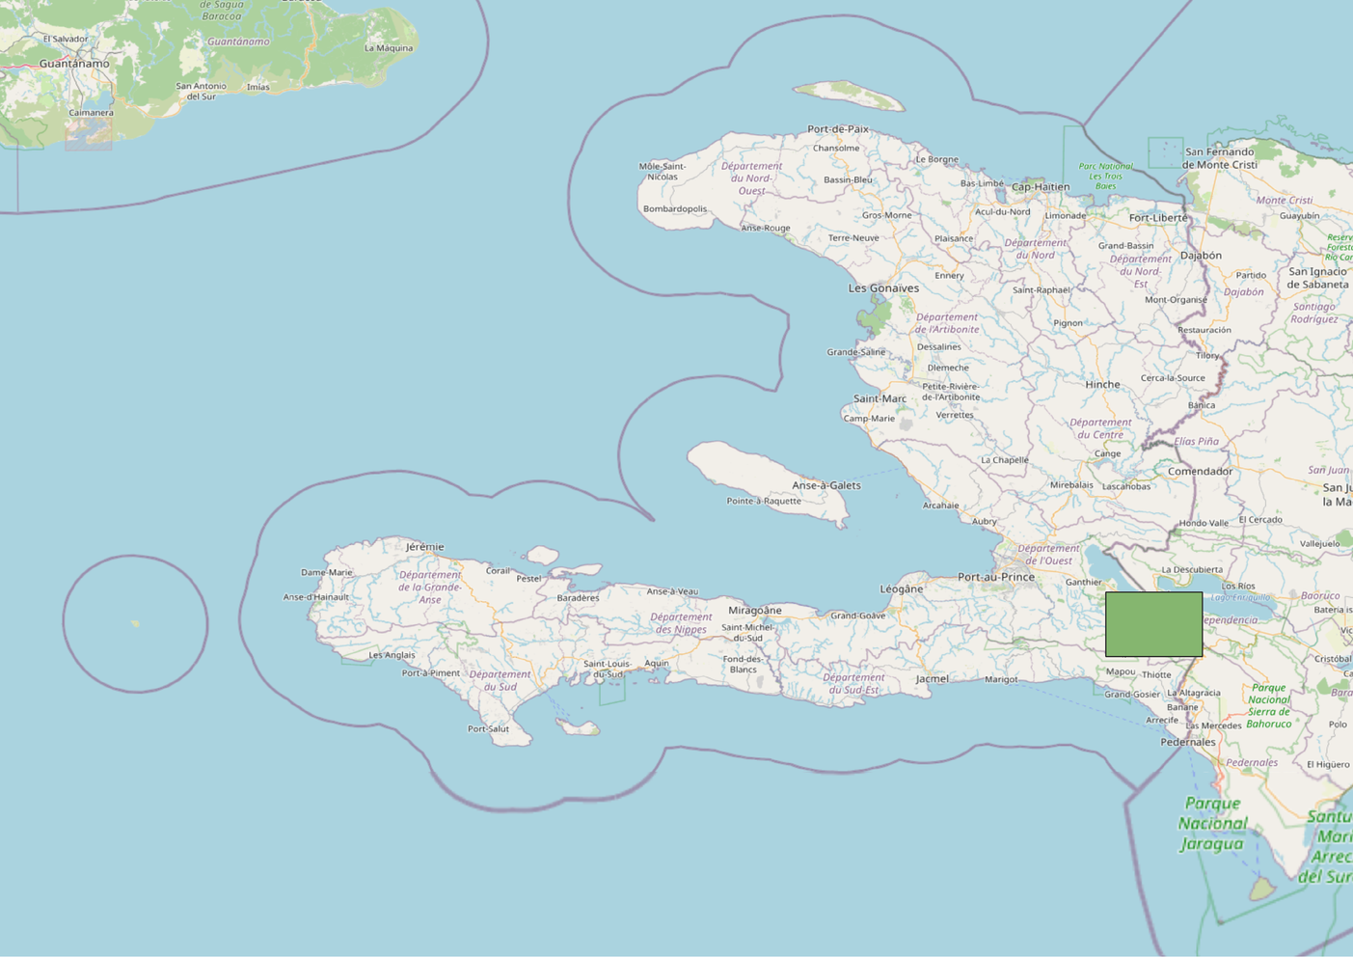
Forest or not
A project by:
Venslee Merilan
Phase 1: Data Acquisition
Area of interest
Pine forest, South-East, Haiti

Slide 5


Forest or not
A project by:
Venslee Merilan
Auto-Labeling
Threshold of NDVI ≥ 0.6 identifies Forest centroids automatically for training.
Patch Extraction
32x32 pixel patches are sliced around centroids to capture spatial textures and context.
Zarr Storage
1,000 balanced samples stored in Zarr format for fast, chunked data access in PyTorch.
Phase 2: Dataset Engineering

Slide 6
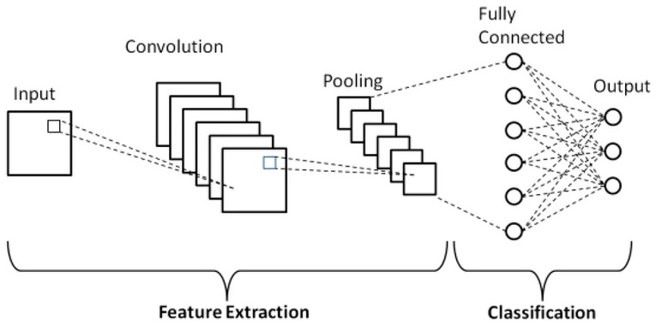
Forest or not
A project by:
Venslee Merilan
SimpleCNN Structure
A custom light-weight architecture designed for multi-spectral patch classification.
Input: 32x32 NDVI Patch (Single Channel)
Feature Extraction: 2x Convolutional Layers (16 & 32 filters) + ReLU
Spatial Reduction: 2x Max-Pooling layers
Classification: 2x Dense layers with Sigmoid activation for binary probability output.
Model Architecture

Slide 7





Forest or not
A project by:
Venslee Merilan
Google Earth Engine
Cloud-based planetary data processing for petabyte-scale satellite image retrieval and composition.
Python Ecosystem
PyTorch for deep learning, Rasterio for geospatial I/O, and Zarr for high-performance data management.
Technology Stack

Slide 8



Forest or not
A project by:
Venslee Merilan
Inference & Final Mapping
Sliding Window Inference
Stride 1: Maximum resolution by overlapping patches pixel-by-pixel.
Probability Averaging: Reduces edge artifacts and smooths transitions.
Binary GeoTIFF: Exports results as uint8 (0: White, 1: Forest Green).

Slide 9
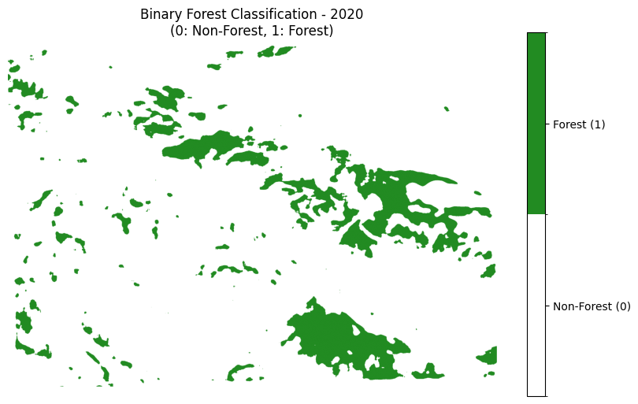
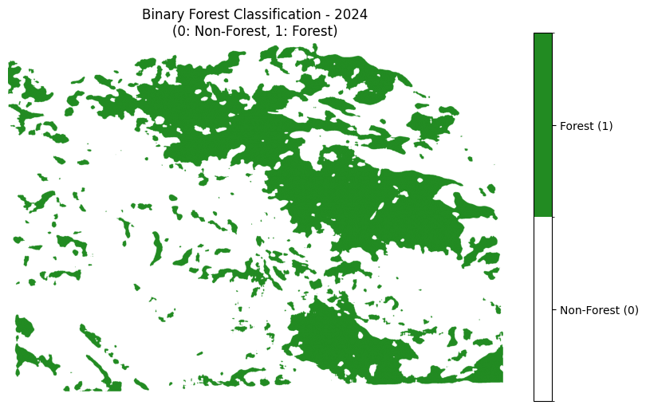
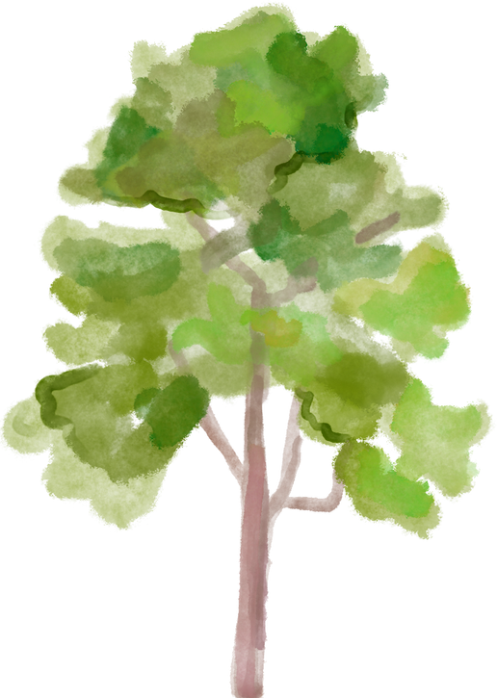
Forest or not
A project by:
Venslee Merilan
Results

Slide 10


Forest or not
A project by:
Venslee Merilan
What do we think of this?
The results indicate an increase in forest cover between 2020 and 2024, yet this requires field verification to distinguish genuine reforestation from seasonal "spectral noise." Because NDVI measures chlorophyll reflectance, a wetter 2024 dry season may have triggered a surge of herbaceous ground cover that the model mistakenly classifies as forest. Despite this, the method provides a vital strategic tool for Haiti; it allows forestry officials to bypass blanket patrols and instead use "anomaly detection" to target specific zones for protection or regeneration, creating a scalable monitoring framework.

Slide 11
Forest or not
A project by:
Venslee Merilan
Thank You
References
Phung, Van & Rhee, Eun. (2019). A High-Accuracy Model Average Ensemble of Convolutional Neural Networks for Classification of Cloud Image Patches on Small Datasets. Applied Sciences. 9. 4500. 10.3390/app9214500.
Ansel, J., Yang, E., He, H., Gimelshein, N., Jain, A., Voznesensky, M., ... & PyTorch Team. (2024). PyTorch 2: Faster Machine Learning Through Dynamic Python Bytecode Transformation and Graph Compilation. 29th ACM International Conference on Architectural Support for Programming Languages and Operating Systems, Volume 2 (ASPLOS '24). https://doi.org/10.1145/3620665.3640366
Paszke, A., Gross, S., Massa, F., Lerer, A., Bradbury, J., Chanan, G., ... & Chintala, S. (2019). PyTorch: An Imperative Style, High-Performance Deep Learning Library. Advances in Neural Information Processing Systems 32, 8024–8035. https://proceedings.neurips.cc/paper/2019/file/bdbca288fee7f92f2bfa9f7012727740-Paper.pdf
Gorelick, N., Hancher, M., Dixon, M., Ilyushchenko, S., Thau, D., & Moore, R. (2017). Google Earth Engine: Planetary-scale geospatial analysis for everyone. Remote Sensing of Environment, 202, 18–27. https://doi.org/10.1016/j.rse.2017.06.031

