Slide 1
Top Ten Tips For Your Top Ten Customers

Slide 2
The First Rule of Business:
“Look After Your Most Important Customers Before Someone
Else Does!”

Slide 3
GOOD
SUPPLIER
PARTNER
Business Understanding
OUTSIDER
FRIEND
POOR
GOOD
Relationships

Slide 4
Partnership Indicators

Slide 5
The Value Staircase
4
Priceless
3
Auditable
2
Quantifiable
1
Identifiable

Slide 6
Audit Questions
Where are we meeting your expectations?
Where are we exceeding expectations?
Where are we falling short?
What unresolved issues are there?
How do we compare to other suppliers?
In our industry?
All others?
How would you sum us up in a sentence?
How many marks out of ten?
If we were an animal or bird what would we be?

Slide 7
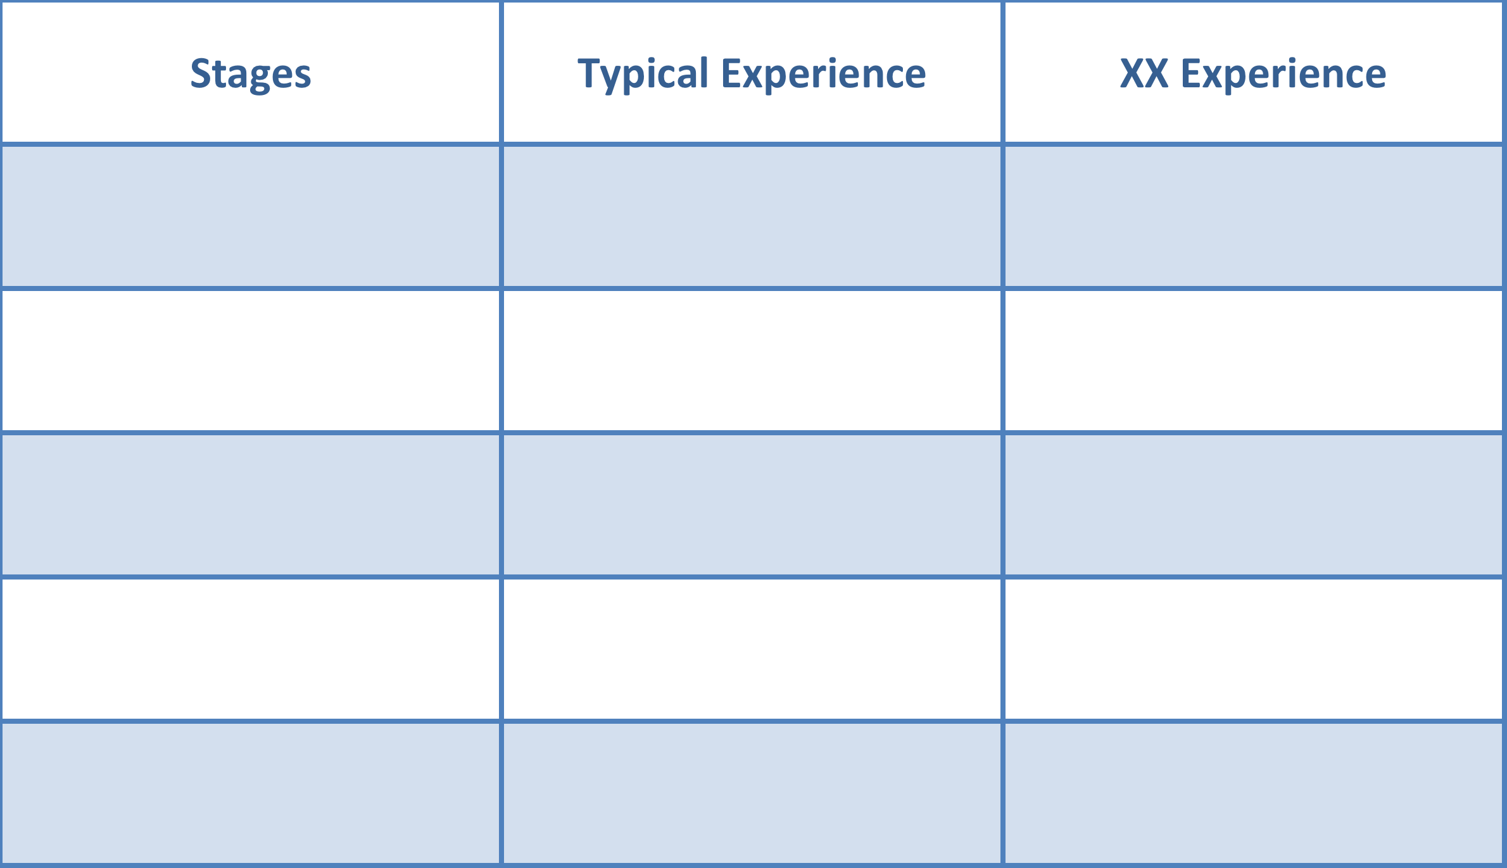
How do you ensure that you exceed the
key account’s expectations at each stage?
Enquiry
Check-In
Room
Bar & Restaurant
Check-Out

Slide 8
Your
Company
Key
Account

Slide 9
Team Diary
“Key account management is a team sport!”
Monday | Tuesday | Wednesday | Thursday | Friday
1 | 2 | 3 | 4 TEAM KAMDAY | 5
8 | 9 | 10 SALES DIR AVAILABLE | 11 | 12
15 | 16 TEAM KAMDAY | 17 | 18 | 19
22 | 23 | 24 | 25 | 26 SALES DIR AVAILABLE
29 CEO K/A AUDIT | 30 CEO AVAILABLE | 31
“None of us is as strong as all of us!”

Slide 10
Intelligence
Intentions
Implementation
What is the
current
situation?
What are the plans for the future?
Who is going to do what by when?

