Slide 1
PARO: Warsztat zwinnego programisty
Author: Karol Rungo

Slide 2
Agenda
ATDD
Code review
Build system- how it works
Clang-format & clang-tidy

Slide 3
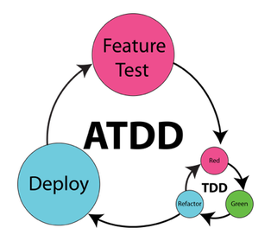
ATDD – Acceptance test driven development
User scenarios are transformed to acceptance tests
Feature is ready when the test passes
As a USER, I can add books to my collection
GIVEN: User is logged in
AND User’s collection is empty
AND book#1 is avaliable in database
WHEN: User selects the book#1
THEN: It is added to his collection
AND Collection view contains newly added book

Slide 4
Code review
When do we do it?
Why do we even do it?
IT IS NOT ABOUT YOU, IT IS ABOUT THE CODE
maintain architecture of the system and code readibility
different point of view
get to know with each other
knowledge spread
Bugs are everywhere
performance issues
Soft skill training, cope with criticism
What do we check?
Who checks the code?

Slide 5
Code review- what to look for
Needle in the haystack
Divide your commits
How many files?
Tests tests tests…
Cultural differences

Slide 6
Code review- what makes it bad
feeding me ego
rat race
metrics are bad (seriosuly)
fast and furious
design patterns hell
lack of trust

Slide 7
The Ten Commandments of Egoless Programming
Understand and accept that you will make mistakes.
You are not your code.
No matter how much "karate" you know, someone else will always know more
Don't rewrite code without consultation.
Treat people who know less than you with respect, deference, and patience.
The only constant in the world is change.
The only true authority stems from knowledge, not from position.
Fight for what you believe, but gracefully accept defeat.
Don't be "the guy in the room”.
Critique code instead of people – be kind to the coder, not to the code.
https://blog.codinghorror.com/the-ten-commandments-of-egoless-programming/

Slide 8
Clang-Tidy and Clang-Format- live example
https://github.com/rungokarol/paro
https://clang.llvm.org/docs/ClangFormat.html
https://clang.llvm.org/docs/ClangFormatStyleOptions.html
https://clang.llvm.org/extra/clang-tidy/
https://clang.llvm.org/extra/clang-tidy/checks/list.html

