Slide 1
test-slides.pptx — PowerPoint test deck
Each slide lists its tests on the right: ID, what is tested, expected result
Tests on this slide
PPTX-01 · Title and subtitle
Expected: Large title text, smaller gray subtitle below it
PPTX-02 · Slide count and order
Expected: Page bar shows 10 slides; thumbnails in order 1-10
PPTX-03 · 16:9 slide size
Expected: Slides are wide (16:9), not square-ish (4:3)

Slide 2
2. Text formatting
Tests on this slide
PPTX-04 · Bold, italic, underline, strikethrough
Expected: Lines 1-4 look like their names
PPTX-05 · Text colors
Expected: Red, blue and green lines in those colors
PPTX-06 · Font sizes
Expected: "Small 12 pt" is small, "Large 32 pt" is big
PPTX-07 · Font families
Expected: Times, Courier and Georgia lines in those fonts
PPTX-08 · Center alignment and superscript
Expected: Last line is centered; the 2 is small and raised
Bold text
Italic text
Underlined text
Strikethrough text
Red text
Blue text
Green text
Small 12 pt
Large 32 pt
Font Times New Roman
Font Courier New
Font Georgia
Centered line with superscript x²

Slide 3
3. Bullets
Tests on this slide
PPTX-09 · Round bullet
Expected: Round •
PPTX-10 · Wingdings §
Expected: Small square ▪ — NOT §
PPTX-11 · Wingdings q
Expected: Hollow box ❑ — NOT q
PPTX-12 · Wingdings n
Expected: Filled square ■ — NOT n
PPTX-13 · Wingdings Ø
Expected: Arrow head ➢ — NOT Ø
PPTX-14 · Wingdings ü
Expected: Check ✓ — NOT ü
PPTX-15 · Wingdings v
Expected: Diamond ❖ — NOT v
PPTX-16 · Multi-level indents
Expected: Levels 1-4 are indented further each time and get smaller
PPTX-17 · Numbered and lettered
Expected: 1. 2. then a)
Round bullet • (Arial)
Square bullet (Wingdings §)
Box bullet (Wingdings q)
Filled square (Wingdings n)
Arrow bullet (Wingdings Ø)
Check bullet (Wingdings ü)
Diamond bullet (Wingdings v)
Level 1
  Level 2 (indented more)
    Level 3 (square)
      Level 4 (smaller still)
Numbered 1.
Numbered 2.
Letter a)

Slide 4
4. Shrink text on overflow
Tests on this slide
PPTX-18 · Shrink text on overflow
Expected: All 14 lines fit above the red line (text is smaller); nothing runs past it
Line 1: this placeholder has more text than fits, so PowerPoint shrinks it.
  Line 2: this placeholder has more text than fits, so PowerPoint shrinks it.
  Line 3: this placeholder has more text than fits, so PowerPoint shrinks it.
Line 4: this placeholder has more text than fits, so PowerPoint shrinks it.
  Line 5: this placeholder has more text than fits, so PowerPoint shrinks it.
  Line 6: this placeholder has more text than fits, so PowerPoint shrinks it.
Line 7: this placeholder has more text than fits, so PowerPoint shrinks it.
  Line 8: this placeholder has more text than fits, so PowerPoint shrinks it.
  Line 9: this placeholder has more text than fits, so PowerPoint shrinks it.
Line 10: this placeholder has more text than fits, so PowerPoint shrinks it.
  Line 11: this placeholder has more text than fits, so PowerPoint shrinks it.
  Line 12: this placeholder has more text than fits, so PowerPoint shrinks it.
Line 13: this placeholder has more text than fits, so PowerPoint shrinks it.
  Line 14: this placeholder has more text than fits, so PowerPoint shrinks it.

Slide 5
5. Shapes and arrows
Tests on this slide
PPTX-19 · Basic shapes
Expected: Rectangle, rounded box, circle, triangle with their colors and labels
PPTX-20 · Arrows
Expected: Right arrow, left-right arrow and up arrow have arrow shapes (not plain boxes)
PPTX-21 · Other shapes
Expected: Star, callout, chevron, pentagon, hexagon have their real outlines
PPTX-22 · Rotation
Expected: "Rotated 30°" box is tilted
PPTX-23 · Outline only
Expected: Red circle outline with no fill
PPTX-24 · Connector with arrow head
Expected: Blue line at the bottom with an arrow head on the right
Rectangle
Rounded
Circle
Triangle
Right arrow
Both ways
Up
Star
Callout
Chevron
Pentagon
Hexagon
Rotated 30°

Slide 6
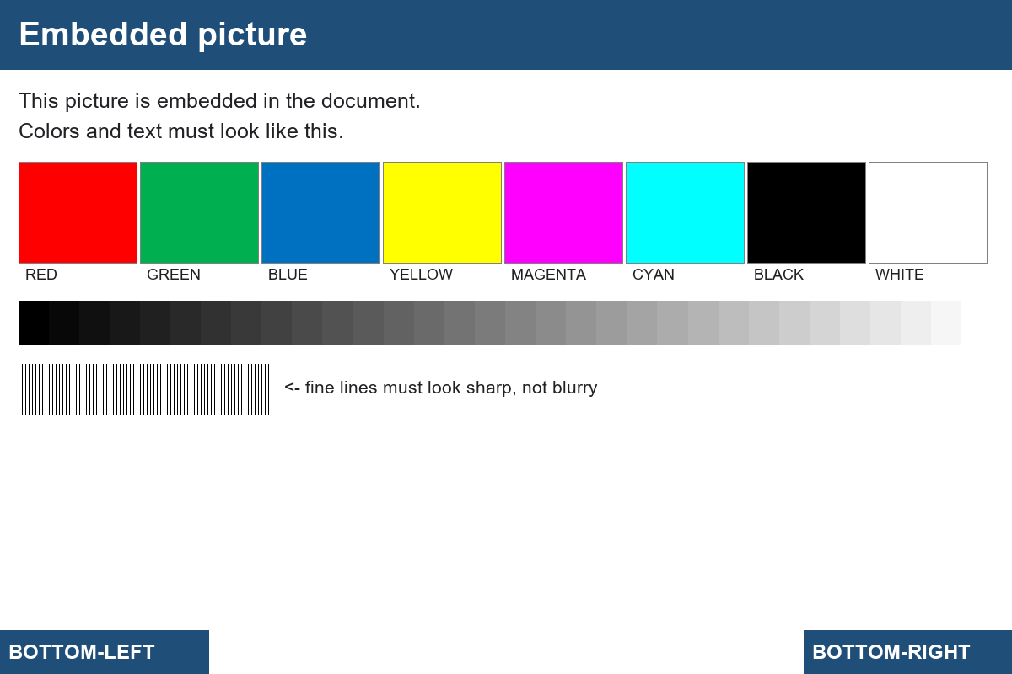
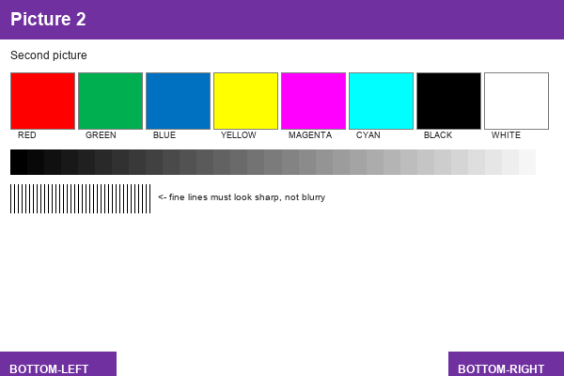
6. Pictures
Tests on this slide
PPTX-25 · Picture
Expected: Top-left: whole "Embedded picture" test chart
PPTX-26 · Cropped picture
Expected: Top-right: only the top-left quarter of the chart (title + RED/GREEN bars), enlarged
PPTX-27 · Picture with border
Expected: Bottom: purple "Picture 2" with a thick red border

Slide 7
7. Table
Tests on this slide
PPTX-28 · Table header
Expected: First row has a colored header with white bold text (theme style)
PPTX-29 · Banded rows
Expected: Rows alternate light / darker shading
PPTX-30 · Cell color
Expected: East total (2,700) has a light green background
PPTX-31 · Merged cells
Expected: Last row is one cell across all 4 columns
Region | Q1 | Q2 | Total
West | 1,200 | 1,350 | 2,550
East | 1,300 | 1,400 | 2,700
North | 1,400 | 1,450 | 2,850
Merged note across all columns

Slide 8
8. Group, gradient, transparency
Tests on this slide
PPTX-32 · Grouped shapes
Expected: Three overlapping colored boxes "Group 1-3", stepping down to the right
PPTX-33 · Gradient fill
Expected: Wide box fades from white (left) to dark blue (right)
PPTX-34 · Transparency
Expected: Red circle is see-through: "TEXT BEHIND" is visible through it
Group 1
Group 2
Group 3
40% opaque
Gradient white -> dark blue
TEXT BEHIND

Slide 9
9. Charts
Tests on this slide
PPTX-35 · Column chart
Expected: Blue and orange columns for Q1-Q4 with a legend (West, East)
PPTX-36 · Pie chart
Expected: Pie with 3 slices: Deposits 55%, Loans 35%, Other 10%

Slide 10
10. Slide background and speaker notes
Tests on this slide
PPTX-37 · Slide background color
Expected: This slide has a light yellow background (other slides are white)
PPTX-38 · Speaker notes
Expected: Notes "These are the speaker notes for slide 10." are available (if the viewer shows notes)
Notes:
These are the speaker notes for slide 10.

