Slide 1
Emerge with a design strategy.
Identify Stakeholders and Communicate with them
Investigate Architecturally Significant Requirements (ASR)
Select an architectural style (Before It Chooses You)
Create a Foundation with Patterns
Build Meaningful Models to Manage Complexity
Visualize Your Design Choices
Describe the Architecture
Evaluate the Architecture
Motivate the Architects on Your Team
Notes:
GitHub - mhadidg/software-architecture-books: A comprehensive list of books on Software Architecture.
Software Architecture Practices in Agile Enterprises – IGI - Global

Slide 2
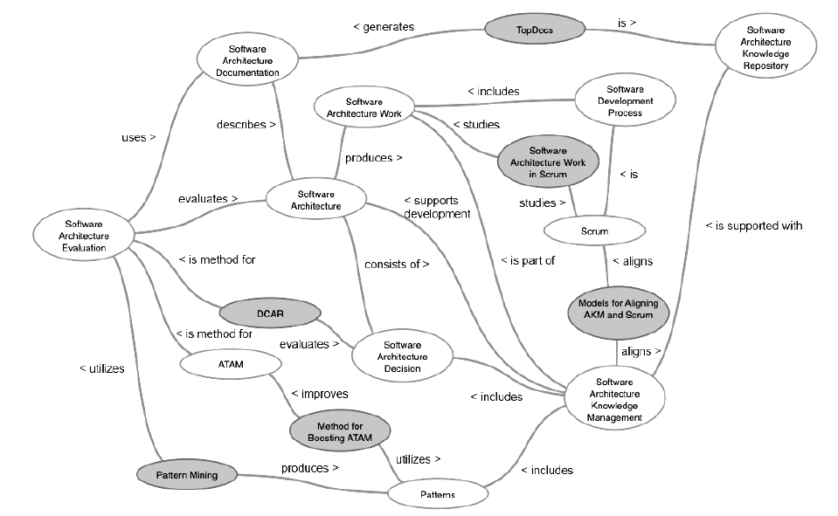
SCOPE OF WORK

Slide 3
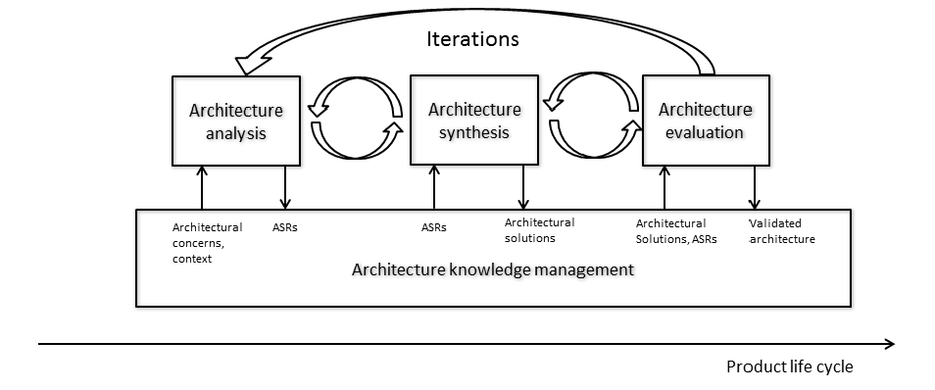
Architecture work flow and knowledge management
Architecturally Significant Requirements (ASR)
Architecture work consists of three distinct activities:
analysis, synthesis and evaluation.

Slide 4
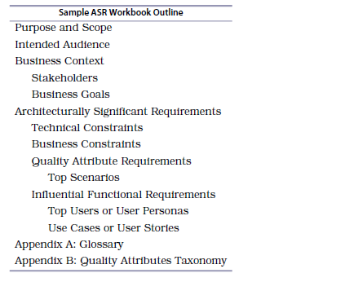
ASR

Slide 5
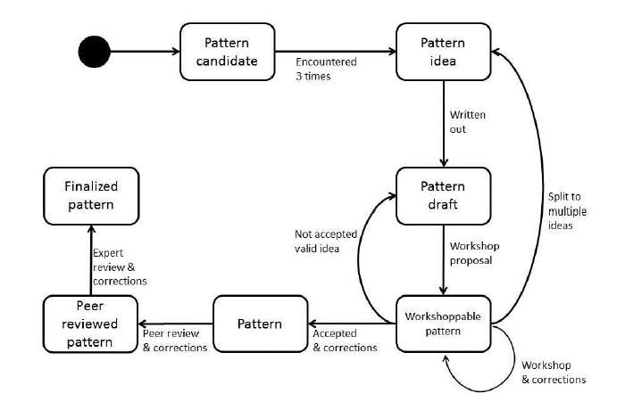
Mining Software Architecture Patterns

Slide 6
Agile Software Development Methods
Individuals and interactions over processes and tools
Working software over comprehensive documentation
Customer collaboration over contract negotiation
Responding to change over following a plan
Kanban
Extreme programming (XP)
Lean software development
Scrum

Slide 7
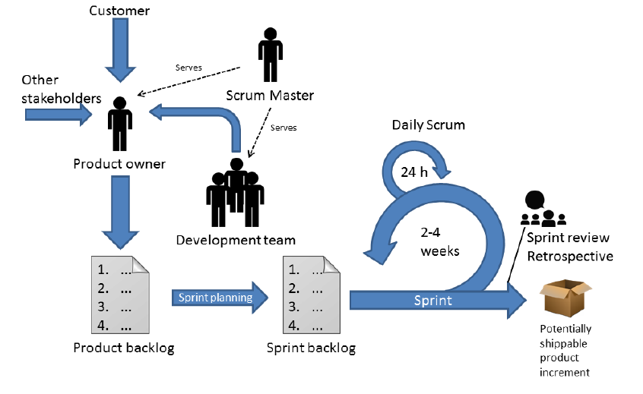
Workflow In SCRUM Framework

Slide 8
Agile Software Development and Software Architecture
Software Architecture and Agile Software Development is a clash of two cultures (Perception)
People using agile methods tend to think that software architecture has a smell of waterfall in it
If you plan and design architecture up-front, you end up with loads of documents and YAGNI (You Ain’t Gonna Need It) features
At the same time, the annual state of the agile survey lists year after year that the greatest concern about (further) adopting agile is lack of up-front planning
Successful usage of Scrum requires some up-front planning and design

Slide 9
contradiction between agile and software architecture
However, one should recognize that the developers of the system are also stakeholders, and the architecture has value for them.
The architecture might enable the developers to deliver value to the end user with increased velocity. In addition, time spent planning in the beginning might result in higher quality of the product.
Architecture is invisible to the end user; it is a way to provide more value to the end user in the future.
Aspects related to internal quality of the product reflect in the external quality of the product
In agile and lean the value delivered to the customer is often emphasized.
If the first sprint or two are used to create an architecture design, there is no value delivered to the customer
Agile often fails to value up-front design
Agile does not provide tools to carry out software architecture work.
Agile does not say how to identify architecturally significant requirements or carry out iterative design.
There is no guidance on software architecture evaluation in agile and Scrum
There is a plethora of methods and tools for software architecture work, but most of them are attuned for waterfall development
Different organizations use different approaches to align agile and software architecture
it is clear that a balance between these two worlds needs to be found

Slide 10
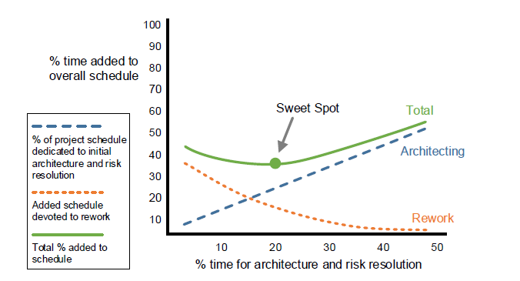
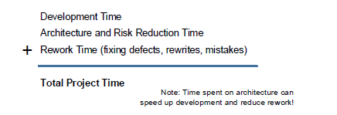
Decide How Much to Design Up Front
Find the Design Sweet Spot
The solid green line represents the sum of architecture design effort (dashed blue line) and the cost of rework (dotted orange line). In the above case, spending less than about 20 percent of the original project schedule on architecture has a diminishing return. While the amount of rework decreases with a greater investment in architecture, the total project schedule increases. Similarly, spending less time on architecture raises the
amount of rework, creating a longer overall project timeline
The architecture sweet spot is highly dependent on the size, requirements volatility, and complexity of the software you’re developing

Slide 11
How To Align Software Architecture Practices To Agile
Big up-front architecture created during the analysis phase before starting the development in sprints (BUFA).
Sprint zero where the team created the architecture in the first planning sprint (SPR0).
Designing architecture when needed in normal sprints (SPR*).
Separate architecture process where architecture is designed outside Scrum process when necessary (SEPA).

Slide 12
BUFA
BUFA is typically used in companies that are building very complex real-time embedded control systems
Systems are huge in terms of lines of code
Companies typically has a proprietary platform that is used to build specific products and working machines.
In many cases, there is a long analysis phase where requirements are gathered, and architecture is designed.
The Product architecture needs serious design effort. The analysis phase might last for six months.
Once most of the architecture is in place, the development starts
Changes are typically handled by the architect or architecture team that designed the original architecture up-front - The Scrum teams do not make architectural decisions at any stage.
Survey reported that typically the features are so big that it is almost impossible to implement them in one sprint
Some companies did prototype as well in the up-front design phase. They experimented with different approaches and technologies, and implemented the basic building blocks of the architecture

Slide 13
SPR0
one sprint before actual development sprints where team build product backlog and the architecture
Typically, SPR-0 sprint was about the same length as the other sprints(1-4 weeks)
Survey reported that later in the development sprints the architecture changed as the knowledge about the system increased. In response the development team made the architectural changes within sprints
In SPR-0 the main designer (or several designers) worked with the development team(s) and design the initial architecture

Slide 14
Architecture in Sprints (SPR*)
Survay reported that teams do not have separate analysis or architecture phase:they just start doing sprints and developing the system
Team produce the initial architecture during the first sprint while implementing potentially shippable features)
In every sprint, the architecture concerning potentially shippable features is refined and already implemented parts are refactored when necessary. This process goes on and the architecture is designed piece by piece during the sprints until it is finished
The architecture is designed in detail only for the features that are shipped after the current sprint.
In some cases, the design was guided by one or more persons in the team that had the most experience on the domain
Requires teams with domain expertise.
This approach increases the amount of required architectural refactoring as architecture is designed incrementally
Notes:
One Survey reported that they have had bad experiences with this approach when the team was new to the domain. The team did not know how to proceed with the design and as there was no up-front architecture, the result was a failure. The architecture
just did not correspond to requirements and it had to be refactored all the time. Finally,
they had to do it again from the scratch.

Slide 15
SEPA - “they don’t mess up the Scrum process in any way”.
Architecture is created by a separate team that may have members from the development team(s) but is organizationally completely separated from the development team(s)
Members of the architecture team might do architecture work part time, meaning that they are working also in the development team, or they can be working only for the architecture team.
Typically, there is one checkpoint for each release of the architecture team (i.e., a new version of the system’s architecture that contains support for new features for the next product release).
The architecture team has checkpoints or milestones when a certain part of the architecture must be ready
From the survey, the checkpoint cycle was three months as their release cycle was four times a year.
In the checkpoint meeting, the architecture team provides the architecture for evaluation. Members of the development team, PO, SM, team lead, and possibly customers participate in the meeting. Once all the participants are satisfied by one of the competing proposals, they select it as a basis of the design.
The separate architecture process is connected to the Scrum process essentially via the product backlog: the architecture process produces items to the product backlog

Slide 16
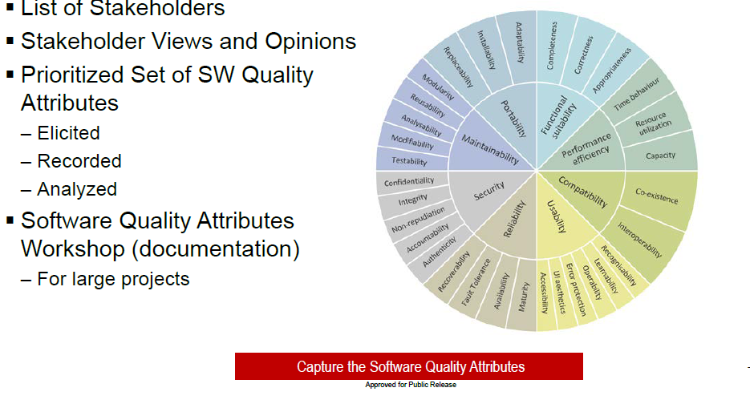
Software Quality Attributes

Slide 17
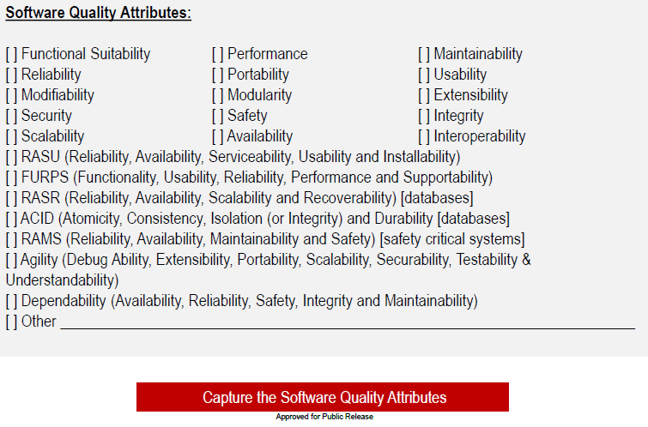
Software Quality Attributes Check List

Slide 18
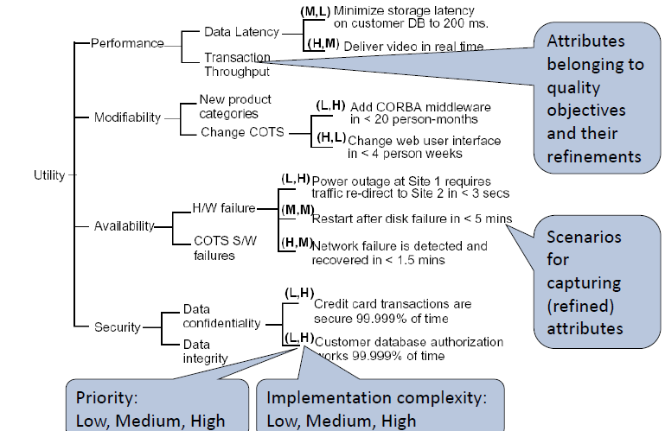
Collection of quality objectives: Utility tree

Slide 19
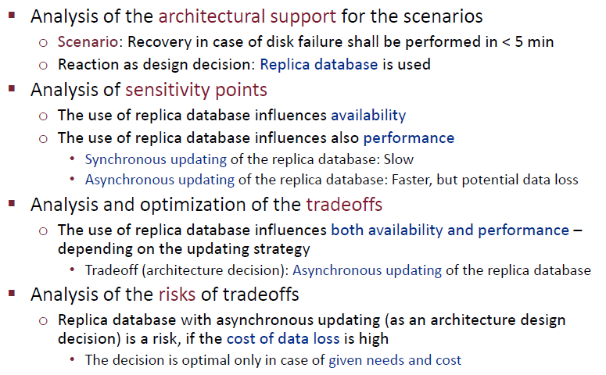
Steps of the analysis

