Slide 2


Monolithic Hell
Successful applications have a habit of growing over time and eventually becoming huge.
After a few years, your small, simple application will have grown into a monstrous monolith.
It’s simply too large for any single developer to fully understand
fixing bugs and implementing new features correctly becomes difficult and time consuming
The larger the application, the longer the start-up time is
large part of developer day will be spent waiting around and their productivity will suffer
Increased Lead time
Difficult to scale when different modules have conflicting resource requirements.
Reliability
Because all modules are running within the same process, a bug in any module, such as a memory leak, can potentially bring down the entire process
If all instances of the application are identical,that bug will impact the availability of the entire application.
Adaptibility
Monolithic apps not open to adopt new frameworks and languages

Slide 3
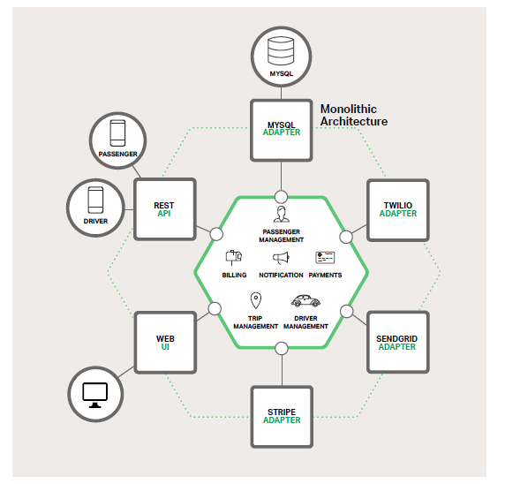
Monolithic
Core Business logic
Core Adapters
Core Services
Messaging Components
Single Large Database
Single Deployment Pipeline

Slide 4
Partitioning Your Business into Services
Application Decomposition
Decomposing by Functionality
Email processing
Decomposing by Maturity
Decomposing by Data-Access Pattern
Reade intensive
write intensive
Decomposing by Context
Application Aggregation
Aggregation for a Derived Functionalities
Aggregation for Business Intelligence
ETL, Fraud detection services
Aggregation for Client Convenience
mobile façade service
Aggregation to Aid System Performance
Cache Service

Slide 5
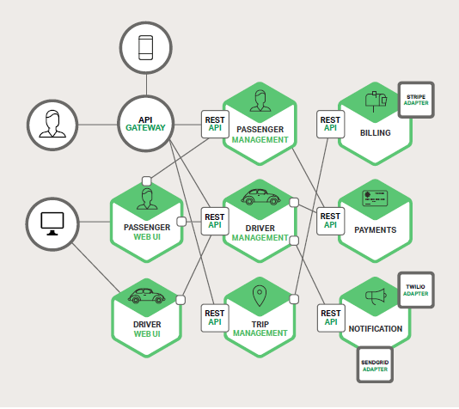
Microservices
A service typically implements a set of distinct features or functionality
Each microservice is a mini-application that has its own hexagonal architecture consisting of business logic along with various adapters

Slide 6
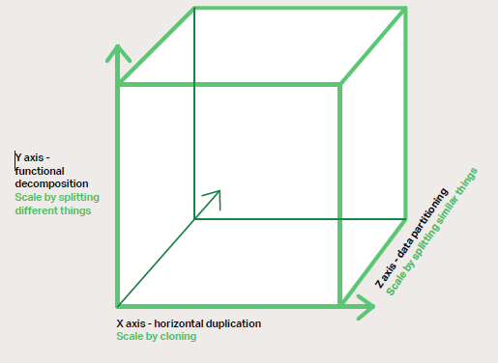
Scale cube
The Microservices Architecture pattern corresponds to the Y-axis scaling of the Scale Cube
X-axis scaling
Cloning
Z- axis scaling
Data Partition

Slide 7
Y-axis scaling
Splitting the application into multiple, different services (microservices)
Then more infra resources can be added to only the micro-service which is bottleneck in the architecture.
Decomposing the application based on its functionalities, services, or use cases

Slide 8
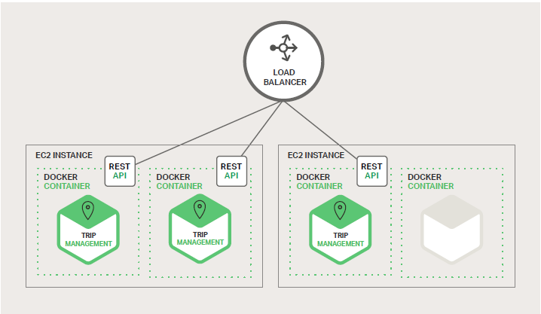
X-axis scaling
Running multiple copies of an application behind a load balancer
Each copy can handle 1/N of the load
Each copy accesses all the data, cache size will be higher.
Doesn't solve increasing development and application complexity

Slide 9
Z-axis scaling
The application is split in such a way that each instance is responsible for only a portion of the whole data
Multiple instances of the same application, each of them operating on a partition of the data
This is commonly used to scale databases where data is partitioned(a.k.a sharded)
Each server deals with a subset of data
Partitioned schema is tricky to repartition data

Slide 10
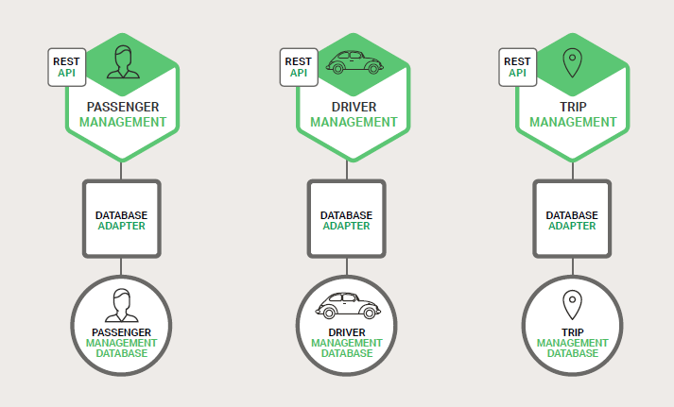
Data Architecture (Z-axis)
Each of the services has its own database.
polyglot persistence architecture
A service can use a type of database that is best suited to its needs

Slide 11
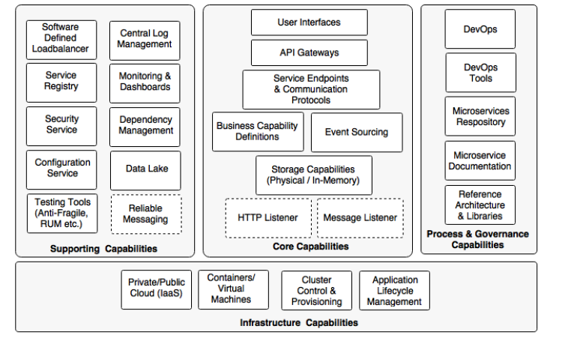
Microservices Capability Model

Slide 12
API Gateway Pattern

Slide 13
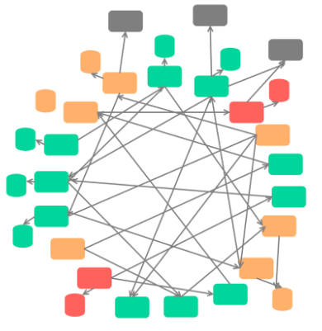
Death Star Pitfall
An architectural anti-pattern that occurs if services are highly coupled with each other
Intense Coupling
Hard To Make Changes
Maintenance Issues

Slide 14
How to Address Death Star Problem
Bounded Context
A bounded context is a set of tiny services (API, Background Jobs, Serverless Functions, etc) that work together to deliver requirements related to a sub-domain of a large software
Technically speaking, the Bounded Context in DDD-speak is a specific boundary within your domain that your Glossary from your Ubiquitous Language can only apply – the idea being that different Subdomains may have competing or conflicting definitions of terms
A Bounded Context is a system that fulfills the goals of the business in the real world.
Any of our software systems (like a web service or web app) that operate as concrete instances in the Real World are considered Bounded Contexts
one of the goals of Domain-Driven Designs is to have a one-to-one mapping from a Subdomain to a Bounded Context.
Notes:
https://hackernoon.com/microservices-bounded-context-cohesion-what-do-they-have-in-common-1107b70342b3
https://vladikk.com/2016/04/05/tackling-complexity-ddd/
https://hackernoon.com/microservices-bounded-context-cohesion-what-do-they-have-in-common-1107b70342b3
https://blog.carbonfive.com/2016/10/04/ubiquitous-language-the-joy-of-naming/
https://blog.carbonfive.com/2016/11/01/bring-clarity-to-your-monolith-with-bounded-contexts/

Slide 15
DDD in Minute
Addresses poor collaboration between domain experts and software development teams
DDD aims to increase the success rates by bridging collaboration and communication gap b/w Domain Experts and Software Development Teams
How they Share Knowledge Fluently ?
Ubiquitous Language – Shared business-domain-oriented language
Language resemble the business domain, its terms, entities, and processes
All Communication ,Documentation and Code should use Ubiquitous Language
The Ubiquitous Language becomes the model of the business domain implemented in code
Notes:
http://domainlanguage.com/ddd/whirlpool/
https://www.amazon.com/Analysis-Patterns-Reusable-Object-Models/dp/0201895420

Slide 16
Ubiquitous Language Issues
Ubiquitous Language term should have exactly one meaning
Words often have different meanings in different contexts
How to overcome this hurdle ?
DDD requires each language to have a strict applicability context
Bounded Context
Bounded Context
Defines a boundary, inside of which a Ubiquitous Language can be used freely, Outside of it, the language’s terms may have different meanings
Each Bounded Context defines the applicability context of a specific model.
A model is only valid in its Bounded Context
Notes:
The word “meter” had different meanings in different parts of the organization. In one department, it referred to the connection between the grid and a location. Others understood “meter” as the connection between the grid and the customer, or, of course, a physical meter attached to a house to measure electrical consumption.
Different stakeholders might represent the same business entity in different models. For example, an Advertising Campaign is a complex entity with many rules and invariants for campaign managers; but for sales agents, an Advertising Campaign is merely a data structure that describes a subset of its metadata. Those are two different models, and thus belong to two different Bounded Contexts.

Slide 17
Low Coupling b/w Bounded Contexts
Data governed by a bounded context would be exposed through main Web APIs
Front-end applications need to communicate with several endpoints (Bad due to latency and TLS factors).
If a single transaction involves several sub-domains, client-side applications need to communicate with all of them.
Cross cutting concerns (Authentication, Logging, Security, Monitoring) needs to be implemented across all web APIs.
Each web API needs to have its own SSL and Domain name(Added Cost).
Cross-Origin Resource Sharing (CORS) gets more complex

Slide 18
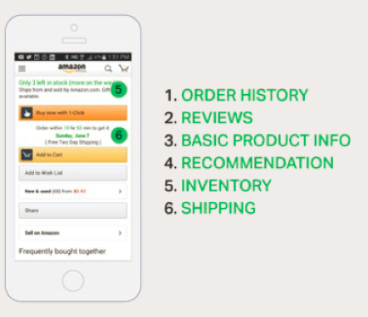
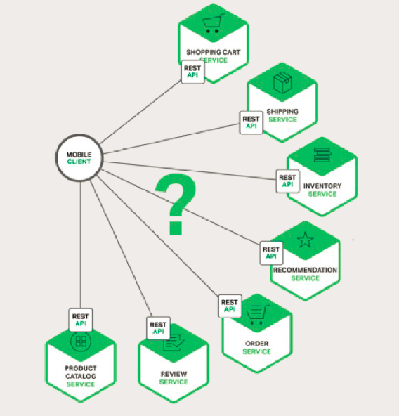
Direct Client-to-Microservice Communication

Slide 19
Direct Client-to-Microservice Communication
Client could make that many requests over a LAN
Incompatible Protocols , Protocols may not be web friendly
One service might use Thrift binary RPC while another
Service might use the AMQP messaging protocol
Direct Communication makes difficult to refactor the microservices

Slide 20
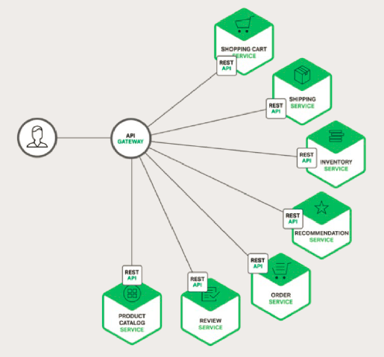
API Gateway Pattern
Request Routing
Composition
Protocol Translation
Aggregating the results.
Encapsulates the internal structure of the application
API gateways are mainly useful in encapsulating the existence of the bounded context APIs from clients

Slide 21
Api Gateway - Design issues
Performance and Scalability
Build the API Gateway on a platform that supports asynchronous, non-blocking I/O.
JVM
NIO-based frameworks such Natty
Vertex
Spring Reactor
Jboss undertow
Node.js
NGINX Plus

Slide 22
Api Gateway - Design issues
API Composition
Dependencies between requests
The API Gateway might first need to validate the request by calling an authentication service before routing the request to a backend service
Not –feasible to implement using Callback hell
Requires Reactive Programming Model
Promises
CompletableFuture in java 8
Reactive Extensions. Net
Future in Scala,

Slide 23
Service Invocation
Inter-process communication mechanism
Styles of inter-process communication
An asynchronous, messaging-based mechanism
Broker Less
JMS , AMQP , ZeroMq
Synchronous Communication
HTTP or Thrift

Slide 24
API gateway pattern drawbacks
Increased complexity - the API gateway is yet another moving part that must be developed, deployed and managed
Increased response time due to the additional network hop through the API gateway

Slide 25
API – Gateway Related Patterns
The API gateway must use either the Client-side Discovery pattern or Server-side Discovery pattern to route requests to available service instances.
An API Gateway will use a Circuit Breaker to invoke services
An API gateway often implements the API Composition pattern

Slide 26

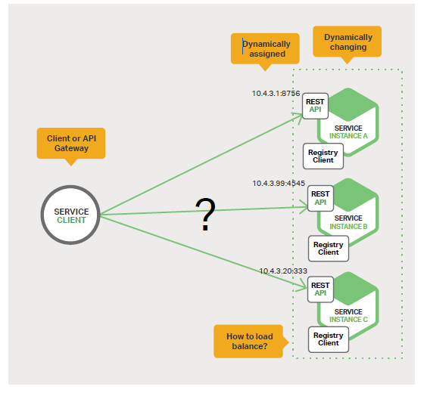


Why Service Discovery

Slide 27
Service Discovery
The API Gateway needs to know the location (IP address and port) of each microservice with which it communicates
Don’t hardwire the locations
Server-side-discovery
Client-side-discovery
Use Service Registry

Slide 28
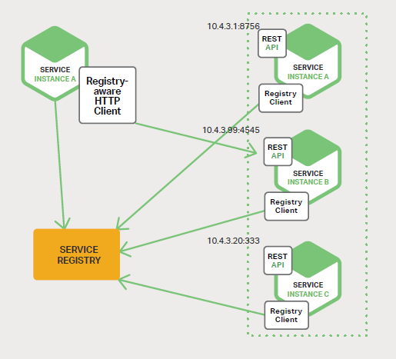
The Client-Side Discovery Pattern
Client is responsible for determining the network locations of available service instances and load balancing requests across them
Client ses a service registry
The client then uses a load-balancing algorithm to select one of the available service instances and makes a request.
This pattern is relatively straightforward and, except for the service registry

Slide 29
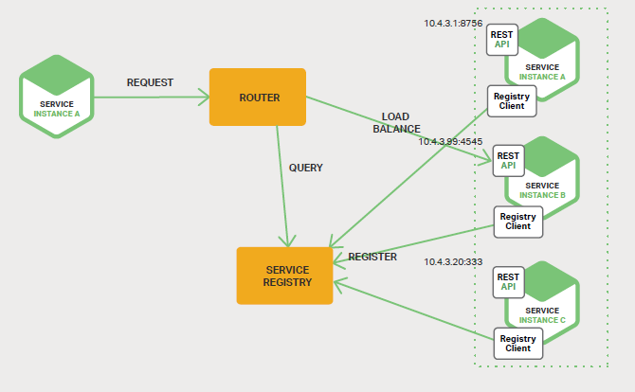
The Server-Side Discovery Pattern
The client makes a request to a service via a load balancer
The load balancer queries the service registry and routes each request to an available service instance
Details of discovery are abstracted away from the client.

Slide 30
The Service Registry
It is a database containing the network locations of service instances
A service registry needs to be highly available and up to date
Clients can cache network locations obtained from the service registry
Some service registry consists of a cluster of servers that use a replication protocol to maintain consistency

Slide 31
examples of service registries
Netflix Eureka
Provides a REST API for registering and querying service instances.
Service instance registers its network location using a POST request. Every 30 seconds it must refresh its registration using a PUT request
Etcd
A highly available, distributed, consistent, key-value store that is used for shared configuration and service discovery
Kubernetes and Cloud Foundry uses etcd
Consul
It provides an API that allows clients to register and discover services
Consul can perform health checks to determine service availability
Apache ZooKeeper
A widely used, high-performance coordination service for distributed applications
Kubernetes, Marathon, Azure and AWS do not have an explicit service registry. Instead, the service registry is just a built-in part of the infrastructure
Notes:
https://www.consul.io/intro/vs/index.html
https://www.nuget.org/packages/Consul

Slide 32
Service Registration Options
Self Registration Pattern
Third Party Registration Pattern

Slide 33
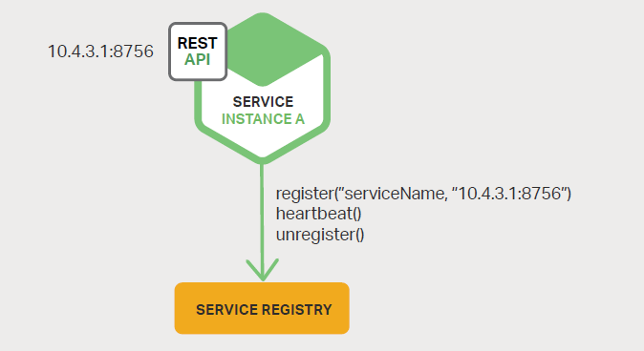
Self Registration Pattern
A service instance is responsible for registering and unregistering itself with the service registry
A service instance sends heartbeat requests to prevent its registration from expiring
Couples the service instances to the service registry

Slide 34
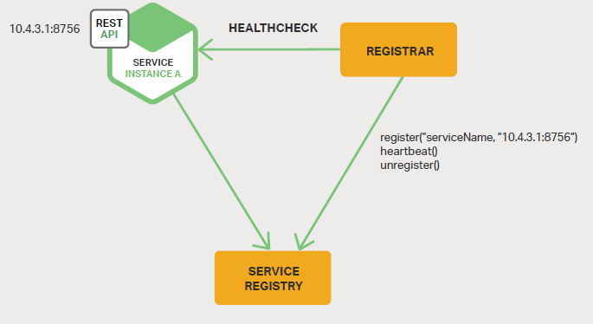
The Third-Party Registration Pattern
A system component known as the service registrar handles the registration
The service registrar tracks changes to the set of running instances by either polling the deployment environment or subscribing to events
When it notices a newly available service instance, it registers the instance with the service registry
The service registrar unregisters terminated service instances.
Services are decoupled from the service registry
Notes:
https://github.com/gliderlabs/registrator
https://github.com/Netflix/Prana
Kubernetes services are automatically registered and made available for discovery

Slide 35
Handling Partial Failures
Partial Failure
This issue arises in all distributed systems whenever one service calls another service that is either responding slowly or is unavailable
Ex:- if the recommendation service is unresponsive in the product details scenario, the API Gateway should return the rest of the product details to the client since they are still useful to the user
The API Gateway could also return cached data if that is available
For example, since product prices change infrequently, the API Gateway could return cached pricing data if the pricing service is unavailable
Use Circuit Breaker Pattern

Slide 36
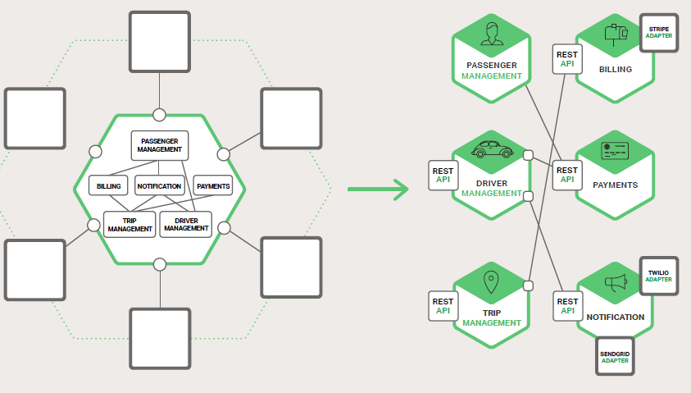
Inter Process Communication

Slide 37
Interaction Styles and Interaction Types
Interaction – Styles
One to One
Each client request is processed by exactly one service instance
One-to-many
Each request is processed by multiple service instances
Interaction Types
Synchronous
The client expects a timely response from the service and might even block while it waits.
Asynchronous
The client doesn’t block while waiting for a response, and the response, if any, isn’t necessarily sent immediately

Slide 38
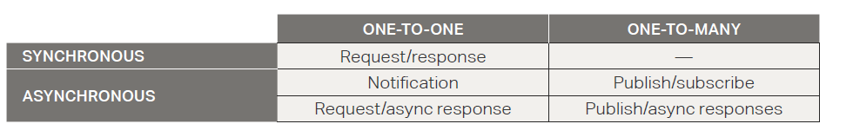
Interaction communication Style

Slide 39
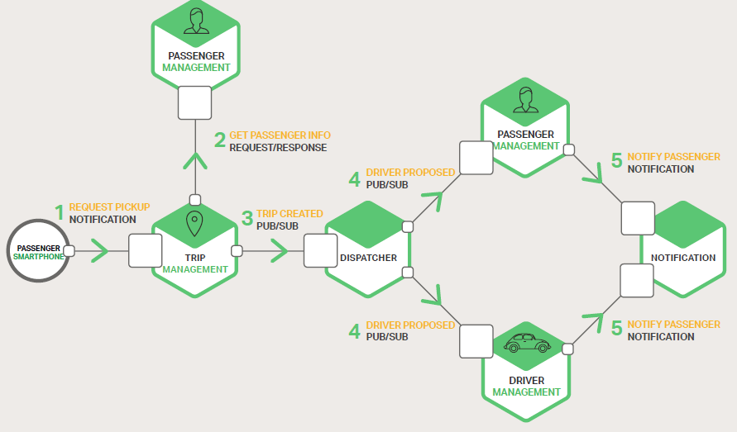
IPC mechanisms for service interactions

Slide 40
Handling Partial Failure
Network timeouts
Never block indefinitely and always use timeouts when waiting for a response
Using timeouts ensures that resources are never tied up indefinitely
Limiting the number of outstanding requests
Impose an upper bound on the number of outstanding requests that a client can have with a particular service
Circuit Breaker Pattern
Track the number of successful and failed requests
Provide fallbacks
Return cached data or a default value, such as an empty set of recommendations
Hystrix , Poly ,

Slide 41
Strategies for Handling Partial Failures
Retry
Allows callers to retry operations in the expectation that many faults are transient and may self-correct: the operation may succeed if retried, possibly after a short delay.
Exponential backoff
Jitter
Circuit Breaker
Prevents calls when a configurable fault threshold is exceeded
Bulkhead Isolation
- A parallelism limit - around one stream of calls
Timeout
Allows callers to walk away from a pending call
Fallback

Slide 42
What is HttpClient factory?
provides configurable logging (via ILogger) for all requests and responses performed by clients created with the factory;
Manages the pooling and lifetime of underlying HttpClientMessageHandler instances
Allows you to name and configure logical HttpClient
Provides configurable logging (via ILogger) for all requests and responses performed by clients created with the factory;
Provides a simple API for adding middleware to outgoing calls, be that for logging, authorization, service discovery, or resilience with Polly.
Manages the pooling and lifetime of underlying HttpClientMessageHandler instances
Consumption Patterns
Basic usage
Named clients
Typed clients
Generated clients
Notes:
https://www.myget.org/feed/refit/package/nuget/Refit
https://docs.microsoft.com/en-us/aspnet/core/fundamentals/http-requests?view=aspnetcore-2.1#logging
https://github.com/App-vNext/Polly/wiki/Polly-and-HttpClientFactory

Slide 43
IPC Technologies
Synchronous Request / Reply
Asynchronous Message Based Communication

Slide 44
Asynchronous, Message-Based Communication
Point To Point Communication
A point‑to‑point channel delivers a message to exactly one of the consumers that are reading from the channel
Publish and Subscribe
A publish‑subscribe channel delivers each message to all of the attached consumers.

Slide 45
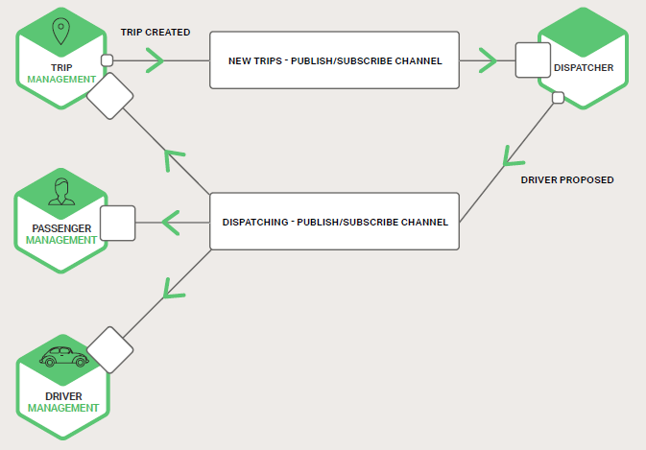
Publisher – Subscriber
RabbitMQ
Apache Kafka
Apache ActiveMQ
NSQ

Slide 46
Advantages and Disadvantaged of using messaging:
Advantages
Disadvantages
Decouples the client from the service
Message buffering
Flexible client-service interactions
Explicit inter-process communication
Additional operational complexity
Complexity of implementing request/response-based interaction
Each request message must contain a reply channel identifier and a correlation identifier

Slide 47
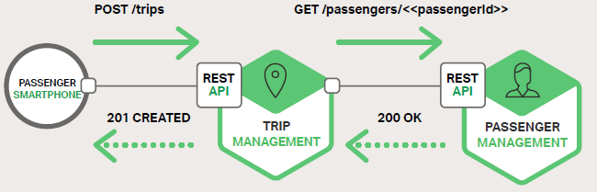
Synchronous, Request/Response IPC
Protocols
HTTP based REST
Thrift

Slide 48
HTTP-based APIs are RESTfull ?
Level 0
Clients of a level 0 API invoke the service by making HTTP POST requests to its sole URL endpoint. Each request specifies the action to perform, the target of the action (for example, the business object), and any parameters.
Level 1
A level 1 API supports the idea of resources. To perform an action on a resource, a client makes a POST request that specifies the action to perform and any parameters.
Level 2
A level 2 API uses HTTP verbs to perform actions: GET to retrieve, POST to create, and PUT to update. The request query parameters and body, if any, specify the action’s parameters. This enables services to leverage web infrastructure such as caching for GET requests
Level 3
The design of a level 3 API is based on the HATEOAS (Hypertext As The Engine Of Application State).
The representation of a resource returned by a GET request contains links for performing the allowable actions on that resource
Notes:
https://martinfowler.com/articles/richardsonMaturityModel.html

Slide 49
Event Sourcing and CQRS
Separates the concern of state management from the concern of receiving stimuli that result in state changes.
Event Source System Concerns
Ordering and Proper time management
Event streams are ordered
Performing calculations against the same set of events but in a different sequence will produce different output
Idempotent
Any function that operates on an event stream must always return the exact same result for identical ordered event streams
Isolated
Any function that produces a result based on an event stream cannot make use of external information. All data required for calculations must be present in the events

Slide 50
Eventual Consistency
sacrifice immediate consistency for scale
complexity leak
The internal workings (or limitations) of our system could leak out of our service and force our clients to bear the burden of additional complexity

Slide 51
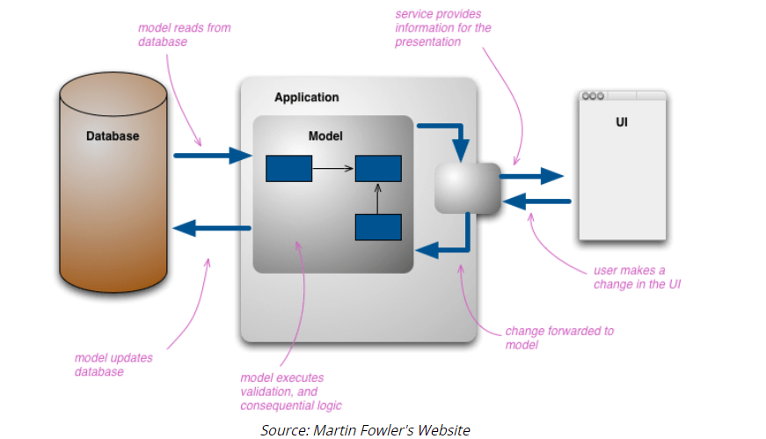
Why CQRS

Slide 52
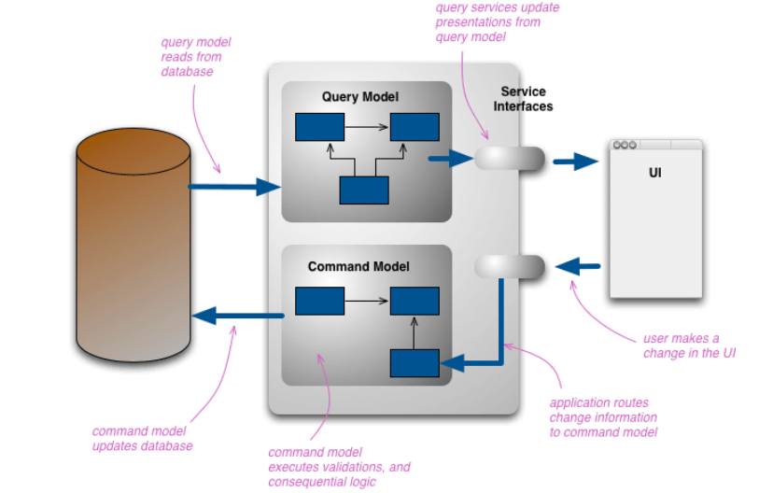
CQRS

Slide 53
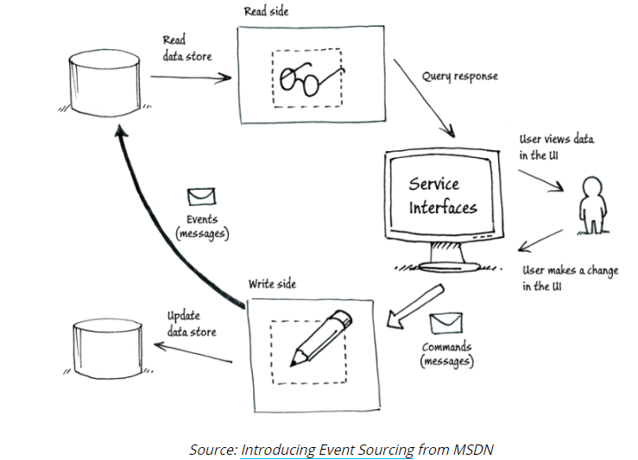
EventSourcing

