Slide 1

TEST AUTOMATION IN BDD WAY
Sushil Tade – Sr. Software Engineer
Mahantesh Maganur – Sr. Project Manager
Philips Healthcare
Philips India ltd. Bangalore

Slide 2


Abstract
BDD Approach for automation testing
Automation testing in an agile way using Behavior Driven Development approach i.e. GWT or Given When Then. The primary purpose is to encourage communication amongst the stakeholders of the project so that the context of each feature is correctly understood by all members of the team (i.e. shared understanding) through ubiquitous language.
Developers/Automation engineers write automated tests for each steps called as step definition. The advantage of BDD over Automation script is to reusability of GWT steps, modularity, scaling the feature, use existing steps definition to create new suites.

Slide 3
Agenda
What is BDD?
Writing test using BDD- with example
Components of BDD
Structure of feature file
What is GWT
Single scenario execution flow
BDD automation flow in Agile development
Advantages
Tools and technologies used
Success story

Slide 4
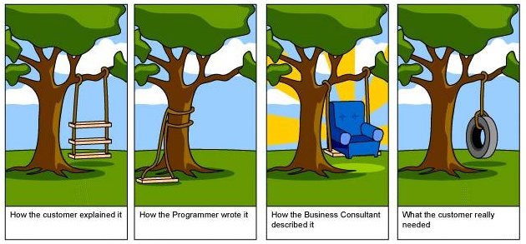
What is BDD?
Behavior Driven Development (BDD) focuses and associates behavioral specifications
with each unit of software.
Encourages collaboration between Product owner, QA Engineers, Developers and
Business Owners through ubiquitous language.
Extends TDD by utilizing natural language that non-technical stakeholders can understand
Helps in bridge gap between Business & Technical language
Image: http://www.jacobsen.no/anders/blog/archives/images/project.html

Slide 5
Traditional Test Case Vs Behavior Driven Development Scenarios (Gherkin)
Steps/Actions | Expected Result
Open Instant messenger in ABC website | Instant messenger is opened
Login into ABC website | Instant messenger home page is displayed
Click on Instant messenger tab | Online friends gets displayed
Scenario: Verify friends are online in Instant messenger (IM)
Given IM is available in ABC website
When I log into ABC social website
And I open up the IM tab
Then I should see my online friends

Slide 6
What is GWT?
Given
<Preconditions and/or Inputs>
When
<The action under test>
Then
<The expected outcome or verification>
Scenario: Verify friends are online in Instant messenger (IM)
Given IM is available in ABC website
When I log into ABC social website
And I open up the IM tab
Then I should see my online friends

Slide 7
Components of BDD
Feature
Background
Scenario
GWT
After Scenario
Scenario Outline
Before
Scenario
Step
Step Definition

Slide 8
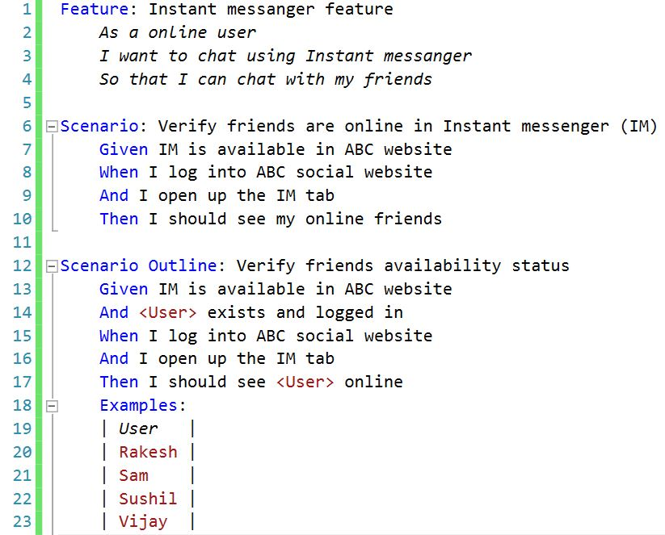
Structure of Feature File
Feature file
Scenario Or
Scenario outline
Scenario Or
Scenario outline
Step
Step
Step Definition
Step Definition

Slide 9
BDD Style: The Step & Step Definition Example (Binding)
Step Definition
Steps
[Given(@"IM is available in ABC website")]
public void GivenIMIsAvailableInABCWebsite()
{
ScenarioContext.Current.Pending();
}
Given IM is available in ABC website
[When(@"I log into ABC social website")]
public void WhenILogIntoABCSocialWebsite()
{
ScenarioContext.Current.Pending();
}
When I log into ABC social website
[Then(@"I should see my online friends")]
public void ThenIShouldSeeMyOnlineFriends()
{
ScenarioContext.Current.Pending();
}
Then I should see my online friends

Slide 10
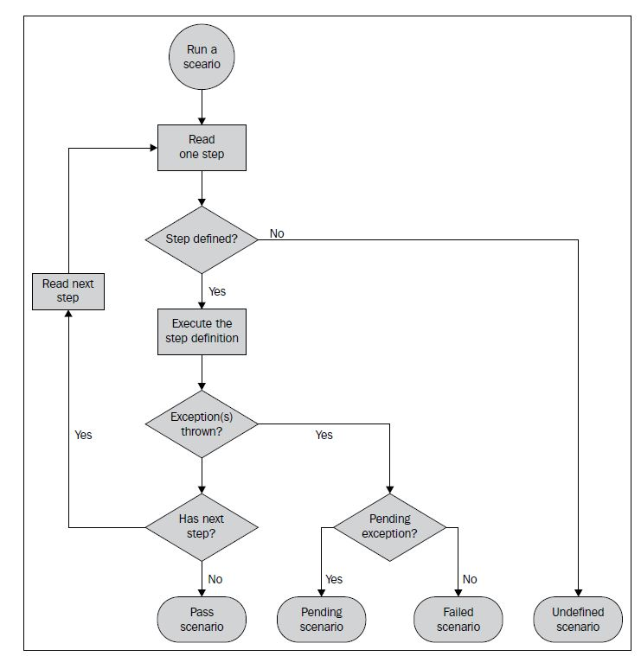
Scenario Execution flow (Single Scenario)

Slide 11




BDD automation flow in Agile Development
Acceptance Criteria -1
Scenario: Verify friends are online in Instant messenger (IM)
Given IM is available in ABC website
When I log into ABC social website
And I open up the IM tab
Then I should see my online friends
Common Understanding
Tester
Common Understanding
User Story-X
Acceptance Criteria -2
Scenario: Verify friends are online in Instant messenger (IM)
Given IM is available in ABC website
When I log into ABC social website
And I open up the IM tab
Then I should see my online friends
Developer
Business Analyst
Acceptance Criteria transforms to Given-When-Then Steps (Gherkin)
Common Understanding
Acceptance Criteria -n
Gherkin tool (Spec flow/cucumber) transforms steps to method stub
[Given(@"IM is available in ABC website")]
public void GivenIMIsAvailableInABCWebsite()
{
ScenarioContext.Current.Pending();
}
[When(@"I log into ABC social website")]
public void WhenILogIntoABCSocialWebsite()
{
ScenarioContext.Current.Pending();
}

Slide 12
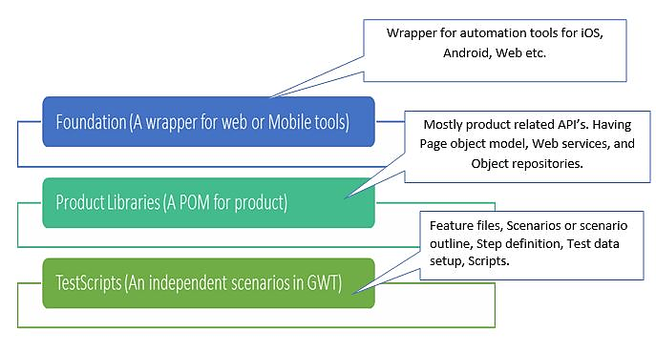
Value add
Reusability – using layered framework

Slide 13
Value add
Structured approach of tagging for consistent information across team members
User Story
Scenarios
Tags
@committed
@manual
@development
@complete
@script_review
1 Once committed
& Approved
2 Sent for scenarios review
Ready for review
3 QA decision
Automatable ?
No
Yes
@manual
@development
Scripting
4 @script_review
Script review
5 Scenarios marked as @complete
Address comments

Slide 14
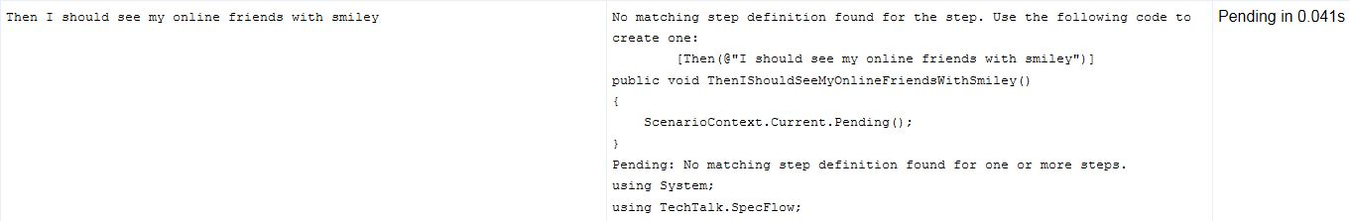
Value add
How BDD supported tool notify change in scenario?
Scenario: Verify friends are online in Instant messenger (IM)
Given IM is available in ABC website
When I log into ABC social website
And I open up the IM tab
Then I should see my online friends
Scenario: Verify friends are online in Instant messenger (IM)
Given IM is available in ABC website
When I log into ABC social website
And I open up the IM tab
Then I should see my online friends with smiley
Original scenario
Scenario updated by QA
Test failed error occurred in specflow with Pending status

Slide 15

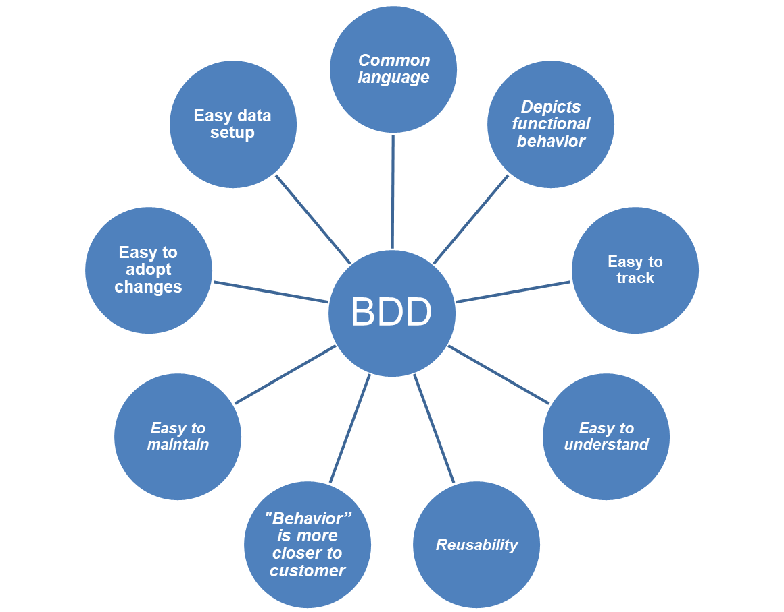
Advantages of BDD for Automation

Slide 16
Tools & Technologies used
.NET libraries
  Appium – Mobile automation
  Selenium – Web automation
  Specflow – BDD
  SpecRun – Report generation
C# as programming language

Slide 17
Success Story of a healthcare application automation
Effort Saved due to Automation( Per Execution)
 | # Number of Scenarios | # Scenarios Automated | % Of test Automation | Benefits
Native | 603 | 444 | 74% | 30 Man Days
Web | 653 | 560 | 85% | 25 Man Days

Slide 18
References
http://toolsqa.com/specflow/specflow-tutorial/
https://cucumber.io/docs
http://www.specflow.org/ - Cucumber for .NET

