Slide 1
TypeScript
JavaScript Simplified

Slide 2
Why should I write my JavaScript using TypeScript?
It is a lot easier to write JavaScript code in TypeScript mode than doing it directly as JavaScript. This is especially true when it comes to larger or more complex programs.
TypeScript is also safer to write due to its type checking features, which minimize potential problems as the code expands, or when writing code as a team.
The learning curve for mastering the language is a lot shorter when using TypeScript. Advanced JavaScript is much more complex.
Just like JavaScript, TypeScript is an open source computer language that transcompiles(language-to-language translation) to JavaScript. It was specifically created by Microsoft to work under JavaScript syntax rules. This means that almost any JavaScript code is also TypeScript.
There are many advantages on writing in TypeScript as opposed to doing it directly in JavaScript such as code safety, which prevents unnoticeable errors, added features like classes, interfaces, modules, static data types, creation of enumerable lists and much, much more.
The new AngularJS version is officially tuned to use TypeScript instead of JavaScript and this is because of its type checking capabilities. That in itself is reason enough to learn the language features added to TypeScript so that we can use them while creating Angular projects.

Slide 3
Declaring a variable and type classification
Method 1 – Declaration and Assignment
var myName = "Tony";
var myNumber = 99;
var isAparent = true;
Method 2 – Declaration without Assignment
var myName: string;
var myNumber: number;
var isAparent: boolean;
Method 3- Declaration and Assignment
var myName: string = "Tony";
var myNumber: number = 33;
var isAparent: boolean = true;
Using the keyword any as a variable data type
var xyz: any;
Then...
xyz = 6; //ok
xyz = "Tony"; // ok
xyz : string = "test"; // ERROR because xyz already has an assigned type

Slide 4
TypeScript Coding Guidelines
https://github.com/Microsoft/TypeScript/wiki/Coding-guidelines
https://mothereff.in/js-variables
To check whether identifier is a reserved keyword or not?
github.com/Microsoft/TypeScript/issues/2536 [6]
List of reserved words

Slide 5
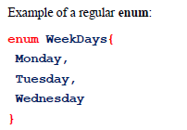

The enum data type
enum stands for enumeration.
Enumeration is used whenever we want to create a collection of fixed named elements, such as the days of the week, or the months of the year.
These names are also known as constants.
In an enum, each name in the collection of names is assigned to a number
we can recall each name by calling its corresponding index number
By default, an enumeration starts from zero (as the first value) but we can override the starting position by assigning the first name to a different number

Slide 6
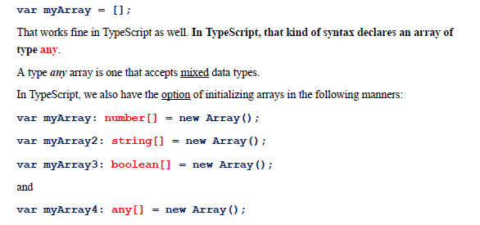
Initializing arrays in TypeScript

Slide 7
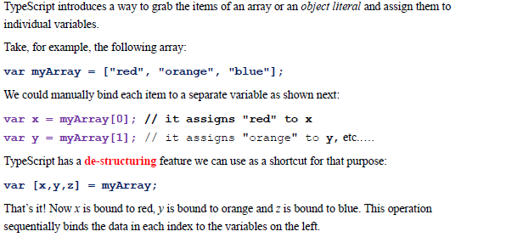
Using de-structuring to individualize data from arrays or objects
When it comes to de-structuring arrays, the sequence of presenting your variables is important because the values will be assigned from left to right.

Slide 8
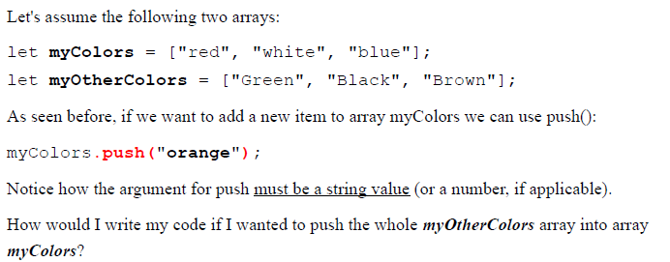
The Spread Operator
Spread operators can be used whenever we need to submit the contents of a complex data structure as individual data components
The spread operator is represented by the three-dot ellipsis (...).

Slide 9
Functions
Making sure the function input data type is validated
TypeScript helps us create rules for the type of data we intend to use.
TypeScript, we can specify what kind of return data type we intend to use in the function,

Slide 10

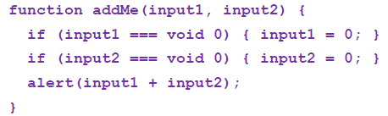
Setting default parameter values
TypeScript introduces the ability to set default values to the input parameters of a function
When mixing default parameters with regular parameters, make sure your default parameters are programmed to the right of the regular parameters

Slide 11
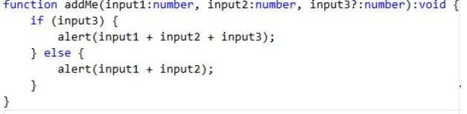
Optional Parameters
An optional parameter is followed by a question mark “?”.
Like in default parameters, just make sure your optional parameters are the last parameters to the right,

Slide 12

A REST parameter
A REST parameter accepts ‘all the other arguments’
The rest parameter syntax allows a function to represent an indefinite number of arguments as an array of arguments
A function with a rest parameter is also called a variadic function in other languages.
The rest parameter needs to be the last option in the parameter signature layout (or the only one).
To indicate that a parameter is a rest parameter we prefix it with three dots.

Slide 13
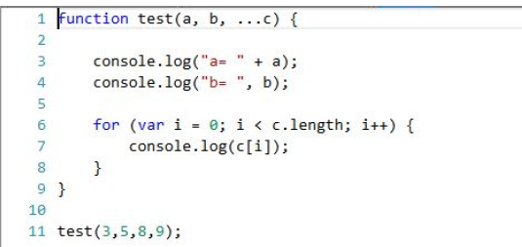
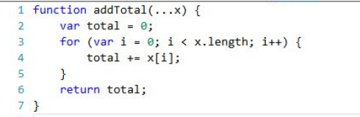
A rest parameter must be of an array type. This is done automatically

Slide 14

Arrow Functions
An arrow function expression is a shortcut for a function expression (which is an anonymous function assigned to a variable
Arrow functions are also known as lambda expressions

Slide 15
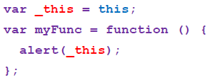

About the THIS in arrow functions
Arrow functions have no "this"
Notice how TypeScript changes the term "this" to "_this" and then it creates a global variable named "_this" which points to the global "this".

Slide 16
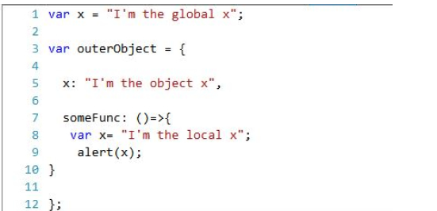
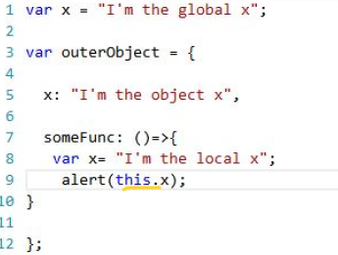
What is the output ?

Slide 17
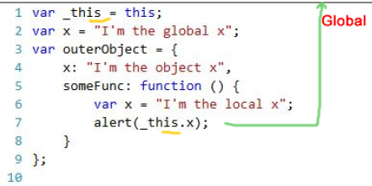
TypeScript assumes that the programmer wants to access the global environment.

Slide 18
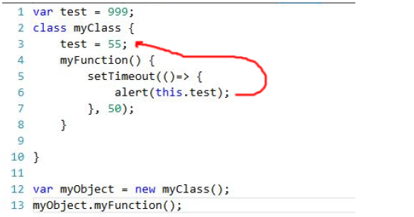
Arrow functions assure the correct context in classes

Slide 19
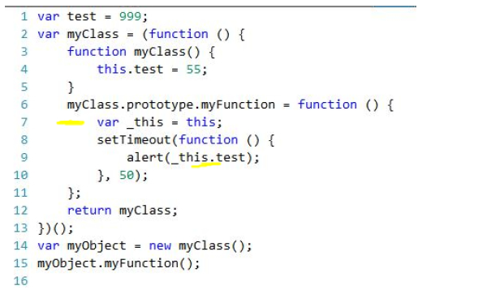
Transcompiled code

Slide 20
Summary
Arrow functions in TypeScript do not have a “this” keyword.
Every time we include a “this” in an arrow function, the TypeScript interpreter replaces it with “_this”, and then it creates a new variable in the global context or, if a class is being used to instantiate the object, in the class context.
Avoid using “this” in arrow functions unless you use it to solve problems such as context problems
The purpose of the fake “this” in an arrow function is to set the “this” where the function is created, rather than setting it in the context where the function is invoked.

Slide 21
Function Overloading
Function overloading in TypeScript limits a function with type any parameters to the specific types available in the declared signatures.
Function overloading narrows the scope of the type any to the available(authorized by the programmer) signatures.
Keep in mind that since TypeScript allows for optional parameters in functions, you may find the optional parameters feature to be a better solution for the outcome you want to achieve, instead of using the overloading

Slide 22
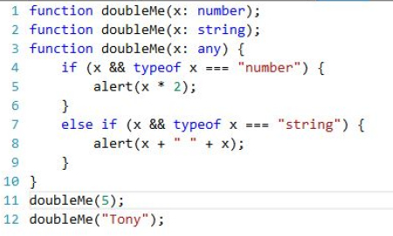
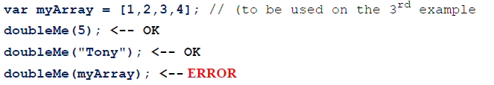

Slide 23
Interfaces
An interface sets the rules for object creation (or the creation of any other type such as arrays and functions
The advantage of building an interface (or custom data type), is that we can safely recreate other individual objects based on the same rules.
The interface becomes a template with rules for a certain type of object creation (this is not a class).
The only job of an interface in TypeScript is to describe a type.
Class and Function deal with implementation while an interface helps us keep our programs error-free by providing information about the type of the data we work with
Interfaces allow us to create custom data types in TypeScript.
An interface acts as a contract, which needs to be followed if implemented (if assigned to another construct).
Interfaces ensure TypeScript type-checking features. (We tell TypeScript to inspect the code as we write it).
Interfaces do not add ‘bulk’ to memory because the overall type information is erased from a TypeScript program compilation
We can freely add customized data types by using interfaces without worrying about the runtime overhead

Slide 24
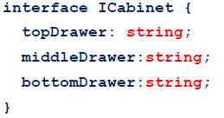
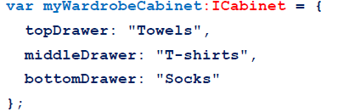
Interface programming
How to create an interface
Establish the rules of the interface
Assigning an interface type to an object
myWardrobeCabinet is now of type ICabinet

Slide 25
Things to know
Interfaces regulate the data type of the properties used by their subscribers
Interfaces also regulate the number of properties a subscriber should have.
Interfaces regulate the name of the properties used by its members

Slide 26

Protocol Syntax
Declaring an object assigned to an interface but with no property values
The properties were implicitly assigned to the object, but they are all set to the value of undefined.

Slide 27
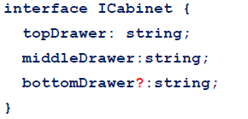
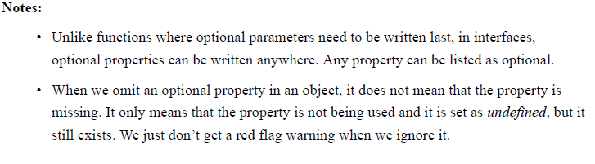
How to create optional properties

Slide 28


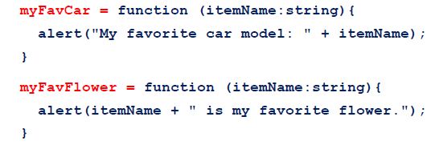
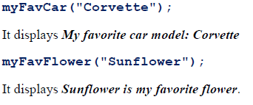
Using an interface to describe a function
A function signature is the top part of the function where we declare the parameters and the type of return statement we want to have. The function name is not part of the signature

Slide 29
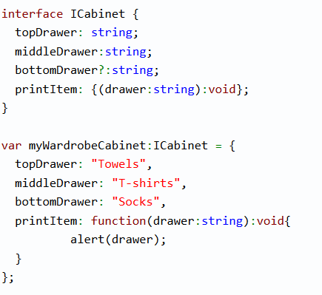
Adding a function (or method) to an object Interface

Slide 30
Using an interface to describe an Array type
We can also create interfaces to set the type rules for arrays.
There are two kinds of array interfaces:
numerically indexed (used for regular arrays)
string-indexed (used to represent objects with an unlimited number of properties)

Slide 31
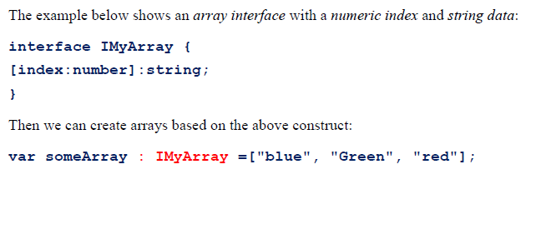
Numeric indexed array interfaces

Slide 32
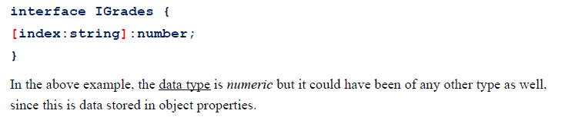
String-indexed array interfaces
Well, there is no such thing as a string-indexed array.
Actually an object with the curly braces {}.
By using a string-indexed array interface, we can declare one single property rule that applies to all properties of the object (almost like an array of property types). This allows for an unlimited number of properties in the object.

Slide 33
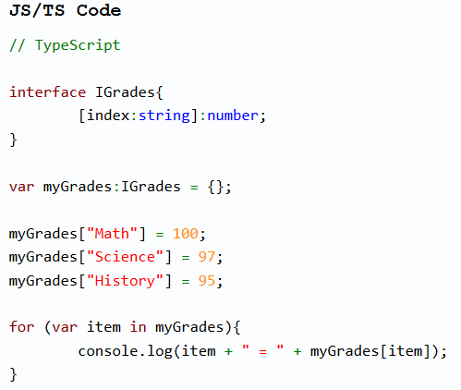


Slide 34
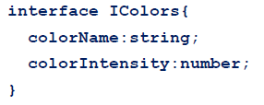
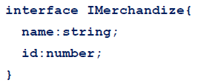
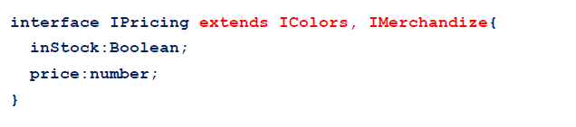
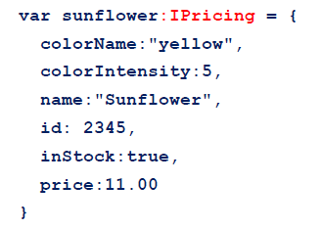

Extending Interfaces
Extending interfaces means to add a second or more interfaces to another interface in order to take advantage of existing rule sets and avoiding repetition.

Slide 35

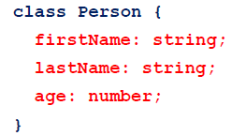
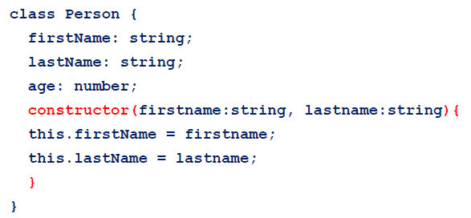
Class
A class is the template structure that defines a live object
Creating a class

Slide 36
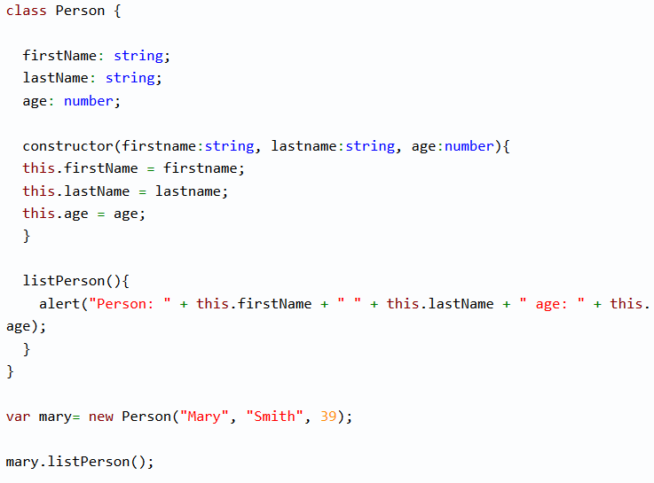

Slide 37
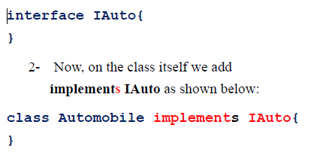
Implementing classes from interfaces

Slide 38
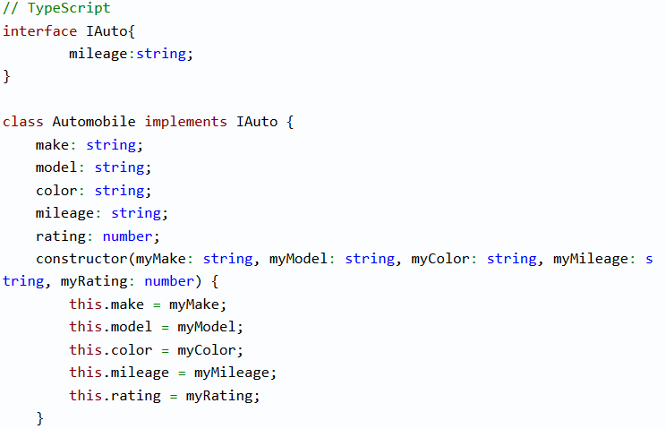
Class and interface

Slide 39
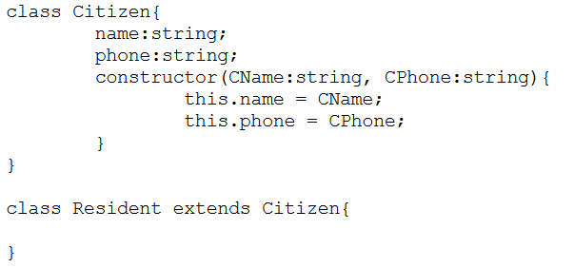
Extending classes by using other classes

Slide 40
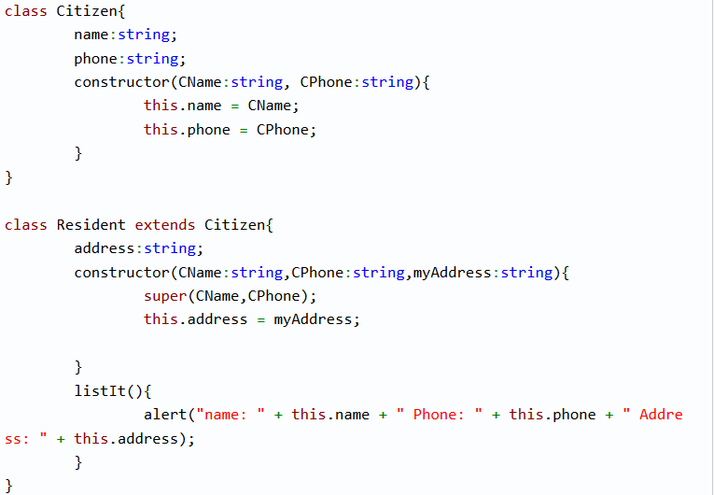
How to add a constructor to the child class

Slide 41
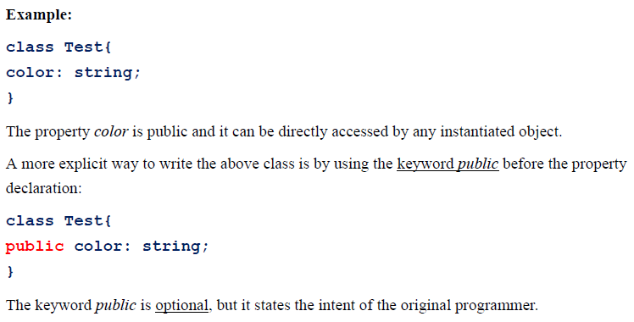
Public properties

Slide 42

Readonly – a TypeScript 2.0 feature

Slide 43
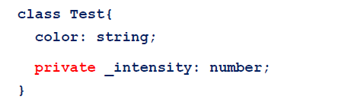

Private members

Slide 44


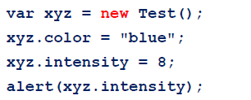
How do we get the value from a private property, or set a new value for a private property?

Slide 45
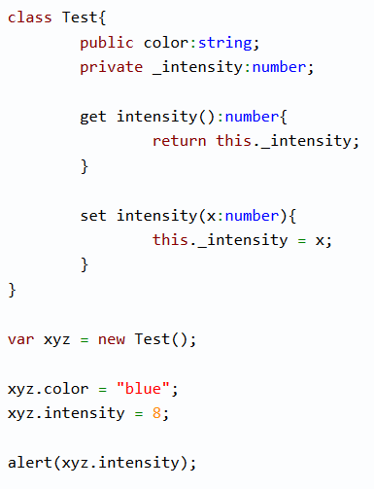

Slide 46
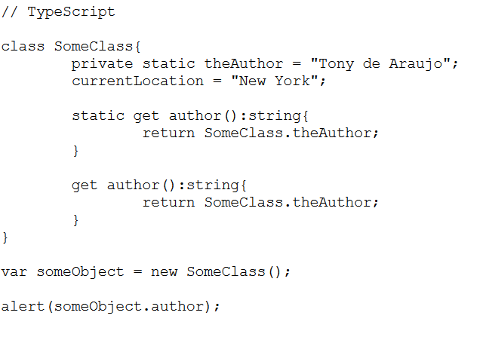
Static properties in a class

Slide 47
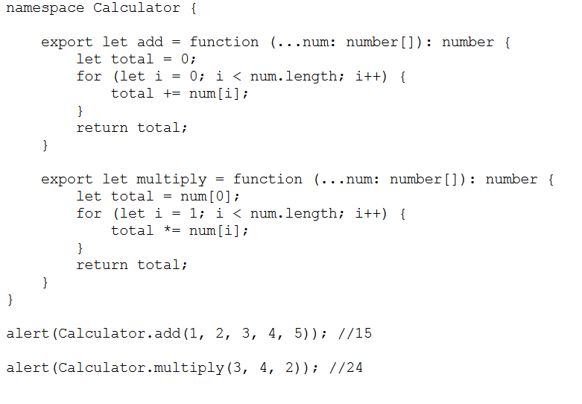
Namespaces

Slide 48
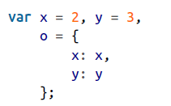
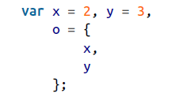
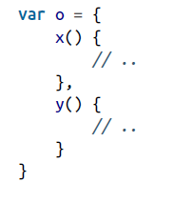
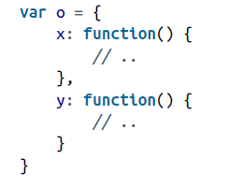
Object Literal Extensions
Concise Methods

Slide 49
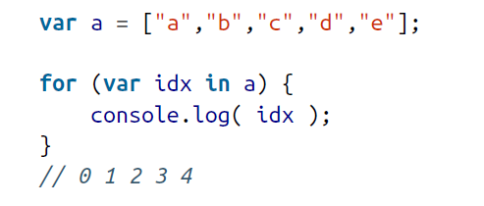
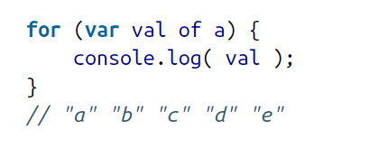
for….of loop

Slide 50
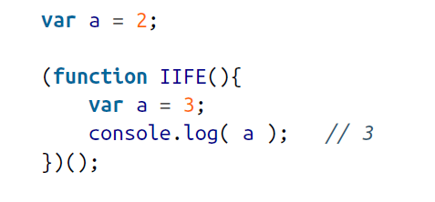

Block-Scoped Declarations

Slide 51


const Declarations

Slide 52

Template Literals

Slide 53

Interpolated Expressions

Slide 54

Tagged Template Literals

Slide 55


Slide 56

Async Flow Controllers(Promises)
Promises provide a trustable intermediary — that is, between your calling code and the async code that will perform the task — to manage callbacks
A Promise can only have one of two possible resolution outcomes: fulfilled or rejected
once a promise is resolved, it’s an immutable value that cannot be changed.

Slide 57



Slide 58


Slide 59








Collections-Maps

