Slide 1
GIT
What is changed?
SVN -> GIT
ATLASSIAN -> GITHUB
Supporting scripts (<issue>.txt/.sql)
Git Structure
Git Environments
Git branch
Supporting script Templates
Work flow
Demo (Video) by Nada

Slide 2
What is changed?
In SVN, you have a revision(HEAD) of repository in your local directory.
In GIT, you will have entire repository in your directory.
In SVN your changes are tracked using revision numbers.
In GIT, your changes are tracked using branch.(uses hash to track).
In SVN, all changes are pulled from /committed to SVN server residing on cloud.(Atlassian)
In GIT, you commit your changes to your local directory. Then you push your changes to local server. CMSupport will push your changes to cloud.(Github)

Slide 3
What is changed?
In SVN, remote server is ATLASSIAN.
In GIT, remote server is GITHUB.
Supporting documents:
In SVN, Issue related documents (like issue.txt, issue.sql) are uploaded to ATLASSIAN.
In GIT, you will commit these to <<project>>.wiki repository and will push to local server. Files need to have .asciidoc extension*. (CMSupport will link these documents in GITHUB).

Slide 4
What is changed?
In SVN, DB objects are compiled based on revision number specified in <issue>.txt file.(SVN Client is installed on DBA machines, so they also use revision number to get correct copy to compile objects)
Since GIT is not installed on DBA machines, developers create <issue>.shl.asciidoc*. This script creates issue folder and copy objects from Issue branch. DBAs run driver script from this folder.

Slide 5
GIT STRUCTURE
GITHUB
LOCAL GIT SERVER (Z:\gitreps)
CMSupport
Developer1
Developer2

Slide 6
GIT Environments
dvlp
test
prod (master)
Unlike in SVN, in GIT, you need to request CM support to process issue in dvlp environment also.

Slide 7
GIT Branch
Branch is the copy of master at the time when you requested issue.
For each issue request, CM support creates issue in GITHUB, issue branch in local GIT server. You will check out this branch on to your working directory.
When you promote issue to dvlp/test/prod, issue objects are merged to dvlp, test, master branches. Then issue branch is deleted.*
You can switch between branches.*

Slide 8
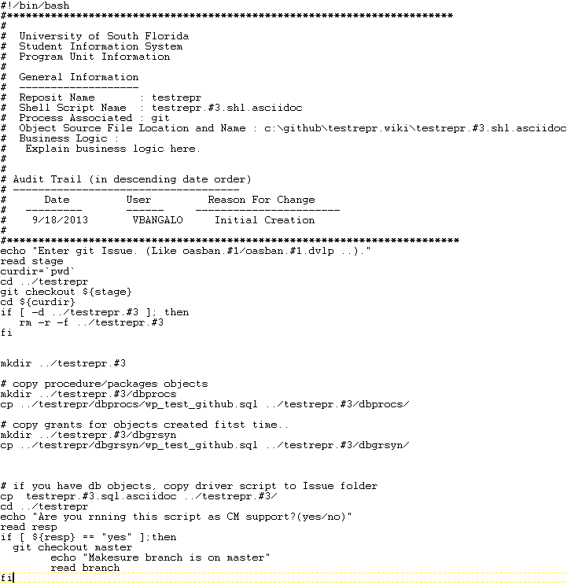
Templates: <Issue.shl.asciidoc>

Slide 9
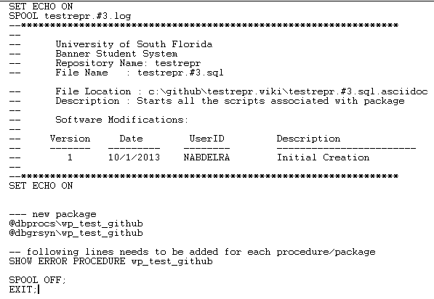
Templates: <issue.sql.asciidoc>

Slide 10
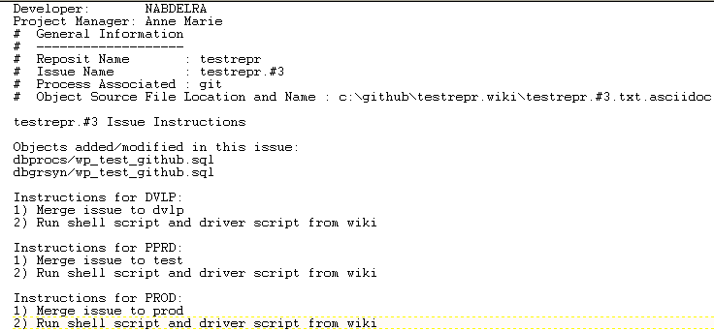
Templates: <issue>.txt.asciidoc

Slide 11
Common Steps Developer needs to remember
Run Clone.shl First time from Git Bash
Run Checkoutissue.shl from Git Bash before working on issue.
Commit your code changes and push to local server using Git Gui (stage changes, commit, push)
Commit supporting documents using Git Gui
Run updatewiki.shl from Git Bash
Push supporting documents using Git Gui.

Slide 12
WORK FLOW
Developer:
Clones Project and Project.wiki (first time)
Request for issue.
CM Support:
Creates a issue in GITHUB
Creates issue branch in local GIT server and assigns to developer
Developer:
Checks out issue branch from local GIT server.

Slide 13
WORK FLOW
Changes code in working directory
Commits changes to working directory
Creates supporting documents for issue. (Issue.shl.asciidoc, Issue.txt.asciidoc, issue.shl.asciidoc etc).
Commits to project.wiki folder
Pushes Issue changes to local server
Pushes supporting documents to local server
Requests CM Support to promote to dvlp stage

Slide 14
Process Steps
CM Support:
Pulls issue related objects from local server and merges to dvlp
Pulls supporting documents, and, if required, compiles database objects
Pushes objects to GITHUB
Updates issue with supporting documents.
Developer:
Requests CM Support to move Issue to test
CM Support:
Merges issue to test
Move objects to GITHUB
Developer:
Requests CM Support to move Issue to Prod
CM Support: Merges issue to prod.

