Slide 1
Nutrition agent
IBM HACKATHON PROJECT
Presented By:
Student name : Venu Gopal Reddy Palugulla
College Name & Department : Galgotias University & MCA

Slide 2
OUTLINE
Problem Statement
Technology used
Wow factor
End users
Result
Conclusion
Git-hub Link
Future scope
IBM Certifications

Slide 3
Problem Statement
Individuals seek personalized nutrition, but existing tools offer generic plans, lack adaptability, and ignore holistic factors(lifestyle, culture, allergies, evolving health). Dietitians and nutritionists face limitations in scaling personalized consultations due to time and resource constraints.
Proposed Solution: A Nutrition AI Agent that uses Natural Language Processing (NLP), Retrieval-Augmented Generation (RAG), to assist users , generating personal efficient meal plans based on health goals, medical conditions, fitness, routines, and preferences. Bridges the gap between one-size-fits-all diet apps and in-person nutrition counseling.

Slide 4
Technology used
IBM cloud lite services
Natural Language Processing (NLP)
Retrieval Augmented Generation (RAG)
IBM Granite model

Slide 5
IBM cloud services used
IBM Cloud Watsonx AI Studio
IBM Cloud Watsonx AI runtime
IBM Cloud Agent Lab
IBM Granite foundation model

Slide 6
Wow factors
This agent will significantly reduce research time, improve the quality of results , help early-stage researchers find direction, and foster interdisciplinary collaboration by making knowledge more accessible and actionable.
Truly Personalized: Considers holistic lifestyle, cultural preferences, allergies, and evolving health conditions.
Contextual Learning: Explains why recommendations are made, fostering understanding.
Dynamic Adaptation: Continuously learns and refines suggestions based on user feedback.
Scalable Personalization: Enables personalized guidance at scale, overcoming dietitian limitations.

Slide 7
End users
Individuals seeking personalized nutrition guidance.
People with specific health goals (weight management, muscle gain, etc.).
Those with evolving health conditions requiring adaptable meal plans.
Fitness enthusiasts and athletes.
Anyone looking to adopt healthier eating habits.

Slide 8
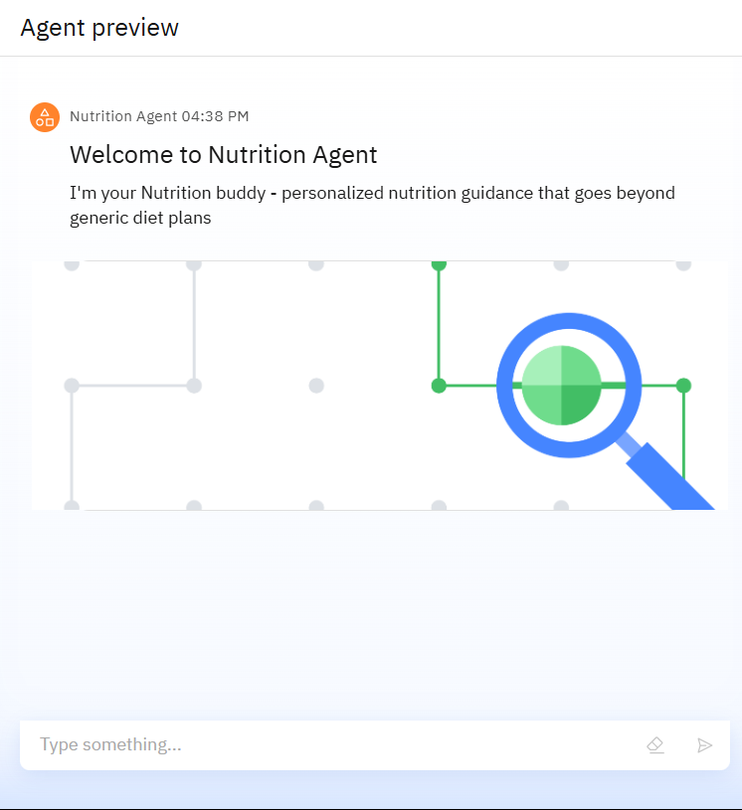
Results

Slide 9
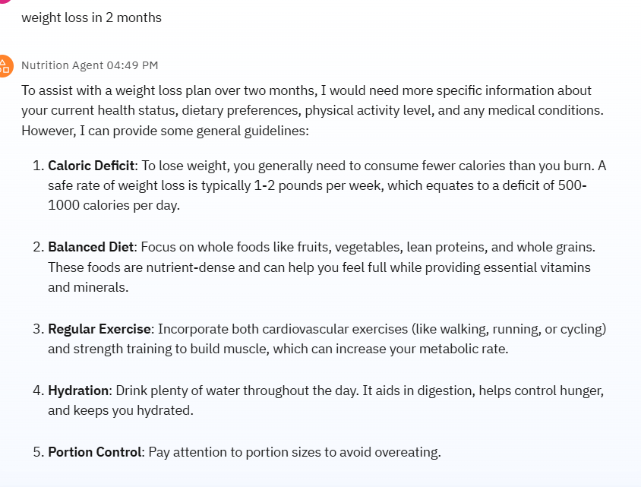
Results

Slide 10
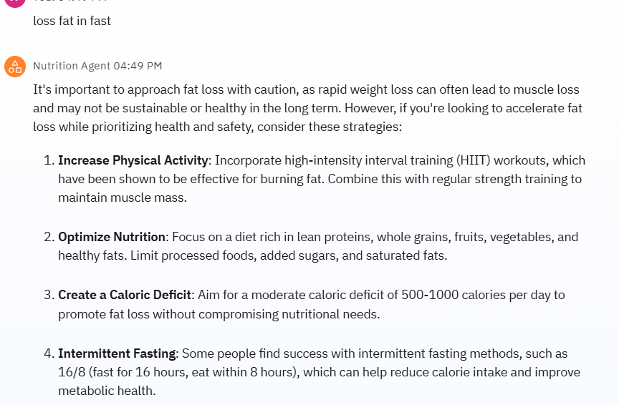
Results

Slide 11
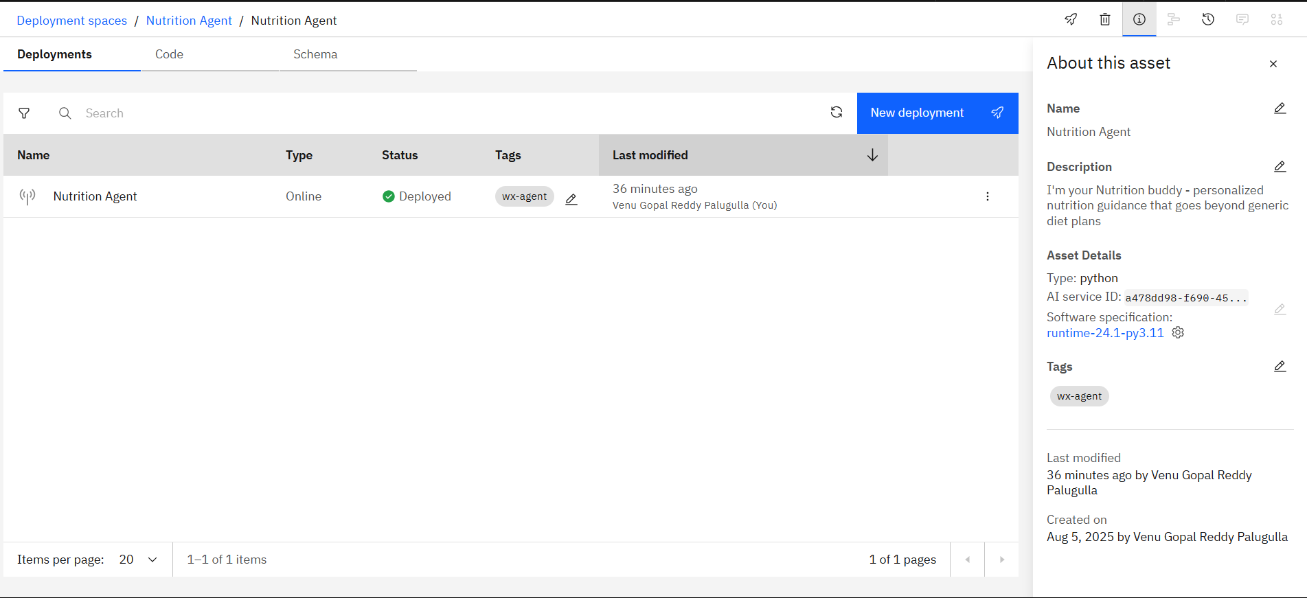
Results
Deployed AI Agent

Slide 12
Conclusion
The Smartest AI Nutrition Assistant provides a groundbreaking solution for personalized nutrition.
It leverages generative AI, multimodal understanding, and adaptive learning to offer tailored meal plans and explanations.
The agent enhances user confidence and promotes healthier lifestyles by bridging the gap between generic apps and expert consultations.

Slide 13
GitHub Link
https://github.com/venu0807/Nutrition_Agent

Slide 14
Future scope
Integration with wearable fitness trackers and health apps for real-time data.
Advanced disease-specific dietary management.
Integration with grocery delivery services for automated shopping lists.
Community features for sharing progress and tips.
Support for more languages and regional cuisines.
Integration with smart kitchen appliances.

Slide 15
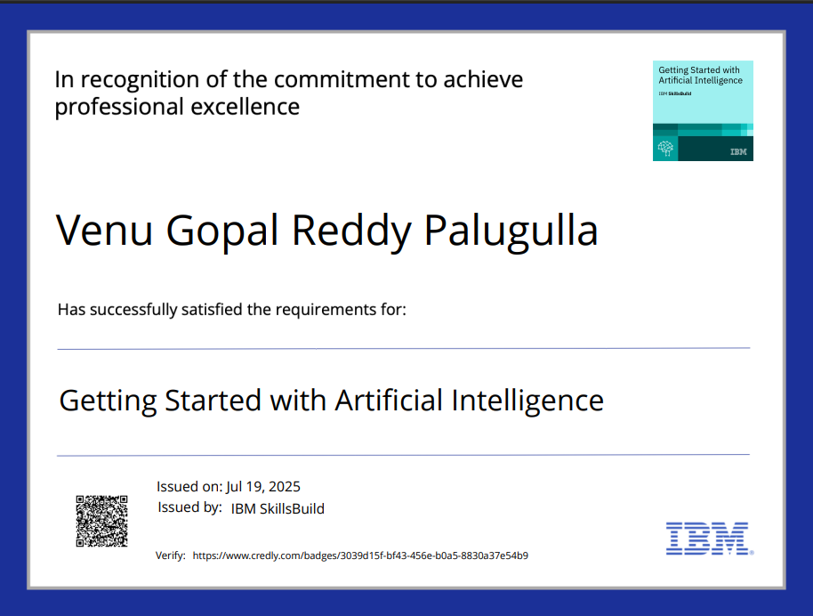
IBM Certifications

Slide 16
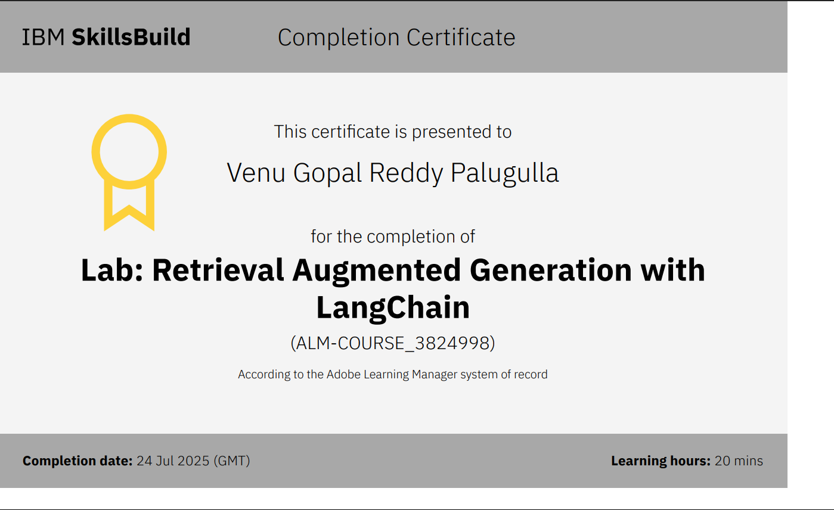

Slide 17
THANK YOU

