Slide 1
Building a smatter AI-powered spam classifier
Enhancing Email Security

Slide 2
Introduction about email spam
The upsurge in the volume of unwanted emails called spam has created an intense need for the development of more dependable and robust antispam filters. Machine learning methods of recent are being used to successfully detect and filter spam emails.
An email box folder filled with spam messages. Email spam, also referred to as junk email, spam mail, or simply spam, is unsolicited messages sent in bulk by email (spamming). The name comes from a Monty Python sketch in which the name of the canned pork product Spam is ubiquitous, unavoidable, and repetitive.

Slide 3


FEATURES
Machine learning
Natural language processing
Feedback loop

Slide 4
Importance of spam classifier
In order to combat this problem effectively, implementing an SMS spam classifier is crucial. An SMS spam classifier is a machine learning model that can accurately identify and filter out spam messages from legitimate ones. Its purpose is to analyze the content, context, and other features of incoming messages to determine their spam probability.

Slide 5

Most popular spam email algorithms.
Some of the most popular spam email classification algorithms are Multilayer Perceptron Neural Networks (MLPNNs) and Radial Base Function Neural Networks (RBFNN). Researchers used MLPNN as a classifier for spam filtering but not many of them used RBFNN for classification.

Slide 6
Challenges in spam filtering
The art of spam filtering should be well understood. So how come there's still room for new and innovative techniques to improve the accuracy of spam filtering?
There are even dedicated academic conferences, talking about new ideas in spam filtering, such as CEAS and the MIT Spam Conference. What's going on?
The first automatic spam filters were probably the USENET cancelbots, which used mathematical techniques such as the Breidbart Index (incidentally, we just passed the 16th anniversary on April 12 of the first major USENET spam). Since then, more and more techniques have been invented -- some have fallen into disuse, but others have found their way into common usage in some kind of Darwinian fight for the survival of the fittest techniques.

Slide 7

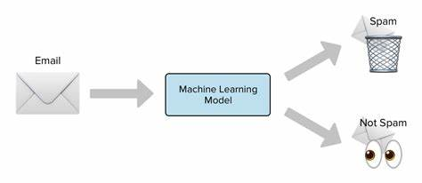




Spam detection method

Slide 8
STEPS INVOLVED IN CLASSIFICATIOON OF SPAM
Define the problem
Data collection
Data processing
Data splitting
Model selection

