Slide 1
Name : A Chatura Class : 7th Roll No : 4 Section : A

Slide 2
Womens Who Made INDIA Proud

Slide 3
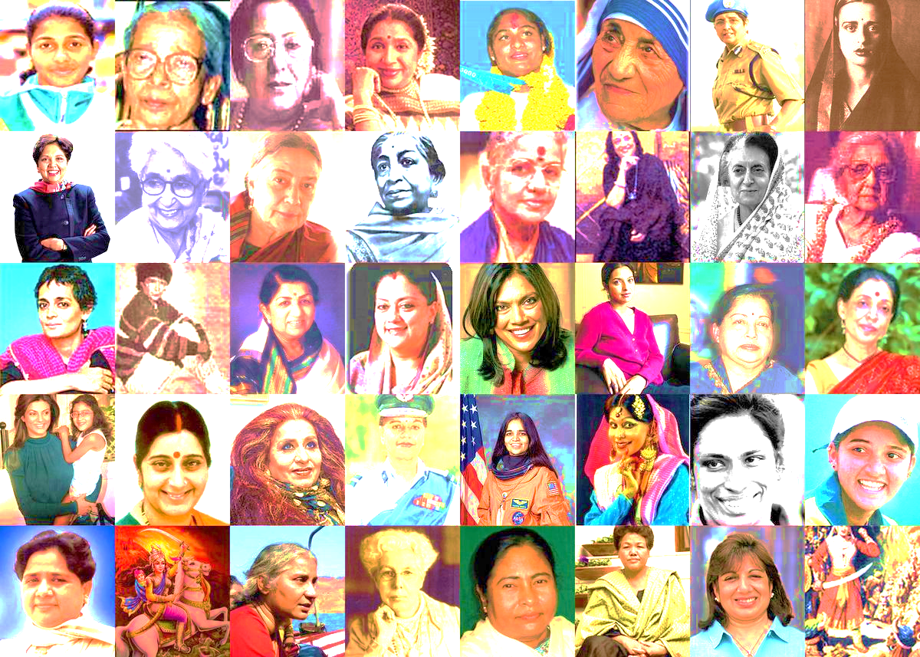
Agenda
Mother Teresa
Hima Das
Sarojini Naidu
Indra Nooyi
Rani Lakshmibai

Slide 4
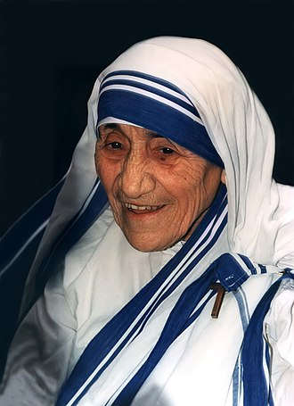
MOTHER TERESA
Mary Teresa Bojaxhiu MC (born Anjezë Gonxhe Bojaxhiu, Albanian: 26 August 1910 – 5 September 1997), better known as Mother Teresa,[a] was an Albanian-Indian Catholic nun and the founder of the Missionaries of Charity. Born in Skopje, then part of the Ottoman Empire,[b] she was raised in a devoutly Catholic family. At the age of 18, she moved to Ireland to join the Sisters of Loreto and later to India, where she lived most of her life and carried out her missionary work. On 4 September 2016, she was canonised by the Catholic Church as Saint Teresa of Calcutta. One of the miracles that were a prerequisite for her canonisation has been challenged. The anniversary of her death, 5 September, is now observed as her feast day.
Mother Teresa founded the Missionaries of Charity, a religious congregation that was initially dedicated to serving "the poorest of the poor" in the slums of Calcutta. Over the decades, the congregation grew to operate in over 133 countries, as of 2012,[6] with more than 4,500 nuns managing homes for those dying from HIV/AIDS, leprosy, and tuberculosis, as well as running soup kitchens, dispensaries, mobile clinics, orphanages, and schools. Members of the order take vows of chastity, poverty, and obedience and also profess a fourth vow: to give "wholehearted free service to the poorest of the poor."[7]
Mother Teresa received several honours, including the 1962 Ramon Magsaysay Peace Prize and the 1979 Nobel Peace Prize. Her life and work have inspired books, documentaries, and films. Her authorized biography, written by Navin Chawla, was published in 1992, and on 6 September 2017, she was named a co-patron of the Roman Catholic Archdiocese of Calcutta alongside St Francis Xavier. However, she was also a controversial figure, drawing criticism for her staunch opposition to abortion, divorce and contraception, as well as the poor conditions and lack of medical care or pain relief in her houses for the dying.
5 September 1997
Calcutta, West Bengal, India

Slide 5
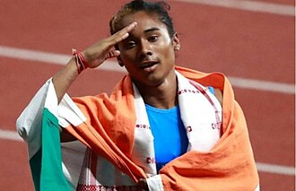
HIMA DAS
In April 2018, Das competed in the 2018 Commonwealth Games at Gold Coast, Australia, in the 400 metres and the 4×400 metres relay.
On 12 July 2018, Das won the 400 m final at the World U-20 Championships 2018 held at Tampere, Finland, clocking 51.46 seconds and becoming the first Indian sprinter to win a gold medal at an international track event.
At the 2018 Asian Games, Das qualified for the 400 m final, after clocking 51.00 in heat 1 and setting a new Indian national record. On 26 August 2018 she improved the national record to 50.79 s in the 400 m final however she could win only the silver medal.[18] Later on 30 August 2018, she, along with M. R. Poovamma, Sarita Gayakwad and V. K. Vismaya won the women's 4 × 400 metres relay clocking 3:28.72. Hima also won a gold medal in the 4 × 400 m mixed relay, which was held for the first time at Asian Games.Das continued her success in 2019 winning the 200m gold in Poznan Grand Prix in Poland, on 2 July 2019, with a time of 23.65 seconds.On 13 July, she won the 200m at the Kladno Meet in the Czech Republic with a time of 23.43 seconds. On 20 July 2019, she achieved her third win in a month, and fifth win, in the 400-meters in Nové Město, Czech Republic in a time of 52.09 seconds.
She was named for the World Championships to be held at Doha in October 2019. However a month before, she was ruled out of participation due to a back problem, that had started right after she competed at the Asian games the previous year.
Country | India
Sport | Track and field
Event(s) | 100 m 200 m 400 m
Coached by | Galina Bukharina^{[2]}

Slide 6
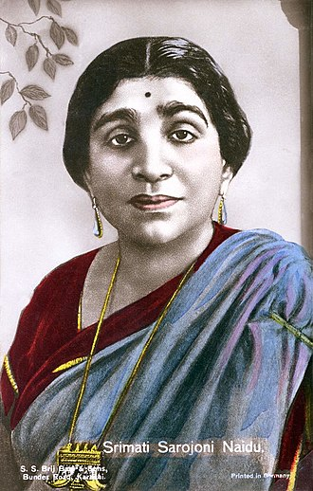
SAROJINI NAIDU
Sarojini Naidu (13 February 1879 – 2 March 1949) was an Indian political activist and poet who served as the first Governor of United Provinces, after India's independence. She played an important role in the Indian independence movement against the British Raj. She was the first Indian woman to be president of the Indian National Congress and appointed governor of a state.
Born in a Bengali family in Hyderabad, Naidu was educated in Madras, London and Cambridge. Following her time in Britain, where she worked as a suffragist, she was drawn to the Congress party's struggle for India's independence. She became a part of the national movement and became a follower of Mahatma Gandhi and his idea of swaraj (self rule). She was appointed Congress president in 1925 and, when India achieved its independence, became Governor of the United Provinces in 1947.
Naidu's literary work as a poet earned her the nickname the "Nightingale of India" by Gandhi because of the colour, imagery and lyrical quality of her poetry. Her œuvre includes both children's poems and others written on more serious themes including patriotism and tragedy. Published in 1912, "In the Bazaars of Hyderabad" remains one of her most popular poems.
1st Governor of the United Provinces
In office 15 August 1947 – 2 March 1949
Preceded by | Position established
Succeeded by | Hormasji Peroshaw Mody
44th President of the Indian National Congress
In office 1925–1926
Preceded by | Mahatma Gandhi
Succeeded by | S. Srinivasa Iyengar

Slide 7
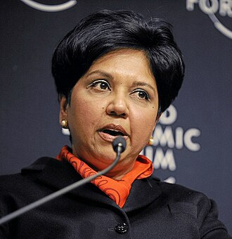
INDRA NOOYI
Indra Nooyi (née Krishnamurthy; born October 28, 1955) is an Indian-born American business executive who was the chairman and chief executive officer (CEO) of PepsiCo from 2006 to 2018.
Nooyi has consistently ranked among the world's 100 most powerful women.[6] In 2014, she was ranked at number 13 on the Forbes list, and the second most powerful woman on the Fortune list in 2015 and 2017. She sits on the boards of Amazon and the International Cricket Council, among other organizations
1831- 1897
24th Lieutenant Governor of Pondicherry
In office 28 May 2016 – 16 February 2021

Slide 8
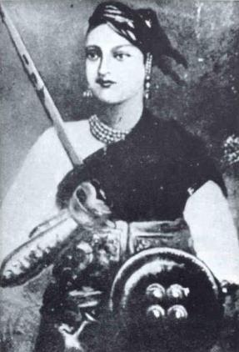
RANI LAKSHMIBAI
Lakshmibai Newalkar, the Rani of Jhansi or Jhansi ki Rani widely known as Rani Lakshmibai (pronunciationⓘ; born Manikarnika Tambe; 19 November 1828 — 18 June 1858),[1][2] was the Maharani consort of the princely state of Jhansi in the Maratha Empire from 1843 to 1853 by marriage to Maharaja Gangadhar Rao Newalkar. She was one of the leading figures in the Indian Rebellion of 1857, who became a national hero and symbol of resistance to the British rule in India for Indian nationalists.
Born into a Marathi Karhade Brahmin family in Banares, Lakshmibai married the Maharaja of Jhansi, Gangadhar Rao, in 1842. When the Maharaja died in 1853, the British East India Company under Governor-General Lord Dalhousie refused to recognize the claim of his adopted heir and annexed Jhansi under the Doctrine of Lapse. The Rani was unwilling to cede control and joined the rebellion against the British in 1857. She led the successful defense of Jhansi against Company allies, but in early 1858 Jhansi fell to British forces under the command of Hugh Rose. The Rani managed to escape on horseback and joined the rebels in capturing Gwalior, where they proclaimed Nana Saheb as Peshwa of the revived Maratha Empire. She died in June 1858 after being mortally wounded during the British counterattack at Gwalior.
Queen consort of Jhansi
Tenure | 1843 – 21 November 1853
Regent of Jhansi (pretendence)
Regency | 21 November 1853 – 4 April 1858
Monarch | Damodar Rao (Anand Rao-adopted son (renamed)) (position disputed)

