Slide 1

Vel Tech Rangarajan Dr. Sagunthala R&D Institute of Science and Technology
School of Computing
Department of Computer Science and Engineering
10211CS224 / FULL STACK APPLICATION DEVELOPMENT (JAVA)
PROJECT REVIEW : MILESTONE PROJECT – 1
Date: 23-03-2026
Full-Stack Skill Learning Academy Marketplace with Secure Authentication
SDG 4– Quality Education
Courses Handling Faculty:
Dr.Hafizur Rahman
Associate Professor
Presented By:
C. Venu Teja– VTU26420 – 23UECS0692

Slide 2
INTRODUCTION
The Skill Marketplace is a web-based application developed to connect users who want to learn or offer skills in a centralized digital platform.
This system provides an online marketplace where users can browse courses, enroll in skill-based programs, and enhance their knowledge in various domains.
The platform allows administrators to manage courses, monitor users, and maintain the overall system efficiently.
It simplifies the process of skill learning and sharing by providing an organized interface for course management and enrollment.
It simplifies the process of skill learning and sharing by providing an organized interface for course management and enrollment.
This system is developed using PHP and MySQL on XAMPP server, ensuring reliable data storage and efficient backend processing.
1
2
3
4
5
6
7
8
9

Slide 3
PROBLEM STATEMENT
Many individuals possess valuable skills but lack a proper platform to showcase and monetize them effectively.
Users often face difficulty in finding reliable and structured skill-based courses in one place.
There is no centralized system to connect learners with skilled professionals or course providers.
Existing platforms are scattered, making course discovery and access inefficient.
Lack of proper tracking makes it difficult for users to manage enrolled courses and learning progress.
Manual or poorly designed systems reduce efficiency in handling users, courses, and enrollments.
Limited accessibility to skill-based opportunities restricts personal and professional growth.
Absence of an integrated system leads to poor communication between learners and course providers.
1
2
3
4
5
6
7
8
9

Slide 4
OBJECTIVE(S)
To design and develop a web-based Skill Marketplace platform using PHP and MySQL.
To provide a centralized system for users to explore and enroll in skill-based courses.
To enable users to register, login, and manage their profiles securely.
To implement a course management system for adding, updating, and deleting courses by the admin.
To allow users to enroll in courses and track their enrolled courses through a dashboard.
To ensure secure authentication and data management using session handling and database integration.
To provide an interactive and user-friendly interface for better user experience.
To improve accessibility to skill development and learning opportunities through a digital platform.
1
2
3
4
5
6
7
8
9

Slide 5
PROPOSED SYSTEM
1
The proposed system is a web-based Skill Marketplace application developed using PHP and MySQL.
It allows users to register, login, and manage their profiles securely.
The system enables users to explore a variety of skill-based courses in one platform.
Users can enroll in courses and access them through a personalized dashboard.
The admin can add, update, and delete courses efficiently through an admin panel.
The system maintains enrollment records for tracking user activity and course participation.
2
3
4
5
6
7
8
9

Slide 6
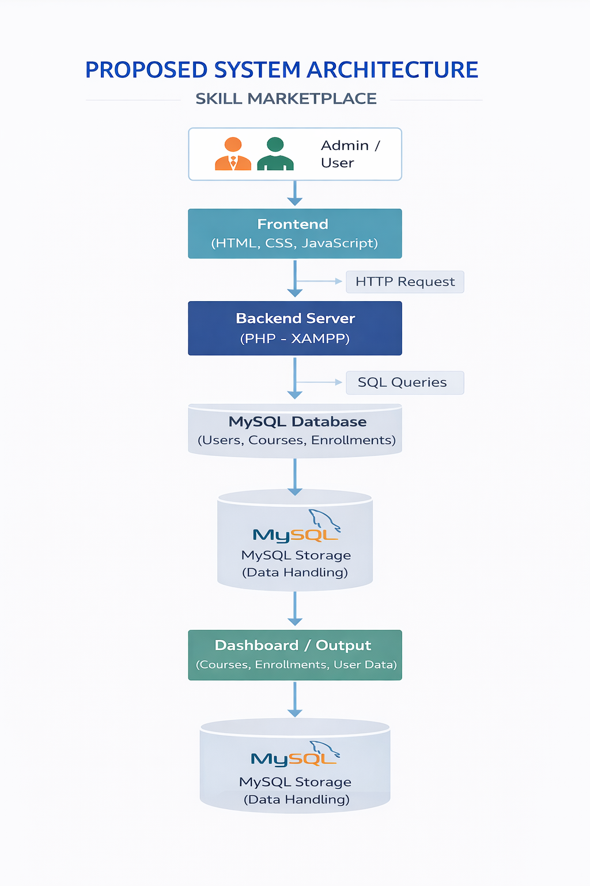
PROPOSED SYSTEM ARCHITECTURE
1
2
3
4
5
6
7
8
9

Slide 7
PROPOSED SYSTEM ARCHITECTURE
➤ Input
Users enter registration details, login credentials, and select courses through web forms. They can browse courses and perform enrollment actions.
➤ Processing
PHP processes user requests, handles authentication, manages course enrollment, and executes necessary operations through server-side logic.
➤ Database
MySQL database stores user details, course information, and enrollment records using relational tables.
➤ Output
The system displays available courses, enrolled courses, and user dashboard information in the browser with real-time updates.
1
2
3
4
5
6
7
8
9

Slide 8
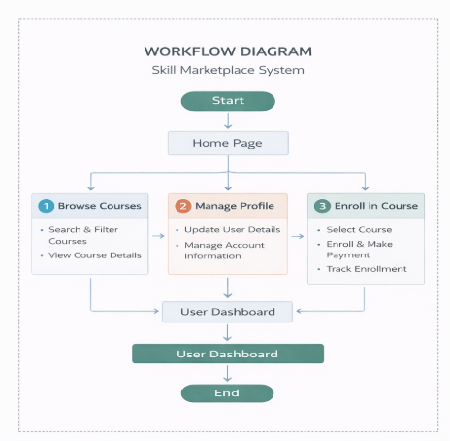
WORKFLOW
1
2
3
4
5
6
7
8
9

Slide 9
TECHNOLOGIES USED
1
2
➤ Frontend: HTML5, CSS3, JavaScript
➤ Backend: PHP
➤ Database: MySQL
➤ Server: XAMPP (Apache Server)
➤ Tools: VS Code, phpMyAdmin
➤ Hardware/Software: Windows OS, XAMPP Server
3
4
5
6
7
8
9

Slide 10
MODULE DESCRIPTION
1
Module 1: User Management
Handles user registration, login authentication, and profile management within the system.
Module 2: Course Management (Admin Module)
Allows the admin to add, update, and delete courses available in the marketplace.
Module 3: Enrollment Management
Enables users to enroll in courses and manages enrollment records efficiently.
Module 4: Dashboard Module
Displays user-specific data such as enrolled courses and provides admin overview of courses and users.
2
3
4
5
6
7
8
9

Slide 11
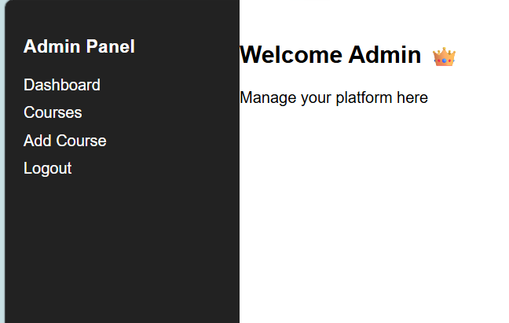
IMPLEMENTATION SCREENSHOTS
1
➤ The Home Page serves as the main navigation interface of the Skill Marketplace system.
➤ It provides quick access to all major modules such as Courses, Dashboard, and Profile.
➤ The Dashboard allows users to view enrolled courses and track their learning activity.
➤ The Admin Panel enables management of courses, users, and system operations efficiently.
➤ The interface is designed to be simple, user-friendly, and responsive.
2
3
4
5
6
7
8
9

Slide 12

IMPLEMENTATION SCREENSHOTS
1
➤ The Dashboard provides a summary view of the Skill Marketplace system.
➤ It displays important information such as Total Courses, Enrolled Courses, and User Details.
➤ These values are dynamically fetched from the MySQL database.
➤ It helps users quickly view their enrolled courses and track their learning progress.
➤ The admin dashboard provides an overview of total users and available courses.
➤ It improves decision-making by showing real-time data.
2
3
4
5
6
7
8(A)
9

Slide 13
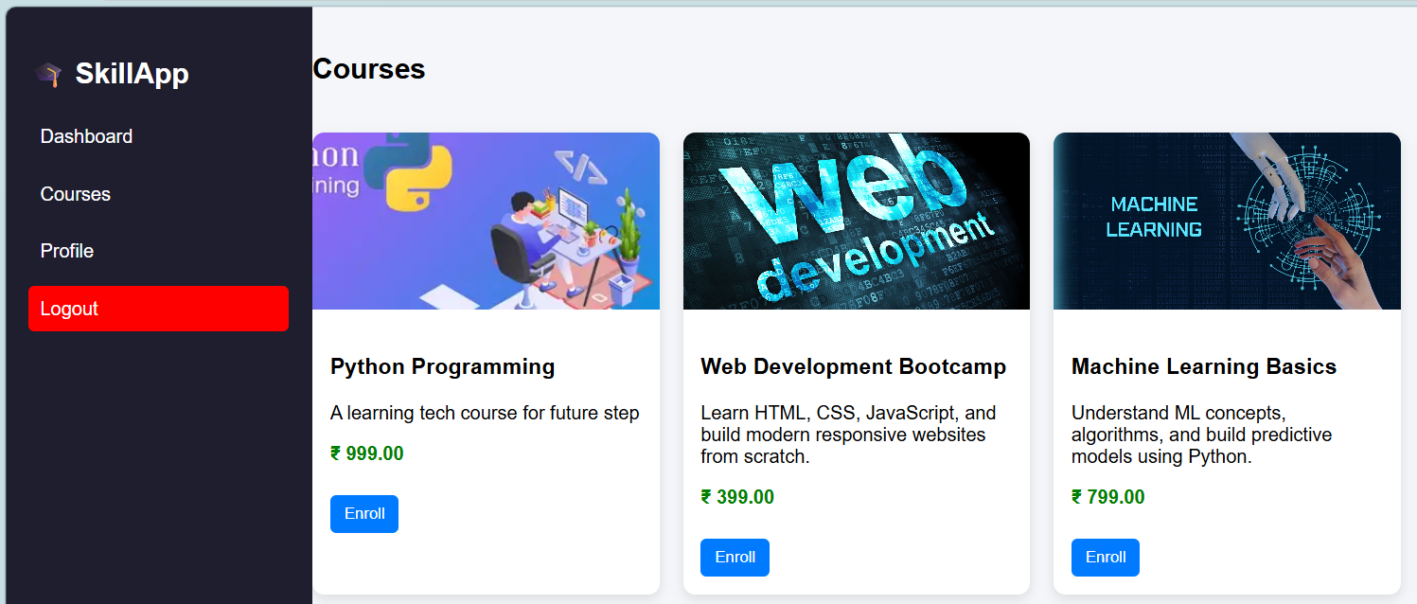
IMPLEMENTATION SCREENSHOTS
1
Course Enrollment MODULE
➤ The Course Enrollment module allows users to enroll in available courses in the Skill Marketplace.
➤ The user selects a course and clicks on the enroll button through the courses page.
➤ The enrollment request is sent to the PHP backend for processing.
➤ The system verifies the user session and checks course availability.
➤ PHP inserts the enrollment details into the MySQL database.
➤ The enrollment records are stored with user ID and course ID for tracking.
➤ The user dashboard is automatically updated after successful enrollment.
➤ Users can view their enrolled courses and manage them easily..
2
3
4
5
6
7
8(B)
9

Slide 14

IMPLEMENTATION SCREENSHOTS
1
Delete Course Module:
➤ The Delete Course module allows the admin to remove existing courses from the Skill Marketplace.
➤ The admin selects a course and clicks the delete button from the courses list.
➤ A request is sent to the PHP backend for processing.
➤ The system verifies admin authorization before performing the delete operation.
➤ PHP executes a delete query to remove the selected course from the MySQL database.
➤ The course list is automatically updated after deletion.
➤ This module helps maintain accurate and updated course information.
2
3
4
5
6
7
8(C)
9

Slide 15
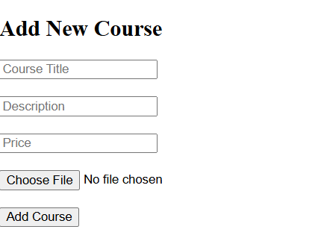
IMPLEMENTATION SCREENSHOTS
1
➤ The Add Course module allows the admin to add new courses to the Skill Marketplace.
➤ The admin enters course details such as title, description, price, and image through a form.
➤ The input data is sent to the PHP backend for processing.
➤ PHP validates the input data before storing it in the database.
➤ The course details are inserted into the MySQL database.
➤ Each course is assigned a unique ID for identification.
➤ The course list is automatically updated after adding a new course.
➤ This module helps in managing and expanding available courses efficiently.
2
3
4
5
6
7
8(D)
9

Slide 16
ADVANTAGES & LIMITATIONS
1
Advantages
Provides a centralized platform for skill learning and course access
Easy-to-use and user-friendly interface
Enables quick course enrollment and management
Reduces manual effort in course handling
Provides real-time updates on enrolled courses
Improves accessibility to skill development opportunities
Limitations
Designed mainly for small-scale usage
Limited advanced features like live classes or video streaming
Requires internet or local server (XAMPP) to run
No integrated online payment system (if not implemented)
Basic security features (can be enhanced further)
2
3
4
5
6
7
8
9

Slide 17
Thank you

