Slide 1
Problem Statement:
A firm wants to launch their new application. To reduce cost it has been decided that the entire application will be hosted on AWS. It’s a photo and video storage application. This application will store movies and videos, and customers can also upload photos and their custom made videos using this application.
To buy videos, movies and wallpapers stored in the application customers have to pay some amount using their credit card. Customer will have to provide their home address and some other personal information as well.

Slide 2

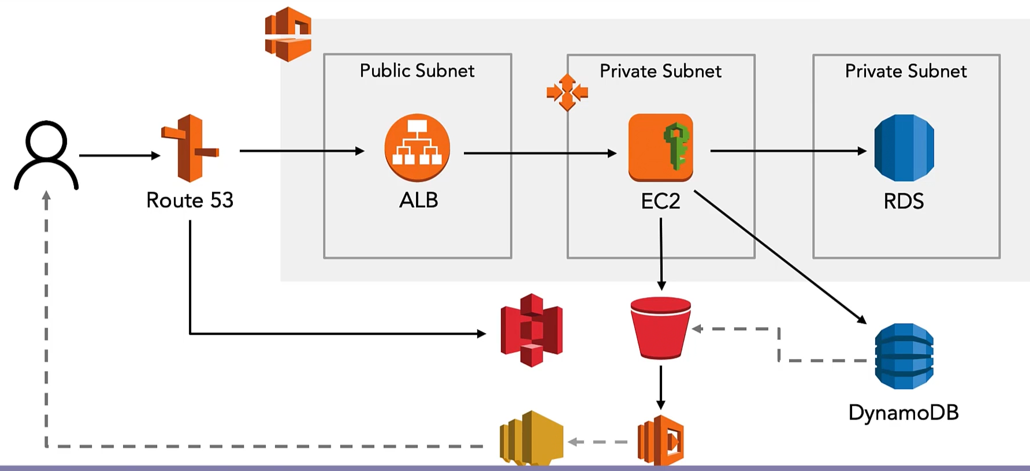

Slide 3
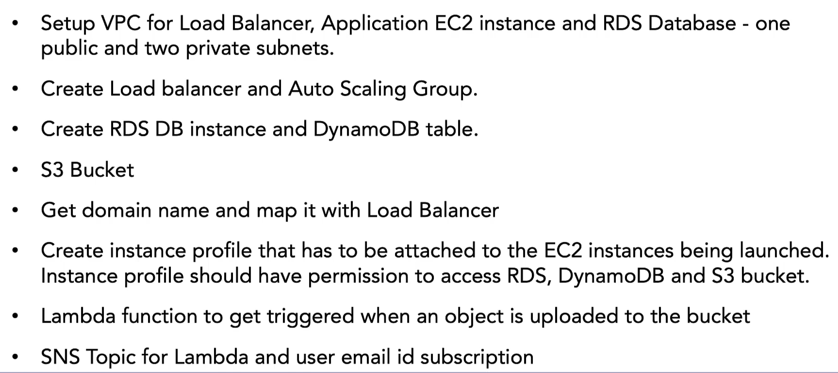

Slide 4

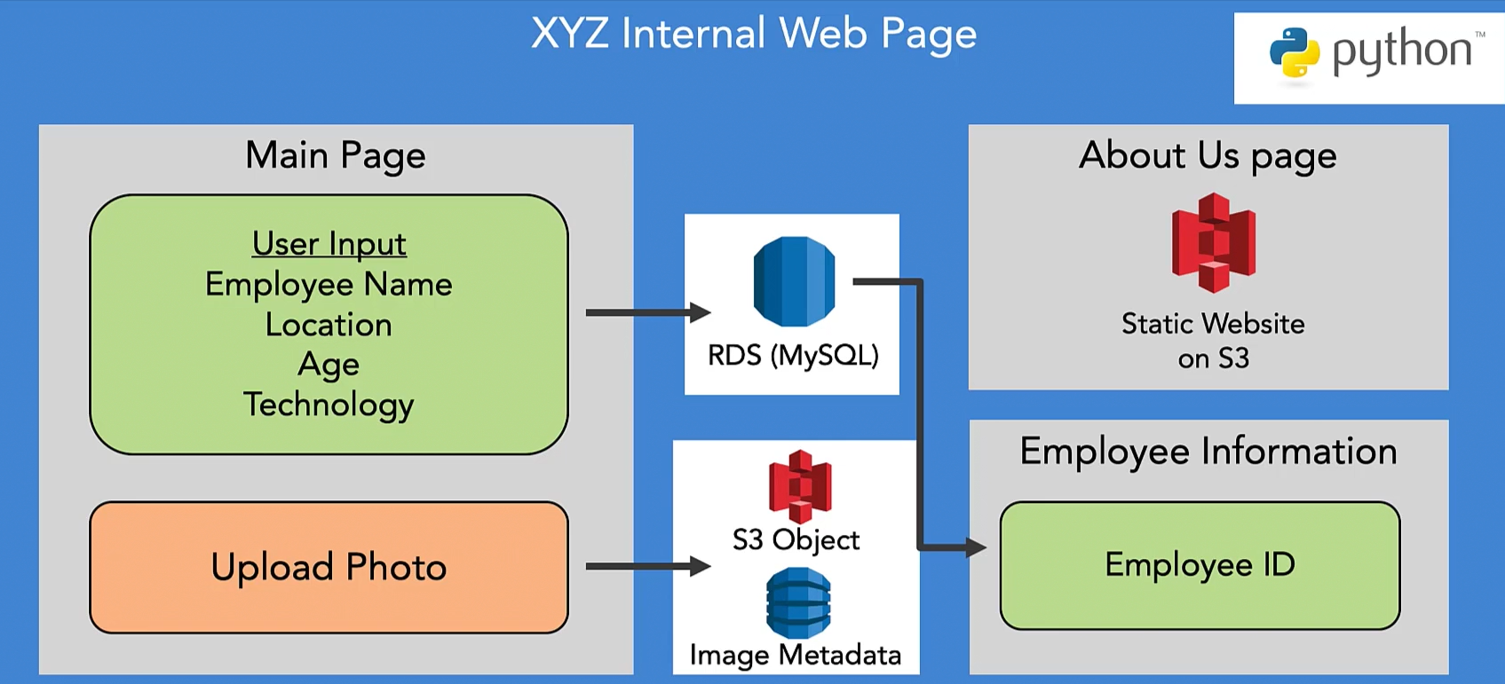

Slide 5

