Slide 1
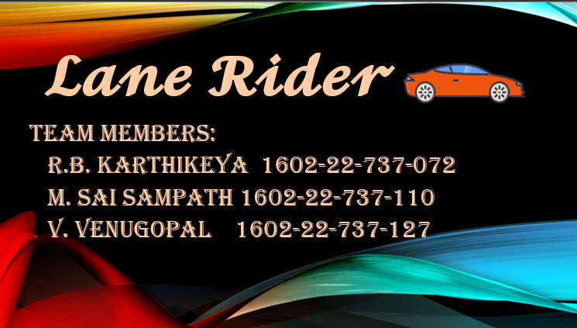

Slide 2
ABSTRACTION :
Lane rider is a game that revolves around controlling a car in a lane based environment avoiding obstacles and collecting coins. And can visit the store in game to purchase new cars which deals with making strategic decisions about purchasing and using them.
Players can view their game statics. As the game loop keeps the game running and responsive to player input the game progressively increases in difficulty challenging the player’s reflexs and decision-making skills.

Slide 3
objectives:
Gameplay: Develop an addictive and challenging gameplay experience that keeps players engaged and entertained.
User Interface: Create an intuitive and visually appealing user interface with main menu screens, in-game HUD (Heads-Up Display), and score displays.
Game Mechanics: Implement smooth and realistic game mechanics, including car movement, obstacle generation, collision detection,

Slide 4
Scoring and Progression: Establish a scoring system and level progression that motivates players to achieve higher scores and unlock new contents
Player Progression: Introduce a system for player progression, such as unlocking new cars, skins, or power-ups as players achieve specific milestones.

Slide 5
REFERENCE :
Chat Gpt
YouTube
Google

Slide 6


