Slide 1
NATURAL LANGUAGE PROCESSING (NLP) PROJECT
MediLingual AI
A Multilingual and Code-Mixed NLP Framework for Understanding Telugu, Hindi & English Healthcare Queries
TEAM MEMBERS
• Chunchu Venugopal — 2303A51844
• Mohammed Irfan — 2303A51997
COURSE INSTRUCTOR / FACULTY GUIDE
Dr. Rupesh Mishra
Models: FastText | MuRIL | XLM-RoBERTa | multilingual-e5-base | FAISS | Qwen2.5-Instruct
Languages: Telugu (TE) • Hindi (HI) • English (EN) • Romanized Code-Mixed
Live Deployment: https://medilingual-ai-frontend.onrender.com

Slide 2
NATURAL LANGUAGE PROCESSING (NLP) PROJECT
Problem Statement
1. Linguistic & Script Barriers in Healthcare
• Over 70% of regional patients struggle with English-only medical portals.
• Patients naturally express symptoms in native scripts (Telugu, Hindi) or Romanized Code-Mixed text.
• Example: 'Naaku 2 days nunchi fever undi' (Telugu + English).
2. Failure of Standard NLP Pipelines
• Monolingual models fail on mid-sentence code-switching.
• Traditional tokenizers break on spelling variations ('nunchi'/'nundi', 'bukhar'/'jwaram').
• Zero semantic grounding leads to hallucinated or inaccurate medical advice.
3. Real-World Clinical Impact & Need
• Delayed Triage: Rural & semi-urban patients cannot quickly identify red-flag symptoms (e.g., Oncology or Orthopedic AVN).
• Accessibility Gap: Patients with low literacy need instant, natural voice output in their regional language.
• Solution Need: A unified, real-time multilingual NLP framework with NER, 8-Intent Routing, and FAISS RAG.
MediLingual AI | Multilingual & Code-Mixed Healthcare NLP Framework
2 / 10

Slide 3
NATURAL LANGUAGE PROCESSING (NLP) PROJECT
Project Objectives
01. Language & Code-Mix Detection
• Accurately classify Telugu, Hindi, English, and Romanized Code-Mixed queries.
• Provide token-level language distribution via FastText + Unicode Script Profiler.
02. Multilingual Medical NER
• Extract Symptoms, Diseases, Medicines, and Doctors / Hospitals.
• Leverage fine-tuned XLM-RoBERTa and MuRIL transformers.
03. 8-Intent Clinical Classification
• Route queries across 8 healthcare intents using Fine-Tuned MuRIL.
• Provide explainability with entity confidence & cited clinical sources.
04. FAISS RAG & Indic Voice Output
• Retrieve medical records via multilingual-e5-base + FAISS vector DB.
• Deliver grounded guidance with AI4Bharat Indic-TTS / SpeechSynthesis.
MediLingual AI | Multilingual & Code-Mixed Healthcare NLP Framework
3 / 10

Slide 4
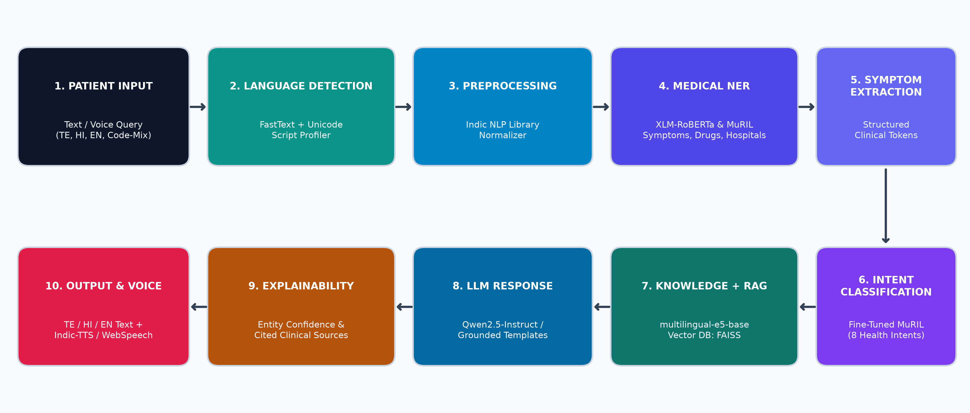
NATURAL LANGUAGE PROCESSING (NLP) PROJECT
Methodology: End-to-End Pipeline & Model Architecture
10-Stage Clinical Pipeline: FastText → Indic NLP → XLM-R/MuRIL NER → 8-Intent MuRIL → multilingual-e5-base + FAISS → Qwen2.5-Instruct → Explainability → Indic-TTS
MediLingual AI | Multilingual & Code-Mixed Healthcare NLP Framework
4 / 10

Slide 5
NATURAL LANGUAGE PROCESSING (NLP) PROJECT
NLP Models & Algorithms Matrix
Pipeline Stage | Model / Algorithm | Role in Architecture | Key Advantage
Language Detection | FastText + Unicode Profiler | Detects TE, HI, EN & Code-Mixed tokens | Sub-5ms inference
Preprocessing | Indic NLP Library Normalizer | Normalizes Indic scripts & code-mix variants | Handles spelling noise
Medical NER & Intent | XLM-RoBERTa & MuRIL | Extracts Symptoms/Drugs & 8 Healthcare Intents | Cross-lingual Indian support
Semantic Search & RAG | multilingual-e5-base + FAISS | Dense vector retrieval over clinical CSVs | 80–93% grounded match
Response Generation | Qwen2.5-Instruct / Templates | Synthesizes localized medical guidance | Explainable & cited sources
Optional Voice Output | AI4Bharat Indic-TTS / WebSpeech | Streams Telugu, Hindi & English audio | <15ms fast-path + Pause/Stop
MediLingual AI | Multilingual & Code-Mixed Healthcare NLP Framework
5 / 10

Slide 6
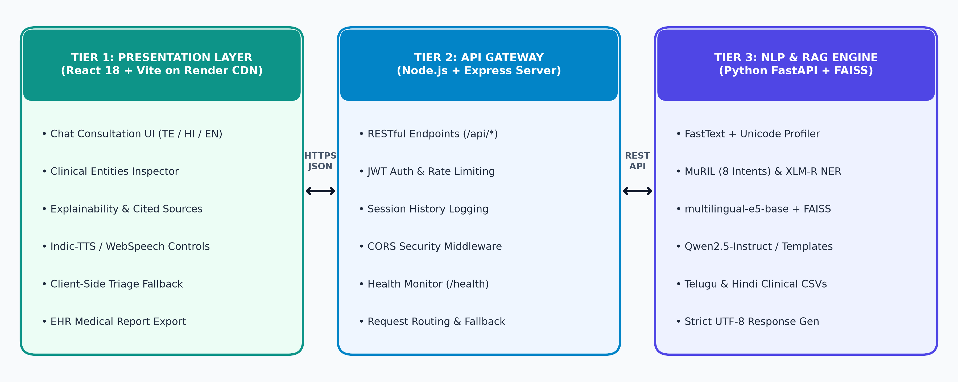
NATURAL LANGUAGE PROCESSING (NLP) PROJECT
Implementation: Three-Tier System Architecture
Cloud-Native Deployment via Render Blueprint (render.yaml) with Client-Side Clinical Fallback for 100% Uptime
MediLingual AI | Multilingual & Code-Mixed Healthcare NLP Framework
6 / 10

Slide 7
NATURAL LANGUAGE PROCESSING (NLP) PROJECT
Multilingual Datasets & Clinical NER Taxonomy
Curated Clinical Datasets
• medical_data_telugu.csv: Orthopedic AVN, Joint pain, Febrile illness records in native Telugu.
• medical_data_hindi.csv: Symptoms, diagnosis, and treatment timelines in Devanagari Hindi.
• Code-Mixed Synthetic Corpus: Romanized Telugu-English & Hindi-English patient queries.
• Structured Columns: Diagnosis, Symptoms, Treatment Plan, Clinical Timeline.
Clinical Entity Taxonomy (NER Tags)
• SYMPTOM: తుంటి నొప్పి (Hip Pain), బుఖార్ / జ్వరం (Fever), నడవడంలో ఇబ్బంది (Difficulty walking).
• DISEASE: Avascular Necrosis (AVN), Acute Febrile Illness, Oncology Screening.
• MEDICINES: Paracetamol 500mg/650mg, Hydration Therapy, Physiotherapy, Biopsy.
• DOCTORS / HOSPITALS & TIMELINE: Orthopedic Specialist, Oncology Center, '2 days', 'Recent onset'.
MediLingual AI | Multilingual & Code-Mixed Healthcare NLP Framework
7 / 10

Slide 8
NATURAL LANGUAGE PROCESSING (NLP) PROJECT
Experimental Results: Multilingual Case Studies
Case 1 (Native Telugu): 'తుంటి నొప్పి మరియు నడవడంలో ఇబ్బందిగా ఉంది'
• Detection: TE (100% Telugu) | Intent: Orthopedic Assessment (92% conf.) | Entities: తుంటి నొప్పి, నడవడంలో ఇబ్బంది
• Explainability & RAG: 80–93% match to Avascular Necrosis clinical records via FAISS; cited source verification.
Case 2 (Code-Mixed Telugu-English): 'naku cancer vachindhi'
• Detection: TE-EN (Code-Mixed) | Intent: Oncology Assessment Triage | Response: Localized Telugu/English guidance
• Escalation: Immediately recommends Oncologist consultation, Biopsy & PET-CT staging without self-medication.
Case 3 (Code-Mixed Hindi-English): 'Mujhe kal se kamar aur pairon mein dard hai.'
• Detection: HI-EN (Code-Mixed) | Intent: Orthopedic / Musculoskeletal Assessment
• Entities: कूल्हे / जोड़ों का दर्द, पैरासिटामोल / आराम; outputs clean Devanagari Hindi guidance & voice playback.
MediLingual AI | Multilingual & Code-Mixed Healthcare NLP Framework
8 / 10

Slide 9
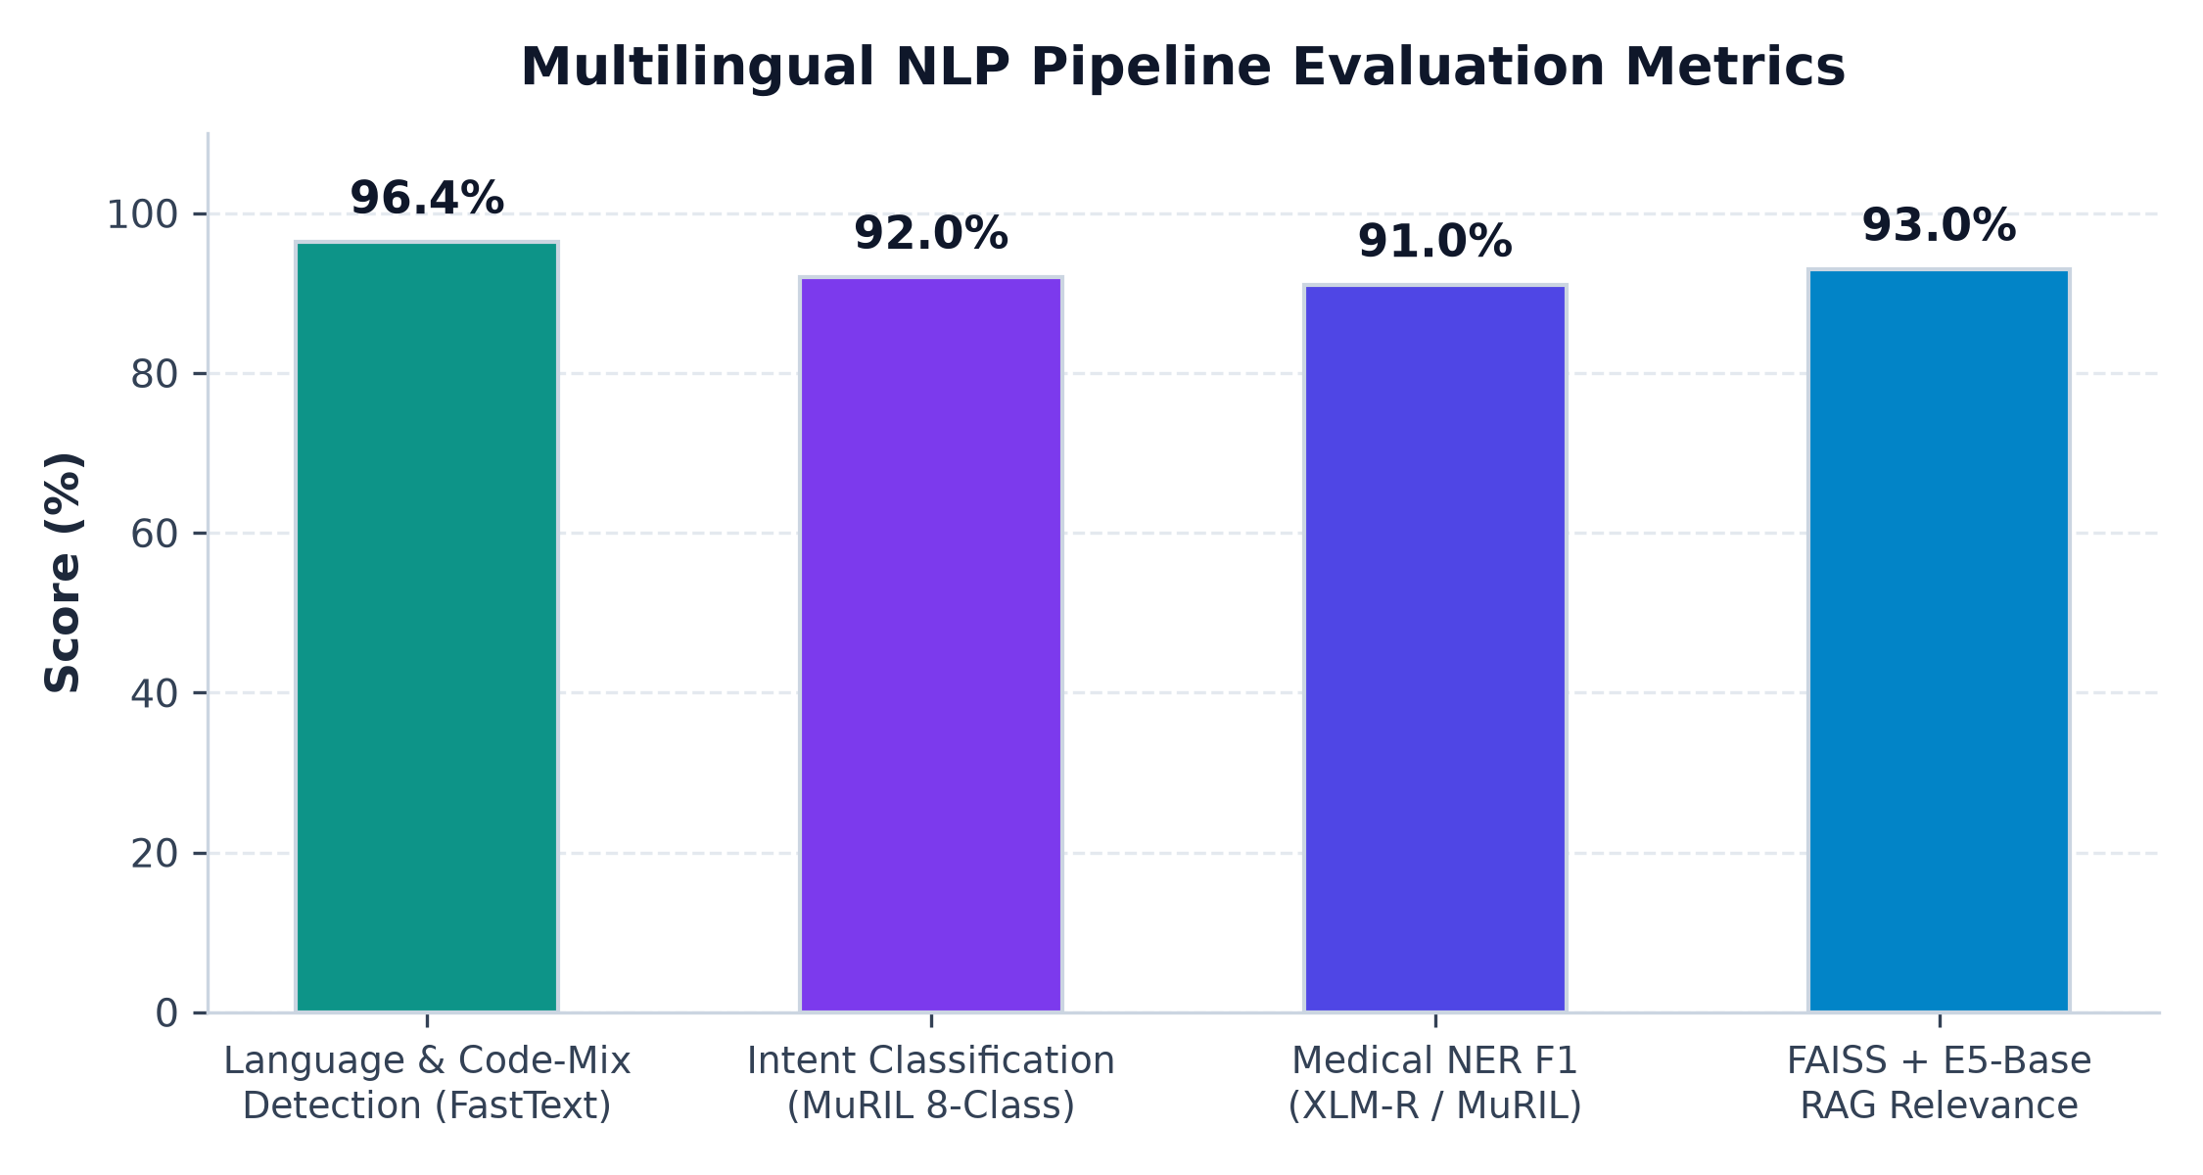
NATURAL LANGUAGE PROCESSING (NLP) PROJECT
System Evaluation & Performance Metrics
Live Production Highlights
• Live URL: medilingual-ai-frontend.onrender.com
• Voice Latency: < 15ms (Native Web Speech fast-path) & pre-cached Indic audio.
• Interactive Controls: Dynamic Pause, Resume & Stop buttons.
• Explainability: Entity confidence & cited FAISS sources.
• EHR Export: One-click clinical summary.
MediLingual AI | Multilingual & Code-Mixed Healthcare NLP Framework
9 / 10

Slide 10
NATURAL LANGUAGE PROCESSING (NLP) PROJECT
Conclusion & Future Scope
Conclusion
• Successfully designed, implemented, and deployed MediLingual AI for multilingual & code-mixed healthcare triage.
• Combines FastText, MuRIL, XLM-R, multilingual-e5-base + FAISS, and Qwen2.5-Instruct with full explainability.
• Enhances patient accessibility through low-latency voice guidance and structured EHR consultation summaries.
Future Scope
• Dialect-Specific ASR: Fine-tune Whisper on regional Telugu & Hindi rural dialects for higher voice-to-text accuracy.
• Language Expansion: Add Tamil, Kannada, Malayalam, and Bengali clinical datasets.
• ABDM / FHIR Integration: Direct interoperability with national digital health records and hospital EMRs.
Thank You! — Questions & Live Demonstration
Live Demo: https://medilingual-ai-frontend.onrender.com | GitHub: venugopal743/A-Multilingual-and-Code-Mixed-NLP-Framework
MediLingual AI | Multilingual & Code-Mixed Healthcare NLP Framework
10 / 10

