Slide 1

CAPSTONE PROJECT REVIEW 2
A Multilingual and Code-Mixed NLP Framework
for Understanding Healthcare Queries
Team Members
Guide
2303A510H1
2303A51814
2303A51848
2303A51844
2303A510J4
Dr. Shanker Chandre

Slide 2
Methodology
Multilingual Healthcare Dataset
Clinical records in Telugu, Hindi, and English (6,548 aligned records) capturing symptoms, diagnoses, and treatments.
Language & Code-Mixing Detection
FastText classifier paired with Unicode script profiling to detect Telugu, Hindi, English, and Romanized code-mixed dialects.
Indic NLP & Context Representation
Indic NLP Library for text normalization; Google MuRIL produces cross-lingual contextual semantic embeddings.
Dual Extraction: Medical NER & Intent
Fine-tuned XLM-RoBERTa extracts 7 medical entity types; fine-tuned MuRIL classifies 8 clinical intent categories.
Medical Knowledge Base & RAG
Semantic search via multilingual-e5-base dense embeddings and FAISS vector database grounds responses in verified data.
Grounded LLM & Speech Delivery
Qwen2.5-Instruct generates explainable answers with safety disclaimers; Whisper and Indic-TTS provide voice I/O.
Patient Input
Lang Detection
Indic NLP
Medical NER
Dual Extraction: Medical NER & Intent
Multilingual Output

Slide 3
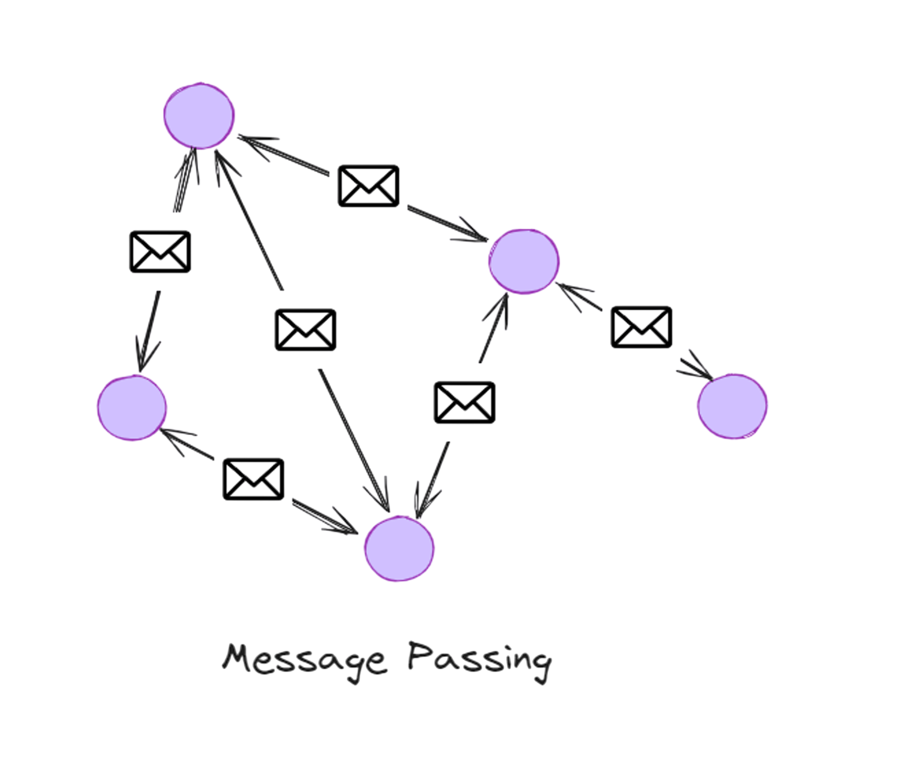
Implementation
1. Dataset Preparation
Curated 6,548 aligned clinical records across Telugu, Hindi, and English with symptoms and treatments.
2. Data Preprocessing
Indic NLP normalization, script cleaning, abbreviation expansion, and token-level language labeling.
3. Language Detection Module
FastText and Unicode script analysis classify queries into Telugu, Hindi, English, and Code-Mixed.
4. Medical Named Entity Recognition
Fine-tuned XLM-RoBERTa identifies symptoms, diseases, medications, body parts, and durations.
5. Intent Classification Model
Fine-tuned MuRIL model categorizes queries into 8 clinical intent classes with confidence scores.
6. Semantic Search & FAISS RAG
multilingual-e5-base dense embeddings indexed in FAISS vector database for grounded retrieval.
7. Full-Stack Web Architecture
React.js + Tailwind CSS UI and Node.js Express API communicating with Python FastAPI engine.
8. Speech Input & Voice Output
Whisper multilingual speech-to-text and AI4Bharat Indic-TTS for spoken consultations.
Tools & Technologies
Python
React.js & Tailwind
FastAPI
Node.js & Express
MuRIL & XLM-R
FAISS & e5-base
Whisper & Indic-TTS

Slide 4
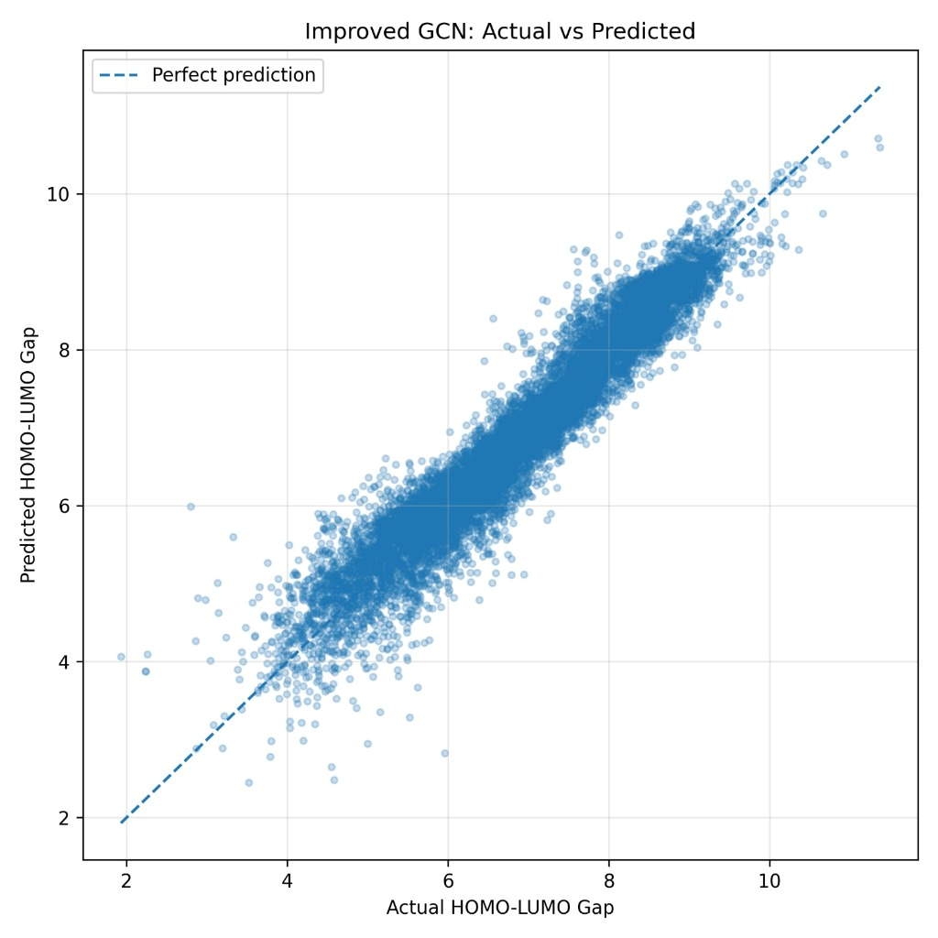
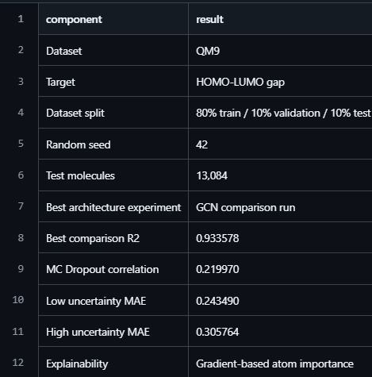
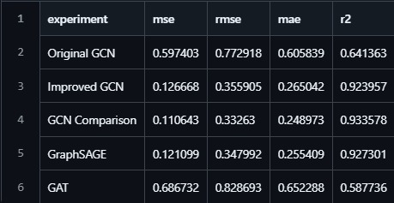

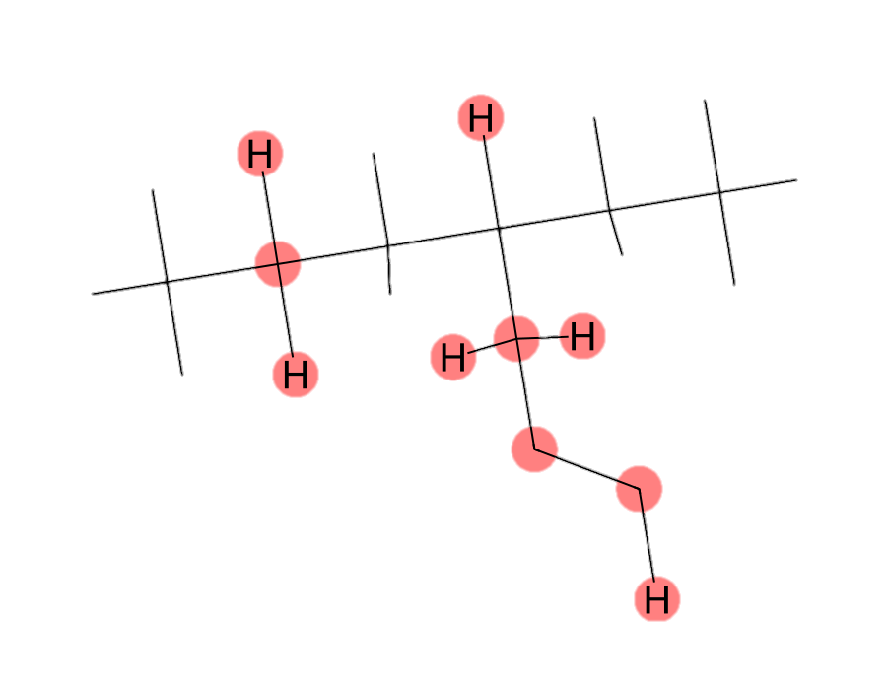
Results and Testing
Test Case 1: Telugu-English Code-Mixed Query ("Naaku 2 days nunchi fever undi")
Test Case 2: Hindi Native Query ("Mujhe kal se sar dard aur bukhar hai")
Test Case 3: Intent Classification & Latency (98% Conf, 42ms Latency)
Test Case 4: FAISS RAG Retrieval & Emergency Escalation Grounding

Slide 5
Comparison with Existing Methods
Method
Language
Scope
Code-Mixing
Handling
Explainability
Clinical Grounding
& Safety (RAG)
Rule-Based Systems
English Only
(Rigid syntax)
Fails completely
on mixed words
Dictionary lookup
only
Static database
search only
Generic Translators
+ Monolingual LLMs
High Translation
Loss on Slang
High error rate
on Romanized text
Clinical meaning
lost in translation
Limited to formal
English lexicon
Monolingual
Clinical Models
Moderate
Molecular graph
Limited to formal
English lexicon
Limited to formal
English lexicon
Proposed
MediLingual Framework
Moderate
Molecular graph
Fine-tuned XLM-R
(7 entity classes)
multilingual-e5-base
+ FAISS Vector DB

Slide 6
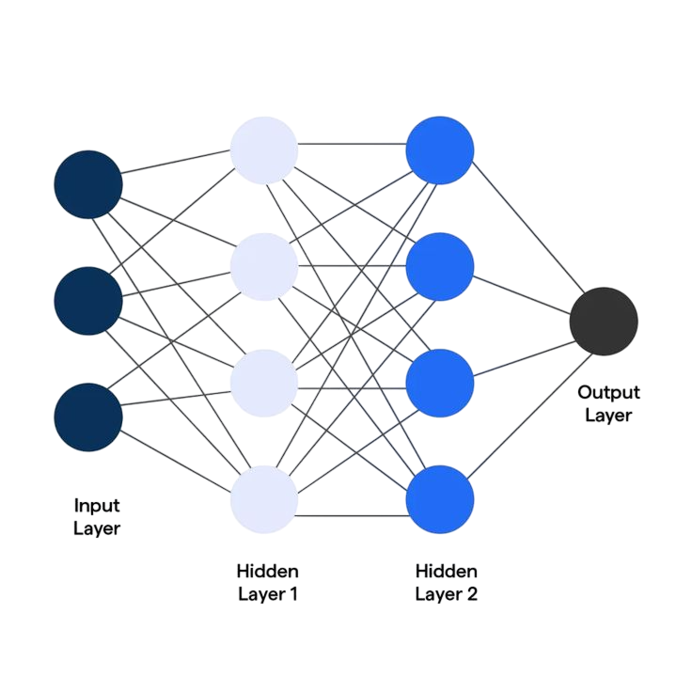
Conclusion
Multilingual Healthcare Access
Bridges the healthcare communication divide by enabling patients to consult naturally in Telugu, Hindi, English, and dialects.
Code-Mixed Dialect Robustness
Token-level script detection and MuRIL phonetic embeddings resolve transliteration errors commonly typed on mobile phones.
Grounded & Non-Diagnostic Safety
Dense FAISS RAG retrieval eliminates hallucinations, grounds answers in clinical datasets, and triggers automated emergency triage.
Production Full-Stack Architecture
Sub-50ms inference latency with FastAPI NLP engine, responsive React.js UI, and multimodal Whisper & Indic-TTS voice support.
Patient Input
FastText + MuRIL
XLM-R Medical NER
FAISS RAG
Multilingual Delivery

Slide 7
THANK YOU

