Slide 1
Header Section (Include Navbar - About Contact Login Register)
Home Screen
Categories (these categories has to come from db and every category should have a hyperlink, when we click that link, it has to show all the products related that category in Most View Medicine Area
Carousel for Images
Most View/Sold Medicines(Top 5)
Footer Section (It includes - All rights are reserved @ medicare)
Media Icons(FB, INsta, …)

Slide 2
Header Section (Include Navbar - About Contact Login Register)
Login Screen
Login Here
User name
Password
Login
Footer Section (It includes - All rights are reserved @ medicare)
Media Icons(FB, INsta, …)

Slide 3
Header Section (Include Navbar - About Contact Login Register)
Register User Screen
Register Here
Based on Db Fields, Design it with proper tools then add the functionality
Register
Footer Section (It includes - All rights are reserved @ medicare)
Media Icons(FB, INsta, …)

Slide 4
If Admin Login’s
We have to get Admin Dash Board
If User Login’s
We have to get User Dash Board

Slide 5
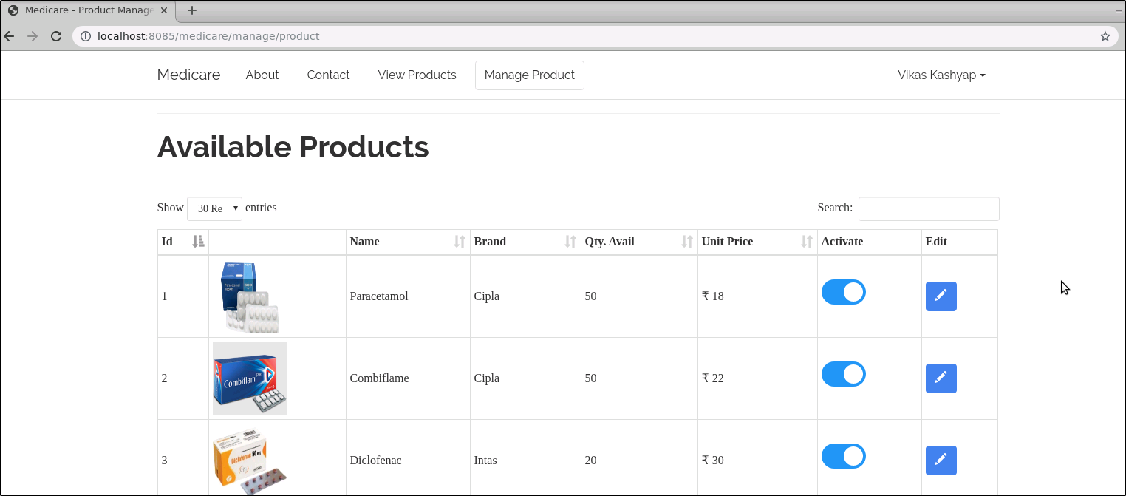
Add Category Add Product View All Products Logout
Admin Dashboard
View Products
Footer Section (It includes - All rights are reserved @ medicare)
Media Icons(FB, INsta, …)

Slide 6
Add Category Add Product View All Products Logout
Admin Dashboard
Add Category
Show All Categories in table format
Category Name(textbox)
Add(btn)
Footer Section (It includes - All rights are reserved @ medicare)
Media Icons(FB, INsta, …)

Slide 7
Add Category Add Product View All Products Logout
Admin Dashboard
Add Product
Product Name
Categories has to come from the db. Which is already added in category page.
When saving these details into db, category id has to store.
Product Brand
Product Price
Qutantity
Category of the Product(dropdown)
Footer Section (It includes - All rights are reserved @ medicare)
Media Icons(FB, INsta, …)

