Slide 1
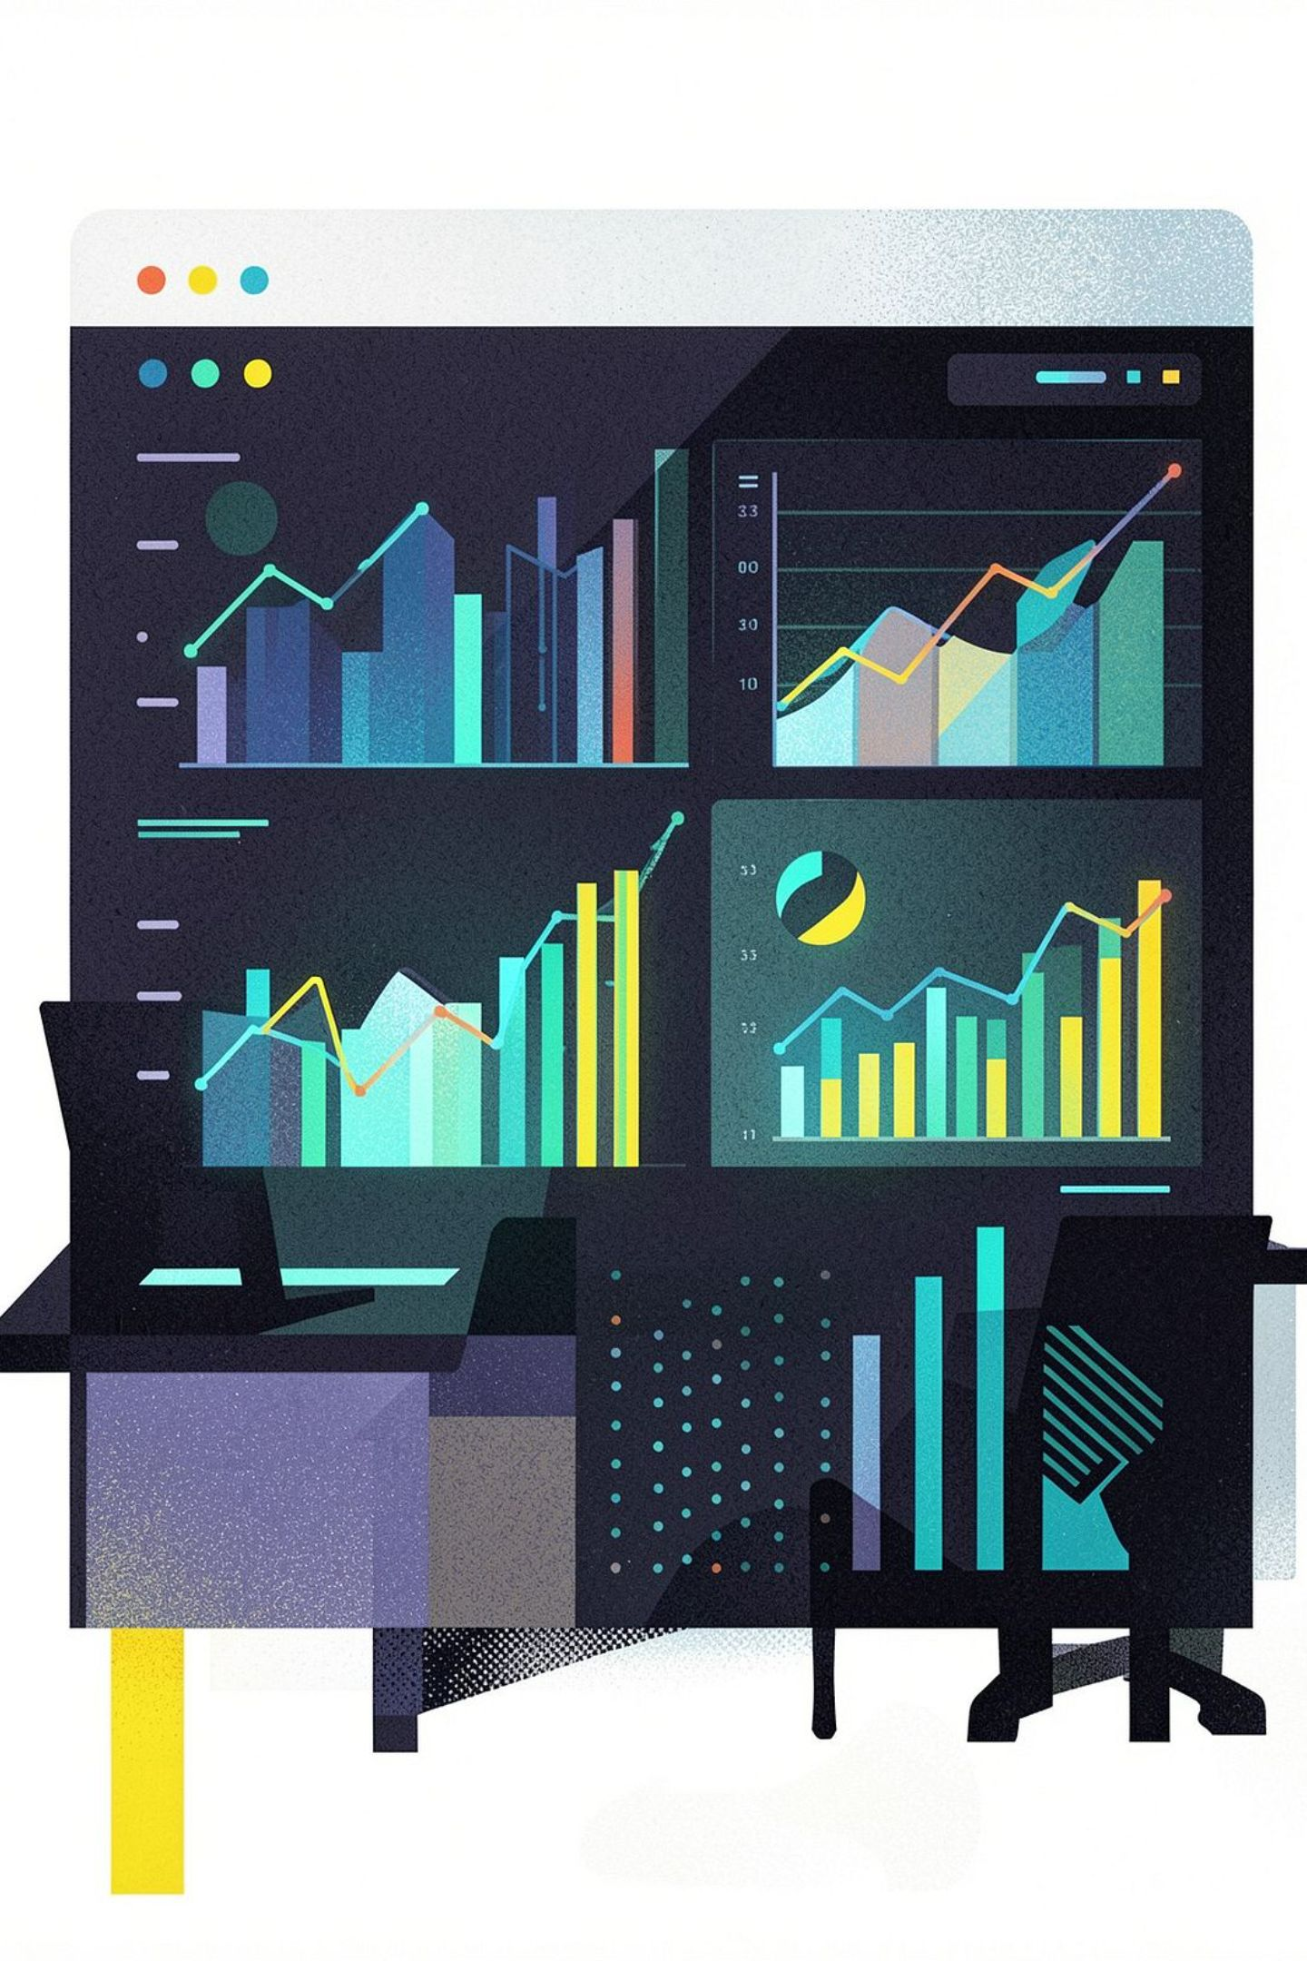
AI-Based Sales Forecasting System
Predicting Product Demand and Revenue Trends Over the Next 30 Days
Mr.LANKA YERNI KUMAR 324129510030

Slide 2
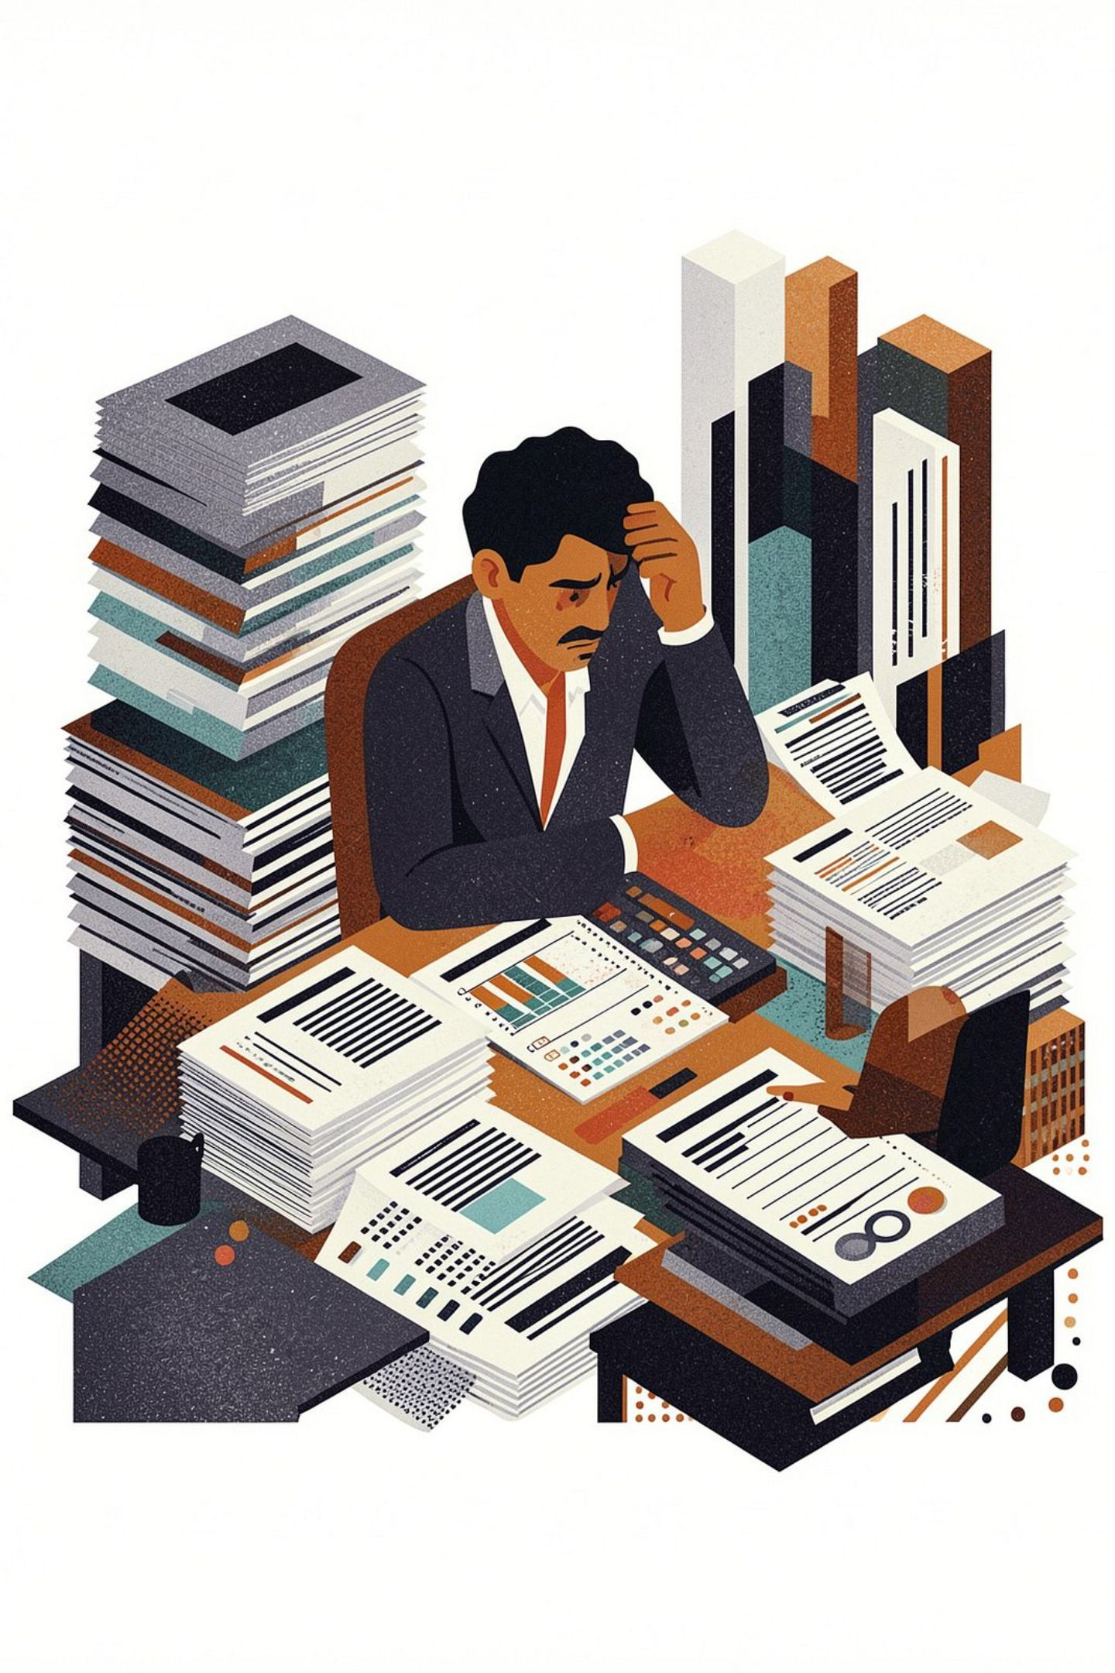
The Problem: Traditional Forecasting Limitations
Time-Consuming & Error-Prone
Manual analysis of historical sales reports introduces delays and human error into critical business decisions.
Unpredictable Market Conditions
Traditional methods struggle to adapt when demand shifts due to changing market dynamics.
Too Many Variables
Simultaneously accounting for seasonal trends, promotions, pricing, holidays, and customer behavior is beyond manual capacity.
Limited Scalability
Conventional approaches break down when applied to large, growing sales datasets.

Slide 3
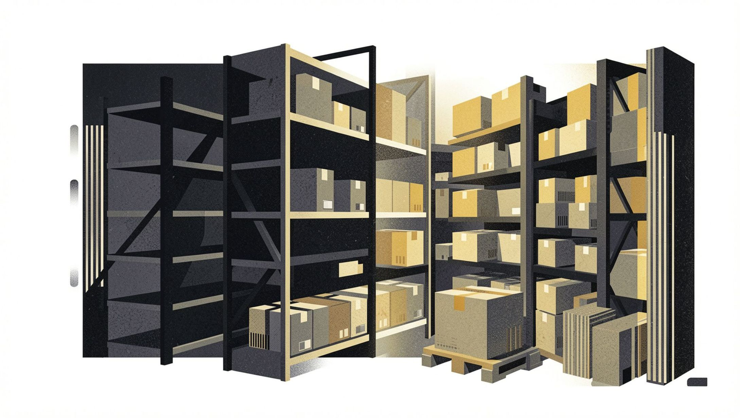
Why This Matters
Accurate sales forecasting is the backbone of effective inventory management and production planning. When forecasts fail, the consequences are immediate and costly.
Stockouts & Overstock
Lost Revenue Opportunities
Need for Intelligence
Poor forecasts lead directly to lost sales or excess inventory that ties up capital.
Businesses miss peak demand windows without reliable forward-looking intelligence.
Organizations require systems that learn from historical data to estimate future demand with high accuracy.

Slide 4
Proposed Solution: System Overview
Centralized AI Platform
ML + Time-Series Models
A unified system that ingests and analyzes historical sales data from across the organization.
Combines machine learning regression with time-series forecasting for robust predictive power.
30-Day Forecasting
Interactive Dashboards
Predicts product demand and revenue trends across a rolling 30-day horizon.
Product-wise analytics and business performance reports delivered through intuitive visual interfaces.

Slide 5

System Architecture
Data Input
Historical sales, pricing, promotions, seasonality, holidays, customer behavior
Forecasting Pipeline
Output
Processing
30-day demand forecasts, revenue trends, product analytics, dashboards
Data cleaning, feature engineering, ML and time-series modeling
The system follows a structured end-to-end pipeline — from raw data ingestion through intelligent processing to actionable 30-day forecasts and interactive business insights.

Slide 6
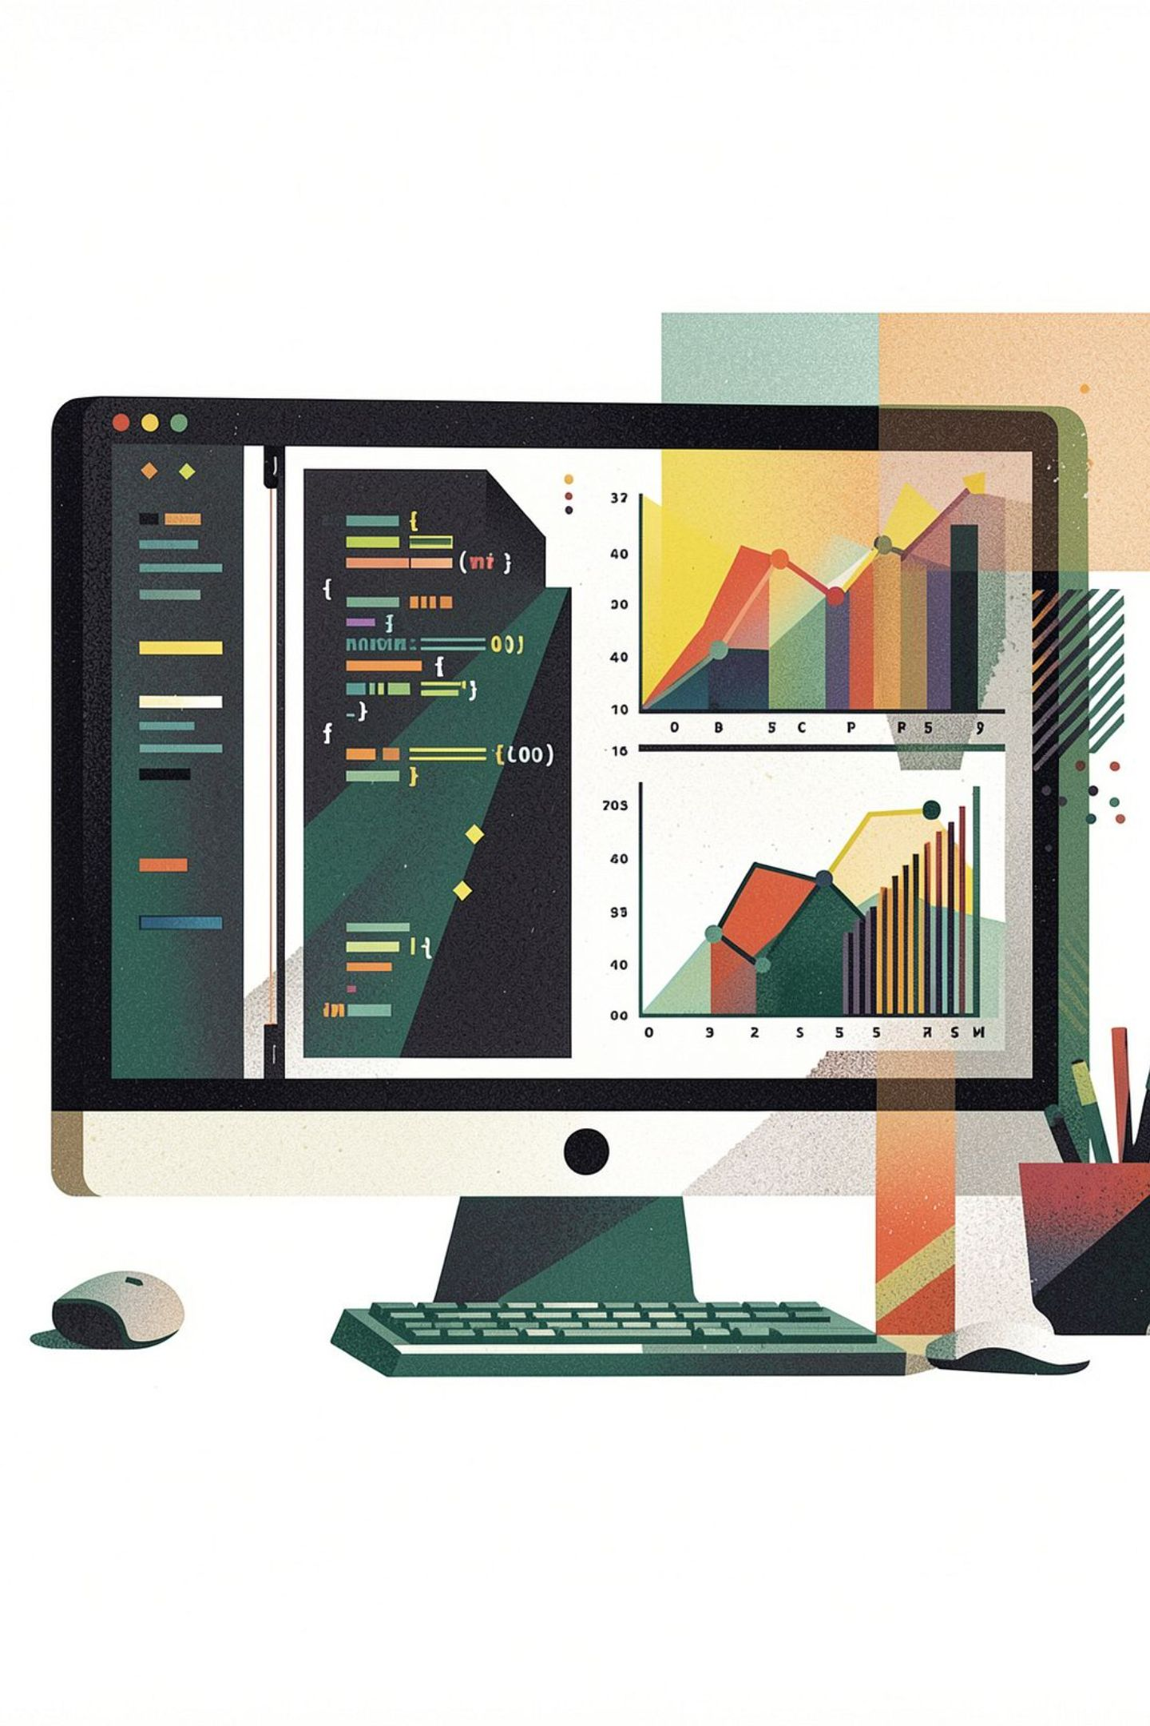
Key Technical Components
Python-Based Analytics
Core data processing and exploratory analysis powered by Python's scientific computing ecosystem.
ML Regression Models
Learns complex relationships between sales-influencing factors and future demand outcomes.
Time-Series Forecasting
Analyzes chronological sales patterns to project future trends with temporal awareness.
Interactive Dashboard
Visualizes forecasts and business insights in a user-friendly, actionable interface.

Slide 7
Forecasting Process
01
02
03
Analyze Historical Patterns
Identify Key Influencing Factors
Train Predictive Models
Examine past sales records to identify underlying trends and recurring behaviors.
Isolate the effects of seasonal cycles, promotions, pricing changes, and customer behavior on demand.
Fit ML regression and time-series models on preprocessed, feature-engineered data.
04
05
Evaluate Model Performance
Generate 30-Day Predictions
Assess model quality using appropriate validation techniques before deployment.
Produce demand and revenue forecasts for the upcoming 30-day window, ready for business use.

Slide 8
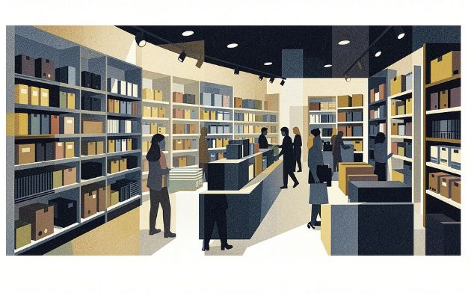
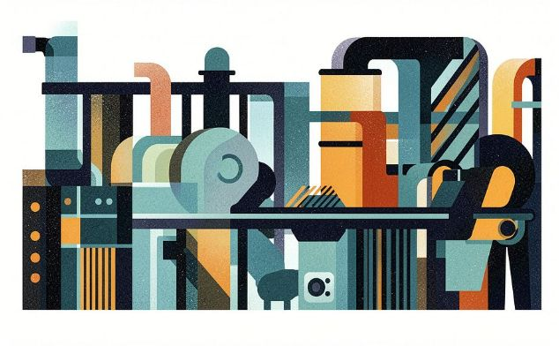
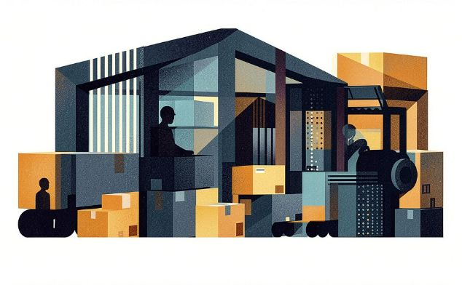

Business Applications & Benefits
Retail & E-Commerce
Manufacturing
Wholesale
Optimize inventory levels and reduce costly stockouts during peak demand periods.
Improve production scheduling and allocate resources more efficiently based on predicted demand.
Anticipate demand fluctuations and strengthen revenue planning across distribution channels.
Enables data-driven decision-making across businesses of all sizes — from growing startups to large enterprises.

Slide 9
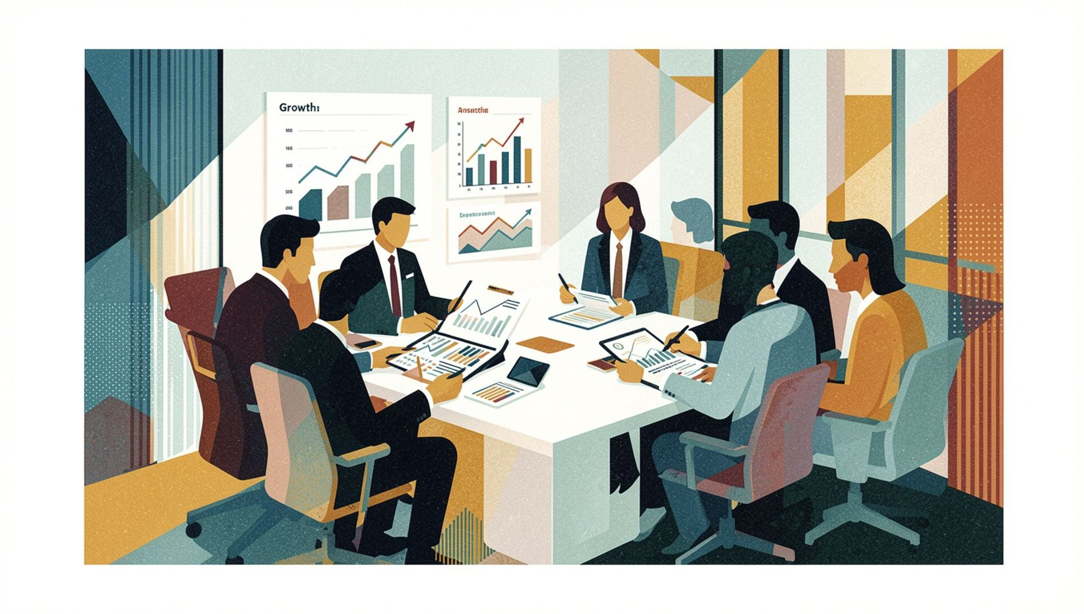
Expected Outcomes & Advantages
The AI-Based Sales Forecasting System is designed to deliver measurable improvements across the entire demand planning lifecycle.
Improved Forecast Accuracy
Better Planning
More reliable demand and revenue predictions compared to manual methods.
Stronger inventory management and production scheduling aligned to predicted demand.
Reduced Manual Dependency
Scalable & Centralized
Automated intelligence replaces time-intensive manual sales analysis workflows.
A unified platform that grows with the business and delivers product-wise strategic insights.

Slide 10
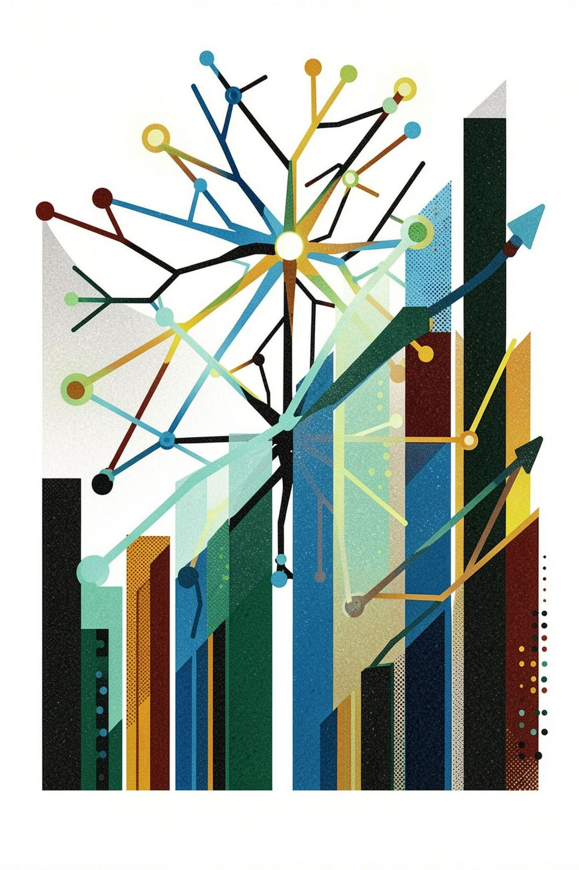
Conclusion
The AI-Based Sales Forecasting System combines Python analytics, machine learning, and time-series forecasting to deliver intelligent 30-day demand and revenue predictions.
By analyzing historical sales alongside seasonal trends, promotions, pricing, holidays, and customer behavior, the system enables organizations to optimize inventory planning, improve revenue forecasting, and support data-driven business growth across retail, e-commerce, manufacturing, and wholesale sectors.
Python Analytics
Scientific computing core
ML Regression
Demand relationship modeling
Time-Series
Chronological pattern analysis
30-Day Forecast
Actionable business intelligence

