Slide 1
Introduction to Spring Boot and JPA
Simplifying Database Operations with Spring Data JPA

Slide 2
Agenda
Introduction to Spring Boot
Introduction to JPA
Spring Data JPA Overview
Setting Up Spring Data JPA
Creating Entities
Creating Repositories
Advanced Features
Demo
Q&A

Slide 3
Introduction to Spring Data JPA
Spring Data JPA is a part of the larger Spring Data family that makes it easier to implement JPA-based repositories. It simplifies data access layers in applications, reduces boilerplate code, and provides powerful database functionalities out-of-the-box.
Key Concepts of Spring Data JPA
JPA (Java Persistence API): JPA is a specification for accessing, persisting, and managing data between Java objects and relational databases. It's not an implementation but a set of interfaces.
Hibernate: An implementation of the JPA specification. While there are other implementations (like EclipseLink), Hibernate is the most commonly used one with Spring Data JPA.
Entities: Objects that represent tables in your database. Each entity instance corresponds to a row in the table.
Repositories: Interfaces that provide CRUD operations and query methods for interacting with the database.

Slide 4
What is JPA?
JPA (Java Persistence API) is a specification for managing relational data in Java applications.
Key Concepts:
Entities: Java objects mapped to database tables
EntityManager: Interface for interacting with the persistence context
Persistence Context: Environment where entity instances are managed
Common Implementations: Hibernate, EclipseLink

Slide 5
Spring Data JPA Overview
Spring Data JPA is part of the larger Spring Data family and simplifies data access layers.
Benefits:
Reduces boilerplate code
Provides powerful repository abstractions
Facilitates data access and manipulation
Key Features:
Repositories for CRUD operations
Derived query methods
Custom query support
Pagination and sorting

Slide 6
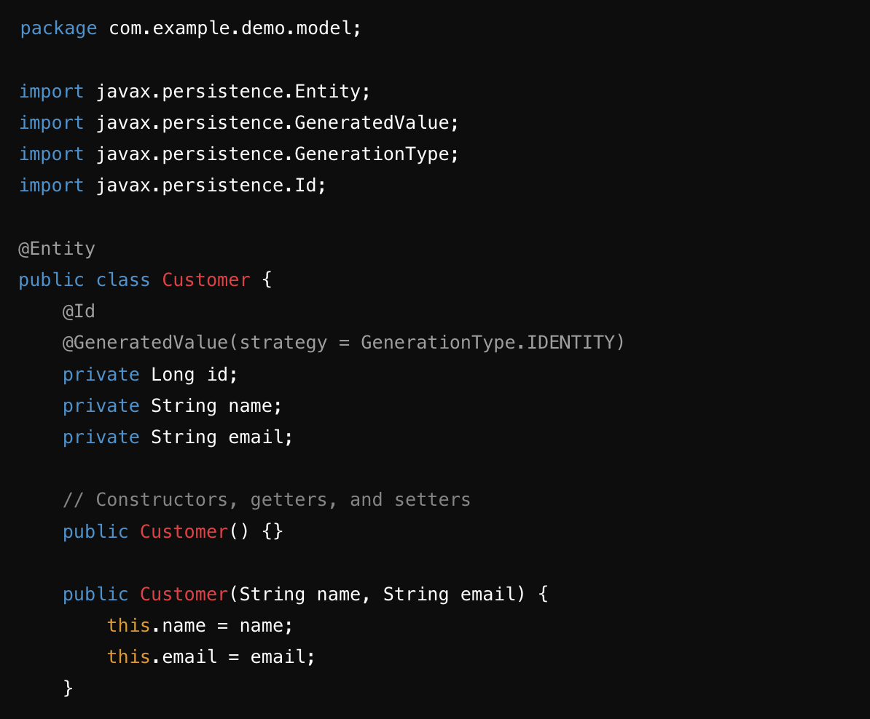
Creating Entities
Entities: Java classes that map to database tables
Purpose: Map Java objects (entities) to database tables or documents.
Annotations:
@Entity: Specifies that the class is an entity
@Id: Specifies the primary key
@GeneratedValue: Specifies the generation strategy for primary key values
@Column: Map fields to specific database columns or document fields.
@Table: Define the name of the database table or collection.

Slide 7
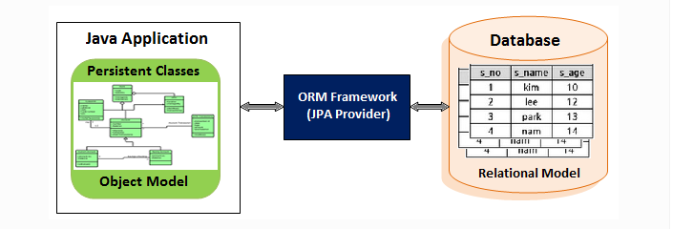
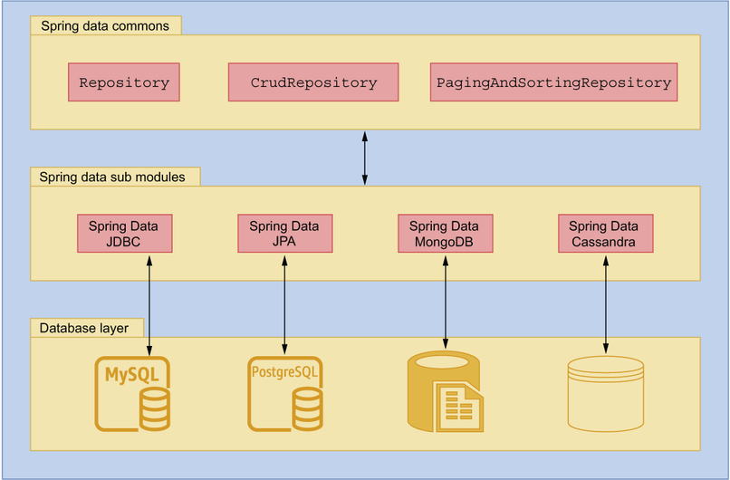
Entity Object will convert as database records with the help of Spring JPA/ORM framework
Dialect is a component that translates object-oriented queries from the ORM framework into specific SQL queries tailored for a particular database system.
Examples:
org.hibernate.dialect.MySQLDialect: For MySQL databases.
org.hibernate.dialect.PostgreSQLDialect: For PostgreSQL databases.

Slide 8
Types of Generation Strategies
AUTO
Provider chooses strategy.
Database-specific (e.g., identity columns).
IDENTITY
Auto-increment columns.
MySQL, PostgreSQL, SQL Server.
SEQUENCE
Database sequences (e.g., Oracle).
Manual sequence management.
TABLE
Simulates sequence using a database table.
Portable but less efficient.

Slide 9
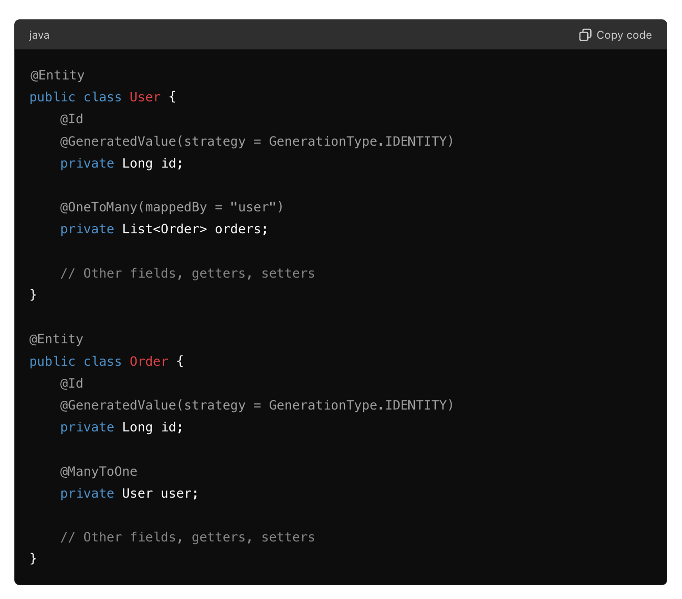
Relationship Mappings
@OneToOne: Establish one-to-one relationships.
@OneToMany and @ManyToOne: Define one-to-many and many-to-one relationships.
@ManyToMany: Establish many-to-many relationships.

Slide 10
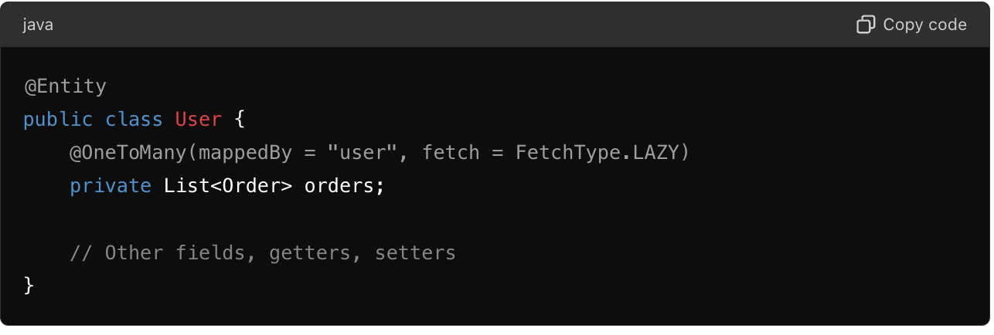
Fetching Strategies
FetchType.LAZY: Lazy loading, fetch when accessed.
FetchType.EAGER: Immediate loading with the owning entity.

Slide 11
Benefits of Mapping
Abstraction: Simplifies database interactions with Java objects.
Performance Optimization: Efficient data retrieval strategies.
Maintainability: Facilitates schema changes without code impact.

Slide 12
Creating Repositories
Repositories: Interfaces for data access operations
JpaRepository: Provides CRUD operations and more
Custom Query Methods: Define methods following Spring Data naming conventions

Slide 13
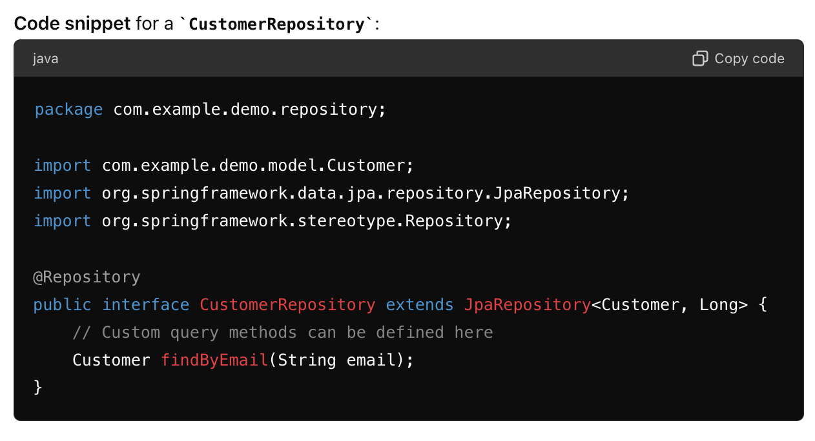
Example Repository Interface
Code snippet for a CustomerRepository:javaCopy code
Explanation:
extends JpaRepository<Customer, Long>: Extends JpaRepository to provide CRUD operations
findByEmail(String email): Custom query method to find a customer by email

Slide 14
Advanced Features
Custom Query Methods
JPQL and Native Queries
Pagination and Sorting
Auditing

Slide 15
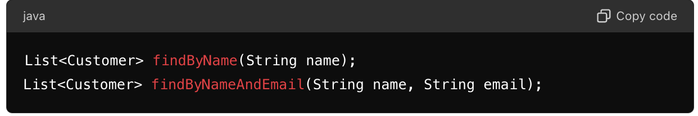
Custom Query Methods
Custom Query Methods:
Define methods in the repository interface following naming conventions
Spring Data JPA generates the queries automatically

Slide 16
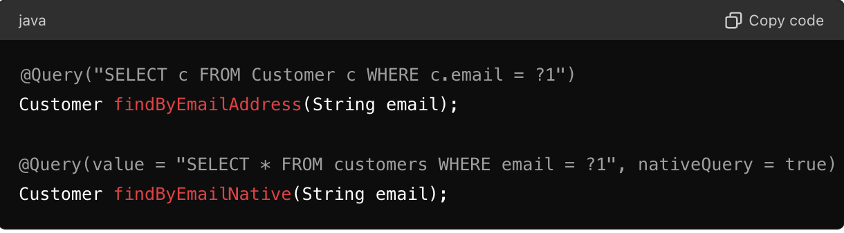
JPQL and Native Queries
JPQL (Java Persistence Query Language):
Similar to SQL but operates on entities
Native Queries:
Use native SQL for complex queries

Slide 17
Pagination and Sorting
Pagination:
Split large datasets into manageable chunks
Sorting:
Order results based on one or more properties

Slide 18
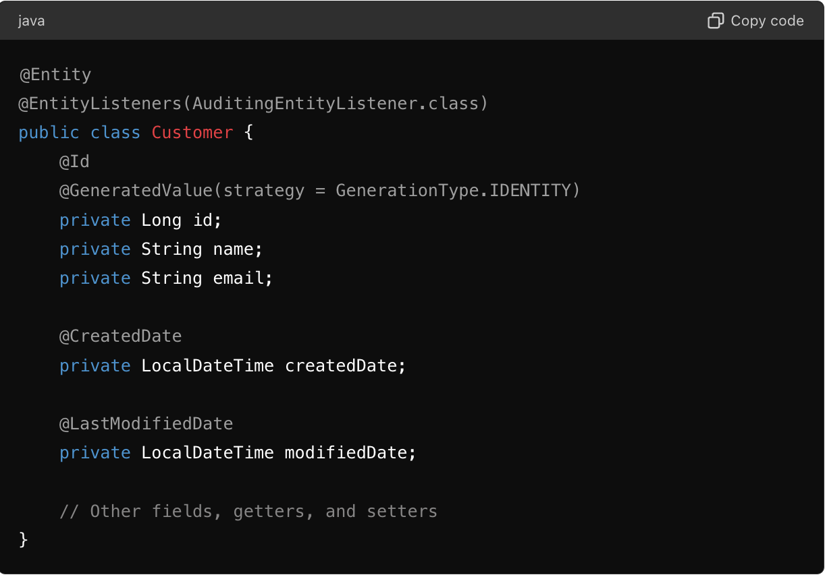
Auditing
Auditing: Automatically populate audit-related fields
Annotations:
@CreatedDate: Stores the creation timestamp
@LastModifiedDate: Stores the last modification timestamp

